Slide 1
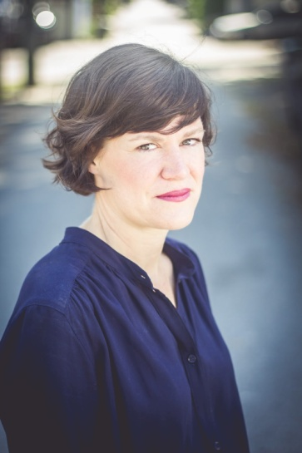
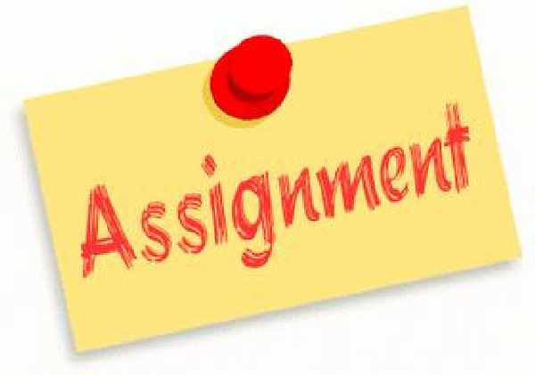
ENG4U Assignment #1 Poem Analysis
Through A Restaurant Window
By Sheryda Warrener

Slide 2
Directions
Using the poem Through A Restaurant Window by Sheryda Warrener, you will write an essay of 200-250 words, analyzing the poem for its literary elements. **See Slide 4 for Poem
Use the TPCAST Format to guide your analysis and structure your essay. See Slide 5 and the Tpcast Lesson on Moodle for more information.
Follow the Assignment Submission Guideline on Moodle (Course Orientation Page). Google Docs/Word Doc; Size 12, Times New Roman etc. With Full Name, Course Code, Date etc.
Put all paragraphs into your own words.

Slide 3
Requirements
Proper Essay Paragraphing and Organization (topic sentences, examples and details, concluding sentences)
Recommended Plan of Paragraphs: 4 Paragraphs, see below
Introduction (Introduce your Poem, Poet and format for analysis)
Analysis of Title, Paraphrase, Connotation
Analysis of Attitude, Shift, Themes
Conclusion (Summarize your Analysis; show how this poem connects to your life)
3. Remember to use your own words to avoid plagiarizing. Put any words or phrases from the poem in Quotations (APA/MLA Format).

Slide 4
Poem To Analyse
Through the Restaurant Window by Sheryda Warrener (b 1978- )
I can see from where I sit
a freight train going by, rolling forward
in the dark. I can't tell if it's one long train
or a dozen - I close my eyes, listen.
A freight train going by, rolling forward
as our conversation backs up, bridges one gap
or a dozen. I close my eyes, listen.
There are gates within us, you say,
as our conversation backs up, bridges a gap.
You reach across the table, take my hand.
There are gates within us, you say
again. You're right, there's always a distance.
You reach across the table, take my hand
in the dark. I can't tell if it's one long train.
Again, you're right, there's always a distance.
I can see from where I sit.

Slide 5
TPCAST Analysis
Title: What Does It Mean? Is it Effective?
Paraphrase: Own Words
Connotation: Symbolism, Any other meanings?
Attitude: of the speaker, mood of the poem
Shift: transition in emotions, thinking
Themes: What is the poet’s message?

Slide 6
Specific Expectations
Reading For Meaning
1.1 read a variety of student- and teacher-selected texts from diverse cultures and historical periods, identifying specific purposes for reading
1.2 select and use, with increasing facility, the most appropriate reading comprehension strategies to understand texts, including complex and challenging texts
1.3 identify the most important ideas and supporting details in texts, including complex and challenging texts
1.4 make and explain inferences of increasing subtlety and insight about texts, including complex and challenging texts, supporting their explanations with well-chosen stated and implied ideas from the texts
1.5 extend understanding of texts, including complex and challenging texts, by making rich and increasingly insightful connections between the ideas in them and personal knowledge, experience, and insights; other texts; and the world around them
1.6 analyse texts in terms of the information, ideas, issues, or themes they explore, examining how various aspects of the texts contribute to the presentation or development of these elements
1.7 evaluate the effectiveness of texts, including complex and challenging texts, using evidence from the text insightfully to support their opinions

Slide 7
Expectations
Understanding Form and Style
2.1 identify a variety of characteristics of literary, informational, and graphic text forms and demonstrate insight into the way they help communicate meaning
2.2 identify a variety of text features and demonstrate insight into the way they communicate meaning
2.3 identify a variety of elements of style in texts and explain how they help communicate meaning and enhance the effectiveness of the texts
Reading With Fluency
3.1 automatically understand most words in a variety of reading contexts
3.2 use decoding strategies effectively to read and understand unfamiliar words, including words of increasing difficulty
3.3 regularly use a variety of strategies to explore and expand vocabulary, discerning shades of meaning and assessing the precision with which words are used in the texts they are reading

Slide 8
Expectations
Developing and Organizing Content
1.1 identify the topic, purpose, and audience for a variety of writing tasks
1.2 generate, expand, explore, and focus ideas for potential writing tasks, using a variety of strategies and print, electronic, and other resources, as appropriate
1.3 locate and select information to fully and effectively support ideas for writing, using a variety of strategies and print, electronic, and other resources, as appropriate
1.4 identify, sort, and order main ideas and supporting details for writing tasks, using a variety of strategies and selecting the organizational pattern best suited to the content and the purpose for writing
1.5 determine whether the ideas and information gathered are accurate and complete, interesting, and effectively meet the requirements of the writing task
Using Knowledge of Form and Style
2.1 write for different purposes and audiences using a variety of literary, informational, and graphic forms
2.2 establish a distinctive and original voice in their writing, modifying language and tone skilfully and effectively to suit the form, audience, and purpose for writing
2.3 use a wide range of descriptive and evocative words, phrases, and expressions precisely and imaginatively to make their writing clear, vivid, and compelling for their intended audience
2.4 write complete sentences that communicate their meaning clearly and effectively, skilfully varying sentence type, structure, and length to suit different purposes and making smooth and logical transitions between ideas
2.6 revise drafts to improve the content, organization, clarity, and style of their written work
2.7 produce revised drafts of texts, including increasingly complex texts, written to meet criteria identified by the teacher, based on the curriculum expectations

Slide 9
Expectations
Applying Knowledge of Conventions
3.1 use knowledge of spelling rules and patterns, a variety of resources, and appropriate strategies to recognize and correct their own and others’ spelling errors
3.2 build vocabulary for writing by confirming word meaning(s) and reviewing and refining word choice, using a variety of resources and strategies, as appropriate for the purpose
3.3 use punctuation correctly and effectively to communicate their intended meaning
3.4 use grammar conventions correctly and appropriately to communicate their intended meaning clearly and effectively
3.5 regularly proofread and correct their writing
3.6 use a variety of presentation features, including print and script, fonts, graphics, and layout, to improve the clarity and coherence of their written work and to heighten its appeal and effectiveness for their audience
3.7 produce pieces of published work to meet criteria identified by the teacher, based on the curriculum expectations

