Slide 1
Lesson 2.3 Happiness
18 May 2023

Slide 2
2.3 Check your understanding quiz
When you are ready, I will give you the password to enter the quiz

Slide 3
Class announcement
Pay attention to Assignment 2 deadlines
Word counts and plagiarism in homework and classwork

Slide 4
Unit 2: Mental Health (21 hours)
Tentative schedule:
Lesson 2.1 – Stress (16 May 2023)
Lesson 2.2 – Happiness (17 May 2023)
Lesson 2.3 – Relationship (18 May 2023)
Lesson 2.4 – Purpose (19 May 2023)
Lesson 2.5 – Mental Illness (23 May 2023)
Lesson 2.6 - Doctor in the House Episode 2 (24 May 2023)
Lesson 2.7 – Assignment 2 Presentation (25 May 2023)
Lesson 2.8 – Midterm test review (26 May 2023)
Lesson 2.9 – Midterm test (29 May 2023)

Slide 5
Today’s lesson plan:
Learn how to Nurture Loving Relationships

Slide 6
Who are you?
Complete the 16 personality test:
https://www.16personalities.com/free-personality-test

Slide 7
Let’s watch a video first…
https://www.ted.com/talks/robert_waldinger_what_makes_a_good_life_lessons_from_the_longest_study_on_happiness/c

Slide 8
Classwork 2.3 (part 1)
Summarize the main points of the video. Write about 100 words.

Slide 9
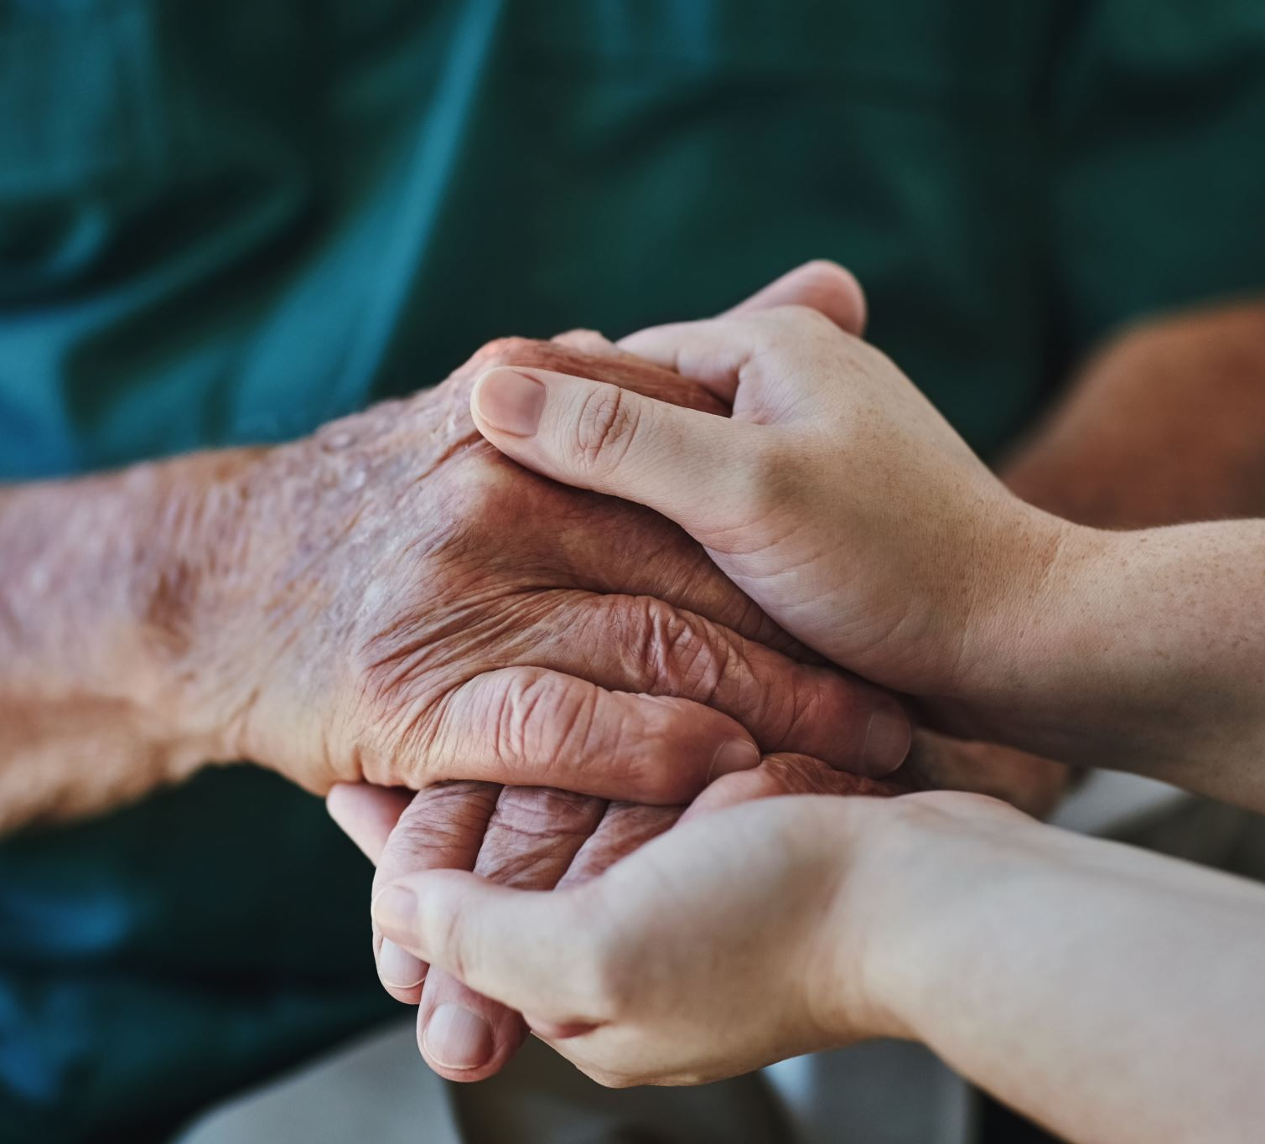
Happiness expert Gretchen Rubin says,
"Ancient philosophers and contemporary scientists agree that strong bonds with other people are a key—perhaps THE key—to happiness. To be happy, we need to feel connected; we need to get and give support; we need to feel like we belong.”
Aside from romantic relationships, we all have so many other types of relationships in life, such as relationships with parents, siblings, friends, colleagues, bosses, classmates, and neighbors. These are all opportunities to build better relationships and hence happier and healthier lives.

Slide 10
So how can we nurture loving relationships? This is a big topic, but we can break it down into three parts:
1. Foundation: Accept and value them for who they are
2. Growth: Use the Five Love Languages and the Four Methods of Guidance
3. Preventing Failure: Build your conflict resolution skills

Slide 11
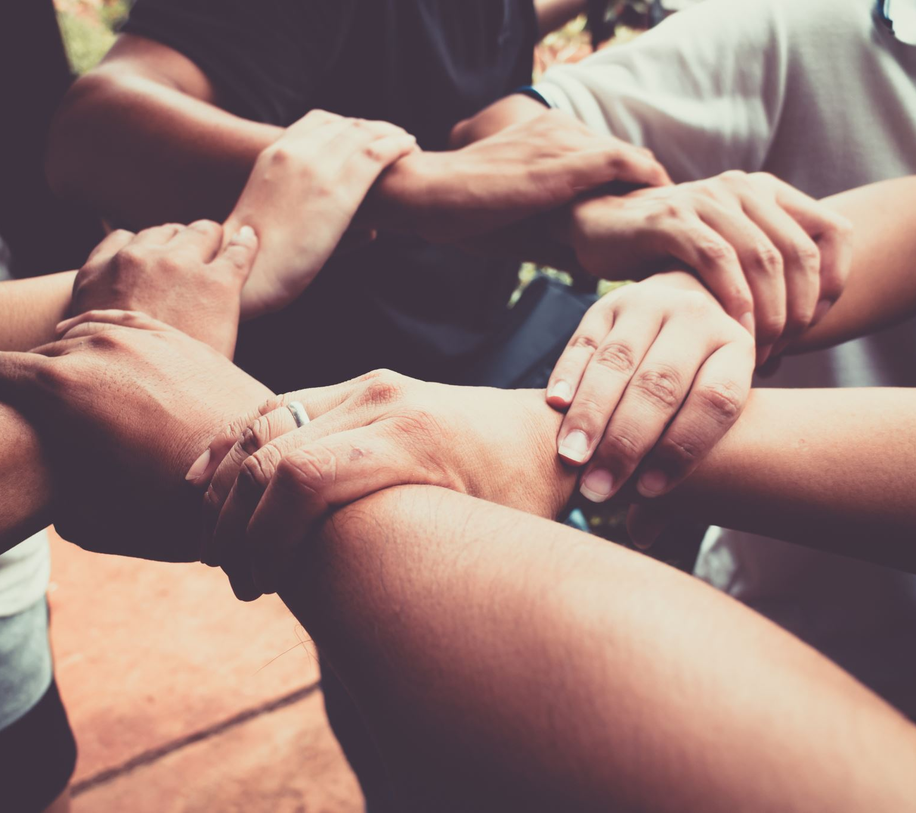
Part 1 - Foundation: Accept and Value Them for Who They Are
Accepting and valuing others for who they are is easy to say, but it takes conscious effort to do. We need to
1. Learn about them more
2. Bring out their strengths
3. Appreciate their contribution

Slide 12
Part 1 - Foundation: Accept and Value Them for Who They Are
Marriage researcher John Gottman found that in happy marriages, there's a magic ratio of 5:1, meaning for every negative interaction, there are at least 5 positive interactions.
When we do any of these three things, we are adding positive interactions. Doing the opposite of these things, namely showing disinterest in them, criticizing their weaknesses, and taking them for granted, would of course hurt the relationship.

Slide 13
Part 1 - Foundation: Accept and Value Them for Who They Are
1.1 Learn about them more (and yourself)
Firstly, you can't value someone for who they are when you don't even know much about them. Just because we've known someone for a long time doesn't actually mean we know them deeply. It takes conscious effort on our part to learn about others more deeply. Here are some great questions shared by motivational speaker Jay Shetty on this podcast that we can ask use to get to know others more deeply:
Who's the most fascinating person you've ever met and why?
What are you best known for among your friends?
Where would your family be most surprised to find you? • What's been the most significant plot twist in your life?
If you unexpectedly won $10,000 what would you spend it on?
What's the most spontaneous thing you've done?

Slide 14
Part 1 - Foundation: Accept and Value Them for Who They Are
No matter how long you've known someone, there are probably still new things to discover about them. It's not the discovery of new things that's important, but rather showing your interest in them that is important. Discovering new things about them is just a likely side effect.
While learning more about them, you can also learn more about yourself. What are your values, strengths, weaknesses, likes, and dislikes? When you understand yourself better, you can be a better partner, and you can help them understand themselves better too.

Slide 15
Part 1 - Foundation: Accept and Value Them for Who They Are
1.2 Bring out their strengths
Second, we need to recognize and bring out their strengths.
Remember that everyone has different strengths and weaknesses. If we always focus on and criticize their weaknesses, then the relationship is headed for disaster.
If we instead focus on their strengths and help them bring out their strengths, then they will feel very happy and appreciative towards us, and we will come to appreciate them more as well!

Slide 16
Part 1 - Foundation: Accept and Value Them for Who They Are
We need to realize that different people have different personalities, and all personalities come with their own set of strengths and weaknesses.
We can't expect others to be perfect, and we shouldn't use our strengths to judge other people. Instead, we should be like detectives searching for other people's strengths, and then be like cheerleaders in helping them bring out their strengths.
When we focus on each others' strengths, we will be happier and stronger together.

Slide 17
Part 1 - Foundation: Accept and Value Them for Who They Are
1.3 Appreciate their Contributions
Motivational speaker Dr. Alan Zimmerman often says that the most common complaint in the workplace is, "You could do a hundred things right and not hear a word about it, but as soon as you do something wrong, they point it out right away.”
This applies not just to workplace relationships, but to all relationships.
It's an awful feeling to be taken for granted and criticized for your occasional mistake. Everyone gives in their own way. Just like we should search for their strengths, we should search for their contribution and then appreciate them for it.

Slide 18
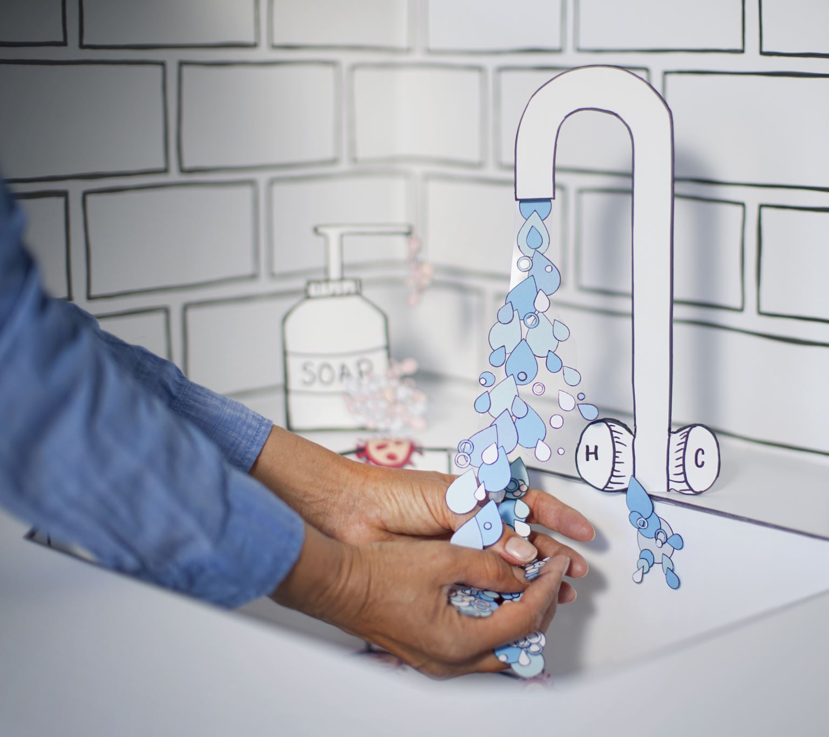
Part 1 - Foundation: Accept and Value Them for Who They Are
Often times, we want the other person to contribute to the relationship in a similar way to the way we contribute.
For example, if you always cook, you might wish your partner would do some cooking once in a while.
On the other hand, your partner is thinking he always cleans the bathroom, and he wises you would do it once in a while.
So the key here is to search for all the ways they contribute and then appreciate them for it. Not only does it help them feel appreciated, but it helps us feel grateful.

Slide 19
Part 1 - Foundation: Accept and Value Them for Who They Are
To give workplace example, maybe your teammate is doing a lot less work than you, and they make many mistakes.
Rather than focusing on his problems, ask yourself what he is contributing to the team and what are his strengths?
When you appreciate him for his contributions, he will naturally want to contribute more. But if you criticize him, he will feel unhappy whenever working on the groupwork, which makes him want to do less.

Slide 20
Part 1 - Foundation: Accept and Value Them for Who They Are
Moreover, you may only be seeing his mistakes because you're using your strengths to judge his weaknesses.
But maybe he's doing a good job in another area that you're not strong at, so you didn't notice it.
When we focus on their contribution and strengths, we all feel better.

Slide 21
Part 2 - Growth: Use the Five Love Languages and Four Methods of Guidance

Slide 23
When combine the two, we get
1. Words of affirmation (Loving Words)
2. Quality Time (Activities in Common)
3. Acts of Service (Beneficial Acts)
4. Gifts (Giving)
5. Touch

Slide 24
Part 2 - Growth: Use the Five Love Languages and Four Methods of Guidance
When we use the Five Love Languages and the Four Methods of Guidance, our motive should simply be to build a good relationship with them or to help them; it shouldn't be to expect something in return.
If we do nice things with selfish intentions, the other person can feel it, and it would make them feel icky, which then hurts the relationship.

Slide 25
Part 2 - Growth: Use the Five Love Languages and Four Methods of Guidance
2.1 Words of Affirmation (Loving Words)
Words of affirmation are all about encouragement and appreciation. When we encourage others, they will feel safe and comfortable around us, which nurtures the relationship.
If we instead criticize them or put them down, they will feel afraid or defensive around us, which hurts the relationship.
For example, let's say your partner started exercising. Words of affirmation might be "Wow you've really shown self discipline! I'm so proud of you!".

Slide 26
Part 2 - Growth: Use the Five Love Languages and Four Methods of Guidance
Appreciation is key in a relationship; as Dr. Alan Zimmerman says, "All people wear a little, invisible sign around their necks.
It says, 'Make Me Feel Important.'" We should focus on all the ways the other person contributes to the relationship and thank them with specificity.
For example, instead of just saying, "Thank you for being a great mom," it's much more impactful to say, "Thank you for always packing my lunch and cooking healthy and tasty food for me. I'm so grateful to have a loving mom like you!"

Slide 27
Part 2 - Growth: Use the Five Love Languages and Four Methods of Guidance
Loving Words is anything spoken with a loving intention. It encompasses encouragement and appreciation, but it also includes telling them things that need need to hear, even if they don't want to hear it, but in a loving way.
For example, maybe your partner really needs to fix some unhealthy habits. Loving Words would involve patiently and kindly reminding them to improve their health for their own benefit, so long as they are willing to listen.
If they get extremely annoyed at your well-intentioned words, then the loving thing to do would be to not keep saying it to prevent resentment from arising in the relationship.

Slide 28
Part 2 - Growth: Use the Five Love Languages and Four Methods of Guidance
2.2 Quality Time (Activities in Common)
Quality time is about giving them your full attention.
Going for a walk together and talking to each other is an example of quality time.
Eating a meal together where you're both focused and engaged in conversation is quality time. But if one or both people are distracted on their phones, then it is not quality time anymore.
Activities in Common also says we should try to do the activities that they like doing to build more commonalities with them.
For example, let's say your partner has a hobby that you don't have. One way to build the relationship is to join them in their hobby, even and especially if you're not that interested in it.
After all, if you knew your partner was willing to do something they're not that interested in for the sake of keeping you company, wouldn't you feel extremely loved and valued?

Slide 29
Part 2 - Growth: Use the Five Love Languages and Four Methods of Guidance
2.3 Acts of Service (Beneficial Acts)
Acts of service refers to doing things for the other person to relieve their stress or to make their life easier.
For example, maybe you help them do their chores because they are really busy right now. Or maybe you go do something that you don’t really like, but you’re willing to do it for them.

Slide 30
Part 2 - Growth: Use the Five Love Languages and Four Methods of Guidance
Beneficial Acts encompasses the meaning of Acts of Service, but it goes a step further to be about putting the other person above yourself.
For example, you do chores for them because you wish to help them and you don't expect anything in return. You view it as your natural duty to help them in whatever way you can. It's similar to how a parent might stay up late at night doing things for children or how teachers work overtime for students without expecting anything in return.
Because the intention is so pure, when the beneficiary eventually realizes, they feel extremely loved and valued.

Slide 31
Part 2 - Growth: Use the Five Love Languages and Four Methods of Guidance
2.4 Gifts (Giving)
When it comes to gifts, thoughtfulness is more important than cost.
For example, if we know that the other person absolutely loves a certain bread from a certain store, then when we pass by that store, we could pick up that bread for them and tell them we got it specifically for them.
When they can feel that we put in effort to pick something specifically for them, they will feel very loved. But if we get them an expensive gadget that they don't need, then they won't feel very loved.

Slide 32
Part 2 - Growth: Use the Five Love Languages and Four Methods of Guidance
Often times in relationships, people give big gifts once in a while, such as on a birthday or holiday. While it's not bad to give big gifts on these special days, remember that thoughtfulness is more important than cost, and also giving frequent small gifts may be more impactful.
Why? Because frequent small gifts requires initiative, and it shows that we are often thinking of them, which makes them feel valued and appreciated.
If you just give a big gift once in a while on these special days, then it just feels like you're doing it because you're supposed to, which doesn't feel as loving.

Slide 33
Part 2 - Growth: Use the Five Love Languages and Four Methods of Guidance
When it comes to Giving in the Four Methods of Guidance, there are actually four types of giving:
1. Materials: objects, money, food, clothing etc.
2. Energy: your time, attention, and energy; quality time, acts of service
3. Comfort / Peace of Mind: A pleasant facial expression; words of affirmation
4. Wisdom: teaching them useful things

Slide 34
Part 2 - Growth: Use the Five Love Languages and Four Methods of Guidance
When we talk about giving gifts, most people think of giving materials, such as food or clothing or jewelry. But there's a lot more we can give! We can give our energy and time, such as listening to them (Quality Time) or doing something nice for them (Acts of Service).
We can also give them comfort and peace of mind by encouraging them (Words of Affirmation), giving them a pleasant facial expression, and reducing their worries.
Finally, we can give them wisdom to improve their lives. As the proverb goes, "Give a man a fish and he will eat for a day. Teach a man how to fish and you feed him for a lifetime."

Slide 35
Part 2 - Growth: Use the Five Love Languages and Four Methods of Guidance
2.5 Touch
Touch refers to things like holding hands, hugs, high fives, kisses, massages, or even just being physically near each other throughout the day.
For example, you could give your parents a massage to show your loving care for them.
Another example is sometimes couples just like to be together in the same room even if they're both doing their own thing. This doesn't count as quality time because they're not talking to each other, but it counts as touch in the sense that they want each other's presence.
Generally speaking, this love language is more for intimate relationships, so use it with proper etiquette.

Slide 36
Part 2 - Growth: Use the Five Love Languages and Four Methods of Guidance
2.6 Learn Their Primary Love Language
Obviously, all five of the love languages (especially the first four) are great for building relationships. All people would appreciate any of the Four Methods of Guidance. But to go a step further in your most important relationships, find out which love language they like the most!

Slide 37
Part 2 - Growth: Use the Five Love Languages and Four Methods of Guidance
According to Gary Chapman, most people have a primary and secondary love language. You can have them take this quiz to find out their primary love language, or you can observe how they like to give love and what they often request from others.
https://5lovelanguages.com/quizzes/love-language
We unconsciously to express love using our love language, but to really strengthen a relationship, we need to express love using THEIR love language.

Slide 38
Part 2 - Growth: Use the Five Love Languages and Four Methods of Guidance
For example, my primary love language is Acts of Service, while my mother's is Words of Affirmation. Hence, I tend to show love by doing things like chores or cooking, while she tends to show love by giving me words of encouragement and appreciation.
While I certainly find it nice to receive kind words, to me, I feel really loved when she does acts of services for me. While she finds it nice that I do some chores, she is really happy when I give her words of encouragement and appreciation. That's the difference between using someone's primary love language versus a random love language.

Slide 39
Part 3 - Preventing Failure: Build Your Conflict Resolution Skills
American signer Dolly Parton said it well when she said,
"If you want the rainbow, you gotta put up with the rain."

Slide 40
Part 3 - Preventing Failure: Build Your Conflict Resolution Skills
Just like how rain is part of the cycle of nature, conflicts are part of the cycle in relationships. Whether conflicts turn out to be good or bad depends on how we deal with them. If we lack conflict resolution skills, then conflicts hurt our relationships. But if we have good conflict resolution skills, then solving conflict can actually become events that strengthen the relationship, and we get a nice rainbow after the storm.
Here are six keys to effective conflict resolution:
1. Cooperation not Competition
2. Opportunity not Problem
3. Timing not Speed
4. Responsibility not Victim
5. Feelings First not Logic First
6. Inspire Change not Force Change
When we follow these six keys, conflicts become positive events that strengthen relationships rather than negative events that weaken them.

Slide 41
Part 3 - Preventing Failure: Build Your Conflict Resolution Skills
3.1 Cooperation not Competition
Motivational speaker Jay Shetty said to his wife, "Remember, it's not me against you, it's us against the conflict."
After all, if you get what you want at the cost of their happiness, that hurts the relationship. If they're hurt, you should feel hurt too. If you feel happy at the cost of their happiness, how can you say you care about them?
A person once told me that she and her husband agreed that if they ever argue, they need to do it holding hands. This helps remind them that they are on the same team, and it helps them reduce conflicts and overcome them productively. What a great method!

Slide 42
Part 3 - Preventing Failure: Build Your Conflict Resolution Skills
3.2 Opportunity not Problem
Remember, conflicts that are solved well actually raise relationships higher. Hence, whenever a conflict arises, rather than seeing it as a "problem", see it as an opportunity to practice your teamwork skills and strengthen the relationship.
It's thanks to this conflict that we can better understand each other and better meet each other's needs.

Slide 43
Part 3 - Preventing Failure: Build Your Conflict Resolution Skills
3.3 Timing not Speed
When problems arise, we often want to address it right away and solve it as fast as possible. This kind of attitude creates further problems.
If they are busy or in a rush, then it's only going to annoy them, and there's no way you're going to solve the problem in a positive way. We need to judge whether or not that moment is appropriate to discuss a problem.
If it's not, then we should schedule or wait for a good time to discuss the problem, such as after dinner or in the morning of a weekend. Pick times when people are relaxed and clearminded. A good beginning is halfway to success!

Slide 44
Part 3 - Preventing Failure: Build Your Conflict Resolution Skills
3.4 Responsibility not Victim
Playing the role of a victim would be blaming them and demanding them to apologize and fix our problems. That is immature because only we can change our lives, so the responsibility is on ourselves.
Hence we need to focus on what we can do rather than on what they should be doing. By focusing on what we can do, we give power back to ourselves, which makes us feel happier and calmer.
When we bring a happier and calmer energy to our interactions with them, they will naturally feel better as well.

Slide 45
Part 3 - Preventing Failure: Build Your Conflict Resolution Skills
We should take responsibility for our part of the problem first.
As actor Will Smith said, "If YOU are having difficulty with another human being...you are ALWAYS bringing poison to the party."
Therefore, we need to become aware of how we are contributing to the problem and fix our part first. That requires us to understand ourselves and solve our own inner problems.
For example, if you get irritated or emotional whenever a certain topic comes up, take responsibility for resolving that emotional discomfort within yourself.

Slide 46
Part 3 - Preventing Failure: Build Your Conflict Resolution Skills
We can always work on improving our character.
For example, rather than expecting others to improve, we can first improve our virtues, such as empathy, kindness, patience, gracefulness, humility, and trustworthiness.
When we focus on improving ourselves, we even become thankful for them giving us this opportunity to train. When we improve, the problems don't seem to be problems anymore, and they just might get inspired by our example and improve themselves as well.

Slide 47
Part 3 - Preventing Failure: Build Your Conflict Resolution Skills
3.5 Feelings First not Logic First
"People will forget what you said, people will forget what you did, but people will never forget how you made them feel." —Maya Angelou
When a conflict arises, our goal should be to help the other person feel safe and comforted, not to win the argument. If we try to win the argument, they will always remember the bitter aftertaste that we put in their mouth.

Slide 48
Part 3 - Preventing Failure: Build Your Conflict Resolution Skills
When conflict arises, it's easy to get lost in our own worries and struggles, but we ought to remember that they are going through their own hurt and challenges too.
The best thing we can do is provide empathy, to acknowledge their feelings. This requires us to improve our emotional intelligence.

Slide 49
Part 3 - Preventing Failure: Build Your Conflict Resolution Skills
Most seemingly logical conflicts are actually emotional conflicts.
When people feel understood, tension and conflict often fades without needing to logically solve anything.
For example, maybe your partner is complaining that you never cook for them. Logically, you might say I cooked that one time last month. Or you might say fine I'll cook for you this weekend. But the conflict is actually that they feel like you don't care about them, so the solution is to provide empathy.
You might say, "It sounds like you feel like I haven't shown that I care about you because I don't cook much for you, is that right?" Even though that statement doesn't offer a solution, just by showing that you understand their feeling, their will feel like their heart just had a knot untied.

Slide 50
Part 3 - Preventing Failure: Build Your Conflict Resolution Skills
3.6 Inspire Change not Force Change
When conflicts happen, we usually want the other person to change in some way. What we don’t appreciate is that change is very very hard. Just think how hard it is for you to change a habit.
Yet when we ask someone to change a few times and they don't, we get really upset at them and think they don't love us! We should instead reflect on ourselves and realize forcing others to change doesn't work. Instead, we need to inspire others to change.

Slide 51
Part 3 - Preventing Failure: Build Your Conflict Resolution Skills
How can we do that? There are five steps:
1. Lead by example – you can only ask of others what you already do
2. Show genuine care – they should feel that you have their best intentions at heart
3. Teach/coach them – people can’t do what they don’t know
4. Provide encouragement, not criticism – people need positive energy
5. Be patient – change takes time

Slide 52
Part 3 - Preventing Failure: Build Your Conflict Resolution Skills
For example, let's say you want your partner to give you more words of affirmation. First, do you give them lots of words of affirmation? If you expect something from others, first expect it from yourself.
Second, have you given a lot in this relationship to show that you genuinely care about them without any selfish motivation? Or do they think you're just a taker who rarely contributes?
Third, do they even know how to do what you want? Maybe they've never written a thankyou note before. Maybe they feel really awkward giving praise because they never do it. You need to teach them what you wish for them to do.

Slide 53
Part 3 - Preventing Failure: Build Your Conflict Resolution Skills
Fourth, when they do make an effort, make sure to praise and encourage them to keep doing it.
Finally, be patient. Don't demand people to change instantly. Imagine if someone has been slouching for years. You can't tell them to stand straight and expect them to be fixed forever. Even if the stand straight for a minute, their back will naturally go back to its normal slouching position. When that happens, we need to stay patient and remind them kindly. The same is true for habits of the mind.

Slide 54
Classwork 2.3 (part 2)
How do our relationships impact our happiness?
What is the "magic ratio" in relationships?
What are three ways we show others that we value them for who they are?
What are the Five Love Languages? Which love language do you think is your primary one?
Are conflicts a bad thing in relationships? Why?
Watch the video “It’s Not About the Nail.” What do you think the video is trying to say?
How can we inspire others to change?

Slide 55
Homework 2.3
Discuss these questions: What is a relationship problem you have with someone in your life?
Using what we learned in the homework, how can you improve your relationship with that person?
Your ideas:
•Parents give me pressure about school and grades
•Parents are upset that I am unhealthy.
•Argument about what I should study in university
•Parents tell me to sleep earlier but I don’t.
•I want to buy or do something but they don’t agree
You should write no less than 500 words.

Slide 56
See you all!

