Slide 1
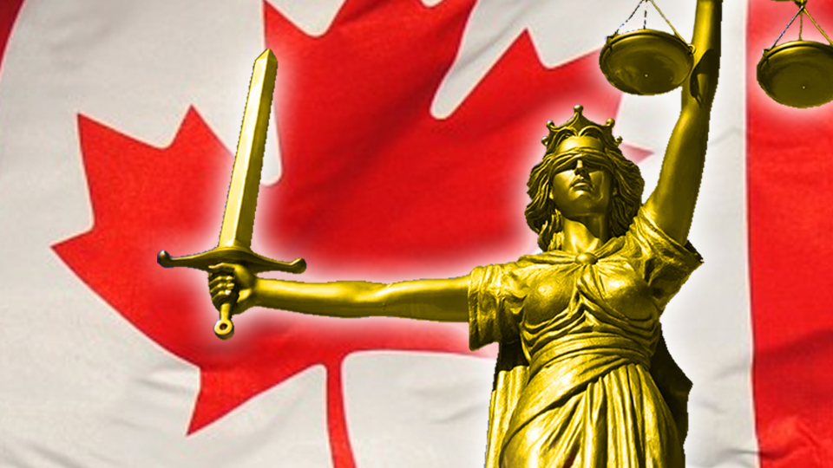
How the Canadian Judicial System is supposed to work
Copyright ©2020 Kosowan’s Korner. All rights reserved.

Slide 2
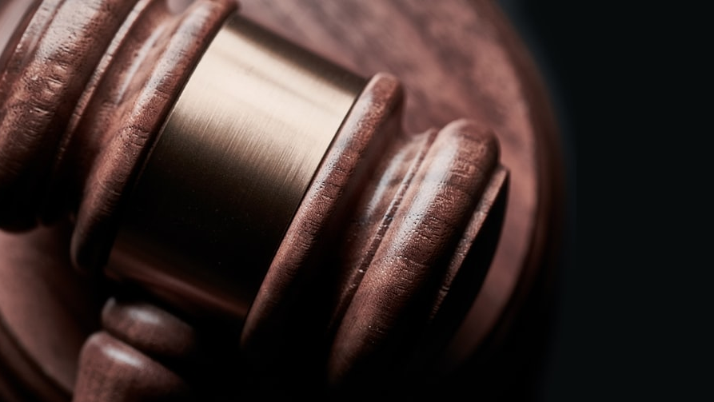
Key Terminology
The Crown – Group of lawyers accusing someone of committing a crime.
The Defence – Group of lawyers defending someone accused of committing a crime.
The Accused - A person who is accused of committing a crime.
Convicted - A person who is found guilty of committing a crime.
Appeal - A second case called for by the Defence or the Crown. It’s like a do-over.

Slide 3
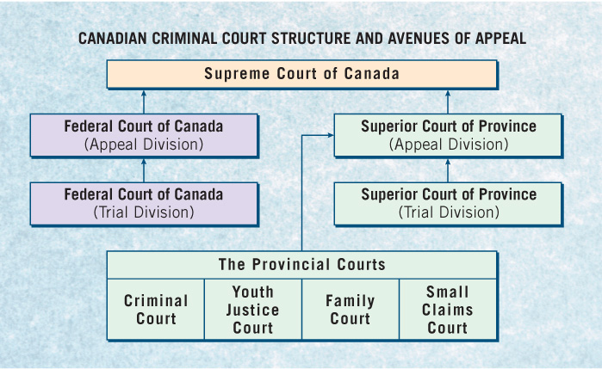
Powers of the Judiciary
The federal, provincial and territorial governments are all responsible for Canada’s judicial system.

Slide 4
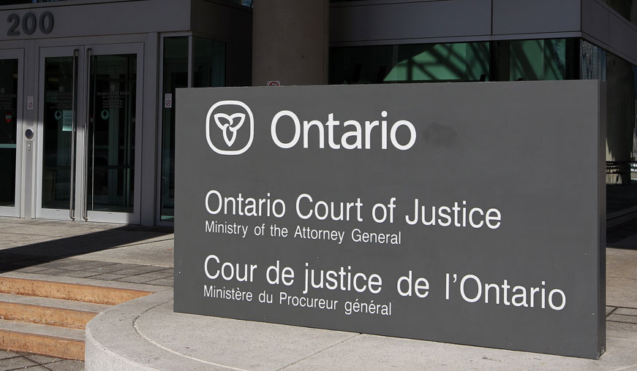
Provincial Courts
Provincial courts are the lowest level of Canada’s Judiciary.
They try most criminal offences, money matters and family matters.
Provincial courts may also include specialized courts, such as youth courts, family courts, and small claims courts.

Slide 5
Superior Courts of Province
They are the highest criminal and civil courts in the provinces and have a trial and appeal division.
Has jurisdiction in both criminal and civil matters, beyond the lower courts.
Judge and jury unless the accused and the provincial Attorney General consent to trial by judge alone.

Slide 6
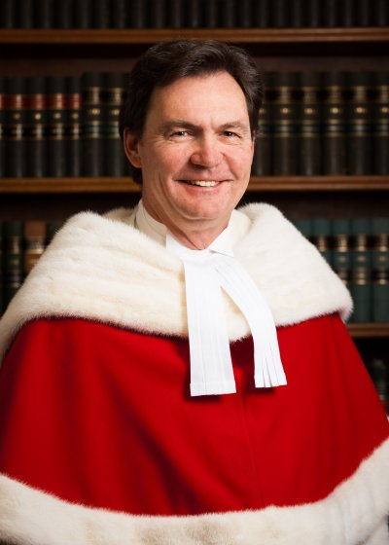
The Highest Courts of Canada
Federal Court of Canada Deals with cases involving the federal government
Also hears appeals from federally appointed boards, commissions and administrative tribunals.
Supreme Court of Canada
Highest appeals court in Canada, which also deals with constitutional questions referred to it by the Federal government.
Consists of a chief justice (Richard Wagner) and eight justices, all of whom are appointed by the federal government.
Three come from Quebec, three from Ontario, two from the western provinces and one from the Atlantic Provinces.
The court sits in Ottawa for three sessions a year.

Slide 7
What is a Crime?
A crime is a deliberate, reckless or negligent act that injures another person or causes damage to property.
For an act to be considered a crime, two basic features must be present:
1) Mens rea
Guilty mind, criminal intent
General or specific intent
2) Actus reus
Actual behaviour, not fantasy
Includes criminal negligence

Slide 8
3 kinds of offences in the law – Summary Offence
These are minor offences
Vagrancy, Causing a Disturbance, Drug Possession. Maximum penalty $5000, 6 months in jail or both. Always heard by provincial court judge. The case must start within 6 months of the act. Sentence served in provincial facility as long as it is less than 2 years (Deuce Less)
Notes:
Examples:
Assisting a Deserter, Prize Fights, Nudity, Obstructing or violence to or arrest of officiating clergyman
Disturbing religious worship or certain meetings, trespassing at night, lottery offence involving ticket, soliciting near children, fraud in obtaining food, beverage or lodging, deface current coin, failure to comply with a data preservation demand, disclosure of jury information, Contempt of court

Slide 9
3 kinds of offences in the law – Indictable Offence
These are more serious offences
Examples include Armed robbery, sexual assault, murder, treason. Trials with evidence and witnesses are key. Serious offences heard only in superior court (e.g. murder). The accused can elect to be tried by a jury instead of the judge. Sentence generally served in federal facility as long as it is longer than 2 years less a day.(Deuce Less)
Notes:
Examples
High Treason
Murder (1st, 2nd degree) + Manslaughter
Hijacking
Intending to cause explosion or use corrosive substances with intent to cause death or serious harm
Committing an offense for a terrorist group
Hoax red terrorist activity (causing death)
Aggravated sexual assault Operation While Impaired causing death
Robbery
Extortion
Break and Enter
Intimidating Parliament
Hate Propaganda (5 yrs)

Slide 10
3 kinds of offences in the law – Hybrid Offences
The seriousness can vary in these.
The Crown can decide to treat as an indictable or summary conviction. This decision is based on the seriousness of the offence and the harm caused by the offence. Some examples of hybrid offences are possession of a weapon obtained by crime, sexual exploitation, and cruelty to animals.
Notes:
Sexual Interference
Operation while impaired, causing bodily harm
Sabotage
Concealing identity during a riot
Assembling automatic firearm
Failure to stop at accident
Theft of cattle
Credit Card data offence
Mischief to cultural property
Hoax re terrorist activity (no bodily harm)

Slide 11
Who participates in a Trial?

Slide 12
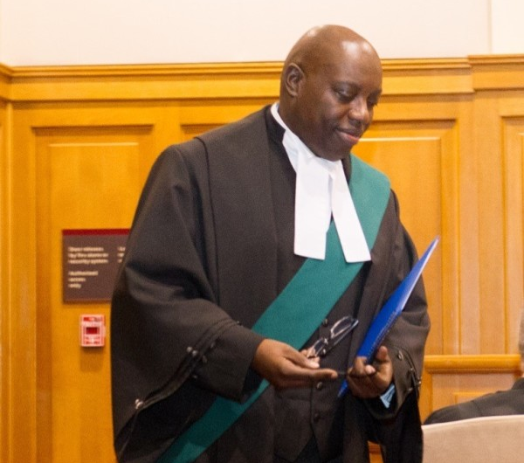
The Judge
The judge is the court official appointed to try cases in a court of law and to sentence convicted persons.
Makes decisions about allowable evidence and interprets the law.
In a jury trial, the judge instructs the jury on points of law, the jury decides the verdict based on the judge’s instructions and the evidence or facts presented, and the judge sentences the person.
Notes:
Judges wear a red sash. JOPs wear a green one. That’s one great way to tell the difference.

Slide 13
The Judge
In a non-jury trial, the judge does both.
A Justice of the Peace is a court official who has less authority than a judge but can issue warrants and perform other judicial functions.
Notes:
Judges wear a red sash. JOPs wear a green one. That’s one great way to tell the difference.

Slide 14
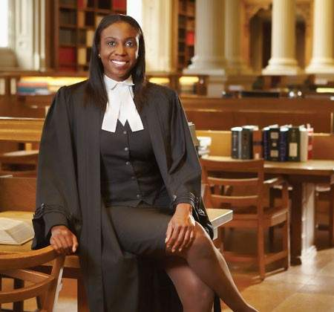
The Defence
The Accused is the person charged with committing a criminal offence.
They are represented by Defence Counsel, the lawyer hired to defend the Accused.
When the Accused cannot afford a lawyer, they are sometimes represented by the Duty Counsel, who gives free legal advice to persons just arrested or brought before the court.

Slide 15
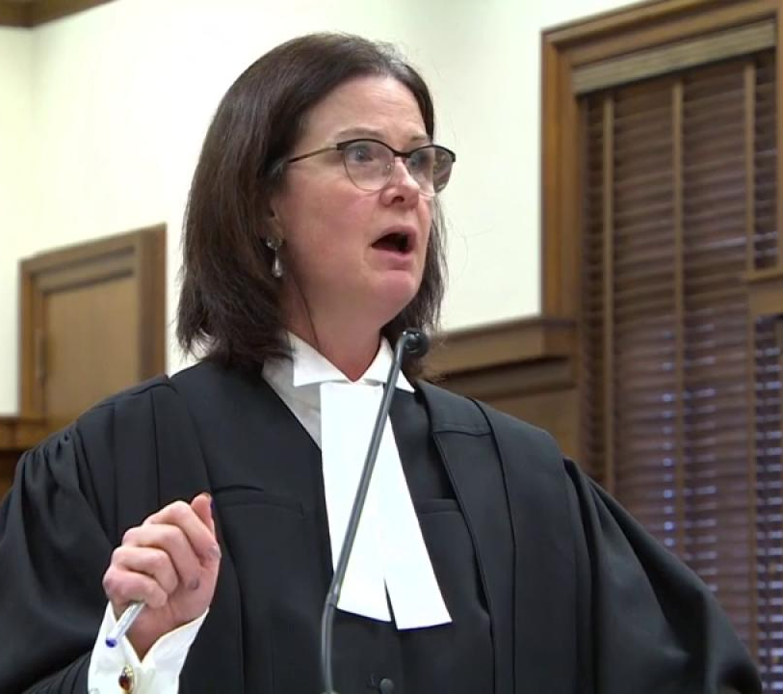
Crown Attorney
The assistant crown attorney or prosecutor is the lawyer representing the government.
They are responsible for bringing forward credible evidence of a crime.
Evidence is relevant information that tends to prove or disprove the elements of an offence.

Slide 16
Court Personnel
Court Clerk – assists judge by keeping a record of the trial exhibits, administering oaths and announcing the beginning or end of the court session.
Court reporter – records word for word everything said during the trial. The reporter can produce a transcript or typed record of everything said in court.
Court security officer – handles accused in custody and maintain security in courtroom.
Sheriff – responsible for jury, including summoning, paying and guarding them.
Bailiff – court official who assists the sheriff.

Slide 17
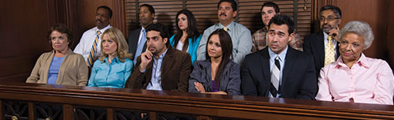
The Jury
The jury is a group of 12 people who decide whether Accused is guilty or not guilty. They are chosen by the crown and defence from a pool of ordinary citizens. They listen to the trial, consider all the evidence and follow the judge’s instructions about the law. They then deliberate, consider the evidence and decide if guilty or not guilty. Their decision must be unanimous.

Slide 18
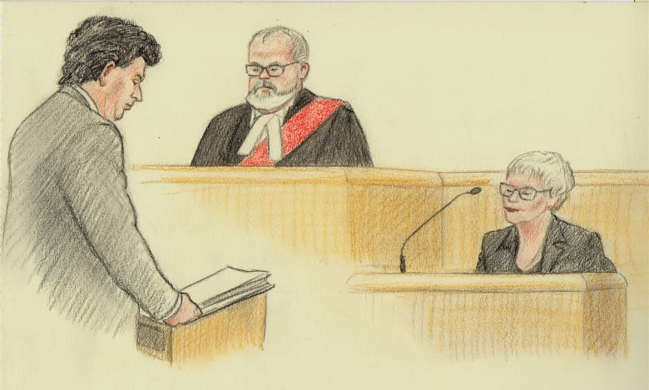
The Witnesses
Witnesses give evidence, under oath of their knowledge of the circumstances surrounding a crime. They are compelled to appear in court by subpoena, a court order requiring witness to appear in court to give evidence. Failure of witness to appear can result in contempt of court charge for obstructing course of justice and disobeying the court’s authority.
Committing perjury, knowingly making false statements in court, is a serious offence. The maximum penalty is 14 years in jail.

Slide 19
Bibliography
“Being a Witness in Court: Rules and Restrictions.” educaloi.qc.ca 2019. https://www.educaloi.qc.ca/en/capsules/being-witness-court- rules-and-restrictions. “Canada’s Criminal Justice System: Getting fair outcomes for victims in Canada’s criminal justice system.” Office of the Federal Ombudsman for Victims of Crime. November 2017. https://www.victimsfirst.gc.ca/res/pub/gfo-ore/CCJS.html. Dostal, Peter. “List of Summary Conviction Offences.” The Canadian Criminal Law Notebook. 2019. http://criminalnotebook.ca/index.php/List_of_Summary_Conviction_Offences. Hopper, Tristin. “Judge finds alleged domestic assault victim unreliable after she calls lawyer ‘beautiful.’” The National Post. September 13, 2017. https://nationalpost.com/news/canada/judge-finds-alleged-domestic-assault-victim-unreliable- because-she-called-lawyer-beautiful. “Hybrid Offense.” Steps to Justice: your guide to law in Ontario. 2018. https://stepstojustice.ca/glossary/hybrid-offence. “Judges of the Court.” Supreme Court of Canada. Last modified September 27, 2019. https://www.scc-csc.ca/judges-juges/index- eng.aspx. “The Judicial Structure.” Department of Justice. Last modified October 16, 2017. https://www.justice.gc.ca/eng/csj-sjc/just/07.html. McFeat, Tom. “Cameras in the Courts.” CBC News. Last modified March 14, 2010. https://www.cbc.ca/news/canada/cameras-in-the- courts-1.869497. Stacy, Paul. “Intro to Criminal Law. PPt1.” PowerPoint Presentation. October 14, 2007. “Jury Duty in Ontario.” Ministry of the Attorney General. September 18, 2019. https://www.ontario.ca/page/jury-duty-ontario.

