Slide 1
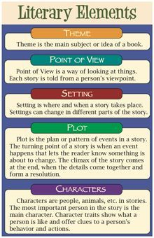
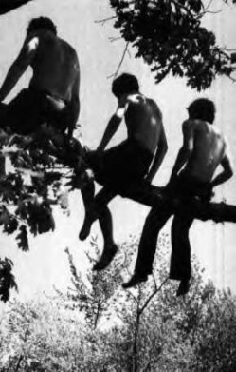
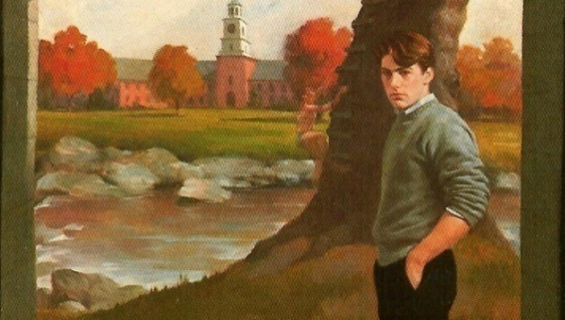
A Separate Peace by John Knowles
Literary Elements: Chapter 6-7

Slide 2
Main Characters
Gene Forrester:
brave –not a coward, ex. Quackenbush was fighting with Gene, Gene fought back and didn’t accept Quackenbush’s threats
Clever-trying to smoke in basement, Brinker accuses Gene of pushing the branch that made Finny fall, Gene says that Brinker is not correct
Friendly-trying to smoke in the Butt Room (basement)
Active: trying to partake in activities (Assistant Crew Manager); active with the other boys at meetings of the Suicide Club
Finny:
Phone Call: speaks to Gene, still believes that Gene is innocent, peaceful call
Returns to school at the end of Ch.7
:

Slide 3
Secondary Characters
Quackenbush:
Uneducated, unliked in the school, goof, causes verbal fight with Gene
2. Leper
Thoughtful-has normal ideas, thinks people should enjoy scenery
3. Brinker
leadership:-aggressive, wants to enlist in the military to help the war effort, first person to want to leave school for this

Slide 4
Setting
Location: Devon School; Smoking Room (Butt Room); rivers on the Foot Bridge; Railroad, shovelling the snow for the workers at war; Gene’s big dorm room without Finny there
Time Period: September, regular school session (not the summer)
Mood:
Tension because the secondary characters (students) are asking/joking about what really happened with the tree branch at the river
Talk of war, sentiment of wanting to help out with the war effort
Mild tension between the boys and Gene
Rebellion, pushing the rules from all the boys ex. smoking

Slide 5
Main Events
Chapter 6
Back at school for regular session
Gene joins the rowing team as Assistant Crew Manager
Quackenbush has a verbal fight with Gene about Finny, Gene defends himself
Mr. Ludsbury (Master in charge of dorm) gets Gene in trouble for the Beach visit and poker playing at night
Phone Call from Finny-both boys speak peacefully
Chapter 7
Brinker joking with Gene about the size of his room and what did he do to push Finny away
Smoking cigarettes in the basement
Boys are helping out railroad by shovelling snow off the tracks, get paid money
Brinker wants to enlist in the military, so does Gene
Finny shows up in the dorm room

Slide 6
Theme
Education: style of education (private boys’ US boarding school at the end of WW2)
Trust: still there, from Finny to Gene because of the phone call that he made to Gene
Friendship: still have a friendship between Finny/Gene; now small sign of social gathering s between the other students and Gene
4. Identity: Gene is trying to feel a sense of who he is now that Finny is absent; trying to carry on with the type of behaviour that Finny showed him before (pushing the rules); joins the rowing team as Assistant Crew Manager; this shows he is trying to find his identity
5. Reality: Gene getting caught by Mr. Ludsbury (dorm master); Finny does return

Slide 7
Meaningful Quotes
Pg. 102 “As though alive itself it poured in a thin yellow flag of brightness from under the door illuminating the dust and the splinter of the whole floor.” Foreshadowing of things that Gene did to Finny; Finny’s presence is felt even though he is not present
Pg. 93 “In the same ways the war beginning almost humourously with annoucements about madis and days spent at apple picking commenced invasion of school the early snow was commandeered as its advance guard.” –imagery, personification, metaphor-the seasons are being compared to the war situation, taking over the sense of school, war and change of season to winter are happening at the same time

Slide 8
Figurative Language
See Slide #8 ex. Simile (bright yellow light referring to Finny’s presence)
See slide #8 ex. Imagery, personification, and metaphor the snow is acting like a military guard

Slide 9
Vocabulary-Ch.6-7
Illuminating
Commandeer
Beaming
Possession
Judiciously
Dungeon
Paralyzed
Ambiguously
Energetically
Alternately

Slide 10
Text and Society
War Affects Everyone in Society: all members of society are affected by war, especially these students; a sense of wanting to support their country by enlisting in the military
Peer Pressure For Teenagers: felt in all societies as experienced by Gene when he is alone in his dorm room without Finny and the other boys are teasing him about Finny’s absence

