Slide 1
Employment Strategies, Education and Workplace

Slide 2
Overview
What we will be covering in class today:
Strategies for employment
Moodle work

Slide 3
Ted Talk Group Work
https://www.youtube.com/watch?v=guXxy8LH2QM
We will watch the video together and then you will discuss.
I want you to explain what you think is the most important point from the video.
You will have ten minutes in your groups. .

Slide 4
Competitive Market
Figuring out which job you want to do is hard
Finding employment can be even harder
Get ready to discuss ‘employment strategies’
Ex. What you could do RIGHT NOW to make yourself more competitive when you graduate from high-school?

Slide 5
Employment Strategies
Grades
Education
Experience
Networking
Marketing

Slide 6
Grades

Slide 7
Why are grades important?
Grades certainly aren’t EVERYTHING but getting better grades will make you more competitive by getting you into better schools
We will discuss on the next slide why going to certain schools is an advantage

Slide 8
Education

Slide 9
Why is education important?
Getting into the top schools makes you more competitive
Example: you and one other person are applying for the same job; you went to Harvard and your competitor went to a lesser-known school. Who will likely get the job?
Also having a degree can increase your earning potential and qualify you for more advanced positions. Many industries, i.e. banking and business, will hire you at an entry-level position, but having a degree makes you stand out
Example: you and one other person are applying to an entry level bank job; you have a degree in banking and the other person only has a high school diploma. Who will likely the job?
Another way to further your education, particularly if you have a bachelor's degree already, is to pursue a certification. Evaluate the different certifications that would enhance your resume and potentially qualify you for more advanced positions.
Example: two teachers are applying for a teaching position. They have the same level of education and experience, but one teacher is certified in special education. Who will likely get the job?

Slide 10
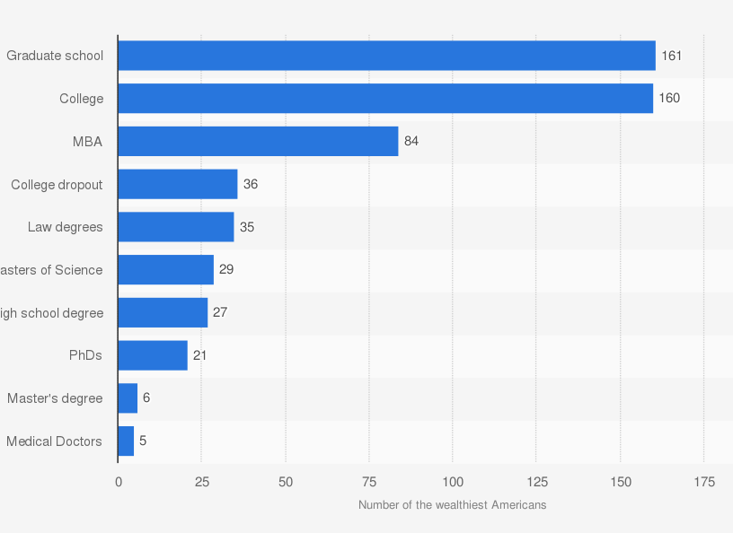
Education Level of the 400 Richest People

Slide 11
Experience

Slide 12
Why is experience important?
If you are pursuing your first professional job, you can stand out from the competition by securing some work experience
Example: you and another person are applying for a babysitter job; you have 10 years of experience, and they only have 1 year. Who is more likely to get the job?
You can also gain experience through an internship (paid or unpaid) – to develop invaluable skills employers are looking for.
You could also search for entry-level roles in the industry or department you want to work within, even if it isn't exactly what you want to do. Again, the experience and skills you learn in these roles can transfer into any future position you hold.
When looking at college or university programs consider taking a program with a practicum component. If you have two options for the same program but one has a practicum/placement component, then seriously consider taking that one. You will gain hands-on experience and will know what employers are looking for.

Slide 13
Networking

Slide 14
Why is networking important?
While experience and education can go a long way toward helping you stand out in a competitive job market, networking can also play a big role in helping you find the right opportunity by building connections to future job openings.
Example: Share personal story
Join professional organizations and/or attend networking events
Engage others in conversation and be personable/leave a positive, lasting impression.
Stay in contact with the people you connect with the most, even if you're not currently looking for a new job.

Slide 15
Marketing

Slide 16
Why is marketing important?
Before even requesting an interview, it’s standard for employers to look up job applicants online. You can learn a lot about someone from the information they put out into the world!
Example: you may be applying to a government job, but have pictures and videos all over the internet of your partying and reckless behaviour. Would an employer see that and want to request an interview?
It’s so important to use the tools available to you to market yourself and build a professional/positive online presence! Use social media to your advantage.
Example: LinkedIn, Twitter, Instagram, Facebook, etc.
Stay up to date on marketing trends
Example: TikTok, Bookstagram, etc.

Slide 17
AS Learning Answer in Moodle
Using your top 3 job options, brainstorm what kinds of strategies you could take now to make you more employable down the road. Be specific to each job you’ve chosen.

