Slide 1
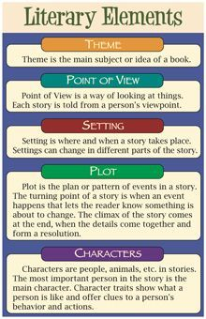
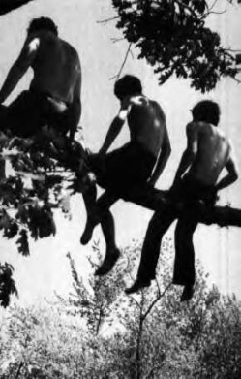
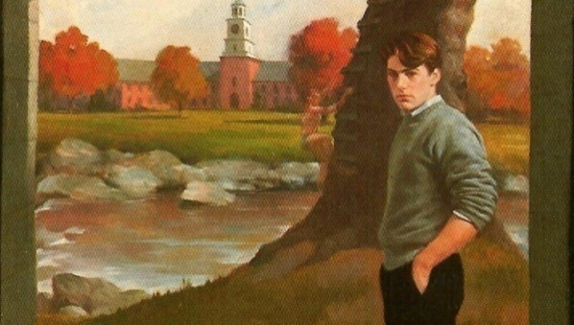
A Separate Peace by John Knowles
Literary Elements: Chapter 4-5

Slide 2
Main Characters
Gene Forrester:
blaming Finny for accident; saying it was his fault; blamed Finny for Gene failing the trigonometry test
Feels competitive towards Finny, wanting to be school valedictorian
Stronger academic than Finny
Finny:
Unfortunate: because he fell out of the tree onto the bank of river
Loyal: to Gene because he didn’t accuse Gene of causing the accident at first
Brave: appears brave and not damaged emotionally by this accident which causing him to lose out on his sporting activities
Accepting: at first accepting of Gene, happy to see him before the conversation became tense
:

Slide 3
Secondary Characters
Doctor: examines Finny and allows him to have a visit with Gene, then sends Gene away saying no more visits
Classmates Belonging to Super Suicide Society: Continue with the nightly meetings

Slide 4
Setting
Location: beach setting at night; in the dorm room of Finny, Gene, arguing about the leap; by the tree/river bank; hospital; Finny’s home in Boston; back at school
Time Period: Summer Session; Summer Holidays; September at school when it resumes
Mood: Tense between the 2 boys, unclear because of the mystery of what happened and no clear conclusions
Regret: because Gene regrets what he said about Finny and his responsibilities academically, failing the trig test

Slide 5
Main Events
Chapter 4
Boys sleep on the beach all night; escaped with no major trouble from school but Gene failed his Trigonometry test; wants to improve his mark, Finny says that he works too hard
Gene tries to be valedictorian; Finny athletic success
Keep up with nightly meetings of Suicide Society
Jumping from the tree, causes Finny to fall and land on the bank; they were supposed to jump together, Finny’s idea
Chapter 5
Finny’s leg shatters in the fall; argument about how it happened
Gene visits Finny in the hospital and they argue about what happened; doctor sends Gene away
Both boys return home for one month of holidays, separate cities
September arrives, Gene visits Finny on the way to school; calm at first, but then tension arrives as they discuss what happened with the fall
Gene confesses that he shook the tree branch

Slide 6
Theme
Education: style of education (private boys’ US boarding school at the end of WW2)
Trust: on the way out, being destroyed because the boys are questioning each other and the actions leading to Finny’s fall; small amount of interest in the friendship still
Friendship: not strong anymore because of the accident and accusations that were flying between both boys; stressed because of the above; tested to see if it will recover or weaken even further; it could possibly be ending
Jealousy: Gene is jealous of Finny’s athletic ability; possibly Gene is jealous of Finny’s calm and jovial and confident manner with people
Identity: Gene struggles at first to take on his own identity, seeming to like Finny’s identity more
Reality: what really occurred with Finny’s fall out of the tree branch
Guilt: as experienced by Gene over the accident

Slide 7
Meaningful Quotes
Pg. 59 “Now I knew that there never was and there never could have been any rivalry between us. I was not of the same quality as him.” Gene speaking to Finny; theme of identity and revealing who he really is; looking down on Finny
Pg. 60 “It was the first clumsy physical action that I had ever seen him make with unthinking sureness I moved out of the limb and jumped into the river. Every trace of my fear of this forgotten.” Gene to Finny about Finny’s legs; realizes Finny was really injured, feeling regretful for this action

Slide 8
Figurative Language
Pg. 68 “Despite everything at the Devon Infirmary he had seen athletic there temporarily enjoyed in a game. Propped now before a great New England fireplace on this quiet old street he looked to me like an invalid housebound.” Simile and Imagery combined to describe poor Finny after the accident
Pg. 49 “The ocean looked bad too that grey waves hissing more daintily along the beach which was grey and dead looking itself.” Personification of the ocean waves becoming like an animal or creature hissing; adds to the dark, sombre mood

Slide 9
Vocabulary-Ch.4-5
Invalid
Disapproving
Clumsy
Visionary
Miniature
Intoxicant
Deliberately
Elegance
Paganism
Decalogue

Slide 10
Text and Society
Consequences of Actions For Students: students need to put in the necessary studying/preparation time for courses/classes
Consequences of Actions For Poor Decisions: ex. Finny’s accident; it would have never happened if Gene and Finny had not been jumping off the tree branch; silly actions have dangerous consequences

