Slide 1
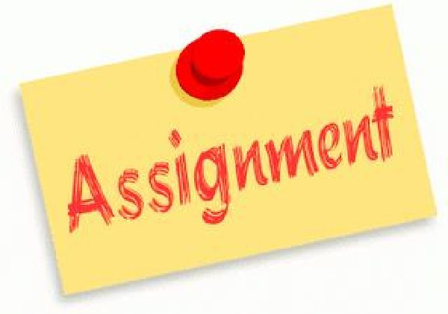
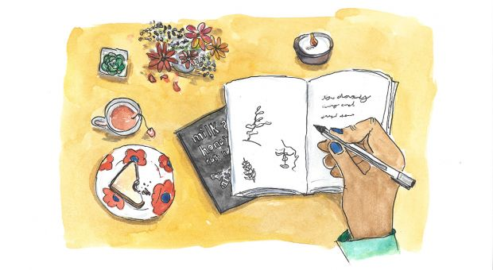
ENG4U Assignment #2 Poem Creation and Analysis
Create Your Own Poem!
Use TPCAST Method of Analysis

Slide 2
Directions
Create a poem of any format (Haiku, Acrostic, Sonnet, Free Verse/Blank Verse; Rhyming; Classic or Modern) using all the tools you have acquired in this Poetry Unit. Poems MUST be at least 3 Lines (Haiku) and no more than 20 lines.
Use the TPCAST Format to guide and structure your analysis. **You only need to do Paraphrasing/Connotations for a section of your poem. See Slide 3 for Planning Guidelines.
Follow the Assignment Submission Guideline on Moodle (Course Orientation Page). Google Docs/Word Doc; Size 12, Times New Roman etc. With Full Name, Course Code, Date etc.
Put all paragraphs into your own words. Do not plagiarize. Your poem and analysis must be in your own words.

Slide 3
Requirements
Proper Essay Paragraphing and Organization (topic sentences, examples and details, concluding sentences)
Recommended Plan of Paragraphs: 4 Paragraphs, see below
Introduction (Introduce your Poem, Poet and format for analysis, reason for writing the poem)
Analysis of Title, Paraphrase, Connotation
Analysis of Attitude, Shift, Themes
Conclusion (Summarize your Analysis; show how this poem connects to your life)
Remember to use your own words to avoid plagiarizing. Put any words or phrases from the poem in Quotations.
Show your Ideas, Plans and Drafts to your teacher BEFORE posting the Assignment for the OF Learning Progress Mark

Slide 4
Follow This Plan
Use a 4 Paragraph Structure for this essay. Follow the Plan below:
**Show your poem at the tart of the essay
Para #1: Introduction (Introduce your Poem, Poet, Why you wrote it, and format for analysis)
Para #2: Body: Analysis of Title, Paraphrase, Connotation
**Topic Sentence MUST include listing the key words Title, Paraphrase, Connotation.
**Examples from the Text MUST include the key words Title, Paraphrase, Connotation
**Concluding sentence needs to be similar to the Topic Sentence and include the key words above
Para #3 Body: Analysis of Attitude, Shift, Themes
**Topic Sentence MUST include listing the key words Attitude, Shift, Theme
**Examples from the Text MUST include the key words Attitude, Shift, Theme
**Concluding sentence needs to be similar to the Topic Sentence and include the key words above
Para #4 Conclusion**Summarize your Analysis
**Use the key words of the Tpcast Elements (Title, Paraphrase, Connotations, Attitude, Shift, Theme)
**Connect your analysis back to your own life. Make personal connections to the poem

Slide 5
TPCAST Analysis
Title: What Does It Mean? Is it Effective?
Paraphrase: Own Words
Connotation: Symbolism, Any other meanings?
Attitude: of the speaker, mood of the poem
Shift: transition in emotions, thinking
Themes: What is the poet’s message?

Slide 6
Expectations
Developing and Organizing Content
1.1 identify the topic, purpose, and audience for a variety of writing tasks
1.2 generate, expand, explore, and focus ideas for potential writing tasks, using a variety of strategies and print, electronic, and other resources, as appropriate
1.3 locate and select information to fully and effectively support ideas for writing, using a variety of strategies and print, electronic, and other resources, as appropriate
1.4 identify, sort, and order main ideas and supporting details for writing tasks, using a variety of strategies and selecting the organizational pattern best suited to the content and the purpose for writing
1.5 determine whether the ideas and information gathered are accurate and complete, interesting, and effectively meet the requirements of the writing task
Using Knowledge of Form and Style
2.1 write for different purposes and audiences using a variety of literary, informational, and graphic forms
2.2 establish a distinctive and original voice in their writing, modifying language and tone skilfully and effectively to suit the form, audience, and purpose for writing
2.3 use a wide range of descriptive and evocative words, phrases, and expressions precisely and imaginatively to make their writing clear, vivid, and compelling for their intended audience
2.4 write complete sentences that communicate their meaning clearly and effectively, skilfully varying sentence type, structure, and length to suit different purposes and making smooth and logical transitions between ideas
2.6 revise drafts to improve the content, organization, clarity, and style of their written work
2.7 produce revised drafts of texts, including increasingly complex texts, written to meet criteria identified by the teacher, based on the curriculum expectations

Slide 7
Expectations
Applying Knowledge of Conventions
3.1 use knowledge of spelling rules and patterns, a variety of resources, and appropriate strategies to recognize and correct their own and others’ spelling errors
3.2 build vocabulary for writing by confirming word meaning(s) and reviewing and refining word choice, using a variety of resources and strategies, as appropriate for the purpose
3.3 use punctuation correctly and effectively to communicate their intended meaning
3.4 use grammar conventions correctly and appropriately to communicate their intended meaning clearly and effectively
3.5 regularly proofread and correct their writing
3.6 use a variety of presentation features, including print and script, fonts, graphics, and layout, to improve the clarity and coherence of their written work and to heighten its appeal and effectiveness for their audience
3.7 produce pieces of published work to meet criteria identified by the teacher, based on the curriculum expectations

