Slide 1
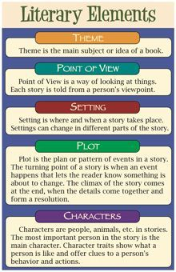
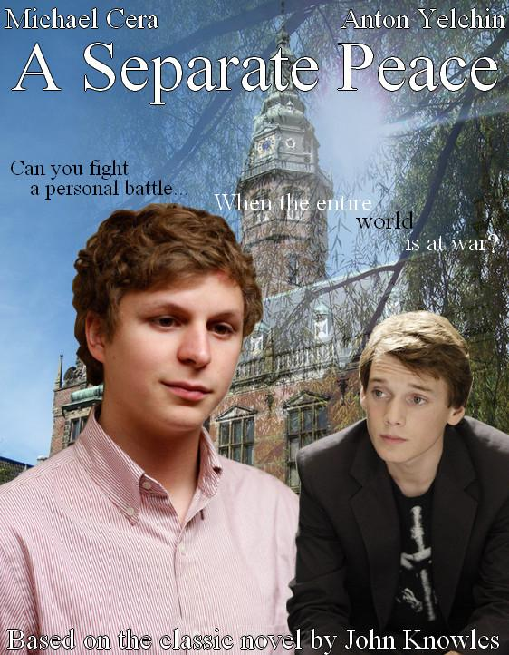
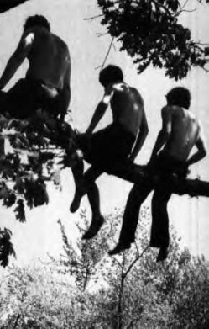
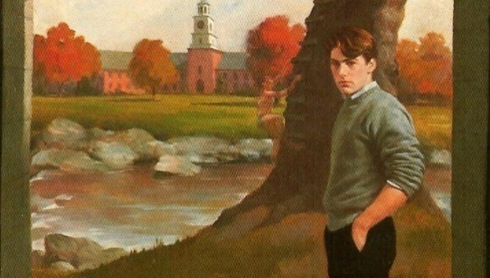
A Separate Peace by John Knowles
Literary Elements: Chapter 8-9

Slide 2
Main Characters
Gene Forrester:
looking for an identity ; planning on entering military because he was inspired by Brinker’s enlistment; willing to take the place of Finny and train for the Olympics
Shows friendship to Finny by returning the training favour and tutoring Finny in academics
Finny:
Doesn’t want to enlist in the war; feels that it doesn’t exist; in denial of war
Seems somewhat satisfied about training Gene and that Gene will pursue Olympic training for Finny
Finny creates/creative his own Olympic Games in the Winter Carnival at the school
**Both boys seem to pull away and socially distance themselves from the other boys and the Suicide Society and Butt Room, so they can train for the Olympics/Tutoring

Slide 3
Secondary Characters
Leper: enlists in military
Chet Douglas: plays the trumpet at carnival; musical
Brinker: guards jugs of Apple Cider in the snow with Brownie
Brownie Perkins: guards jugs of Cider in snow with Brinker
Mr. Ludsbury: supply teacher sees Gene and Finny training for Olympics; more focused on the wartime effort and encourages the boys to focus more on enlistment

Slide 4
Setting
Location:
Stadium for sports training where Gene is running around the track
Cinema, watch the movie
Small route where boys practice running
Natuamsett Park where Carnival took place
Time Period: winter term
Mood:
Exciting because of the winter carnival; social for the boys; teamwork and comraderie for the boys; good spirits
Acknowledging the war effort and enlistment; confusion over who will enlist and who won’t; changing opinions

Slide 5
Main Events
Chapter 8
Finny, Gene and Brinker talking about enlisting for the war, not serious at this point
Finny seems relieved that Gene will not be enlisting; we learn that Finny is not convinced there is a war, not interested in it at all
Teamwork and friendship as Finny trains Gene for the Olympics; Gene returns favour by tutoring Finny in academic subjects
Mr. Ludsbury sees the boys training and says that they should be enlisting for the war
Chapter 9
Leper enlists in the military
Finny and Gene hold back on many Suicide Society meetings to pursue their teamwork and partnership
Finny decides to create Winter Carnival idea with music from Chet and cider; ski jump; prizes
Everyone gets drunk on cider
Telegram received from Leper

Slide 6
Theme
Education: style of education (private boys’ US boarding school; takes a second spot to the War Effort
Trust: between Finny and Gene as they show partnership with Olympic training/tutoring
Friendship: strong between Finny/Gene and rest of boys
4. Identity: Gene is working on his self-identity; Is this Olympic training really for him, or he doing this to satisfy Finny?
5. Reality: Finny is out of touch with reality because of the war effort; doesn’t fully believe it exists

Slide 7
Meaningful Quotes
Pg. 119 “ The northern sunshine seemed to pick up faint particles of whiteness floating in the air and powdering the sleek blue sky.” Describing the setting; imagery; personification
Pg. 123 “This was my first, but not my last lapse into the private explanation of the world.”-Gene is saying the difference of their thinking (Gene and Finny); conflicting views on the war; Finny sees it as not really existing, while Gene considers enlisting

Slide 8
Figurative Language
Pg. 119 “ The northern sunshine seemed to pick up faint particles of whiteness floating in the air and powdering the sleek blue sky.” Imagery, Description, Using Sight, personification powdering the sleek, blue sky
Pg. 128 “Now winter itself an old, corrupt, tired conqueror loosens its grip on the desolation.” Personification; Winter as an old man

Slide 9
Vocabulary-Ch.8-9
Corrupt
Unemphatically
Colonial
Agitatedly
Preliminaries
Bitterly
Superiority
Abundant
Strained
Exhausted

Slide 10
Text and Society
Teenage Perspective on War: the boys have differing opinions about enlisting to support the war effort; Is this representative of all societies? How does youth in general feel about supporting the war effort?
Teenage Spirit of Youth and Energy: by creating the Winter Carnival, Finny and the students are escaping reality and enjoying themselves. Is this true of students today? Are they able to move past an upsetting and dangerous world event and have fun among themselves? Ex. Getting drunk on cider etc.

Slide 11
AS Learning Winter Carnival/Olympic Activity
Directions
Choose EITHER Winter Carnival OR Gene training for the Olympics.
Work in groups of 1-4 to answer the Guiding Questions (next slides) about your event.
Then, create a Winter Carnival OR Olympic Training for Students and Teachers at TCA. Be creative and have fun.
Put your answers/ideas onto a Google Docs/Slides/Video and casually share with the class. Be ready to answer questions about your Main Event.
Remember to talk clearly, naturally and causally. Try to use the vocabulary words/expressions from Ch.2-9 to enhance your Presentation.

Slide 12
Guiding Questions
Winter Carnival
What is the Winter Carnival? Who organized it?
2. What are some examples of games, activities that the boys organized and performed?
Do you think the Winter Carnival had a positive or negative effect on the boys? Did it distract them from the wartime pressure? Explain your thinking.
Create your own Winter Carnival for the students and teachers at TCA. Where will it be? What games, music, food, traditions, awards, prizes , events and activities will you play and/or organize? Include etc. Add pictures, details, maps etc. on your PPT.

Slide 13
Guiding Questions
Olympic Training
Why was Finny helping Gene to train for the Olympics?
Do you think Gene will be successful? Explain.
Do you think Finny is jealous of Gene? Explain.
Does this training have a positive effect on the boys? Did it distract them from the wartime pressure? Explain.
Create your own training schedule for an Olympic Event for the students and teachers at TCA. Who will participate? What event will it be? Location of event? Add pictures, details, maps etc. on your PPT.

