Slide 1
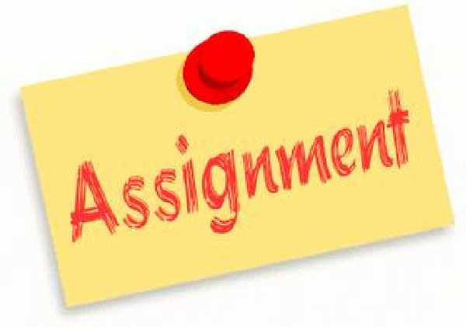
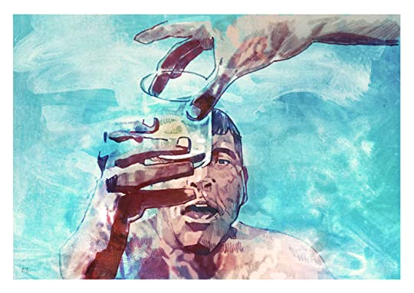
ENG4U Assignment #3 The Swimmer Analysis and Presentation
Group Work and Presentation
Choose 3 Questions to Analyze

Slide 2
Directions
Read The Swimmer by John Cheevers (see today’s Moodle Lesson 2.4).
Working in groups of 1-3, together with your group you will answer any 3 questions on Slides 4-5.
Follow the Assignment Submission Guideline on Moodle (Course Orientation Page). Google Docs/Word Doc/Slides/Prezi; Size 12, Times New Roman etc. With Full Name, Course Code, Date etc.
Put the answers to your questions into your own words (Google Docs, Word Document, Google Slides, PPT, Prezi, Canva etc.). Point Form is fine. Do not plagiarize. **Your analysis must be in your own words. **Be creative and have fun with your Presentation.
You and your group will answer the questions in a short 2-5 Minute Oral Presentation.

Slide 3
Requirements
Answer each question using clear examples from the text (The Swimmer) to show what you mean. Use Quotes if you are taking the words directly from the text. **Avoid plagiarizing.
Connect your example back to the question so that it is clear.
3. Proofread your work with your partners to check for spelling, grammar, and correct content. Use partner/teacher editing.
4. Remember to speak clearly, naturally and confidently in the oral presentation. Try not to read directly from your screen.

Slide 4
Questions For Analysis (Pick 3)
What are the emerging themes? Explain with examples from the text.
What are the ideas about upper middle class neighbourhoods and pool parties? Do you think everyone owns a pool and has parties like this, or does it represent only a wealthy part of society?
Why is Neddy swimming home? Where is his family? Do you think his family is worried about him?
What are people saying about Neddy? Do you think these people are nice? Do you feel sorry for him?

Slide 5
Questions For Analysis (Pick 3)
5. What are the references to time? What is the time at the beginning of the story, in the middle and in the end? Does the story seem to jump forward in time?
6. Does the fact that Neddy is drinking a lot in the story make Neddy’s story unbelievable? Did these events really happen to him? How do we know that this story really happened? Who’s point of view is being told in the story?

Slide 6
Expectations
Reading For Meaning
1.1 read a variety of student- and teacher-selected texts from diverse cultures and historical periods, identifying specific purposes for reading
1.2 select and use, with increasing facility, the most appropriate reading comprehension strategies to understand texts, including complex and challenging texts
1.3 identify the most important ideas and supporting details in texts, including complex and challenging texts
1.4 make and explain inferences of increasing subtlety and insight about texts, including complex and challenging texts, supporting their explanations with well-chosen stated and implied ideas from the texts
1.5 extend understanding of texts, including complex and challenging texts, by making rich and increasingly insightful connections between the ideas in them and personal knowledge, experience, and insights; other texts; and the world around them
1.6 analyse texts in terms of the information, ideas, issues, or themes they explore, examining how various aspects of the texts contribute to the presentation or development of these elements
1.7 evaluate the effectiveness of texts, including complex and challenging texts, using evidence from the text insightfully to support their opinions

Slide 7
Expectations
Understanding Form and Style
2.1 identify a variety of characteristics of literary, informational, and graphic text forms and demonstrate insight into the way they help communicate meaning
2.2 identify a variety of text features and demonstrate insight into the way they communicate meaning
2.3 identify a variety of elements of style in texts and explain how they help communicate meaning and enhance the effectiveness of the texts
Reading With Fluency
3.1 automatically understand most words in a variety of reading contexts
3.2 use decoding strategies effectively to read and understand unfamiliar words, including words of increasing difficulty
3.3 regularly use a variety of strategies to explore and expand vocabulary, discerning shades of meaning and assessing the precision with which words are used in the texts they are reading

Slide 8
Expectations
Speaking To Communicate
2.1 communicate orally for a wide range of purposes, using language effective for the intended audience
2.2 demonstrate an understanding of a variety of interpersonal speaking strategies and adapt them to suit the purpose, situation, and audience, exhibiting sensitivity to cultural differences
2.3 communicate in a clear, coherent manner, using a structure and style effective for the purpose, subject matter, and intended audience
2.4 use the most appropriate words, phrases, and terminology, and a variety of stylistic devices, to communicate their meaning in a compelling way and to engage their intended audience
2.7 use a variety of audio-visual aids effectively to support and enhance oral presentations and to engage an audience

Slide 9
Expectations
Developing and Organizing Content
1.1 identify the topic, purpose, and audience for a variety of writing tasks
1.2 generate, expand, explore, and focus ideas for potential writing tasks, using a variety of strategies and print, electronic, and other resources, as appropriate
1.3 locate and select information to fully and effectively support ideas for writing, using a variety of strategies and print, electronic, and other resources, as appropriate
1.4 identify, sort, and order main ideas and supporting details for writing tasks, using a variety of strategies and selecting the organizational pattern best suited to the content and the purpose for writing
1.5 determine whether the ideas and information gathered are accurate and complete, interesting, and effectively meet the requirements of the writing task
Using Knowledge of Form and Style
2.1 write for different purposes and audiences using a variety of literary, informational, and graphic forms
2.2 establish a distinctive and original voice in their writing, modifying language and tone skilfully and effectively to suit the form, audience, and purpose for writing
2.3 use a wide range of descriptive and evocative words, phrases, and expressions precisely and imaginatively to make their writing clear, vivid, and compelling for their intended audience
2.4 write complete sentences that communicate their meaning clearly and effectively, skilfully varying sentence type, structure, and length to suit different purposes and making smooth and logical transitions between ideas
2.6 revise drafts to improve the content, organization, clarity, and style of their written work
2.7 produce revised drafts of texts, including increasingly complex texts, written to meet criteria identified by the teacher, based on the curriculum expectations

Slide 10
Expectations
Applying Knowledge of Conventions
3.1 use knowledge of spelling rules and patterns, a variety of resources, and appropriate strategies to recognize and correct their own and others’ spelling errors
3.2 build vocabulary for writing by confirming word meaning(s) and reviewing and refining word choice, using a variety of resources and strategies, as appropriate for the purpose
3.3 use punctuation correctly and effectively to communicate their intended meaning
3.4 use grammar conventions correctly and appropriately to communicate their intended meaning clearly and effectively
3.5 regularly proofread and correct their writing
3.6 use a variety of presentation features, including print and script, fonts, graphics, and layout, to improve the clarity and coherence of their written work and to heighten its appeal and effectiveness for their audience
3.7 produce pieces of published work to meet criteria identified by the teacher, based on the curriculum expectations

