Slide 1
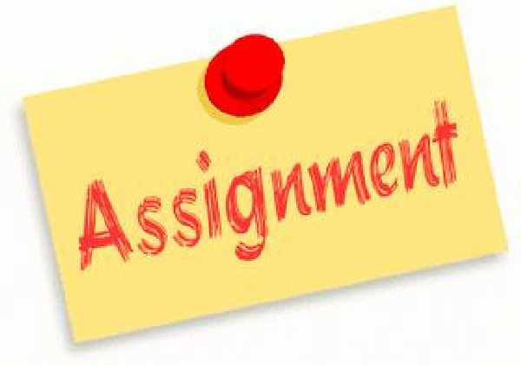
ENG4U Assignment #3 Opinion/Persuasive Essay
Topic Selection
Brainstorming/Research
Thesis Statement
Planning/Drafting
Revising/Editing
Publishing

Slide 2
Directions
Select a topic that interests you and that you feel strongly about. **See the Essay Structure PPT for suggestions.
Perform some research and gather ideas to build your Opinion/Thesis Statement. **See Essay Structure PPT
Follow the Plan and Paragraph format to construct your essay. 350-500 words. **Put all research into your own words.
Review/Edit your Draft. **Use the same draft from your AS Learning Opinion Essay.
Polish/publish your essay.
Follow the Assignment Submission Guideline on Moodle (Course Orientation Page). Google Docs/Word Doc; Size 12, Times New Roman etc. With Full Name, Course Code, Date etc.
Put all paragraphs into your own words. Do not plagiarize. Your essay and analysis must be in your own words. Use the APA/MLA Citation Guidelines for your Reference Page. **See Essay Structure PPT

Slide 3
Requirements
Proper Essay Paragraphing and Organization (topic sentences, examples and details, concluding sentences)
Recommended Plan of Paragraphs: 3-5 Paragraphs, see Essay Structure PPT
Remember to use your own words to avoid plagiarizing. Put any words or phrases from the poem in Quotations using APA/MLA Guidelines.
Show the teacher your plans and work BEFORE posting for your Of Learning Observation/Discussion Progress Mark.
Add your Reference Page according to APA/MLA Guidelines.

Slide 4
Expectations
Developing and Organizing Content
1.1 identify the topic, purpose, and audience for a variety of writing tasks
1.2 generate, expand, explore, and focus ideas for potential writing tasks, using a variety of strategies and print, electronic, and other resources, as appropriate
1.3 locate and select information to fully and effectively support ideas for writing, using a variety of strategies and print, electronic, and other resources, as appropriate
1.4 identify, sort, and order main ideas and supporting details for writing tasks, using a variety of strategies and selecting the organizational pattern best suited to the content and the purpose for writing
1.5 determine whether the ideas and information gathered are accurate and complete, interesting, and effectively meet the requirements of the writing task
Using Knowledge of Form and Style
2.1 write for different purposes and audiences using a variety of literary, informational, and graphic forms
2.2 establish a distinctive and original voice in their writing, modifying language and tone skilfully and effectively to suit the form, audience, and purpose for writing
2.3 use a wide range of descriptive and evocative words, phrases, and expressions precisely and imaginatively to make their writing clear, vivid, and compelling for their intended audience
2.4 write complete sentences that communicate their meaning clearly and effectively, skilfully varying sentence type, structure, and length to suit different purposes and making smooth and logical transitions between ideas
2.6 revise drafts to improve the content, organization, clarity, and style of their written work
2.7 produce revised drafts of texts, including increasingly complex texts, written to meet criteria identified by the teacher, based on the curriculum expectations

Slide 5
Expectations
Applying Knowledge of Conventions
3.1 use knowledge of spelling rules and patterns, a variety of resources, and appropriate strategies to recognize and correct their own and others’ spelling errors
3.2 build vocabulary for writing by confirming word meaning(s) and reviewing and refining word choice, using a variety of resources and strategies, as appropriate for the purpose
3.3 use punctuation correctly and effectively to communicate their intended meaning
3.4 use grammar conventions correctly and appropriately to communicate their intended meaning clearly and effectively
3.5 regularly proofread and correct their writing
3.6 use a variety of presentation features, including print and script, fonts, graphics, and layout, to improve the clarity and coherence of their written work and to heighten its appeal and effectiveness for their audience
3.7 produce pieces of published work to meet criteria identified by the teacher, based on the curriculum expectations

