Slide 1
Lesson 3.2 TCM: Food and TCM
31 May 2023

Slide 2
Class Announcement
Implementation of the Seating Plan
Every day when you enter the classroom, you will be assigned with a new seat in the way of a lucky draw
Remember to charge all your device properly starting from tomorrow as you might not have a seat next to the socket

Slide 3
Class Announcement
Assignment 3 arrangement:
We will talk about how to finish assignment 3 tomorrow

Slide 4
Midterm test result
Average mark: 47.29
Standard Deviation: 18.86
4+ (98) | 4 (91) | 4- (83) | 3+ (78) | 3 (75) | 3- (71) | 2+ (68) | 2 (65) | 2- (61) | 1+ (58) | 1 (55) | 1- (51)
89 | 83 | 77 | 71 | 65 | 59 | 53 | 47 | 41 | 35 | 29 | 23

Slide 5
Assignment 3
Imagine you are a student studying Chinese Medicine and you are working with your doctor, who is a mentor that supervise your practicums.
You will receive a patient profile on 6th June and you will be given 1 hour to prepare.
The teacher will act as the patient’s family member and will ask you some questions regarding the patient.

Slide 6
Assignment 3
Knowledge (25%)
You demonstrate knowledge about TCM taught during lesson 3.1 – 3.4.
Thinking (25%)
You can answer the concerns of the questions asked by the patient’s family member
Communication (25%)
You can explain your ideas to the patient’s family member effectively.
Application (25%)
Your grades of all the homework and classwork in Unit 3

Slide 7
Preparation for Assignment 3
As you will only know your patient’s information by the due date of assignment 3, it is the best that you study the content for Unit 3 so that you know where to retrieve relevant information as quick as possible
The rough copy for assignment 3 will be any form of notes you produce while you are revising for unit 3 e.g. notes in point form, mind map etc.)

Slide 8
Assignment 3 arrangement
Once you arrive at the classroom on 6th June, you will receive your patient’s profile. Everyone will receive a different profile.
You can have one hour to prepare for the interview. After one hour, you will take turn to complete the interview with me in the front of the classroom.
You are not allowed to talk to your classmates after you receive your patient profile. Talking results in mark deduction.
You can use all electronic device you like during the preparation time. However, during the interview, you can only bring paper as your notes. No electronics are allowed when you are participating in the interview. You can write everything you deem important on your patient profile with a pen/pencil.
You can leave the classroom once you are done. However, there will be no break time on 6th June.

Slide 9
TCM: Food and Cooking
The aim of this series is to provide you with foundational and practical knowledge of TCM that you can use to improve your own health at home in daily life. The recommendations in this series are simple, accessible, and mostly free. After all, good health should be something that is accessible to everyone!

Slide 10
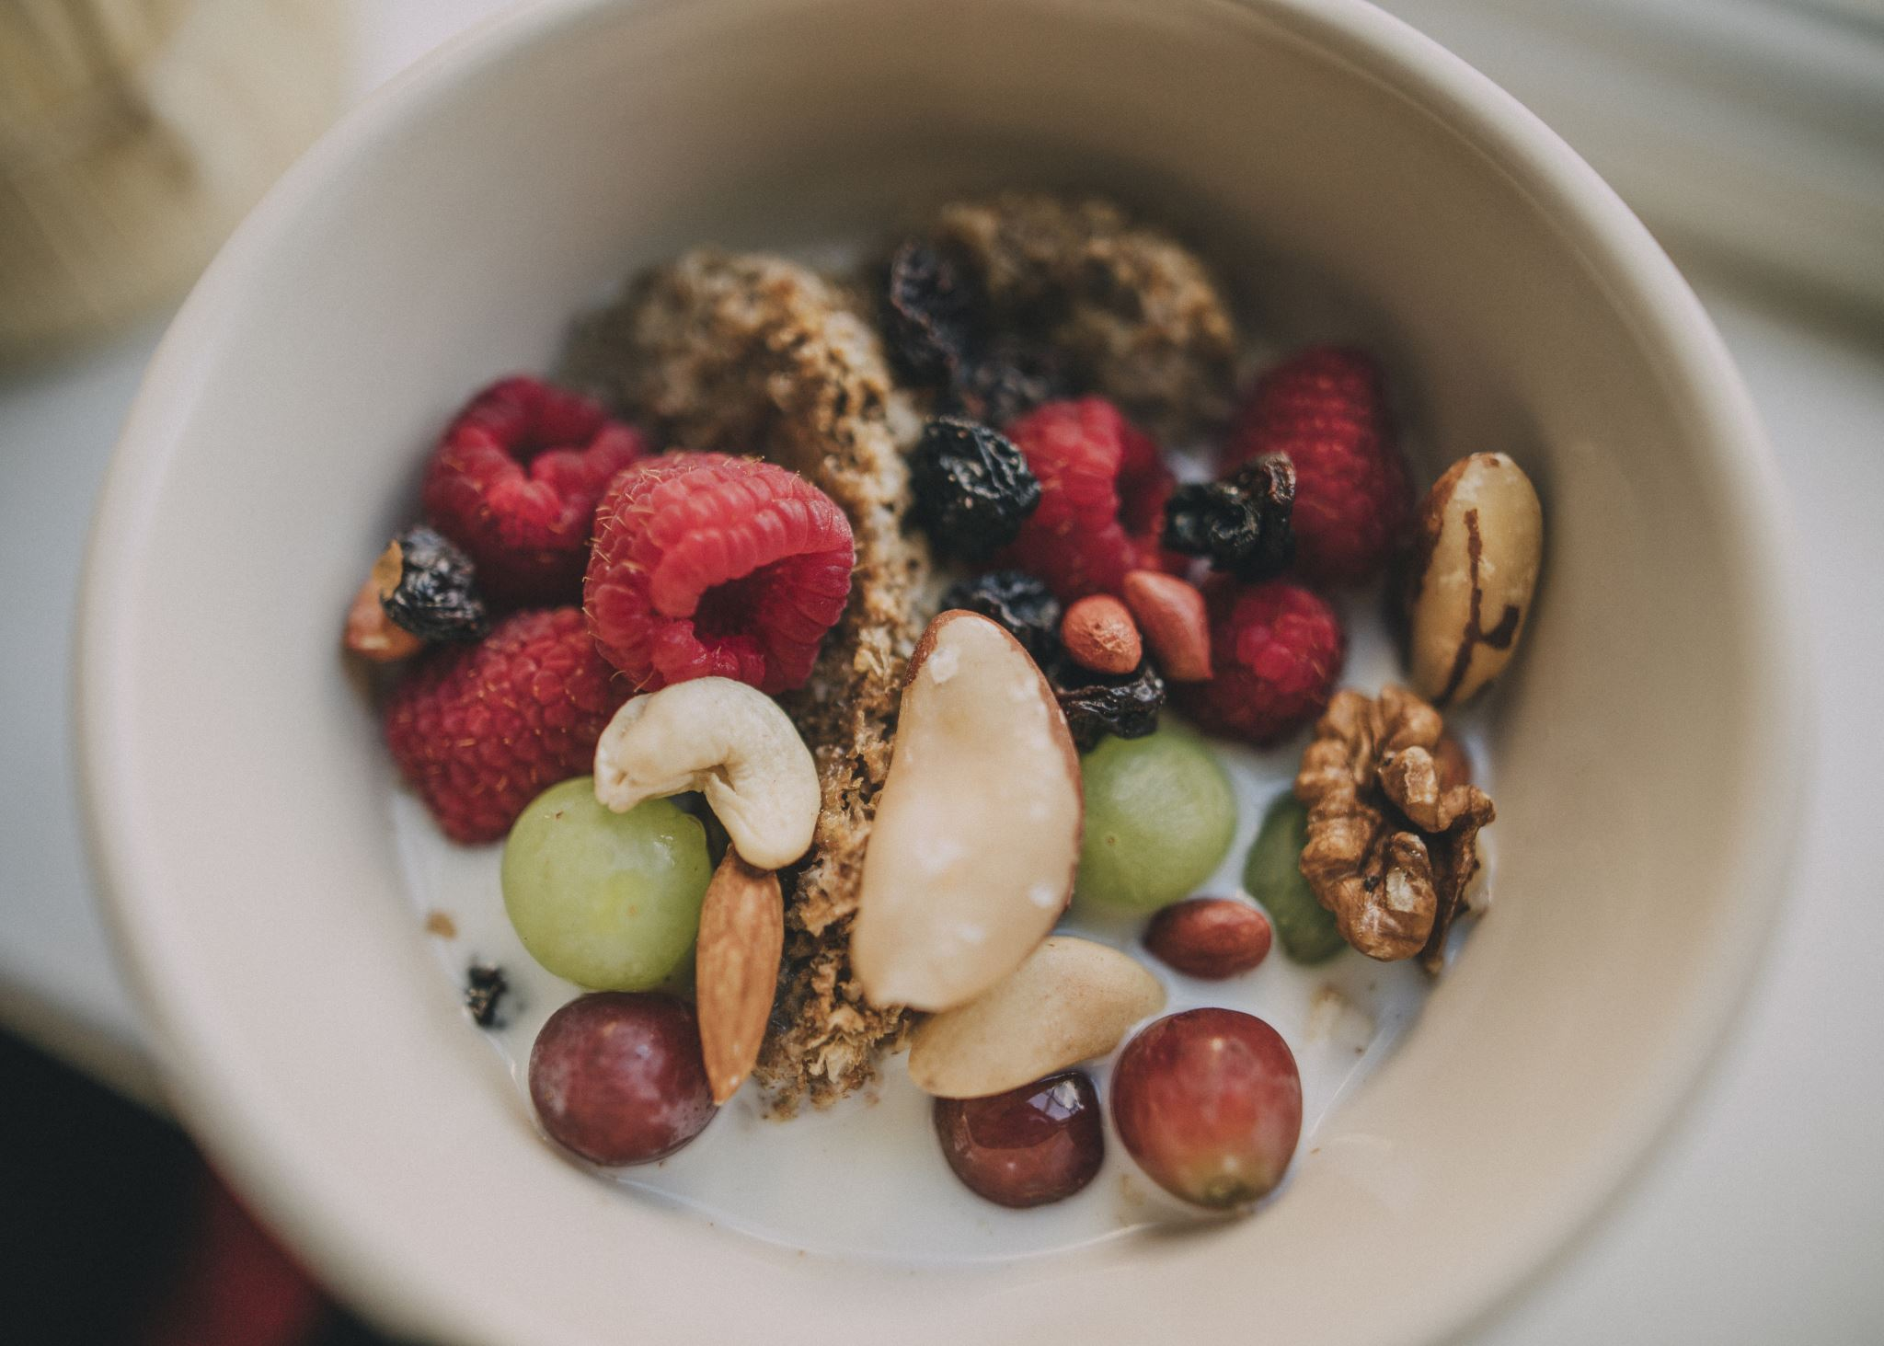
Food Energies
In TCM, foods have different energies and effects. Chinese classics like the Shen Nong Ben Cao Jing explain that there are four energies: cold, cool, warm, and hot. We can also add neutral energy for foods that are neither cooling nor warming.
The food energy refers to how the food makes the body feel, not the temperature of the food. For example, lettuce is considered cold, so even if you eat hot, cooked lettuce, the energy is still cold. Another example: Chinese tea is considered cool even though we drink it hot. After drinking the tea, the heat fades quickly and generates cool energy in the body.

Slide 12
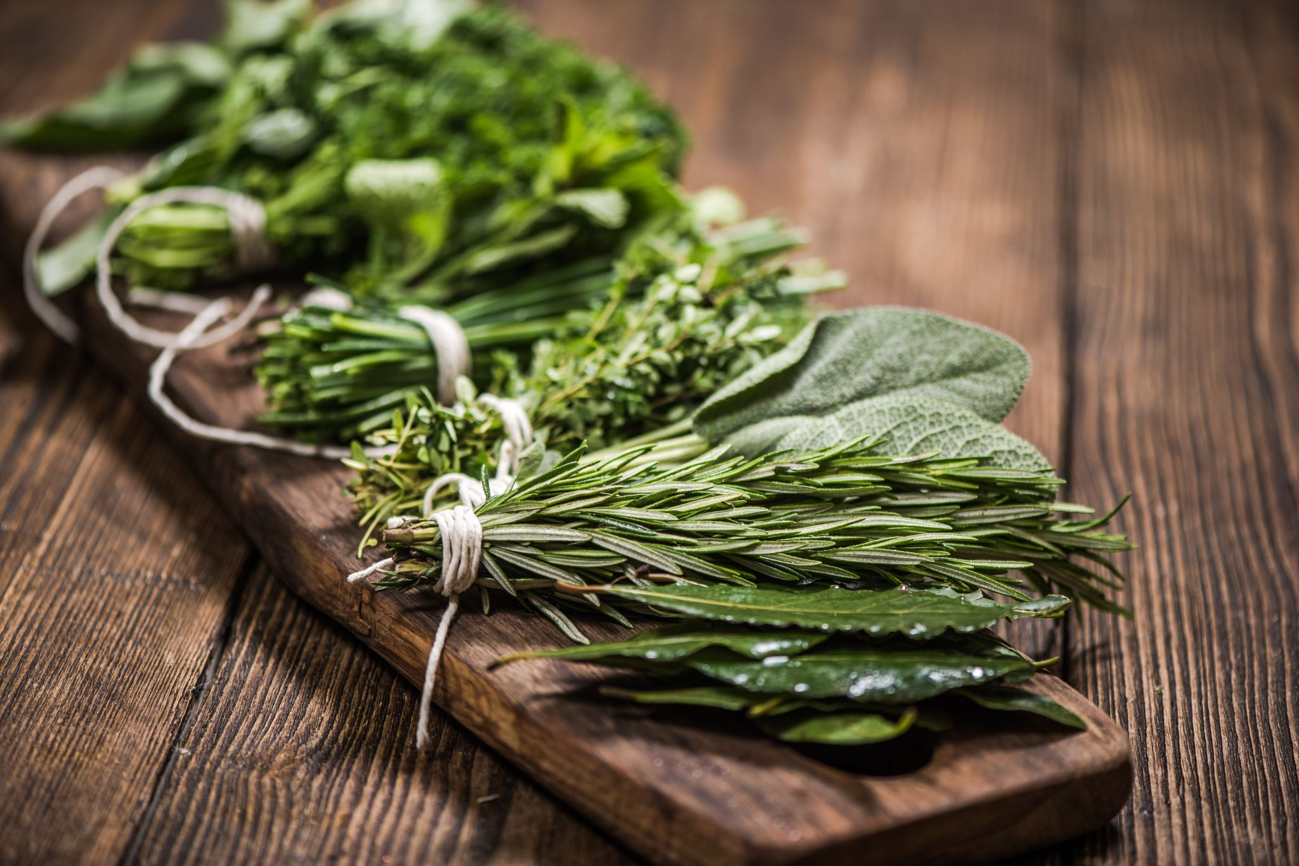
Food Flavors
In terms of food effects, we have to look at the five flavors: sour, bitter, sweet, pungent/spicy, and salty.
Recall from the previous lesson that TCM associates each of the five elements to a taste and organ. That means foods of a particular taste will be good for the organ of that element. For example, the metal element is associated with the pungent and spicy flavors and the lungs and large intestines. That means eating pungent or spicy foods like ginger, garlic, and chili peppers will help those two organs.

Slide 13
Food Flavors

Slide 14
Food Flavors
Note that different foods in the same category have different levels of strength in effect.
For example, both ginger and chili peppers are spicy, but chili peppers are much stronger than ginger.
Hence it is much easier for people to get excess heat symptoms such as canker sores and constipation from eating chili peppers compared to ginger.

Slide 15
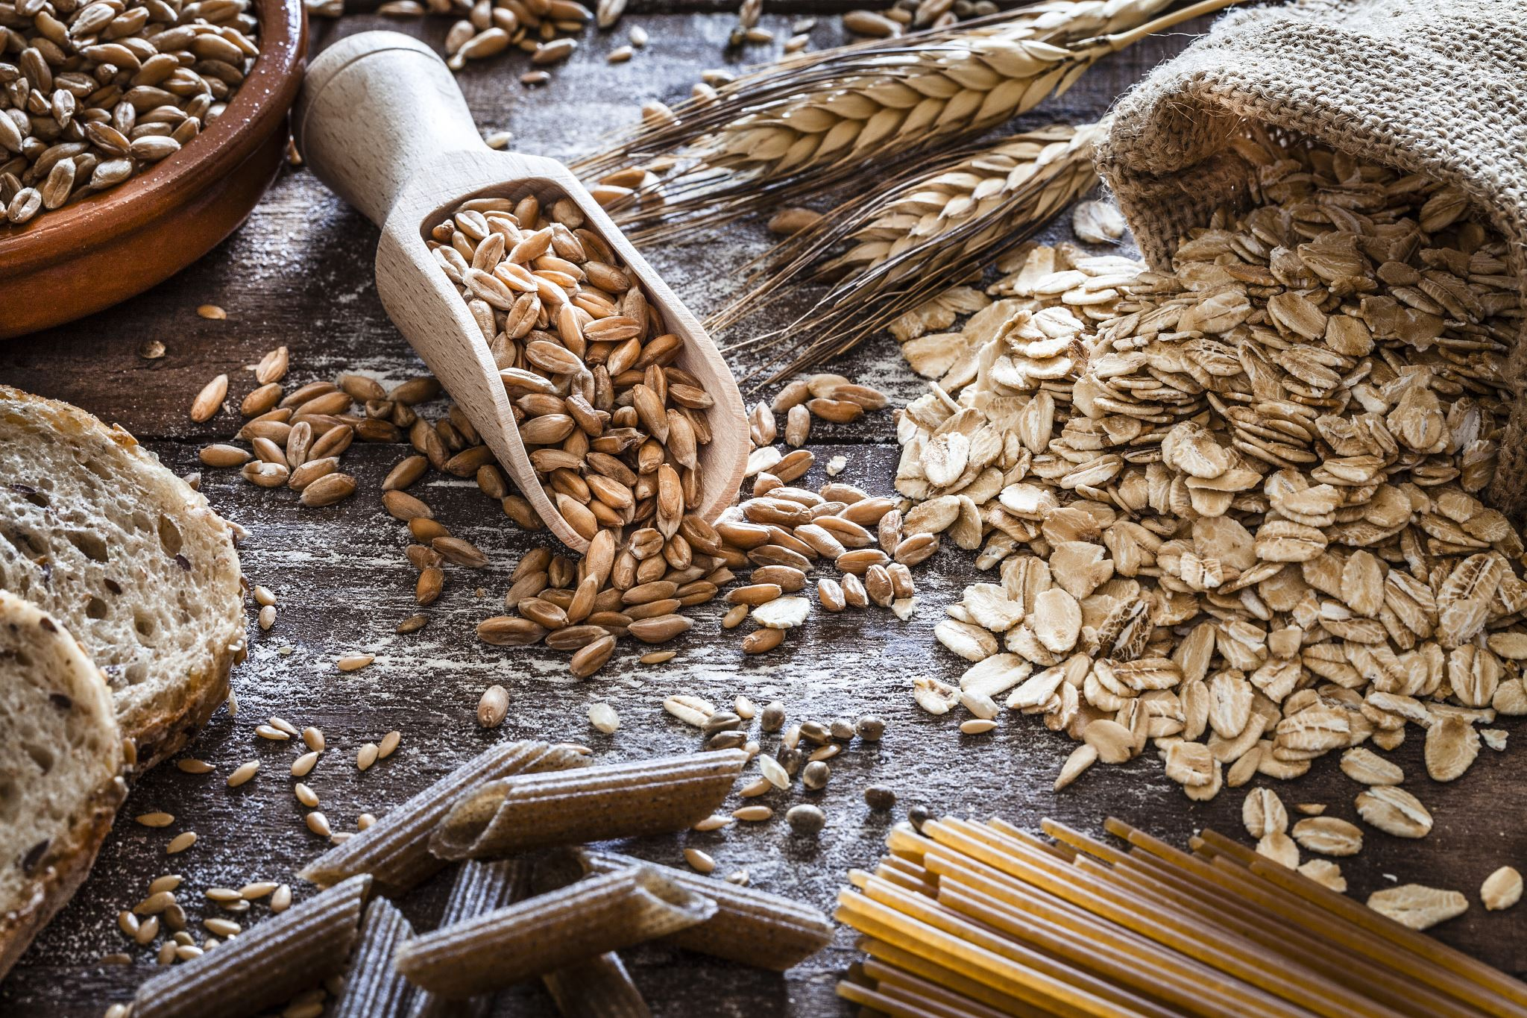
Food Flavors
Another important point is that when TCM talks about sweet food or salty food, it's not talking about processed white table sugar or processed white table salt. It's talking about naturally sweet foods or naturally salty foods.
For the salty flavor, natural sea salt counts. Sea salt comes in crystals and is not homogenous in color; it might be a little gray or even pink.
Natural sugars and natural sea salt are binded to many nutrients that processed sugar and salt do not have.

Slide 16
Food Colors
Remember that each element also has a corresponding color, as shown above in the color of each row. Eating foods of that element’s color also helps the organ of that element. For example, eating white or white-center foods like help the nourish lungs and large intestines.

Slide 17
Food Colors

Slide 18
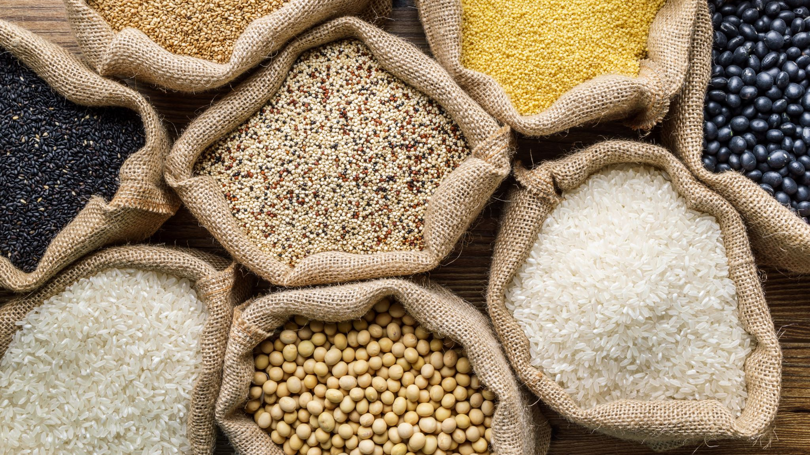
Food Colors
Here are common foods under each color category:
Green (wood): leafy greens, beans, avocado
Red (fire): tomatoes, carrots, strawberries, raspberries, apples
Yellow (earth): lemon, soy beans, barley, summer squash
White (metal): daikon radish, turnip, cauliflower, potatoes, mushrooms, garlic, onion, and apples
Blue/Black/Purple (Water): seaweed/kelp, black beans, black rice, blackberries, blue berries, eggplant/aubergine

Slide 19
A Healthy Diet
Individualized Diet
In the west, people look at food in terms of calories and nutrients. There’s a lot of focus on getting enough calories in a day, as well as getting enough nutrients.
There’s this assumption that everyone’s bodies are the same. If a food is nutritious, it should be good for everybody.
In TCM, whether or not a food is healthy for you depends on your body’s situation and the qualities of that food.
If that food has qualities that nurture your specific body situation, then it is healthy for you.

Slide 20
A Healthy Diet
For example, you might hear that ginger is really healthy, and a western view would just recommend ginger for everyone.
In TCM, ginger yellow in color, which means it helps the stomach/spleen and treats digestion related issues like nausea.
When the stomach has excess cold energy, you might feel morning sickness or get car sick, and ginger also helps treat these. But if your body is showing symptoms of excess heat, such as redness and constipation, then ginger would not be appropriate.

Slide 21
A Healthy Diet
Food Temperature and Degree of Cookedness
TCM typically recommends warm, well-cooked foods. The way TCM views digestion is like a cooking pot.
Our body needs food to be at 37 degrees Celsius to digest it. If the food is too cold, then the body needs to divert energy from other parts of the body to warming that food up.
Well-cooked foods also tend to be softer and basically partially digested, so it takes less energy for the stomach and spleen, which makes it easier on the whole body.

Slide 22
A Healthy Diet
Food Proportions
In terms of proportion, different people have different health situations and body constitutions, so there is no one-size-fits-all approach.
But generally speaking, TCM views the sweet flavor (e.g., grains, legumes, starchy vegetables) as the main dish, with the other flavors being complementary.

Slide 23
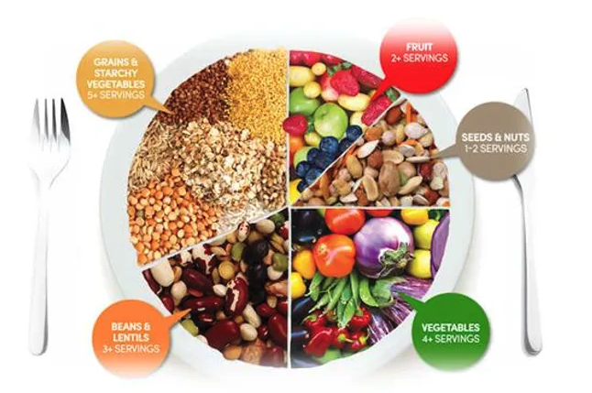
A Healthy Diet

Slide 24
A Healthy Diet
From the image, we can see lots of whole grains, beans & lentils, nuts, and fruits, and veggies. All these combined should provide the five flavors and five colors.
If we look at it from the western medicine perspective, most of these belong in the sweet category and provide carbs.
Beans and lentils provide lots of protein, while seeds and nuts provide healthy fat.
Around a third of the plate is fruits and vegetables, which provides a variety of vitamins and natural sugars (which are much healthier than processed sugars).

Slide 25
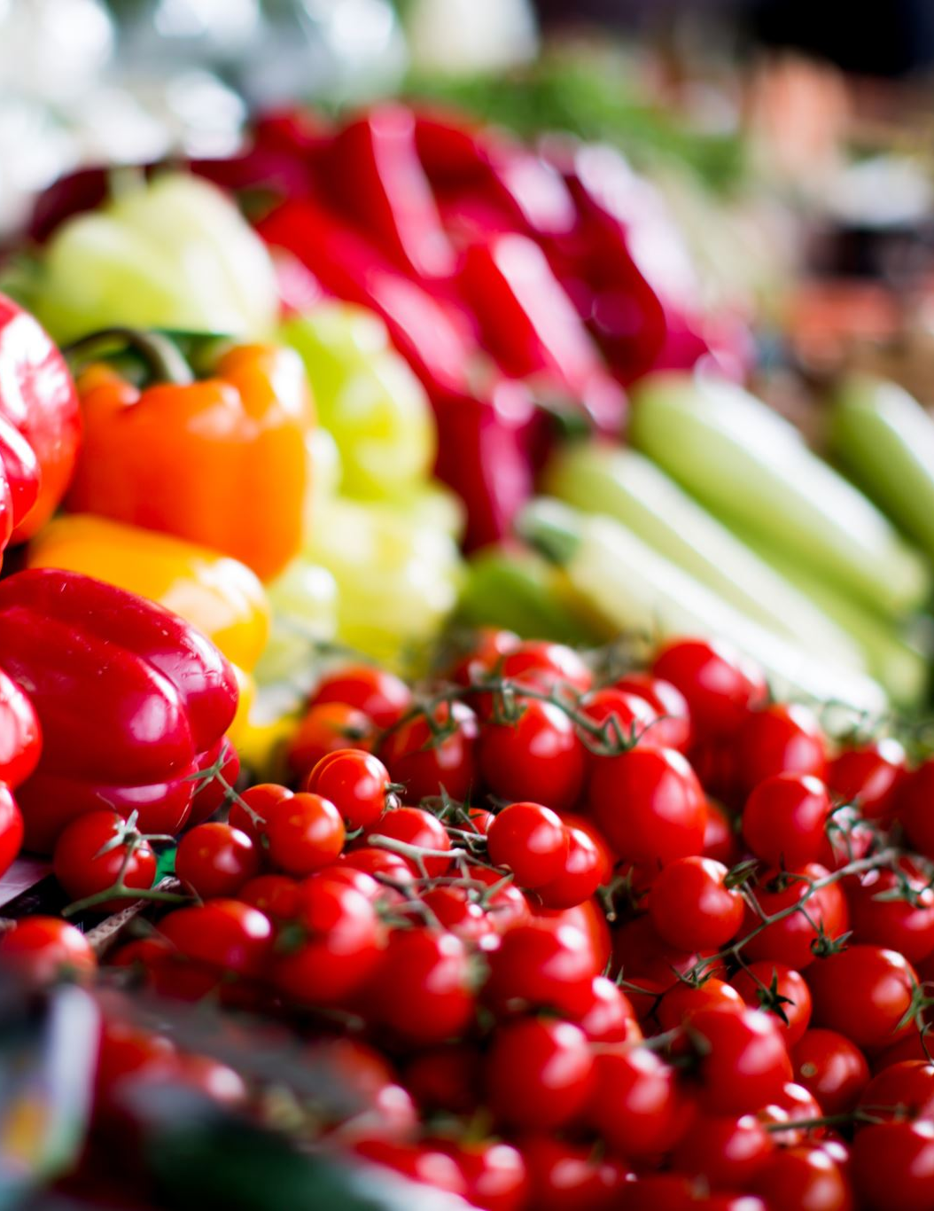
A Healthy Diet
Although there is no meat in the image, TCM is not against meat. However, TCM recommends no more than 10% of our meal be meat. From western medicine, we know that meat has a lot of saturated fat, and factory farmed meat has lots of harmful chemicals.
Notice that healthy eating in TCM is quite simple and tasty. It promotes eating a variety of flavors and colors, and it emphasizes natural and plant-based foods.
When we have all the flavors from natural foods in a meal, we reduce cravings for unhealthy foods.

Slide 26
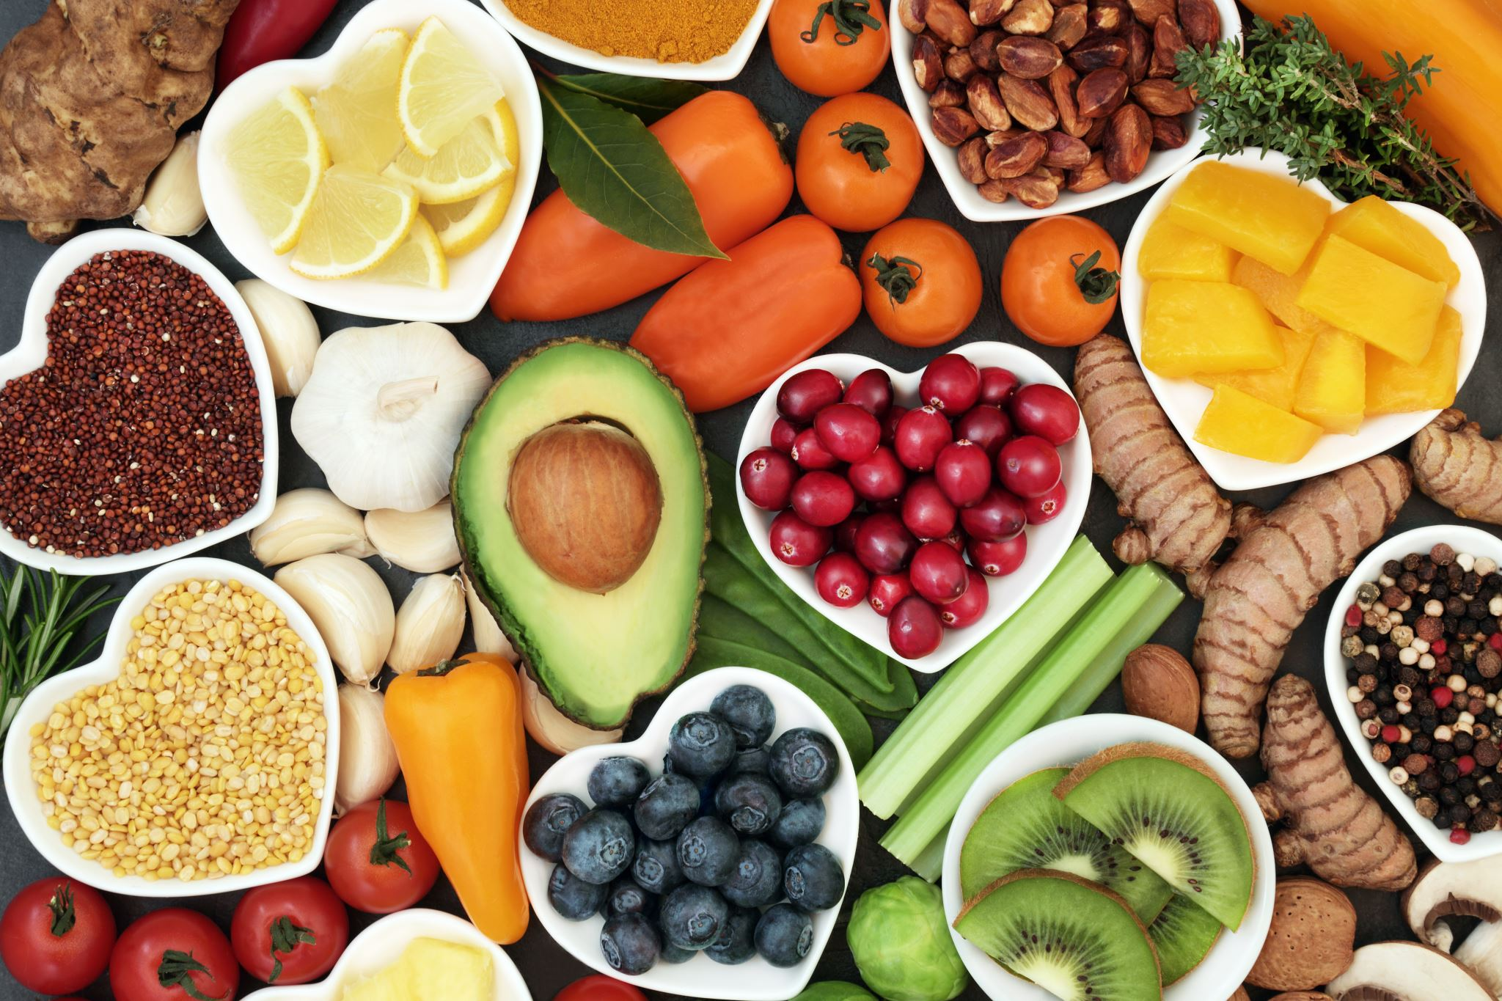
A Healthy Diet
An Unhealthy Diet
TCM does not actually ban any foods, but there are common foods that people commonly eat too much of or eat in the wrong situations.

Slide 27
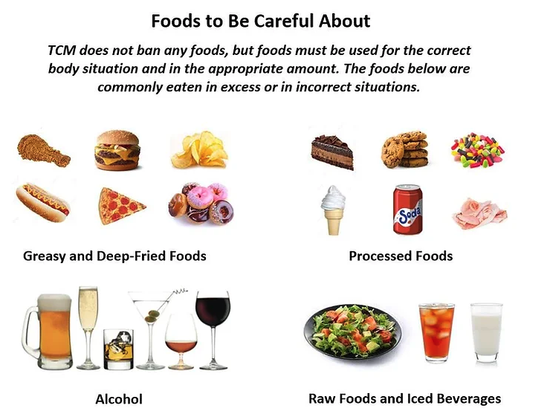
A Healthy Diet

Slide 28
A Healthy Diet
For most people in most situations, we should reduce these foods:
Raw foods and iced beverages because it they are a shock to the body, and it takes a lot of energy for the body to heat up those foods for digestion. (But if your body constitution has too much heat, then these foods can lower your heat)
Oily, greasy, and deep fried foods because they can easily cause excess dampness, heat, and stagnation.
Processed foods because they cause inflammation. These are foods that are produced in a factory, such as any packaged foods that come in boxes, plastic wrappers, or cans. These foods usually have at least 5 ingredients, most of which are scientific names that normal people don't understand.
Alcohol because it can easily lead to excess heat and is highly damaging to the liver. (But some herbal formulae do use alcohol to treat certain illnesses)
Dairy: Dairy is very damp and cold, so it weakens the digestive organs and easily creates excess mucous in the body. Avoid large amounts of dairy.

Slide 29
A Healthy Diet
Clear Bland Diet
If you are experiencing poor digestion, you can try the Clear Bland Diet. Basically, you eat really bland and cooked foods like white rice, stews, and cooked veggies such that they are nice and soft. All these foods are really easy to digest, and it’s basically food that you would use to wean a baby. You’re not allowed to eat processed foods, meaning anything that has artificial ingredients or that comes in a box, can, jar, or package. You also can’t eat rich and heavy foods such as dairy.
Do this until you feel your digestion is good again; it usually takes 3 to 5 days. After that, add back foods one by one and pay attention to how you feel after you add back a food. If you experience negative symptoms, then your body probably has a problem with that food.

Slide 30
Cooking Methods
TCM also has some guidelines about how to cook foods. Different cooking methods will be more yang or yin. In general, cooking with fire adds yang energy. The fire dries, hardens, and shrinks the food. Food gets harder to digest this way, and it should be avoided by people are have too much yang in the body. Cooking with water adds more yin. The food becomes more moist and soft, becoming easy to digest. This is good for all people. Most spices and seasonings are warm or hot in nature, so they are good for balancing cool and cold foods like many vegetables.

Slide 31
Cooking Methods
1. Raw
People often eat raw salad vegetables, fruits, and nuts. No one really thinks about cooking fruit, though it certainly can be done! In the west, raw vegetables are viewed to be healthier because it offers more vitamins and nutrients, whereas cooking them gets rid of some of those nutrients. The west focuses on the food.
In TCM, the focus is on the person. Yes, raw vegetables have more nutrients, but does the person have a strong enough digestive system to actually digest raw foods? Raw vegetables and fruits are very cooling. Some signs of your digestive system being too weak and cold to handle raw foods would be bloating, having gas, stomach pain, or diarrhea after eating raw foods. In that case, you should cook your foods instead. If you don’t have those problems, and you’re generally pretty hot and energetic, then you have the digestive heat and strength to handle raw foods.

Slide 32
Cooking Methods
2. Boiling: Cooking food in boiling water
Boiling foods (e.g., soups and stews) will warm the food and the nutrients will flow out into the liquid. Hence, it’s best to drink the soup rather than throwing away those nutrients. Boiling with too much water will reduce the yang energy and is not recommended.
3. Steaming: Cooking food with steam from boiling water
Steaming foods (e.g., steamed vegetables, dumplings) is a neutral cooking method, and it is one of the healthiest ways. It helps to retain the nutrients and does not change the energy of the food much.

Slide 33
Cooking Methods
4. Stewing: Cooking food slowly for a long period of time with a minimum amount of liquid.
Stewing food (e.g., using a slow cooker) is great for restoring yang energy in people lacking yang.
5. Stir Frying: Cooking food in hot oil over a wok or pan.
Stir frying (e.g., fried rice, fried vegetables) adds yang energy to food. You can use high heat to make the surface of the food crunchy (yang) while maintaining the inner juice (yin) and nutrients.

Slide 34
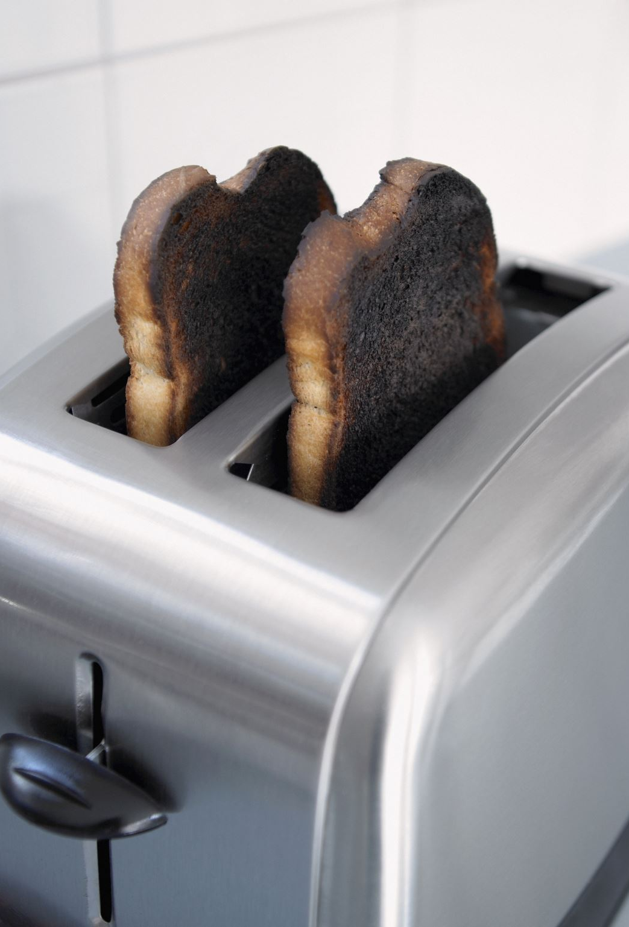
Cooking Methods
6. Baking/Roasting: Cooking food in dry heat such as an oven.
Baking food (e.g., roast vegetables, bread) adds yang energy. It is good for balancing cooling foods with a lot of yin energy.
7. Grilling: Cooking by applying direct heat to the surface of the food
Grilling (e.g., BBQ skewers) adds a lot of yang energy.

Slide 35
Seasonal Eating

Slide 36
Seasonal Eating
Spring
In spring, the wood element is strongest, so we should eat less sour foods to prevent excess wood in the body. We should increase sweet and pungent flavors because they help the liver (the wood organ) regulate qi throughout the body. Examples of foods include leafy greens, asparagus, mushrooms, peas, and may culinary herbs.

Slide 37
Seasonal Eating
Summer
In summer, the fire element is strongest, so we should eat less bitter foods. Summer is a season of fast growth, and our bodies’ qi and blood also become more vigorous in this season. This can cause the heart to over-function, which then weakens the lungs. Hence we should eat more pungent flavors to support the lungs and reduce bitter flavors to calm down the heart.
People also sweat a lot in the summer, and excess sweating dissipates the heart’s qi. Eating salty flavors can help retain liquids in the body. Summer is of course a very hot season with a lot of yang energy, so we should eat more cooling foods such as fruits and vegetables to provide a cooling energy and adequate fluids.

Slide 38
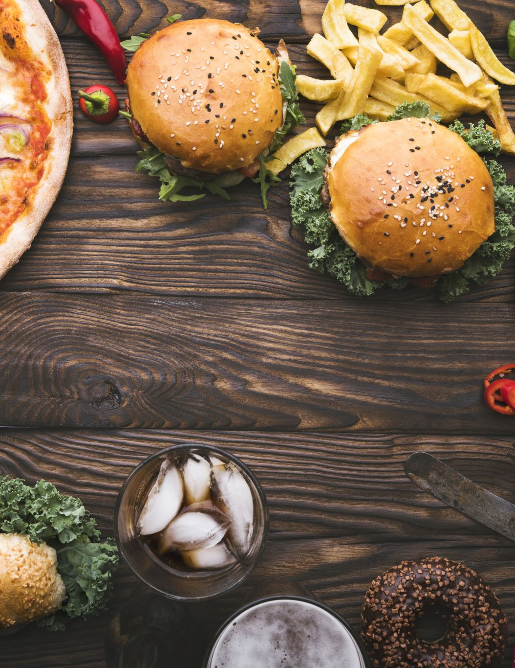
Seasonal Eating
Examples of foods to avoid would be bitter foods like coffee, grapefruit, and dark leafy greens. Examples of foods to eat in the summer would be cooling or pungent foods, such as tomatoes, cucumbers, summer squash, most fruits, and culinary herbs. These foods are typically ready to be harvested in summer.

Slide 39
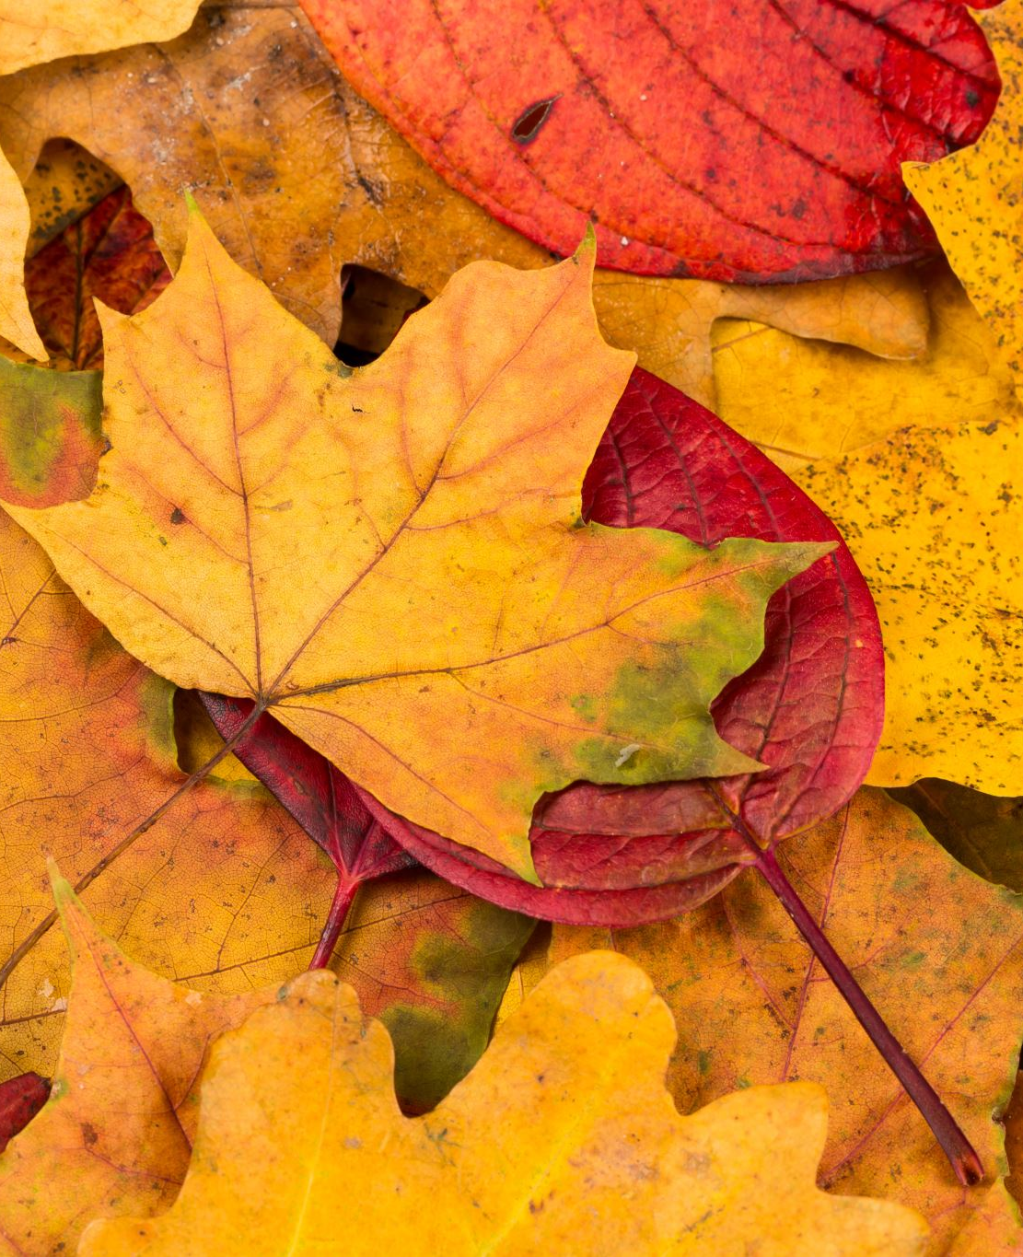
Seasonal Eating
Autumn
In autumn, the metal element is strongest, so we should eat less pungent/spicy foods. Autumn has very cold winds, and pungent/spicy foods open up our skin pores, which can make it easier for us to get sick from the cold autumn wind.
Since the lungs are most affected by the dry winds in autumn, we should eat more sweet foods such as grains and root vegetables, which are ready to be harvested in autumn. These sweet foods will promote the production of body fluids to prevent dryness. Sour foods also help in autumn because they help to retain liquids.

Slide 40
Seasonal Eating
Winter
In winter, the water element is strongest, so we should eat less salty foods, most of which are also cold-natured. Instead, we should eat more bitter foods of the fire element and add warming spices. The kidneys are associated with the water element, and a hyperactive kidney weakens the heart. Hence, eating less salty foods and more bitter foods reduces the burden on the kidneys and supports the heart.

Slide 41
Seasonal Eating
Know your body’s constitution
From a TCM perspective, we eat food to balance our body’s constitution, and our constitution can get affected by the outer environment. For example, summer is a very hot season, so it’s easy to get a lot of yang in this season. Hence we should eat more yin foods like fruits and cooling vegetables. However, you have to pay attention to your constitution first. If you know your constitution is cold and lacking yang, then even if it is summer, you should still eat in a way to nourish your yang.

Slide 42
Other TCM Eating Tips
Tip 1: Listen to your body
Just because someone tells you a food is good doesn’t mean it’s good for YOUR body. Pay careful attention to how you feel after eating a food you suspect isn’t working for you.
Tip 2: Eat until 80% full
Eating until 100% full burdens the stomach and spleen. It’s no surprise that people living in Blue Zones (areas in the world where there are the most number of people living healthily to 100) all eat until 80% full.
Tip 3: Eat at regular times
The stomach and spleen love routine. Eating irregularly will make them unhappy.
Tip 4: Eat mindfully
When we are in a state of stress or worry, our digestive organs can’t function properly. We should focus on our food and feel gratitude for our food when eating to support the stomach and spleen.

Slide 43
Other TCM Eating Tips
Tip 5: Eat regional
According to TCM, food that grows naturally in our region at the time it is harvested is more beneficial to the people living in that region. For example, it's better to eat apples freshly harvested from your province than to eat apples shipped to your grocery store from another country harvested at who-knows-when.
Tip 6: Walk after eating
A short walk helps the digestive organs
Tip 7: Do a quick massage on your shin
Before or after your meal, spend a minute to push along the tendon that’s on the outer side of the shin, which is a part of your stomach meridian.

Slide 44
Classwork 3.2
If you eat something hot, does it mean the food is “hot” according to TCM energy? Explain.
What are the five flavours in TCM, and which element relates to each flavor?
What is considered a healthy diet in TCM?
What foods should be limited according to TCM?
How does cooking with fire versus water affect food?
What is “seasonal eating”?
True or false: massaging your shins can help digestion.

Slide 45
Homework 3.2
The Smiths family love eating fast food. Last night, they ate McDonald's burgers (beef, bread, ketchup, pickles), french fries, and a vegetable salad (lettuce, tomatoes, cucumbers)
Answer these questions:
Knowledge: List the elements and flavors in their dinner.
Thinking: Score the healthiness of this meal from 1 to 10 (1 = very unhealthy. 10 = very healthy). Explain your score.
Communication and Application: Create an example of a healthy meal according to TCM.

Slide 46
See you all!

