Slide 1
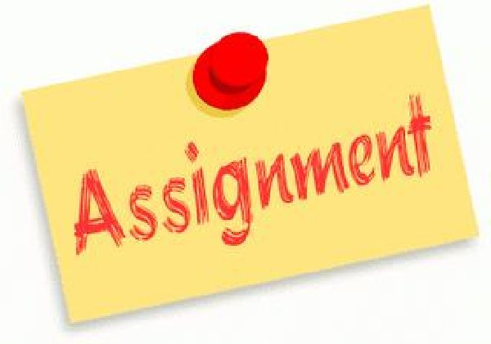
GLC20: Assignment #3 Resume Building
Listing your Education
Identifying Your Transferrable Skills and Strengths
Describing Your Work Experience
Identifying Your Career Goals

Slide 2
Directions
Working by yourself, you will prepare a Written Resume detailing your Past Education, Work Experience, Present Education and Career Goals, and your Transferable Skills and Strengths.
Review the Resources on Resumes on Slide 5. Select a template or create one of your own. Use the Guiding Questions on Slide 4 to assist you in your Planning.
Choose a format for your Resume (ex. Google Docs, Word etc.).Be clear and organized. **Remember you want your Resume to stand out.

Slide 3
Requirements
Written Section: Outline your Past Education, Work Experiences and Current Transferable Skills, Interests and Education/Career Ambitions (2 pages)
Organize your Resume according to the following sections on Slide 4. **You can switch the order of the Sections according to your Interest; see some examples to get an idea of how to set it up.
Use dates to show when you completed your past school and work experience.
Use the term ‘Current’ for present school and work.
Use the term ‘Future’ for future education and career goals.
Consult the Assignment Directions and Upcoming Success Criteria.
Show your work BEFORE posting for your OF Learning Progress Mark.

Slide 4
Required Sections
Section 1
Your Name, Address, Email, Phone Number etc.
Section 2
Your Education and Career Goals
Section 3
Your Transferable Skills and Strengths
Section 4
Your Past Education
Section 5
Your Past Work Experience
Section 6
Your Current Education and Work Experience

Slide 5
Resources
Website Links
https://www.beamjobs.com/resumes/college-student-resume-examples
https://resumegenius.com/resume-samples/college-student-resume-example
https://www.businessnewsdaily.com/3207-resume-writing-tips.htmlhttps://www.themuse.com/advice/43-resume-tips-that-will-help-you-get-hired
https://ca.indeed.com/career-advice/resumes-cover-letters/resume-writing-tips
https://zety.com/blog/resume-tips
https://zety.com/blog/student-resume
Video https://www.youtube.com/watch?v=aD7fP-2u3iY

Slide 6
Expectations
B1.2 explain how transferable skills are developed through school, extracurricular, and/or community experiences, and analyse how they contribute to a person’s readiness for future educational, life, and work opportunities and to their career development
B1.3 reflect on how the transferable skills they have developed so far have aided them in their learning and in life, and identify the skills that they may need to develop further
B2.1 investigate their own interests, values, skills (including transferable skills), strengths, and areas that require further development, documenting their insights in a personal profile

