Slide 1
Careers

Slide 2
Overview
What we will be covering in class today:
Post-Secondary Education Fees
Financial Aid
Loans
Bursaries
Scholarships
Exit Ticket
Moodle Work

Slide 3
At this point you all have a plan and a backup plan of what you would like to do some day. This week, our focus will be on the financial side of things and figuring out how to pay for it all. First expense on the docket: post-secondary education.
Note – these are domestic fees. International student fees are higher.

Slide 4
Post-Secondary Education Fees
College, university tuition fees
Residence, housing fees
Meal plan fees
Book fees
Other

Slide 5
Program Fees: College
To enroll in any college program, you must pay tuition (money charged by a school for instruction)
Tuition costs vary from college to college, program to program and between the different types of college programs
However, on average, you can expect to pay between $2500-5000 for one year of college education + $800 in ancillary fees (i.e. athletic fees, health and dental)
This might seem like a lot, but it is much less expensive than university tuition

Slide 6
Program Fees: University
To enroll in any university program, you must also pay tuition fees
Like college, tuition varies from university to university and program to program
However, on average you can expect to pay around $7000 per year just for university tuition plus an additional $1500 per year for ancillary fees (i.e. athletic fees, health and dental, etc.)

Slide 7
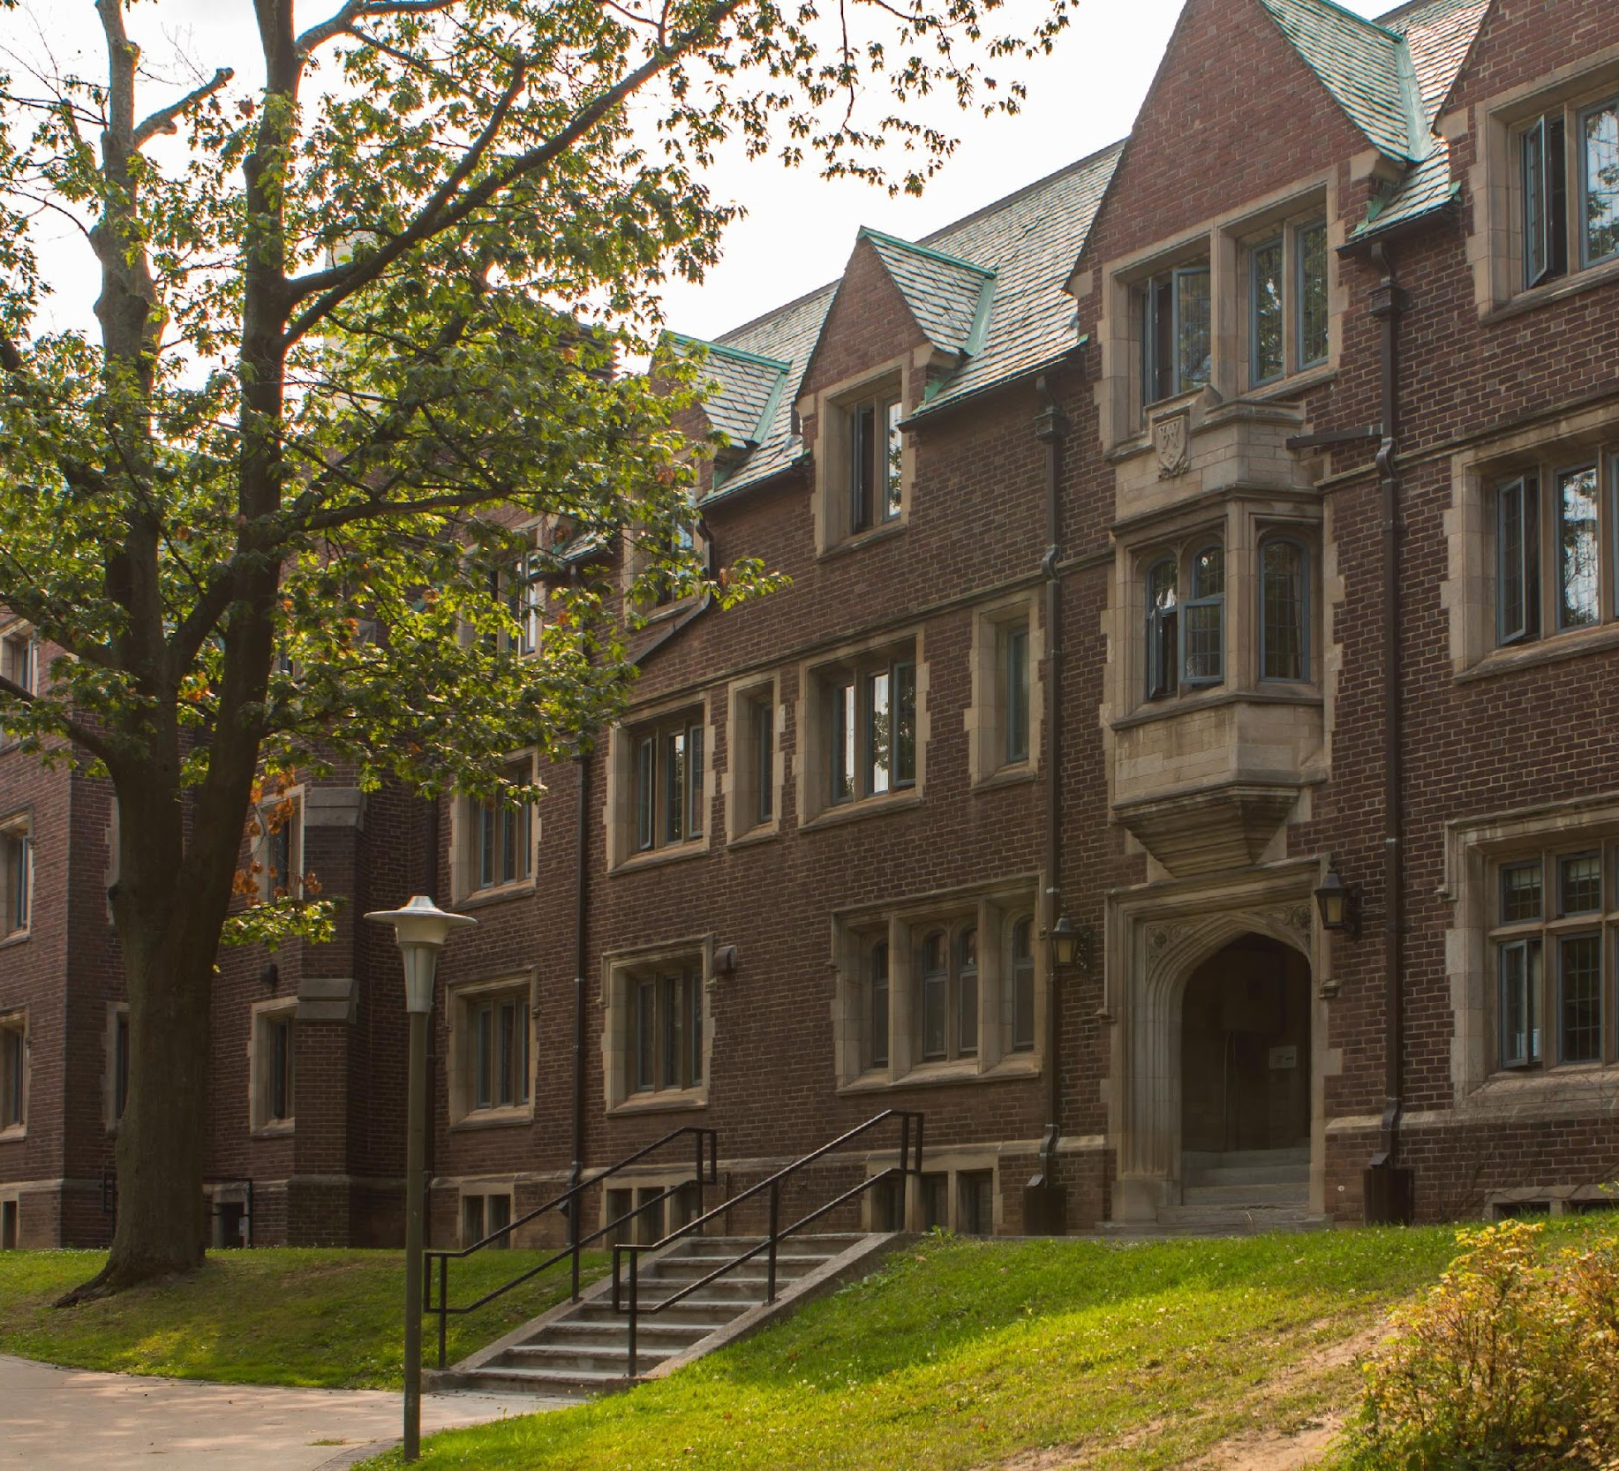
Housing Fees
On-campus residence
Costs vary per university and style of room, but on average, expect to pay $8000-10000 per year
Off-campus residence
Depending on city, home style (i.e. private apartment or shared space) and proximity to school, but on average, expect to pay between 5500-15000/year
Commuting from home is an alternative option to living near school
Consider paying cost of vehicle maintenance, insurance and gas

Slide 8
Food Fees
College and university campuses provide students with options for meal plans
How it works: you buy a plan, get a card with money on it (like a debit card but only for food), go to the dining hall on campus and pick whatever food you want, then swipe your meal card to pay
Average cost: $5000 / year

Slide 9
Book Fees
Average cost of new books: $1,000
Some universities make the sale of textbooks final. Meaning you cannot return the books. So make sure that you are buying the right book.
Tips to save money: look for used books or e-books online, or wait a few weeks into starting a course before you buy books (even though courses may say you need a book, you don’t always need to buy it because the prof will summarize the book’s key points in their lessons)
Note: you can’t get away with this with every class

Slide 10
Other Fees
Tuition for specialized programs may be higher. For example, programs that involve training on specialized equipment (such as heavy equipment operator or aviation) require college investment in this equipment. These costs are often factored into tuition costs.
Other programs, such as photography or fine arts programs, may require you to buy extra equipment or supplies on top of the cost of tuition fees, which can increase your expenses.

Slide 11
Financial Aid

Slide 12
Loans
If you don’t have money to pay tuition right away, you can opt for a ‘loan’. Loans must be paid back, usually once your education is complete and often with interest.
Government Loans: Ontario residents may apply for government loans through the Ontario Student Assistance Program (OSAP).
Private Loans: Many private banking institutions offer postsecondary education loans.

Slide 13
Bursaries
Bursaries do not need to be paid back
A bursary is a monetary reward given to a student, typically with financial needs/difficulties
A bursary may also involve other selection criteria such as extracurricular activities, community involvement and leadership

Slide 14
Scholarships
Scholarships do not need to be paid back
Scholarships are usually awarded based on academic merit, rather than financial need
You can apply to scholarships through individual college/university websites, or through private sources

Slide 15
Exit Ticket
For today's exit ticket, please figure out how much tuition would cost for the #1 career you chose, then calculate the additional student fees discussed today. How much will you need to spend just for your education?

