Slide 1
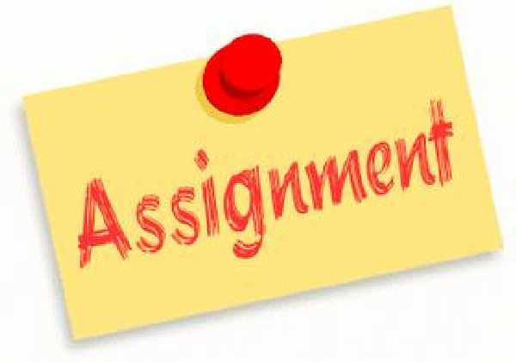
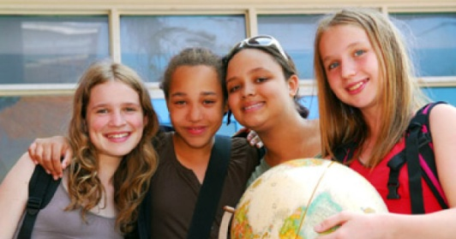
Assignment #6 Treatment of Girls and Women Reflection
Treatment of Girls and Women
Esperanza’s Perspective on Gender Roles of Girls/Women
Your Perspective on Gender Roles in Today’s Society

Slide 2
Directions
Select ONE Vignette from Mango Street which shows how Esperanza is treated (by boys, men and/or other women) ex. The Family of Little Feet pg. 39-42
Using your chosen Vignette, write a Personal Reflection (100-150 words/2-3 paragraphs)to show your opinion/thinking of how Esperanza is treated by boys, men or other women in your chosen Vignette.
Use the Reflection Questions on Slide 4 to help you gather your ideas and shape your Reflection.
Be ready to orally share your Reflection (your personal thinking) in an oral discussion (1 minute).

Slide 3
Requirements
Make sure that your Reflection is organized and well written with topic sentences, key ideas and concluding sentences for each paragraph. **Use your own words and thinking to avoid Plagiarism. Add quotes and proper citations where needed according to APA/MLA Guidelines.
2. Make sure your Name, Assignment Title and Date are on the first page.
Make sure all your References are put in APA/MLA Format on the last page (1-3 References only).
Use clear, natural speaking for your oral sharing without reading. Be ready to respond to Discussion Questions. (1 minute)

Slide 4
Reflection Questions
1. Explain how Esperanza is treated in your chosen Vignette. Is she treated poorly, unfairly or positively by boys, men, girls or women? Explain.
What are Esperanza’s views on the way that she is being treated? Does she care? Do her emotions appear to be harmed or not? Does she take any action towards this?
What are Esperanza’s views on the role of girls and women in your chosen Vignette? Why do you think Esperanza feels this way? **Remember to include the theme of identity, culture and coming of age.
What are your ideas and perspectives on the role of girls and women in your society today? Can you relate to Esperanza and her experiences and perspectives on gender roles? Explain your thinking with examples.
**Suggested Format= 2 Full Paragraphs
Para #1: (Introduction, Questions 1, 2)
Para #2: (Questions 3, 4, Conclusion)

Slide 5
Expectations
Developing and Organizing Content
1.1 identify the topic, purpose, and audience for a variety of writing tasks
1.2 generate, expand, explore, and focus ideas for potential writing tasks, using a variety of strategies and print, electronic, and other resources, as appropriate
1.3 locate and select information to fully and effectively support ideas for writing, using a variety of strategies and print, electronic, and other resources, as appropriate
1.4 identify, sort, and order main ideas and supporting details for writing tasks, using a variety of strategies and selecting the organizational pattern best suited to the content and the purpose for writing
1.5 determine whether the ideas and information gathered are accurate and complete, interesting, and effectively meet the requirements of the writing task
Using Knowledge of Form and Style
2.1 write for different purposes and audiences using a variety of literary, informational, and graphic forms
2.2 establish a distinctive and original voice in their writing, modifying language and tone skilfully and effectively to suit the form, audience, and purpose for writing
2.3 use a wide range of descriptive and evocative words, phrases, and expressions precisely and imaginatively to make their writing clear, vivid, and compelling for their intended audience
2.4 write complete sentences that communicate their meaning clearly and effectively, skilfully varying sentence type, structure, and length to suit different purposes and making smooth and logical transitions between ideas
2.6 revise drafts to improve the content, organization, clarity, and style of their written work
2.7 produce revised drafts of texts, including increasingly complex texts, written to meet criteria identified by the teacher, based on the curriculum expectations

Slide 6
Expectations
Applying Knowledge of Conventions
3.1 use knowledge of spelling rules and patterns, a variety of resources, and appropriate strategies to recognize and correct their own and others’ spelling errors
3.2 build vocabulary for writing by confirming word meaning(s) and reviewing and refining word choice, using a variety of resources and strategies, as appropriate for the purpose
3.3 use punctuation correctly and effectively to communicate their intended meaning
3.4 use grammar conventions correctly and appropriately to communicate their intended meaning clearly and effectively
3.5 regularly proofread and correct their writing
3.6 use a variety of presentation features, including print and script, fonts, graphics, and layout, to improve the clarity and coherence of their written work and to heighten its appeal and effectiveness for their audience
3.7 produce pieces of published work to meet criteria identified by the teacher, based on the curriculum expectations

Slide 7
Expectations
Reading For Meaning
1.1 read a variety of student- and teacher-selected texts from diverse cultures and historical periods, identifying specific purposes for reading
1.2 select and use, with increasing facility, the most appropriate reading comprehension strategies to understand texts, including complex and challenging texts
1.3 identify the most important ideas and supporting details in texts, including complex and challenging texts
1.4 make and explain inferences of increasing subtlety and insight about texts, including complex and challenging texts, supporting their explanations with well-chosen stated and implied ideas from the texts
1.5 extend understanding of texts, including complex and challenging texts, by making rich and increasingly insightful connections between the ideas in them and personal knowledge, experience, and insights; other texts; and the world around them
1.6 analyse texts in terms of the information, ideas, issues, or themes they explore, examining how various aspects of the texts contribute to the presentation or development of these elements
1.7 evaluate the effectiveness of texts, including complex and challenging texts, using evidence from the text insightfully to support their opinions

Slide 8
Expectations
Understanding Form and Style
2.1 identify a variety of characteristics of literary, informational, and graphic text forms and demonstrate insight into the way they help communicate meaning
2.2 identify a variety of text features and demonstrate insight into the way they communicate meaning
2.3 identify a variety of elements of style in texts and explain how they help communicate meaning and enhance the effectiveness of the texts
Reading With Fluency
3.1 automatically understand most words in a variety of reading contexts
3.2 use decoding strategies effectively to read and understand unfamiliar words, including words of increasing difficulty
3.3 regularly use a variety of strategies to explore and expand vocabulary, discerning shades of meaning and assessing the precision with which words are used in the texts they are reading

Slide 9
Expectations
Speaking To Communicate
2.1 communicate orally for a wide range of purposes, using language effective for the intended audience
2.2 demonstrate an understanding of a variety of interpersonal speaking strategies and adapt them to suit the purpose, situation, and audience, exhibiting sensitivity to cultural differences
2.3 communicate in a clear, coherent manner, using a structure and style effective for the purpose, subject matter, and intended audience
2.4 use the most appropriate words, phrases, and terminology, and a variety of stylistic devices, to communicate their meaning in a compelling way and to engage their intended audience
2.5 identify a variety of vocal strategies, including tone, pace, pitch, and volume, and use them effectively and with sensitivity to audience needs and cultural differences
2.6 identify a variety of non-verbal cues, including facial expressions, gestures, and eye contact, and use them effectively to help convey their meaning and with sensitivity to audience needs and cultural differences
2.7 use a variety of audio-visual aids effectively to support and enhance oral presentations and to engage an audience
Reflecting on Skills and Strategies
3.2 identify a range of their skills in viewing, representing, reading, and writing and explain how the skills help them improve their oral communication skills

