Slide 1
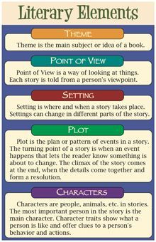
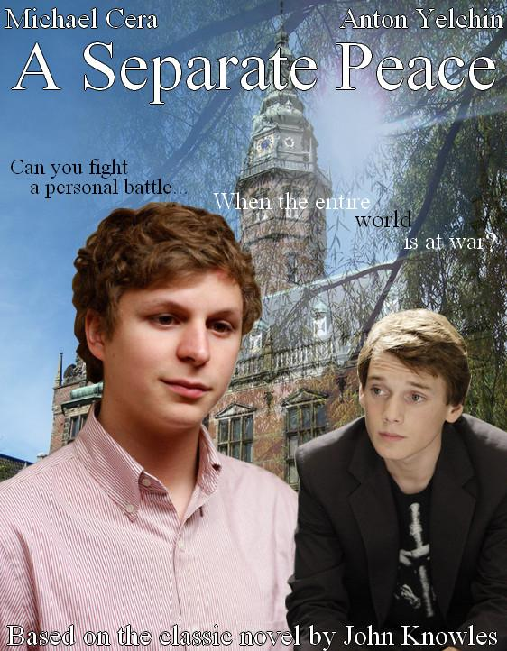
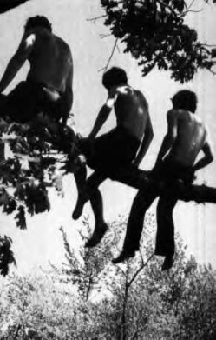
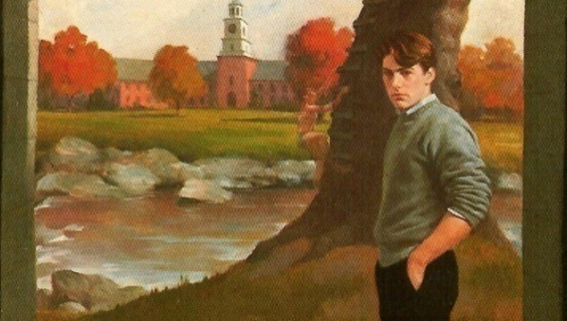
A Separate Peace by John Knowles
Literary Elements: Chapter 1

Slide 2
Main Characters
Gene Forrester, returning to Devon School after 15 years.
Feeling pensive/reflective about his time at that school ex. Sees the facility of the school, brings back memories of his time at the school
Social with friend Finny; will follow Finny’s actions for fun ex. Jumped into the river off a tree branch
Follower: follows Finny’s lead of jumping off the tree branch
2. Finny: Gene’s roommate at Devon School;
bold/daring, likes to push himself physically ex. First one to jump off a tree branch into the river
Leader/Inspirational: not in an aggressive way, but inspires Gene to try new things, like jumping in the river
:

Slide 3
Secondary Characters
None have appeared yet…

Slide 4
Setting
Location: Devon School, preserved, like a museum, New Hampshire, New England, Dean’s Residence, Far Common, First Academy Building, The Cage,
Time Period: November, 15 years after the War, Summer 1942
Mood: Negative based on the author’s past feelings towards the school; a feeling of being controlled by the teachers/faculty at this school
As an adult, now the mood is more confident, Gene has a career and an income and feels established

Slide 5
Main Events
Author re-visiting Devon School where he was a student 15 years earlier. Memories of school are somewhat bitter and rigid with structure.
Finny asked 4 boys to jump into the river from the tree branch.
Finny and Gene become good friends after the jump.

Slide 6
Theme
Education/School: style of education (private boys’ US boarding school at the start/during of WW2)
Adventure: boys jumping off tree branch; free spirited ex. Jumping off tree branch
Friendship: between Finny and Gene; jumping off the tree branch together

Slide 7
Meaningful Quotes
Quote #1: “I was taller, bigger generally in relation to these stairs. I had more money and success and ‘security’ than in the days when spectres seemed to go up and down them with me.” (p.12)
His memory of his times at the school was of feeling small and inferior, but now more important and confident
Quote #2: pg. 14 “This was the tree….
As a student he felt small at school under the authority of the faculty, but now he feels changed
Quote #3: pg. 17 “With the sensation that I was throwing my life away, I jumped into space…”
Means Gene’s memory of Finny inspired him to be brave during the jump

Slide 8
Figurative Language
Simile: a figure of speech comparing two unlike things that is often introduced by like or as(as in cheeks like roses) (Merriam-Webster)
“and then blinked out like a candle the day I left.” (p.10)
“Preserved along with it, like stale air in an unopened room was the well-known fear”
“Today with their failing ivy and stripped , moaning trees, the houses looked both more elegant and more lifeless than ever.” (p.11)
2. Metaphor: a figure of speech in which a word or phrase literally denoting one kind of object or idea is used in place of another to suggest a likeness or analogy between them (as in drowning in money)
“I felt fear’s echo, and along with that I felt unhinged…” (p. 10)

Slide 9
Figurative Language
3. “I started the long trudge across the fields and had gone some distance before I paid any attention to the soft and muddy ground which was dooming my city shoes.” (p. 13)-Metaphor

Slide 10
Vocabulary-Ch.1
Sedate
Perpendicular
Strait-laced
Tacit
Cupola
Soggily
Forlorn
Trudge
Harmonized
Ramshackle

Slide 11
Text and Society
Challenges of Attending Boarding School: living away from home; the value of a complete on-site education v. staying at home
Challenges of Friendship and Peer Pressure: boys inspire each other to jump off tree branch; Is this safe? Is it a good idea? Who is responsible for supervising the boys and ensuring that they make appropriate decisions to follow the school guidelines? What is the message to society and current high school boys?

Slide 12
Point of View
Gene: Main character, his somewhat negative view, memories of his time at this school

