Slide 1
Lesson 3.2 TCM: Treatment of TCM
31 May 2023

Slide 2
Class Announcement
Implementation of the Seating Plan
Every day when you enter the classroom, you will be assigned with a new seat in the way of a lucky draw
Remember to charge all your device properly starting from tomorrow as you might not have a seat next to the socket

Slide 3
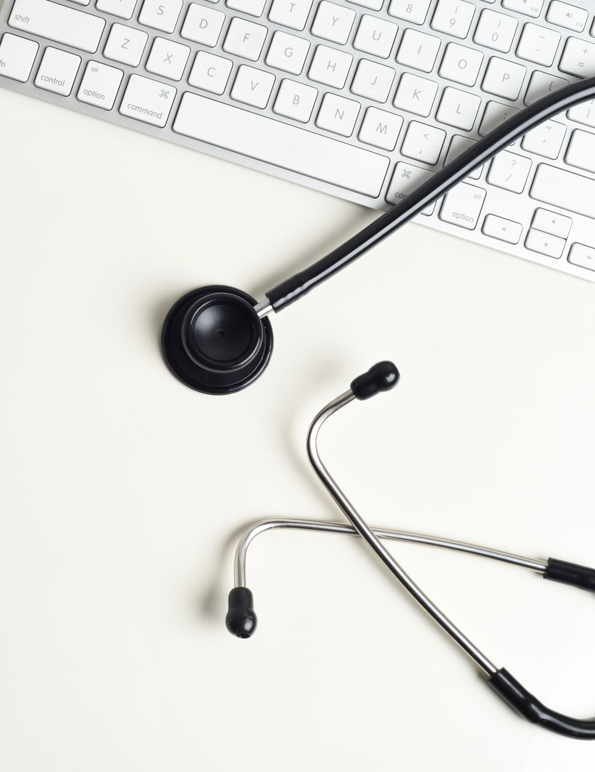
Assignment 3
Imagine you are a student studying Chinese Medicine and you are working with your doctor, who is a mentor that supervise your practicums.
You will receive a patient profile on 6th June and you will be given 1 hour to prepare.
The teacher will act as the patient’s family member and will ask you some questions regarding the patient.

Slide 4
Assignment 3
z
Knowledge (25%)
You demonstrate knowledge about TCM taught during lesson 3.1 – 3.4.
Thinking (25%)
You can answer the concerns of the questions asked by the patient’s family member
Communication (25%)
You can explain your ideas to the patient’s family member effectively.
Application (25%)
Your grades of all the homework and classwork in Unit 3

Slide 5
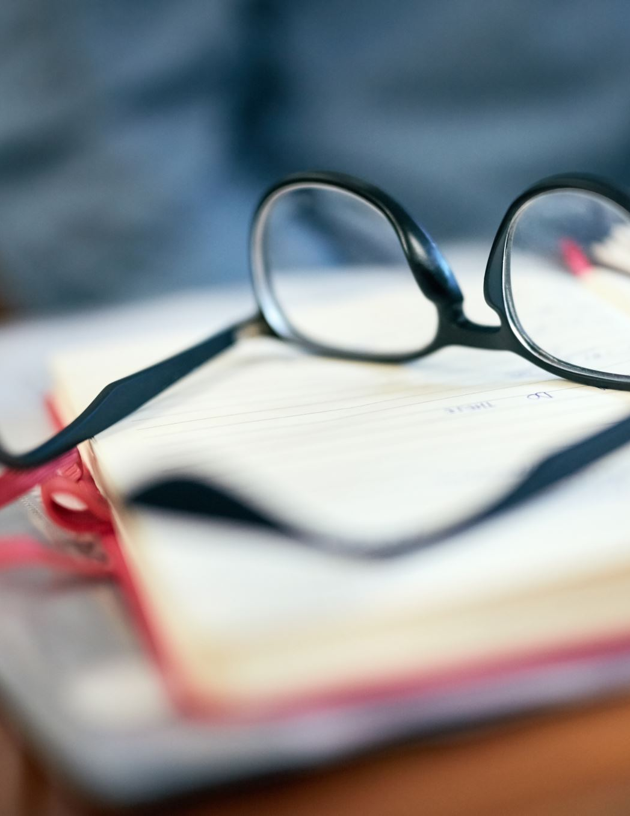
Preparation for Assignment 3
As you will only know your patient’s information by the due date of assignment 3, it is the best that you study the content for Unit 3 so that you know where to retrieve relevant information as quick as possible
The rough copy for assignment 3 will be any form of notes you produce while you are revising for unit 3 e.g. notes in point form, mind map etc.)

Slide 6
Assignment 3 arrangement
Once you arrive at the classroom on 6th June, you will receive your patient’s profile. Everyone will receive a different profile.
You can have one hour to prepare for the interview. After one hour, you will take turn to complete the interview with me in the front of the classroom.
You are not allowed to talk to your classmates after you receive your patient profile. Talking results in mark deduction.
You can use all electronic device you like during the preparation time. However, during the interview, you can only bring paper as your notes. No electronics are allowed when you are participating in the interview. You can write everything you deem important on your patient profile with a pen/pencil.
You can leave the classroom once you are done. However, there will be no break time on 6th June.

Slide 7
1: Acupuncture
Acupuncture is very well-known in the world now. It is when the doctor inserts acupuncture needles on to specific acupoints to make qi and blood flow more freely. The needles are usually as thin as hair, so they don’t hurt unless that acupoint has a problem; the pain indicates a blockage. But usually, inserting the needles will feel like a temporary “mosquito bite” prick that goes away quickly. The stimulation from the needles tell the body to focus its attention there for healing. Some people feel energized from the treatment, while others feel relaxed.
Acupuncture helps to restore health in the body, reduce pain, and relax the nervous system.

Slide 9
https://www.youtube.com/watch?v=JnKPNw9K2Ng&ab_channel=NCCIH

Slide 10
2: Tui Na Massage
Tui Na massage is very similar to acupuncture, except instead of using needles, it’s massaging the acupoints. The previous articles talked about massing acupoints at home; that’s basically doing Tui Na on yourself.
Getting Tui Na from a practitioner also means you get energy from that practitioner; this is really helpful for people who are already very weak. Tui Na is also helpful for muscle tension and soreness.

Slide 11
z

Slide 12
https://www.youtube.com/watch?v=s_gtzXG1hMs&t=2s&ab_channel=ExpertVillageLeafGroup

Slide 13
3: Moxibustion
Moxibustion is a form of infrared heat therapy applied on to acupoints by applying a burning herb called mugwart, which is usually rolled into small cylinders. Burning these mugwart cylinders sends pinpointed heat to an acupoint. Most people know about saunas which are another form of infrared heat therapy that is great for detox and stimulating energy movement. Moxibustion is similar.
Moxibustion is often used in conjunction with acupuncture since the heat provides extra stimulation to the acupoint. It is warming and promotes qi and blood circulation and strengthens immunity. At home, you can use microwavable heat bags and apply them onto acupoints. This is especially useful after massaging those acupoints yourself, but you can apply heat bags even if you didn’t massage the points.

Slide 15
https://www.youtube.com/watch?v=dTCAkgpEtnk&ab_channel=RoadsToBliss

Slide 16
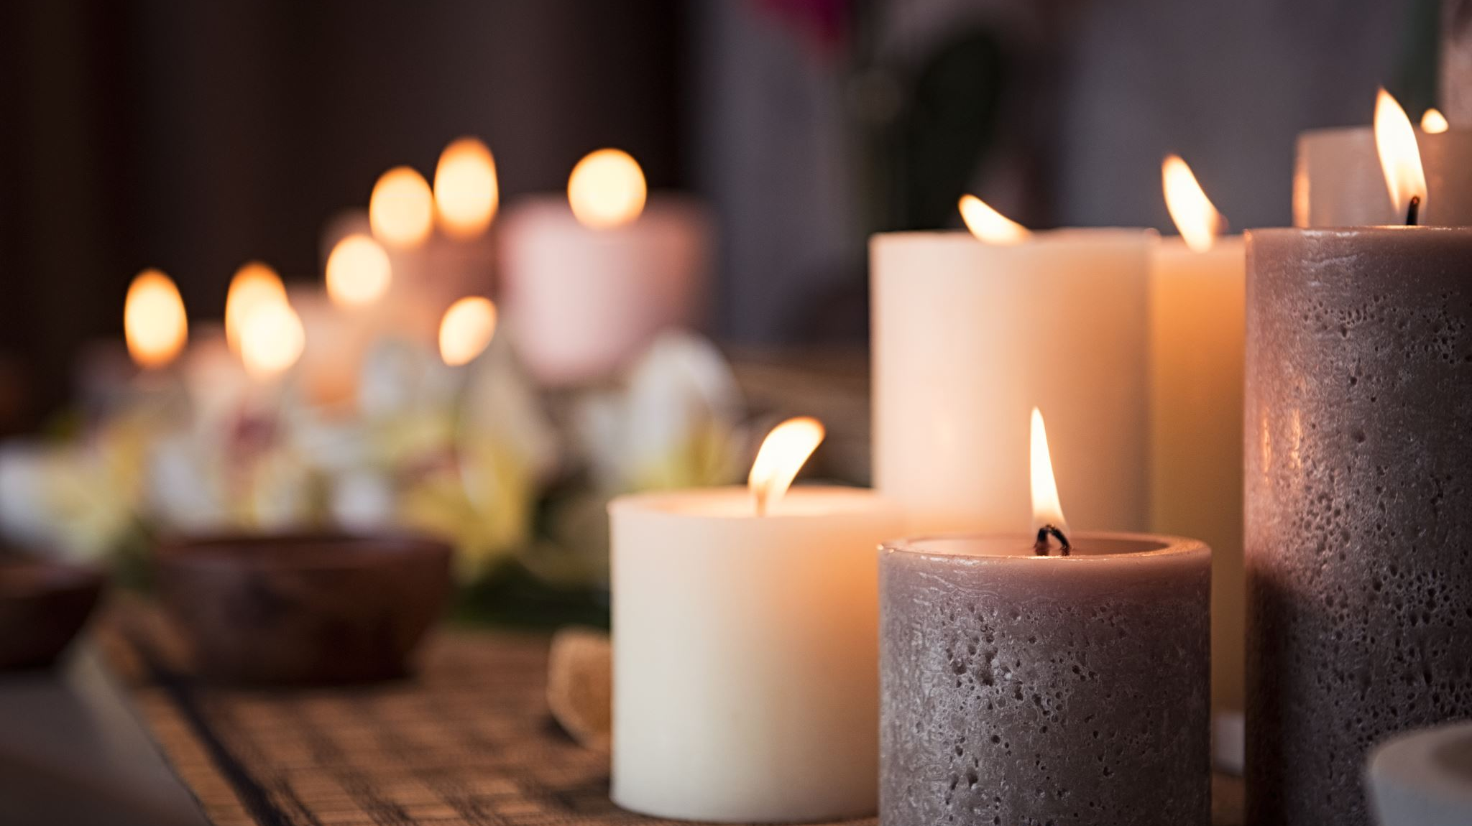
4: Cupping
Cupping is when the practitioner takes a cup and then lights a fire in the cup to burn away the oxygen, which creates a vacuum. Then the practitioner puts the cup on your body, and the vacuum draws your skin up into the cup. You can think of it as the opposite of a massage. A massage uses a pushing action, while cupping uses a pulling action. This helps to draw out toxins deep in the muscle. It also improves blood blow. It is also not painful and is actually quite relaxing.
Cupping is really great for muscle soreness, which is why lots of athletes use it. it also helps with blood stagnation, dampness, and cold/flu symptoms.
Cupping leaves red marks, which may look scary, but they usually go away within a week. Since many athletes and celebrities have shown off their cupping marks, more people are embracing cupping.

Slide 17
Light pink marks indicate healthy circulation, dark red marks indicate moderate stagnation, dark purple marks indicate sever stagnation, and pale purple marks indicate qi and blood deficiencies.
z

Slide 18
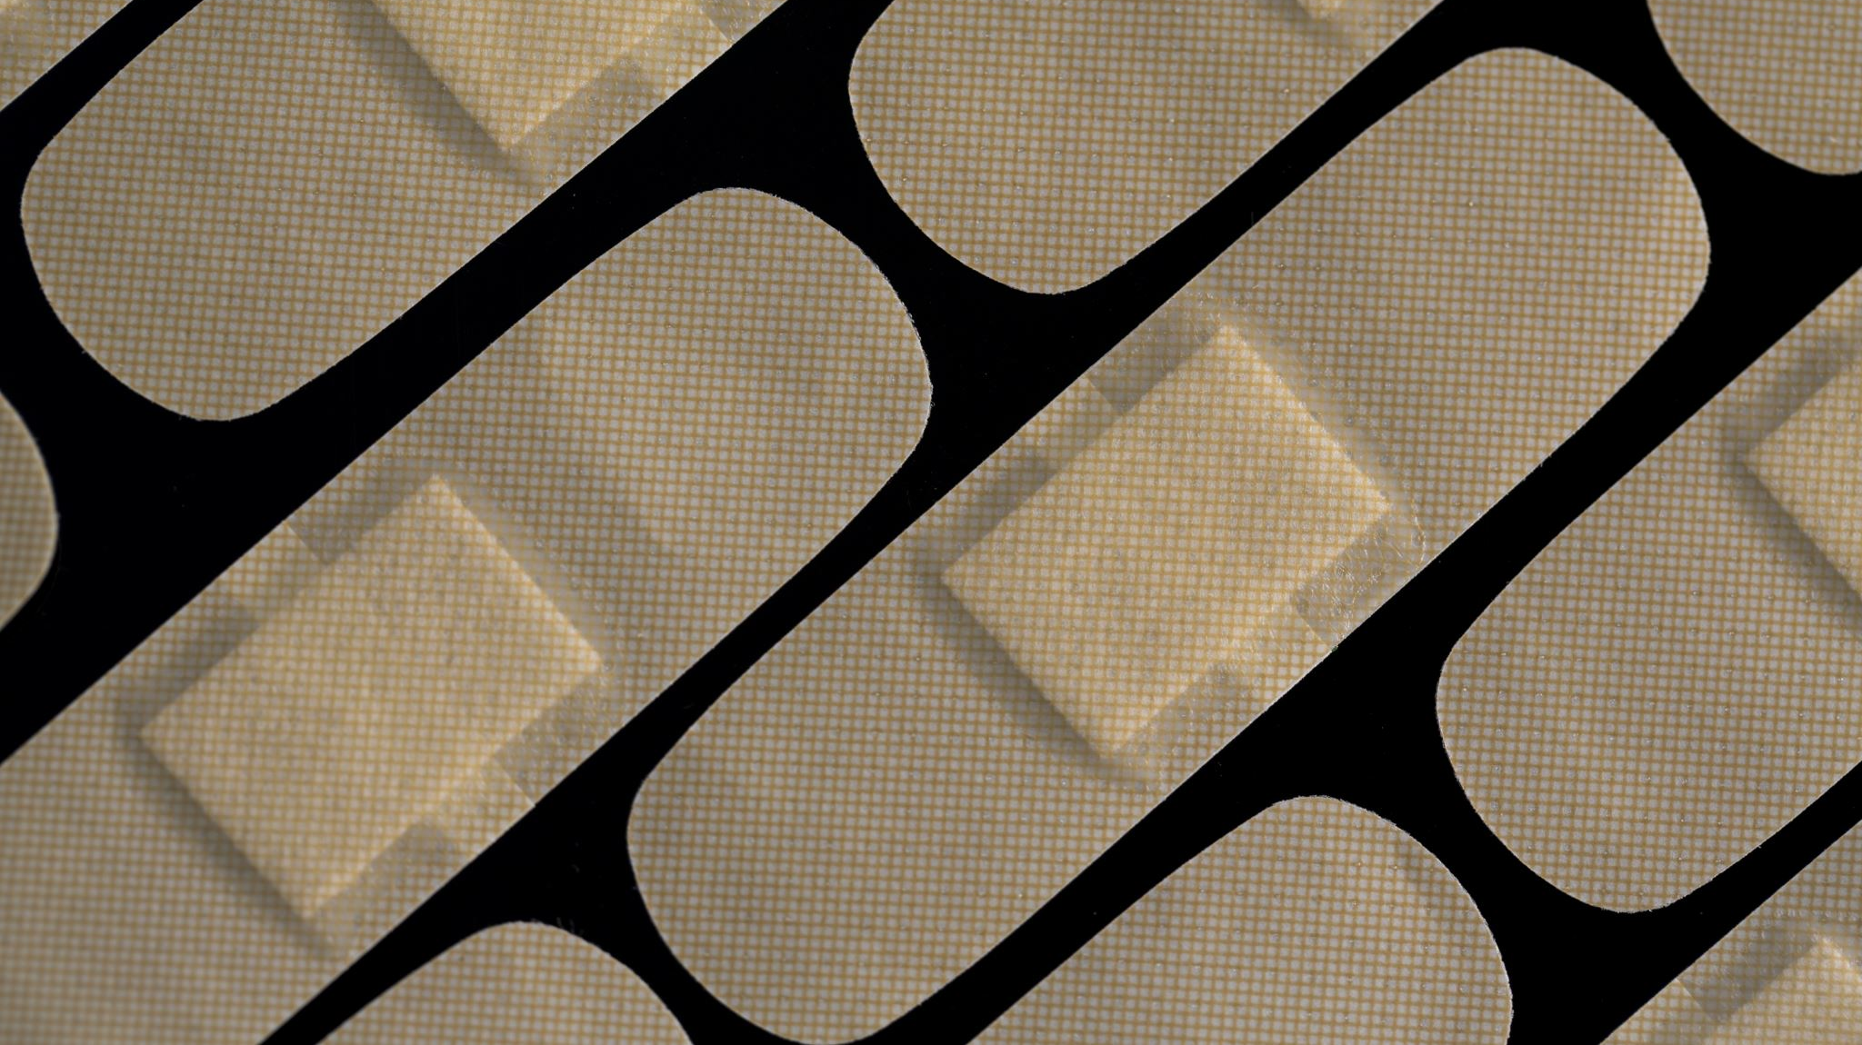
5: Gua Sha
Gua Sha is a massage that involves applying herbal oil over the skin and then scraping it with a gua sha tool such as a spoon or coin. This scraping provides a deep stretch and release of the body there, which improves blood circulation, as well as flush away toxins that were stuck deep within the muscles.
The scraping does leave red marks similar to cupping, and depending on your body’s condition, the marks will look different. It’s very relaxing, and the marks usually go away within a week.

Slide 19
https://www.youtube.com/watch?v=ivS_-jIHR3w&t=294s&ab_channel=AbigailSurasky
z

Slide 20
6: Herbal Medicine
Chinese herbal medicine uses naturally occurring substances such as barks, seeds, fruits, flowers, roots, and leaves. Some common examples include cinnamon, ginger, ginseng, liquorice, goji berries, and chrysanthemum. The purpose of herbal medicine is to replenish nutrition, enhance digestion, and restore proper functioning of organs.
A TCM doctor can create a specific combination of herbs with a specific dosage for your specific condition. While you can buy herbs over the counter in a Chinese medicine shop, it’s best to consult a TCM doctor first.
Herbs are usually used in combination with other treatments that stimulate acupoints. Those treatments tell the body where to focus its energy, while the herbs provide the necessary energy and fuel to help the body heal.

Slide 21
7: Food Therapy
z

Slide 22
8: Qi Gong and Tai Chi
The TCM doctor might also prescribe some exercises to help your body with qi circulation and blood circulation. Exercise also has great benefits for our emotions and mental health too.
You can think of Qi Gong like the Chinese version of yoga. Fun fact: one of the benefits of stretching exercises like yoga and qi gong is that it stretches your meridians, which improves qi flow! Qi Gong involves doing breathing exercises, maintaining poses, and repeating movements. Qi Gong is practiced to improve health and spirituality.
Tai Chi is the martial arts version of Qi Gong. It is a meditative form of martial arts that nurtures a peaceful mind, a strong body, and a spiritual connection to nature.
Qi Gong is simpler to learn, just like how yoga is simpler to learn than martial arts, so your doctor might teach you some Qi Gong poses.

Slide 23
See you all!

