Slide 1
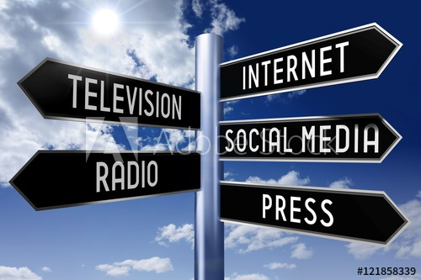
Media Studies
Creating Media Texts
Fake News
Reality TV
Commercial Advertising

Slide 2
Creating Media Texts
When creating a Media Text, focus on the 5 W’s and H to get more quality information for your text.
Who is the text about?
What are the details about it?
When did it happen?
Where did it happen?
Why did it happen?
How did it happen?

Slide 3
Fake News
Definition
noun: False stories that appear to be news, spread on the internet or using other media, usually created to influence political views or as a joke
Harm:
Spreads false information and misinforms the public; creates uneasiness and tension/mistrust among the public, especially during election time
Key Questions:
How is fake news spread in society?
How can it be stopped?
3. What can citizens do to avoid being influenced by fake news?
Cambridge English Dictionary
https://dictionary.cambridge.org/dictionary/english/fake-news

Slide 4
Reality TV
Definition
Noun: Television programmes about ordinary persons who are filmed in real situations, rather than actors
Examples of Reality TV Programmes
Survivor
Real Housewives of Beverly Hills etc.
So You Think You Can Dance
America’s Got Talent
American Idol
The Bachelor/The Bachelorette
Key Questions:
1.Are these shows really representative of reality? What audience are these shows created for?
2.What is the harm for society in these shows?
Cambridge English Dictionary
https://dictionary.cambridge.org/dictionary/english/reality-tv

Slide 5
Commercial Advertising
Definition
Advertising is typically designed to make consumers more aware of people, places or products. The purpose of advertising is to gain the interest and trust of consumers.
Harm
Sometimes the truth or details about a product are omitted, or placed in hard to see areas of the advertisement.
Often the goal is to sell more of a product, instead of informing the consumer about the product.
Often they use celebrities or famous people to sell their products, thinking it will appeal to more people.
Key Questions
What is the advertisement really telling me?
Why should I buy this product?
Do I know all the facts about this product?
https://www.infobloom.com/what-is-commercial-advertising.htm

Slide 6
Resources
Media Texts
Websites
http://www.edugains.ca/resourcesLIT/CoreResources/Media_Literacy_Guide.pdf
https://www.literacytoday.ca/home/reading/reading-strategies/reading-visual-texts/reading-media-texts
https://edu.gcfglobal.org/en/digital-media-literacy/deconstructing-media-messages/1/
https://rosshallreads.files.wordpress.com/2020/06/s1-into-s2.pdf
Fake News
Websites
https://dictionary.cambridge.org/dictionary/english/fake-news
https://www.lib.sfu.ca/help/research-assistance/fake-news
https://onesearch.library.utoronto.ca/faq/how-do-i-spot-misinformation
https://spotfakenews.ca/
https://news.umanitoba.ca/how-do-i-spot-fake-news/
https://sps.columbia.edu/news/real-impact-fake-news-rise-political-misinformation-and-how-we-can-combat-its-influence
https://www.apa.org/topics/journalism-facts/misinformation-disinformation

Slide 7
Resources
Reality TV Shows
Websites
https://www.britannica.com/topic/reality-TV
https://time.com/collection/reality-tv-most-influential-seasons/6199108/reality-tv-influence-on-world/
https://people.howstuffworks.com/reality-tvs-influence-on-culture1.htm
https://www.ruanliving.com/blog/%2Fimpact-reality-shows-younger-generation
https://www.aceprensa.com/english/beyond-the-gossip-why-reality-tv-is-so-popular/
https://www.esquire.com/entertainment/tv/g33298000/best-reality-shows/
Commercial Advertising
Websites
https://www.indeed.com/career-advice/career-development/what-is-commercial-marketing
https://www.youtube.com/watch?v=-ne7Iwi31Lo
https://crtc.gc.ca/eng/television/publicit/publicit.htm
https://asheragency.com/commercial-advertising-techniques/

