Slide 1
Unit 1 Career Journey

Slide 2
Welcome!

Slide 3
What to expect
Reflection and discussion. This includes individual work and pair/group work.
Covering topics such as:
Reflecting on your past, current and future education
Choosing a career that’s right for you & which path to take to get there
Stress Management and Healthy Lifestyle Balance

Slide 4
A.K.A. (Also Known As) The stuff that matters.

Slide 5
Overview
What we will be covering in class today:
My education story
How to choose a career
Moodle work
Exit Ticket

Slide 6
My Story

Slide 7
My Education
In Ontario there are private, public, and Catholic schools
I went through the private education system
I went to one private elementary school for Grades 1-8; grades 9-11 and then grades 12-13
I earned a Bachelor of Arts Degree from mt. Allison University in New Brunswick, Canada; Major in French and Political Science**I took International Language Course and North American History Courses

Slide 8
My Education
I earned my Ontario and New York State Teaching Certificate from St. Bonaventure University in NY State
I earned my Master of Education from OISE/University of Toronto
I have also taken many professional development courses with OISE and York University
And even though I am no longer in university I am still learning each day – don’t think education ends when school ends – education continues long past school

Slide 9
Your Education Moodle Forum
What does your education look like so far?
How many schools have you gone to and where are the schools located?
Which school do you think has been most influential on you so far?
You will work on this for the next ten to fifteen minutes. Once you have posted your response you will comment on two other posts.

Slide 10
Stress Management
Stress is a part of our everyday lives and it’s important to learn how to manage stress properly so that it does not interfere with our daily lives and ambitions
Causes of Stress: personal and social, family, friends, school, health, work, career
Stress Management Solutions: exercise, get outdoors, communicate your feelings, eat healthy foods, learn new things
Websites
https://www.verywellmind.com/tips-to-reduce-stress-3145195
https://www.cdc.gov/violenceprevention/about/copingwith-stresstips.html

Slide 11
How to choose a career

Slide 12
The “BIG 3”…
STRENGTHS
INTERESTS
HOBBIES

Slide 13
What are your BIG 3?
Take five to ten minutes to post the following on Moodle:
Your strengths
Your interests
Your hobbies
Note: add pictures, colour, design and images to personalize this!

Slide 14
Example
Strengths: Planning
Interests: Languages
Hobbies: Art

Slide 15
How do my “Big 3” relate to my job?

Slide 16
For Learning Forum Discussion
Come up with a list of 3 potential careers based on your BIG 3.
The challenge will be to think of something that matches your strengths/interests/hobbies but is also realistic and profitable.
Don’t forget to submit your exit ticket on Moodle before class ends.

Slide 17
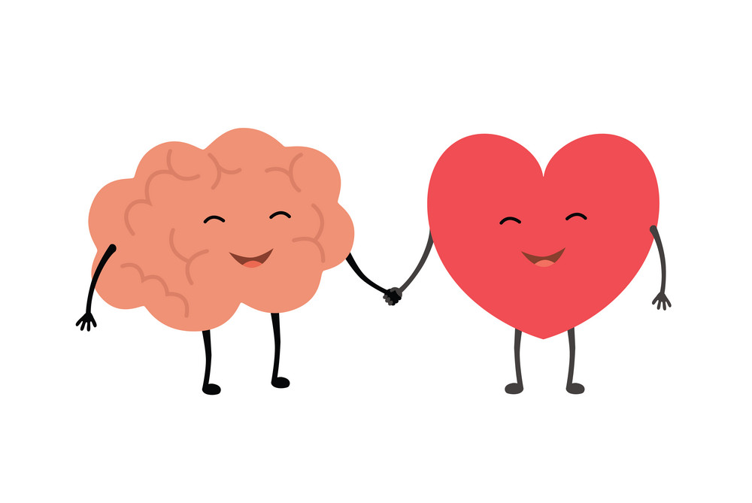
Career Quiz
Go to the following website and choose one quiz (or a few) to get a list of possible career options
https://www.jobbank.gc.ca/career-planning/quizzes
When you finish your quiz (or quizzes), be sure to skim through the list of careers at the end and jot down any 3 that stand out/speak to you

Slide 18
Resources
Video: 5 Minutes on Careers Planning
https://www.youtube.com/watch?v=ABVpi3V8_Hw
Jobs People Do
https://jobspeopledo.com/
Careers Quiz Activity
https://www.jobbank.gc.ca/career-planning/quizzes

