Slide 1
Convicted Canadians

Slide 2
Serial Killers
While serial killers are shown to be mostly in the United States or Europe, there have been serial killers in Canada
Today we are going to look at a famous couple

Slide 3
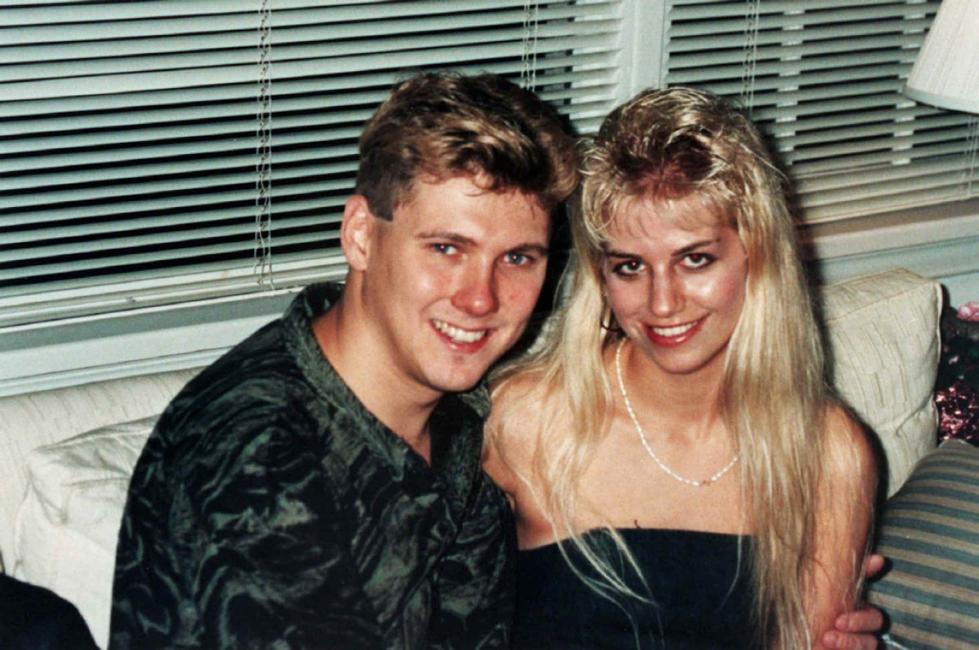
Paul Bernardo and Karla Homolka

Slide 4
Paul Bernardo and Karla Homolka
They were married
Bernardo is also known as the Scarborough Rapist – he committed a series of rapes between 1987 and 1990 – one of his confessions exonerated another man who had already served a full sentence for sexual assault
Bernardo and Homolka committed three murders together – each of the girls was raped, abused, and tortured before being murdered
On December 23rd 1990 they killed Homolka’s sister Tammy (who was 15)
On June 16th 1991 they killed Leslie Mahaffy (who was 14)
On April 19th 1992 they killed Kristen French (who was 15)
There were other victims but they survived
The police mishandled evidence in the case and the Campbell Report of 1996 occurred to investigate the mishandling

Slide 5
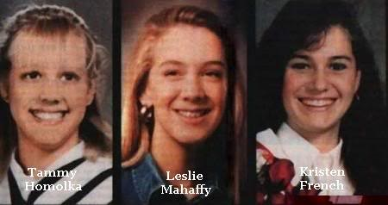
Paul Bernardo and Karla Homolka

Slide 6
Paul Bernardo and Karla Homolka
The police did interview both Bernardo and Homolka multiple times but they did not consider Bernardo a suspect
An acquaintance of Bernardo and Homolka reported Bernardo as a possible murder suspect in May 1992
In December 1992 the Centre of Forensic Sciences finally began testing DNA from Bernardo
On December 27th 1992 Bernardo severely beat Homolka – in the January her parents physically removed her from the house she lived in and Homolka filed charges against Bernardo claiming she was a battered spouse
26 months after he submitted a DNA sample there was a match with the Scarborough Rapist and Bernardo was put under 24 hour surveillance

Slide 7
Paul Bernardo and Karla Homolka
The police interviewed Homolka again on February 9th 1993 in which Homolka focused on Bernardo’s abuse of her
Homolka confessed to her aunt and uncle that Bernardo was the Scarborough rapist and that she and Bernardo were involved in the rape and murder of Mahaffy and French – but she did not mention her sister – and that there were videotapes of what had happened
Homolka met with a lawyer and he sought legal immunity for Homolka in exchange for her full cooperation. But full immunity was not an option because Homolka was involved in the case
Bernardo was arrested on February 17th 1993
Police executed search warrants (which were limited due to the weak link between Bernardo and the murders) at Bernardo and Homolka’s home but only found one video which did not show much – their search took 71 days

Slide 8
Paul Bernardo and Karla Homolka
The police offered Homolka a plea deal on May 5th 1993 that was for 12 years in prison but if she declined she would be charged with two counts of first-degree murder, one count of second-degree murder, and other crimes
Homolka’s lawyer accepted the deal on her behalf and she formally accepted it later
The plea deal was finalized on May 14th and she then began giving statements to the police
The plea deal was criticized by many Canadians once all of the videotapes were known – Bernardo’s lawyer had withheld the videotapes for 17 months even though they were considered to be crucial evidence and prosecutors said they never would have made the plea deal if they had seen tapes
Homolka testified against Bernardo at his trial

Slide 9
Paul Bernardo and Karla Homolka
On September 1st 1995 Bernardo was found guilty and convicted of the following – two first-degree murder charges and two aggravated sexual assault charges
He was sentenced to life in prison without parole for at least 25 years – both of his parole hearings (2018 and 2021) have been denied as he is considered a high risk offender who would reoffend if let out
Bernardo scored 35/40 on the Psychopathy Checklist which is clinical psychopathy
Homolka served her 12 years and when she released she was under strict rules/conditions
She eventually married again to another man and now has three children and lives in Quebec – however, as of January 2020 she was living without her husband or her children

Slide 10
Convicted Canadians AS learning
Submit your answer to the following question (in one paragraph) on Moodle in the proper submission file
Was justice fully served? Why or why not?

