Slide 1
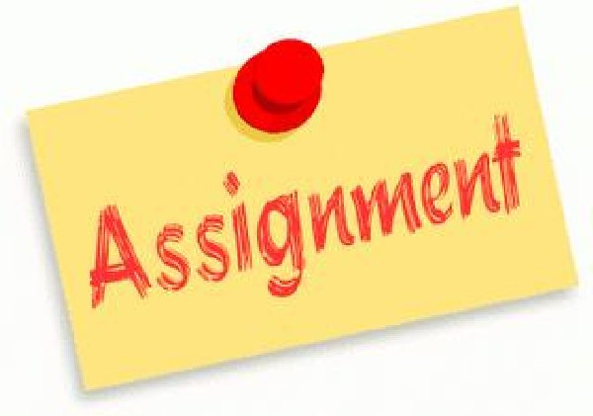
GLC20: Assignment #1 Education and Career Goals Presentation
Reflecting on Your Past Education
Assessing your Present Education
Considering Your Future Education and Career Goals

Slide 2
Directions
Working by yourself, you will prepare an Oral and Visual Presentation on the following topics: Your Past, Present and Future Education and Your Possible Career Interests
Reflect on your Past Education, Assess and Evaluate your Current Education and Consider your Future Education Needs and Dreams, together with some possible Career Ideas.
Use the Guiding Questions on Slide 4 to assist you in your Planning.
Choose a format for your Presentation (ex. Google Slides, Prezi, Canva etc.).Be creative! Add pictures, colour, designs to your Presentation!
Remember to personalize your presentation by adding your own beliefs, opinions and values.
Document your sources at the end of your Presentation using APA/MLA Format

Slide 3
Requirements
Written Section: Key Titles to show each Section; Answers to Guiding Questions in key Points; add pictures, photos, designs etc.
Oral Presentation: Speak confidently and naturally (5 minutes); Be ready to answer Discussion Questions
Documentation of Sources: Put your sources in APA/MLA Format
Consult the Assignment Directions and Upcoming Success Criteria.
Show your work to your teacher BEFORE posting for your OF Learning Progress Mark.

Slide 4
Guiding Questions
**You may change these or adjust them to suit your presentation and interests. You need a total of 5 Questions. Each question can be on a separate slide
What were some advantages of your past education? What were some weaknesses? Explain.
What are some positives about your current education? What are some problems or challenges? Explain.
What are your future education dreams? Do you think they will be possible? Explain.
What are some possible career ideas that you have? How do you feel about these ideas? Are you nervous or excited? Explain
How can you demonstrate resilience and determination in achieving your educational and future career goals? How can you manage stress and challenges?

Slide 5
Expectations
A1.1 demonstrate an understanding of the importance of resilience and perseverance in school, life, and work – why it is helpful to acquire skills for adapting to change, persevering in the face of adversity, learning from mistakes, and thinking positively about setbacks – and analyse how developing resilience and perseverance can help them in all areas of their lives
A1.2 identify a range of strategies to help manage stress and achieve and maintain a healthy school/life/work balance, and explain how they have used such strategies in their lives so far and how they might apply them in the future
A2.1 apply various decision-making strategies as they set personal, social, educational, and career/life goals, then evaluate and revise those goals based on what they learn about themselves during this course

