Slide 1
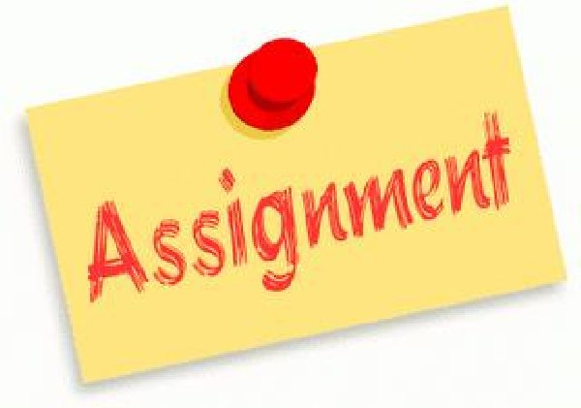
Assignment #5 Diary Entry A Separate Peace Ch.1-13
Analyzing One Main Event from Ch.1-13
Through the Eyes, Opinion and Perspective of
Gene OR Finny

Slide 2
Directions
1. Working independently you will choose the following for your Journal Entry.
2. Select ONE Main Event from Chapters 1-13.
3. Choose ONE Main Character, Gene OR Finny.
4. Write 1-2 Paragraphs (1.5 pages skipping lines) on how your chosen character feels about the Main Event that you selected. You can add photos, images, maps, symbols for drama and creativity.
5. Include your character’s: emotions, feeling, thinking, actions, etc. and explain why they feel this way.

Slide 3
Requirements
1. Write your Diary Entry in the First Person ex. (I feel scared to jump off the tree branch, yet I do it anyways to please Finny.)
2. Use the Writing Process (Brainstorming, Planning, Drafting, Partner Editing, Publishing etc.)
Use proper paragraphing, organization, sentence structure, word choice and spelling.
Use descriptive language, figurative language and imagery to convey your thoughts, feelings and ideas and bring your character to life. Add photos, symbols or images for creativity.
Be creative and have fun!
6. PDF and Post to Moodle
7. Be ready to share screen BEFORE posting for your OF Learning Progress Mark.

Slide 4
Expectations
Reading For Meaning
1.1 Read a variety of student and teacher selected texts from diverse cultures and historical periods, identifying specific purposes for reading
1.2 Select and use the most appropriate reading comprehension strategies to understand texts, including increasingly complex or difficult texts
1.3 Identify the most important ideas and supporting details in texts, including increasingly complex or difficult texts
1.4 make and explain inferences of increasing subtlety about texts, including complex or difficult texts, supporting their explanations with well-chosen stated and implied ideas from the texts
1.5 Extend understanding of texts, including increasingly complex or difficult texts, by making appropriate and increasingly rich connections between the ideas in them and personal knowledge, experience, and insights; other texts; and the world around them
1.6 Analyze texts in terms of the information, ideas, issues or themes they explore, examining how various aspects of the texts contribute to the presentation or development of these elements
1.7 evaluate the effectiveness of texts, including increasingly complex or difficult texts, using evidence from the text to support their opinions
1.8 identify and analyze the perspectives and/or biases evident in texts, including increasingly complex or difficult texts, commenting with growing understanding on any questions they may raise about beliefs, values, identity and power

Slide 5
Expectations
Developing and Organizing Content
1.1 Identify the topic, purpose, and audience for a variety of writing task
1.2 Generate, expand, explore and focus ideas for potential writing tasks, using a variety of strategies and print, electronic and other resources as appropriate
1.3 Locate and select information to effectively support ideas for writing, using a variety of strategies, print, electronic and other resources as appropriate
1.4 Identify, sort and order main ideas and supporting details for writing tasks, using a variety of strategies and selecting the organizational pattern best suited to the content and purpose for writing
1.5 Determine whether the ideas and information gathered are accurate and complete, interesting and effectively meet the requirements of the writing task

Slide 6
Expectations
Using Knowledge of Form and Style
2.1 Write for different purposes and audiences using a variety of literary, informational, and graphic forms
2.2 Establish a distinctive voice in their writing, modifying language and tone skillfully and effectively to suit the form, audience and purpose for writing
2.3 Use appropriate descriptive and evocative words, phrases and expressions imaginatively to make their writing clear, vivid and interesting for their intended audience
2.4 Write complete sentences that communicate their meaning clearly and effectively, skillfully varying sentence type, structure and length to suit different purposes and making smooth and logical transitions between the ideas
2.5 Explain, with increasing insight, how their own beliefs, values and experiences are revealed in their writing
2.6 Revise drafts to improve the content, organization, clarity and style of their written work, using a variety of teacher-modeled strategies
2.7 Produce revised drafts of texts, including increasingly complex texts, written to meet criteria identified by the teacher, based on the curriculum expectations

Slide 7
Expectations
Applying Knowledge of Conventions
3.1 Use knowledge of spelling rules and patterns, a variety of resources and appropriate strategies to recognize and correct their own and others’ spelling errors
3.2 Build vocabulary for writing by confirming word meaning (s) and reviewing and refining word choice, using a variety of resources and strategies, as appropriate for the purpose
3.3 Use punctuation correctly and effectively to communicate their intended meaning
3.4 Use grammar conventions correctly and appropriately to communicate their intended meaning clearly and effectively
3.5 Regularly proofread and correct their writing
3.6 Use a variety of presentation features, including print and script, fonts, graphics and layout, to improve the clarity and coherence of their written work and to heighten its appeal and effectiveness for their audience
3.7 Produce pieces of published work to meet criteria identified by the teacher based on the curriculum expectations

Slide 8
Teacher Modeling Assignment 1 Journal Entry
Choose Main Character/Perspective: Gene
Choose Main Event From Ch.1-13: Finny falling from tree branch
Sample Section Below: **This is a sample only. You will need to extend and elaborate your own (1.5 pages, 1-2 paragraphs) using proper Paragraph Form, topic Sentences etc.
What is Gene Feeling?
I feel so angry for what happened. Finny fell and broke his leg and it seems like it’s all my fault! I never should have gone to the river with Finny. My friendship with Finny was never a good idea. He is my roommate and that’s all.
How does Gene understand the event?
What really happened? Why can’t I remember? Finny thinks it could be my fault. Did I push him? What will people think? I feel so confused!
What does Gene worry about?
What will happen to my friendship with Finny? We are leaving for the holiday and I will see him in September for the start of school. Maybe I should visit him at home and see if he’s OK. I hope he will be able to play sports again.

Slide 9
Style of Writing Creative and Personal
Journal Writing
Personal thinking, feelings and beliefs
Mostly thoughts that have not yet been spoken
Extending a Main Event or Idea
Includes Narrative First Person ‘I think, I feel, According to me…etc.’
Uses a lot of description, adjectives, Figurative Language
Uses creativity, imagination and new thinking; adds to an existing story
Drafting
Formal Topic Sentences are not needed, but the reader needs to follow an organized train of thought…
Paragraphs organized according to categories
EX. Para #1: Character’s View of what occurred
Para #2: Thinking, Emotions, Feelings of the character and follow-up actions taken by the character

