Slide 1
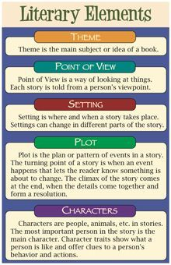
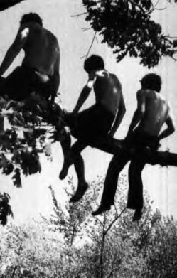
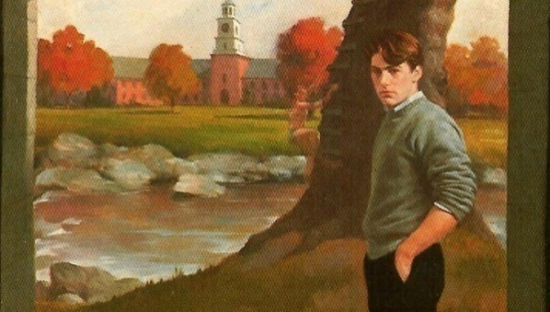
A Separate Peace by John Knowles
Literary Elements: Chapter 10-11

Slide 2
Main Characters
Gene Forrester:
Listens to Leper’s adventures in the military; difficulty accepting the truth that Leper was crazy/disturbed by his time in the war
Cooperates with Finny about the truth over Finny’s fall from the tree
Finny:
Leader when he returns to Devon; started a snowball fight
Wants to protect Gene about truth of his fall and what really happened
Finally recognizes that the war is real after hearing Leper’s experiences
Mad and upset about the Inquiry in the Meeting Room
:

Slide 3
Secondary Characters
Leper:
plays a more important role sharing about his disturbing war experience; plays an important role in the Inquiry Process as a witness for Finny’s fall
2. Brinker:
shows leadership and curiosity by asking about Finny’s fall and what really happened; he acts as a judge

Slide 4
Setting
Location: Leper’s home in Vermont; battlefield where Leper carries out war duties; boot camp
Time Period: war
Mood:
Tense in Inquiry Process
Tense hearing about Leper’s war experience

Slide 5
Main Events
Chapter 10
Gene visits Leper’s home in Vermont after he left the military; he left because he was going to be given a Section 8 discharge for insanity which would have affected his education and career
Leper and Gene argue about Finny’s fall and what happened
Gene was upset at Leper’s wartime hallucinations
Chapter 11
Back at Devon; Finny and Gene roommates
Hanging out with Gene, Finny, Brinker, Leper, discuss the war and also the accident
Brinker’s idea to hold an Inquiry Process at Assembly Hall for the events of Finny’s fall
Leper acting as a witness, Brinker as a judge
Finny says he doesn’t care anymore about the results; he hobbles out of the Inquiry, seemed upset and likely fell down the stairs

Slide 6
Theme
Education: style of education (private boys’ US boarding school; takes a second spot to the War Effort); finding the truth about Finny’s fall
2. Trust: still good trust between Finny/Gene; Brinker does not trust Gene about the Fall; All boys trust Leper’s bad experiences from the war
Friendship: New developing Friendship between Leper/Gene, takes the focus away from Gene/Finny; Brinker seems to be looking for friendships
4. Identity: Gene still trying to find his identity (pursuing Leper as a friend); Leper trying to find his identity; Finny still has strong identity; Brinker strong identity
5. Reality: all seem to be tuned into the war experience, becomes more real after Leper’s experience; Inquiry Process turns Finny’s fall into more of a reality; digs up the past

Slide 7
Meaningful Quotes
Pg. 152 “I wanted to see Phinneas and Phinneas only. With him there was no conflict except between athletes. Something Greek inspired and Olympian in which victory would go to whoever was the strongest in body and heart.”This was the only conflict he had ever believed in”. Gene speaking, still looking up to Finny, really admiring him for his athletic strength
Pg. 160 “ I don’t know” he shrugged and chuckled in his best manner , “nobody knows “. Then the charm disappeared and he added “unless you knew. Brinker talking to Gene about what happened; pushing/prodding

Slide 8
Figurative Language
pg. 140 “ In which the snow white almost too blueness lay like a soft comforter over the hills and the birches and pines indestructibly held their ground.” describing the season and setting, importance of it, stillness, Simile
Pg. 139 “A bleak draughty train ride that deports seemingly near no town a bus station in which none of the people were fully awake or seems claim or looked as though they had homes anywhere.” Simile to show poor town

Slide 9
Vocabulary-Ch.10-11
Indestructibly
Bleak
Draughty
Dishonourable
Imperceptibly
Timidly
Recruited
Irresponsibility
Cheerfully
Enthusiasm

Slide 10
Text and Society
1. Wartime Negative Effects: Leper’s Hallucinations could be too much pressure for Leper and too difficult to handle; Gene is disturbed by this; Does participating in the military have too dangerous emotional consequences for students in any society? Are students from any society prepared emotionally to handle war?
2. Inquiry Process For Students: The aftermath/following up of an accident. Is this fair? Is this just? Does it place too much pressure on Gene? Is it necessary to solve the issue over what really happened between Finny and Gene at the time of the accident? Is an Inquiry Process too difficult for students to handle?

