Slide 1
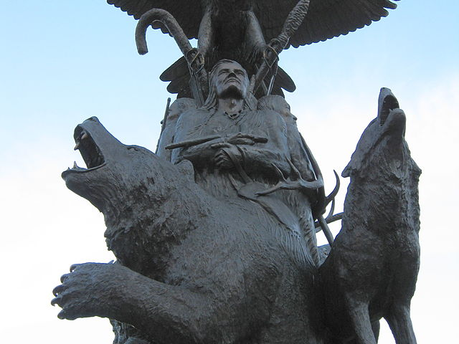
Indigenous Governance in Canada
Copyright ©2022 Kosowan’s Korner. All rights reserved.
Notes:
Copyright ©2022 Kosowan’s Korner. All rights reserved.

Slide 2
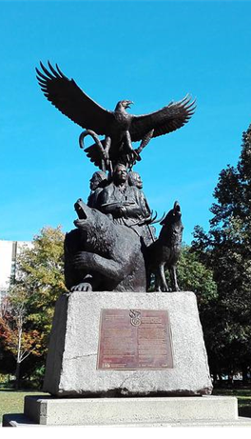
Indigenous Forms of Government
Indigenous peoples had their own forms of government for thousands of years.
These government structures reflected the economic, social and geographic diversity of Indigenous peoples.
After European colonizers, initial partnerships between colonial governments with Indigenous nations developed through treaties, trade and military alliances.

Slide 3
Relationship Sours
Over many centuries, these relationships were eroded by laws, policies and decisions that were based on a colonial and paternalistic approach.
This includes the Indian Act, which was passed in 1876 and still determines the way the First Nations in Canada are governed to this day. The Indian Act imposed a colonial governance system on First Nation communities where authority rested with the federal Minister.

Slide 4
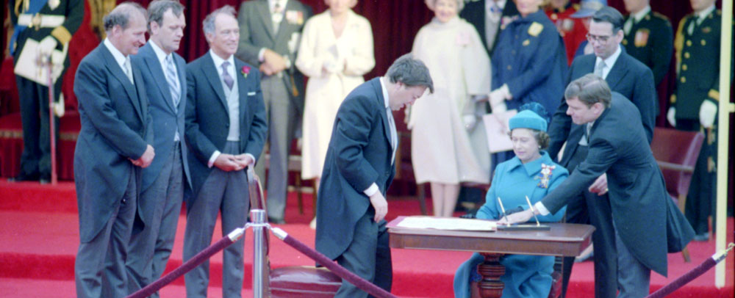
Control of Indigenous Government
Since Confederation, Canadian colonial legislation dictates how Indigenous peoples were to be governed.
In Canada, First Nations, Intuit and the Métis have a right of self-government that is guaranteed in Section 35 of The Constitution Act, 1982.

Slide 5
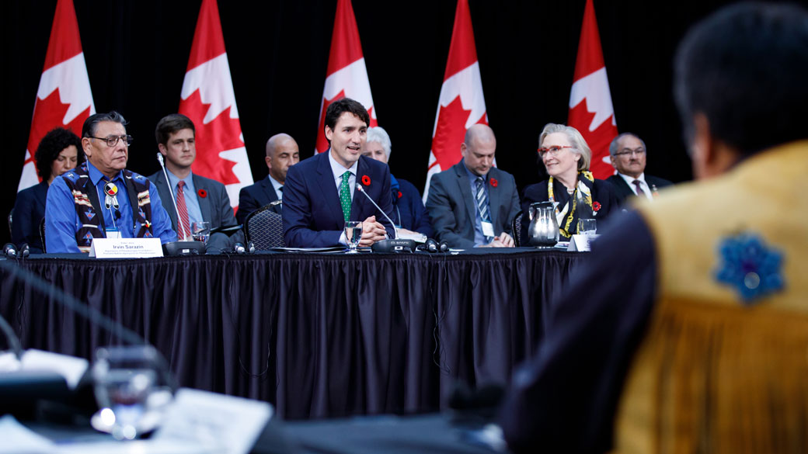
Indigenous Governance
Today, decision making power about how social programs and services are delivered is in the hands of local Indigenous governments.
Self governance deals with implementation of services such as public health, social supports, education, land access and hunting/fishing rights amongst others.

Slide 6
Indigenous Governance
All Canadian governments, including Indigenous ones, are subject to the Constitution and the Charter of Rights and Freedoms.
Land Claims have been a catalyst for change for Indigenous Communities across Canada.

Slide 7
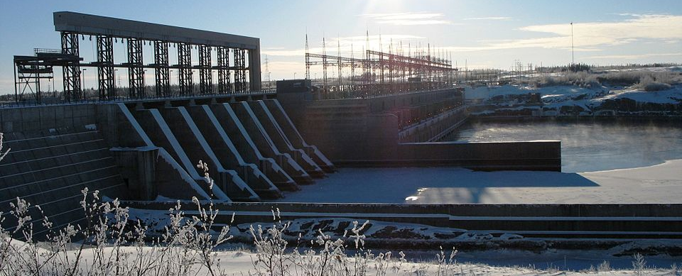
Land Claims & Effective Change James Bay & Northern Quebec Agreement (1975)
Negotiated and settled because of a proposed hydroelectric power development. The Cree and Inuit, who had not signed a treaty with Canada fought the project.
The resulted in the Cree-Naskapi (of Quebec) Act, 1984, the first piece of Indigenous self-government legislation in Canada. This replaced the Indian Act and established Indigenous communities in the region as corporate entities.

Slide 8
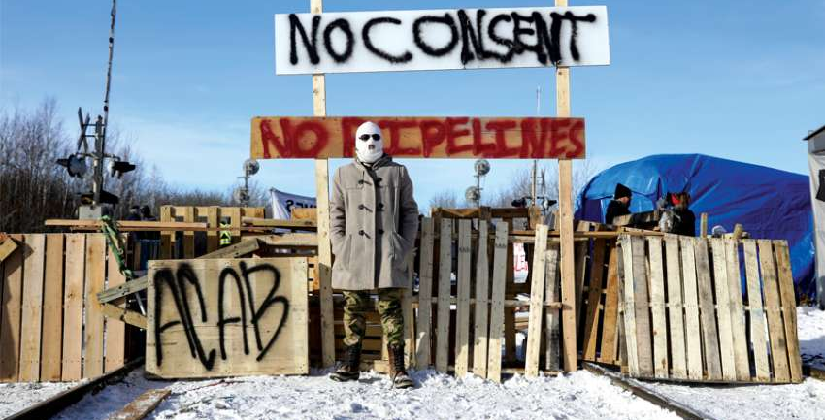
Land Claims & Effective Change Wet'suwet'en
Recently, the Office of the Hereditary Chiefs of the Wetʼsuwetʼen were involved in a landmark Land Claim issue in British Columbia.
The Wetʼsuwetʼen are ruled by Hereditery Chiefs and are run as a Non-Profit Society with a Board of Directors.
Notes:
WET-SO-IH-TIN

Slide 9
Land Claims & Effective Change Wet'suwet'en
After conflict over Gas Pipelines running under unceded lands, provincial and federal Governments came to an agreement with the Wet’suwet’en hereditary chiefs.
The agreement recognized that Wet’suwet’en rights and title are held by the Wet’suwet’en under their system of governance and that Indigenous communities should have control over infrastructure such as pipelines.
Notes:
WET-SO-IH-TIN

Slide 10
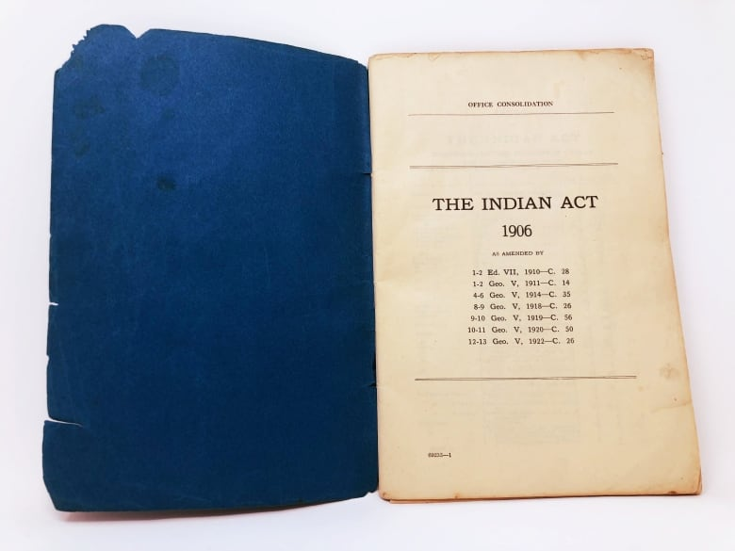
The Indian Act
The Indian Act is the federal government’s central legislation that provides authority to administer Indian status, local First Nations governments and the management of reserve land.
It also outlines governmental obligations to First Nations peoples.

Slide 11
The Indian Act
Many see the Act as a symbol of Native Oppression, as it provided the Government with incredible control over the lives of its Indigenous peoples.
The Residential School System and the Potlach Law of 1884 are examples of how the Indian Act made it possible for the Canadian Government to restrict Indigenous Rights.
Notes:
In 1884, the federal government banned potlatches under the Indian Act, with other ceremonies such as the sun dance to follow in the coming years.
These were important ceremonies for coastal First Nations in the British Columbia.

Slide 12
Reflecting on The Indian Act
To be federally recognized as an Indian either in Canada or the United States, an individual must be able to comply with very distinct standards of government regulation… The Indian Act in Canada, in this respect, is much more than a body of laws that for over a century have controlled every aspect of Indian life. As a regulatory regime, the Indian Act provides ways of understanding Native identity, organizing a conceptual framework that has shaped contemporary Native life in ways that are now so familiar as to almost seem “natural.”
–Bonita Lawrence
How do you think the Indian Act impacted the lives of Indigenous Peoples?
Notes:
In 1884, the federal government banned potlatches under the Indian Act, with other ceremonies such as the sun dance to follow in the coming years.
These were important ceremonies for coastal First Nations in the British Columbia.

Slide 13
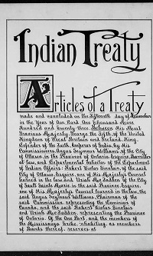
Treaties
There are more than 40 treaties and other land agreements cover Ontario.
Treaties are legal agreements that set out the rights and responsibilities of First Nations and the provincial and federal governments.
The Indigenous Land Acknowledgement you hear every morning names the specific treaties for the land upon which your school is built.
Notes:
A written page of the Williams Treaty for the Mississaugas of Rice, Mud and Scugog Lakes and Alderville. (Library and Archives Canada)

