Slide 1

Embed a video to show a technology used in education

Slide 2
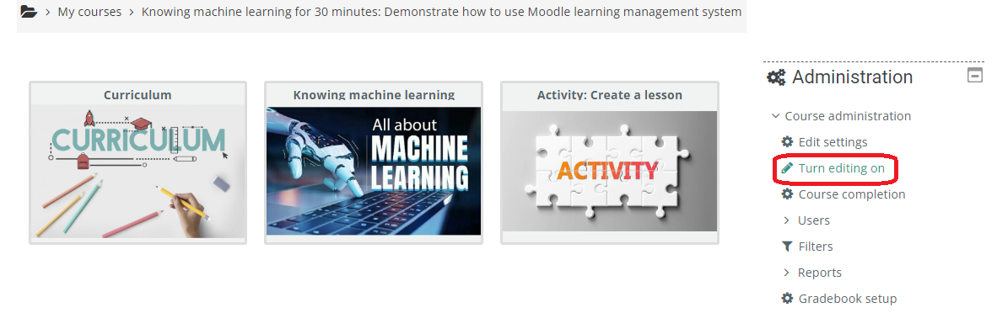
Step 1. make course editable
Click ‘Turn editing on’

Slide 3
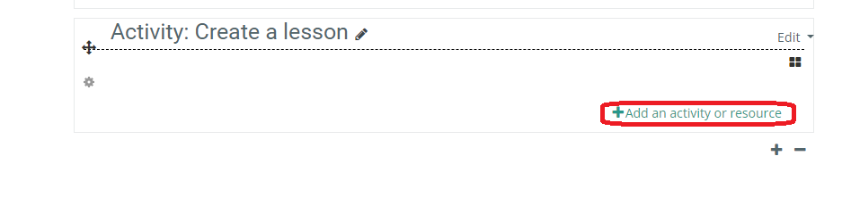
Step 2. Add an activity or resource
Click ‘add an activity or resource’

Slide 4
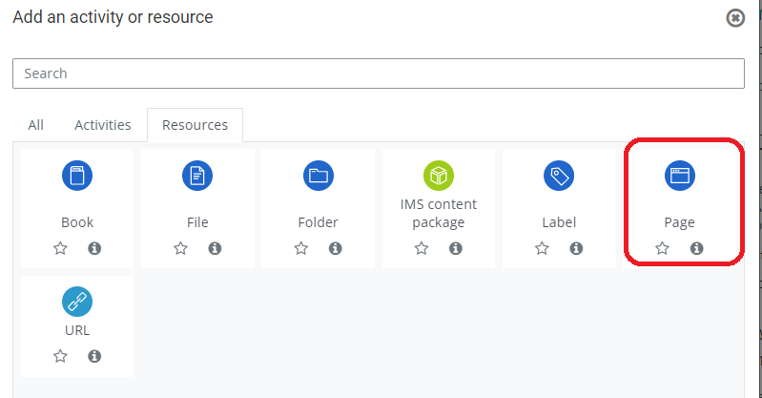
Step 3. Add an resource
Click ‘Page’

Slide 5
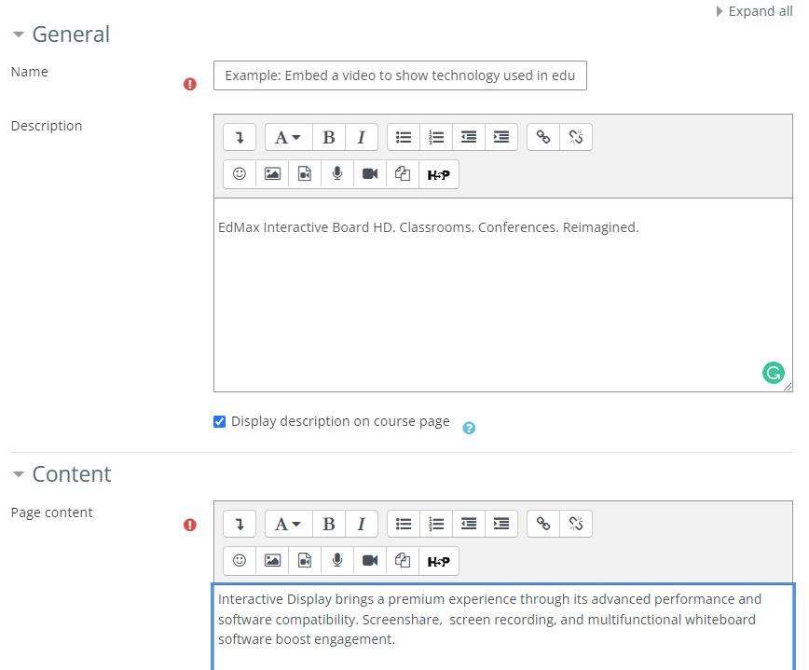
Step 4. Add page content
Fill out name, description, and content

Slide 6
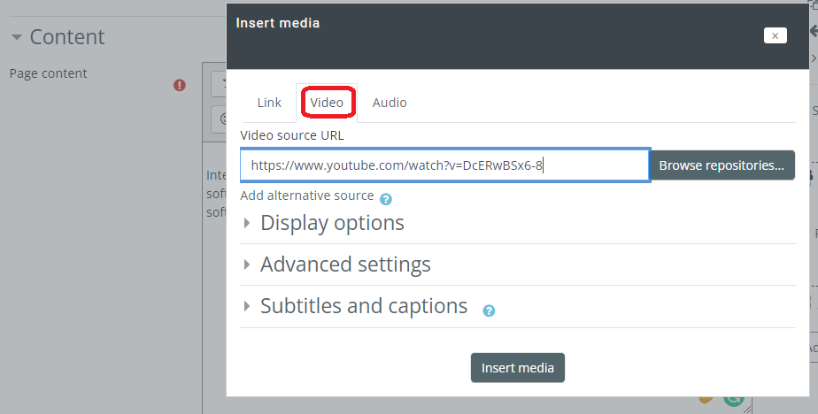
Step 5. Embed video
YouTube video

Slide 7
Step 6. save page
Click ‘Insert media’ and then click ‘save’

Slide 8

Step 7. A video is embed in a Moodle course
Edmax Interactive Board

