Slide 1

Embed a geogebra file to show a technology used in education

Slide 2
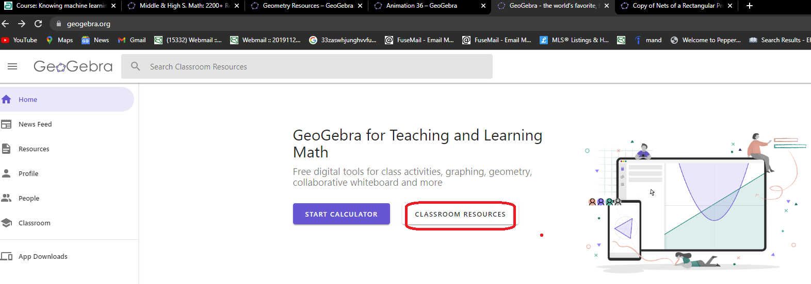
Step 1. Go to www.geogebra.org
Create a account if you do not have one. Click Classroom Resources

Slide 3
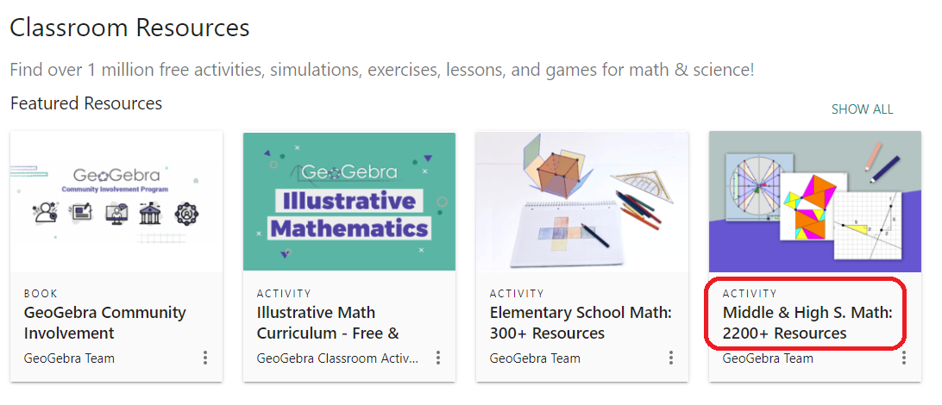
Step 2. Select resource category
Click ‘Middle & High S. Math’

Slide 4
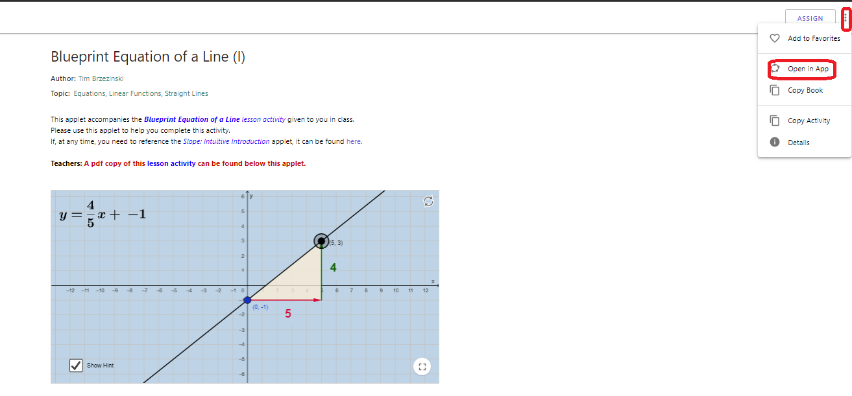
Step 3. find what you want to embed in moodle
Find "Blueprint Equation of a Line" as an example. Open it in App

Slide 5
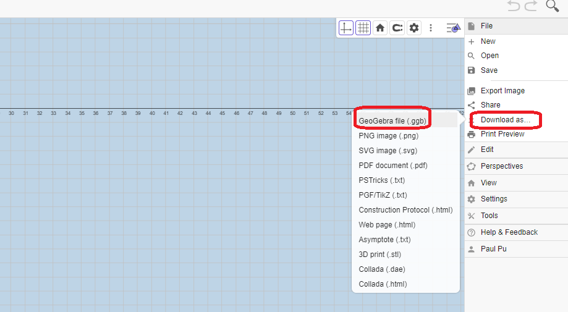
Step 4. download Geogebra file
Download and save ggb file format

Slide 6
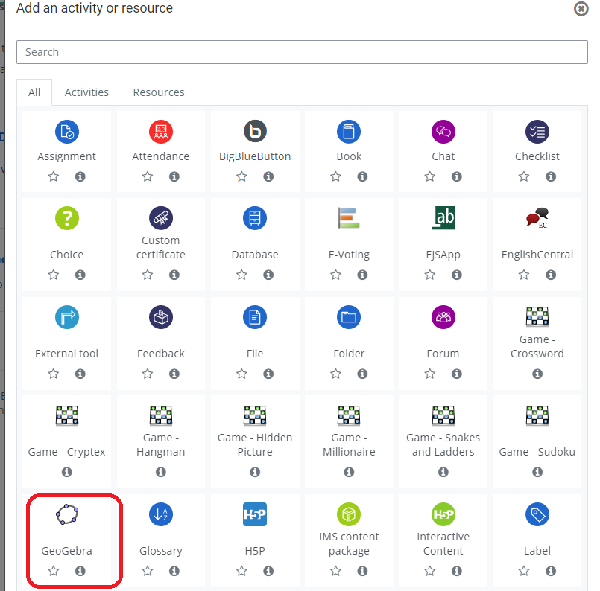
Step 5. Add Geogebra in moodle
Click “Add an activity or resource” and GeoGebra

Slide 7
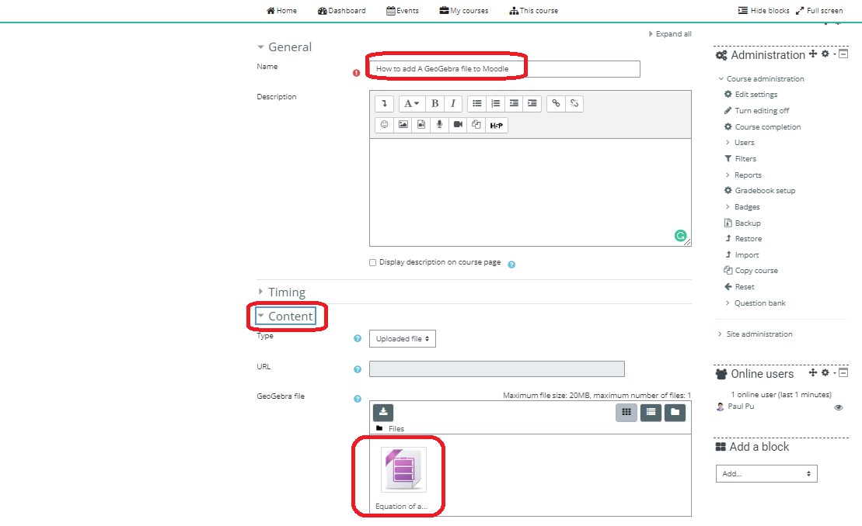
Step 6. save page
Give a activity name and Click “Content”, then upload or drag the ggb file

Slide 8
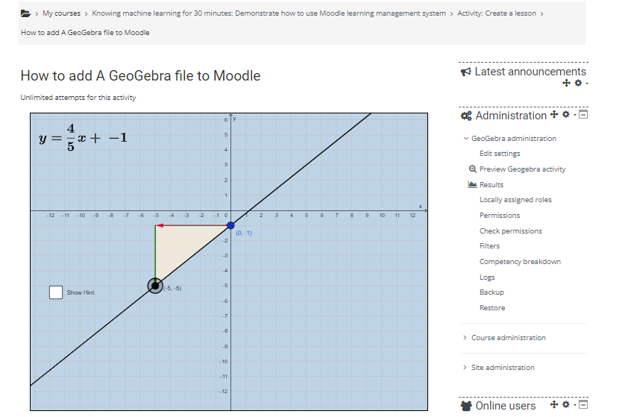
Step 7. Save and display
Equation of a Line demo is ready to use

