Slide 1
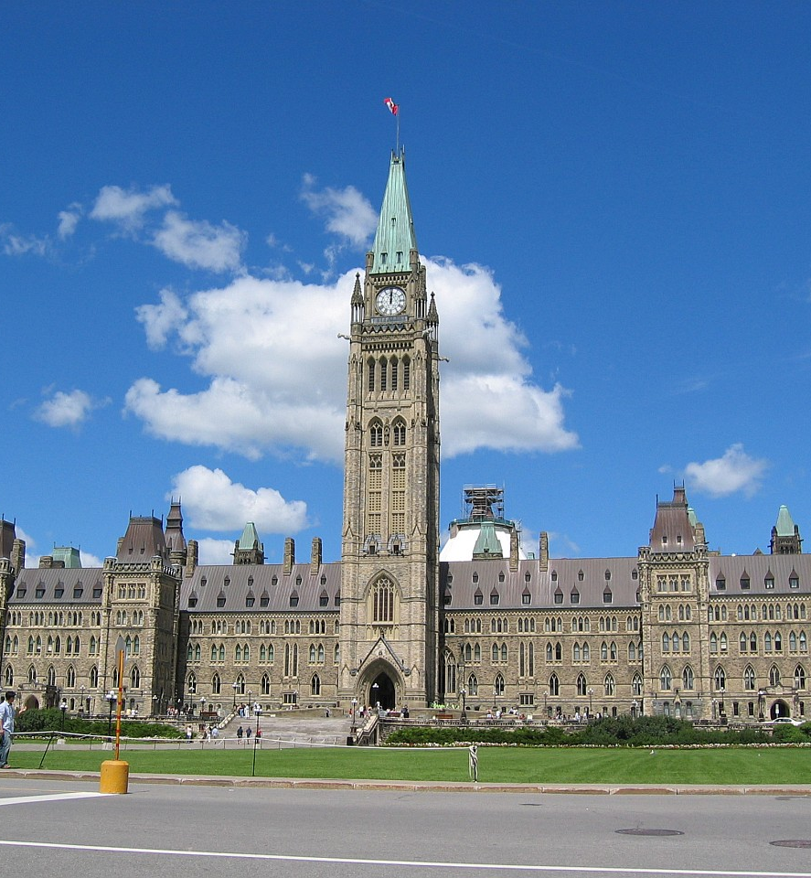
Canada’s Federal Government Structure and Passing a Bill
CHV2O
Canadian Civics & Citizenship
Copyright ©2020 Kosowan’s Korner. All rights reserved.

Slide 2

Parliamentary
Structure
Parliament is the LEGISLATIVE branch … at the FEDERAL level.
There are 2 houses in Parliament, so it is …
a BICAMERAL system.

Slide 3
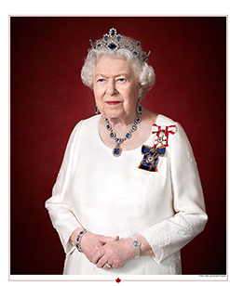
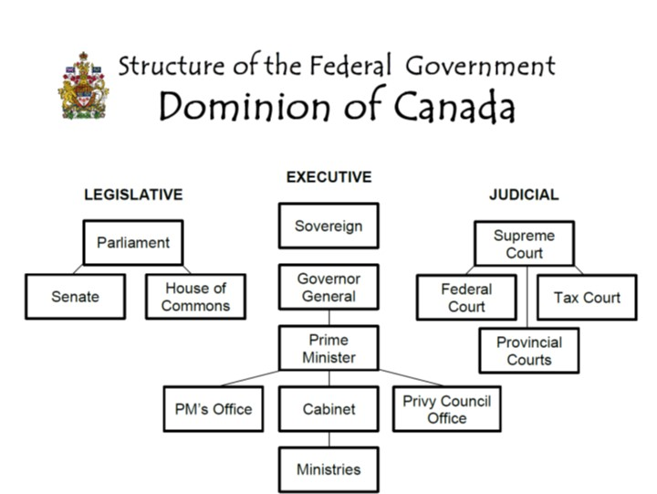
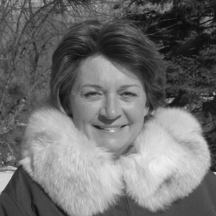
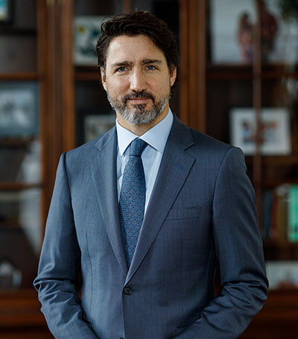
Her Majesty Queen Elizabeth II
Sovereign
Her Excellency
The Right Honourable Mary Simon
Governor General (Designate)
The Right Honourable
Justin Trudeau
Prime Minister

Slide 4
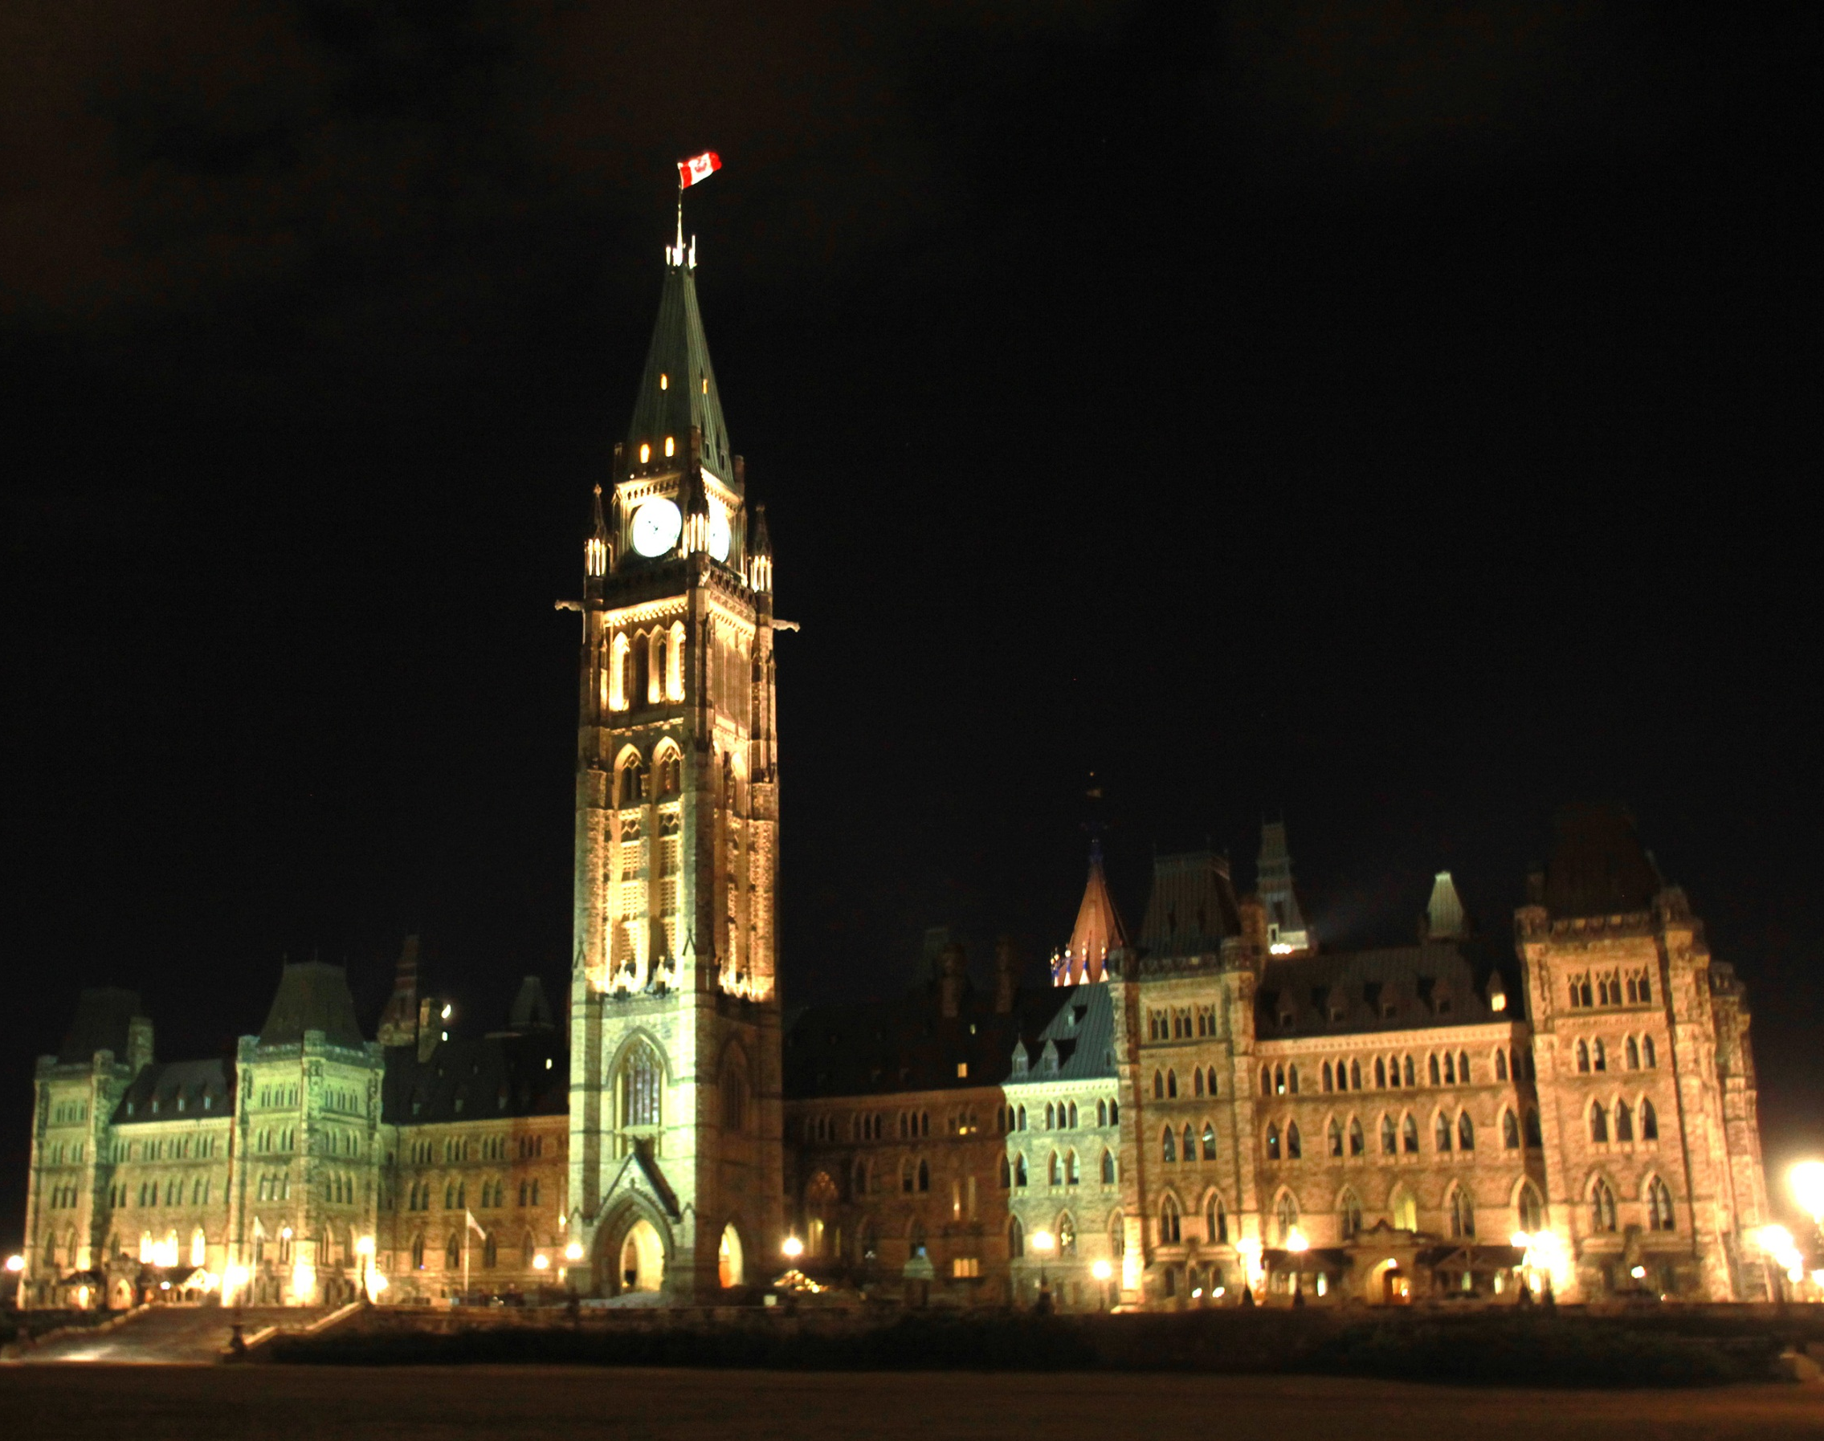
There are Two Legislative Chambers:
The House of Commons
and the Senate

Slide 5
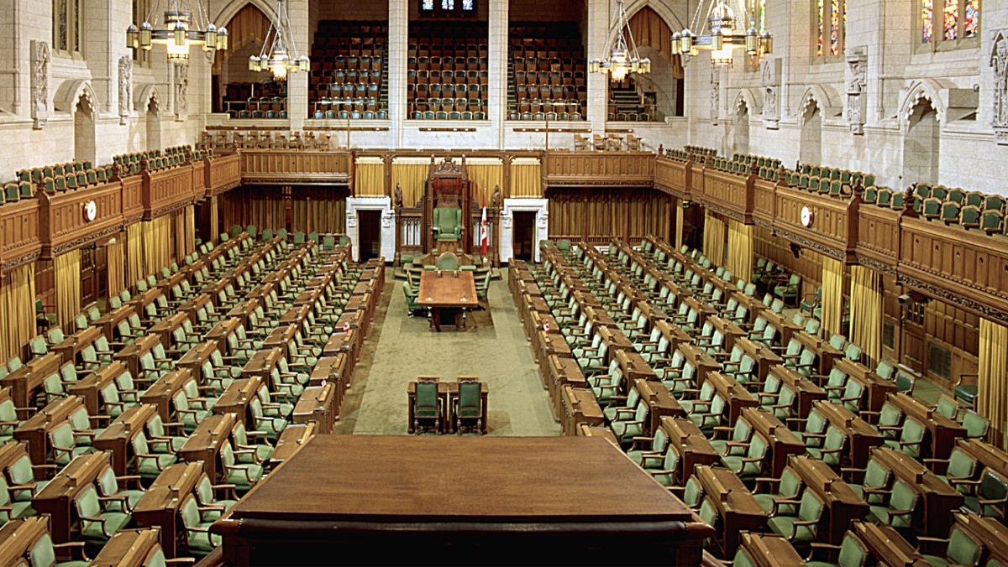
Canada’s House of Commons
  338 MPs (Members of Parliaments)
Elected from ridings across Canada
What are commoners?

Slide 6

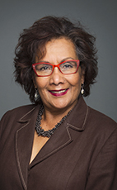
Who can be an MP?
Any Canadian citizen 18 years of age and older can become an MP.
May 31, 1991
March 19, 1941
Youngest person to be elected is Pierre-Luc Dusseault (NDP, Sherbrooke) who was first elected at 19.
The longest sitting MP is Hedy Fry (Liberal, Vancouver Centre), who has served as a Member of Parliament since 1993.

Slide 7

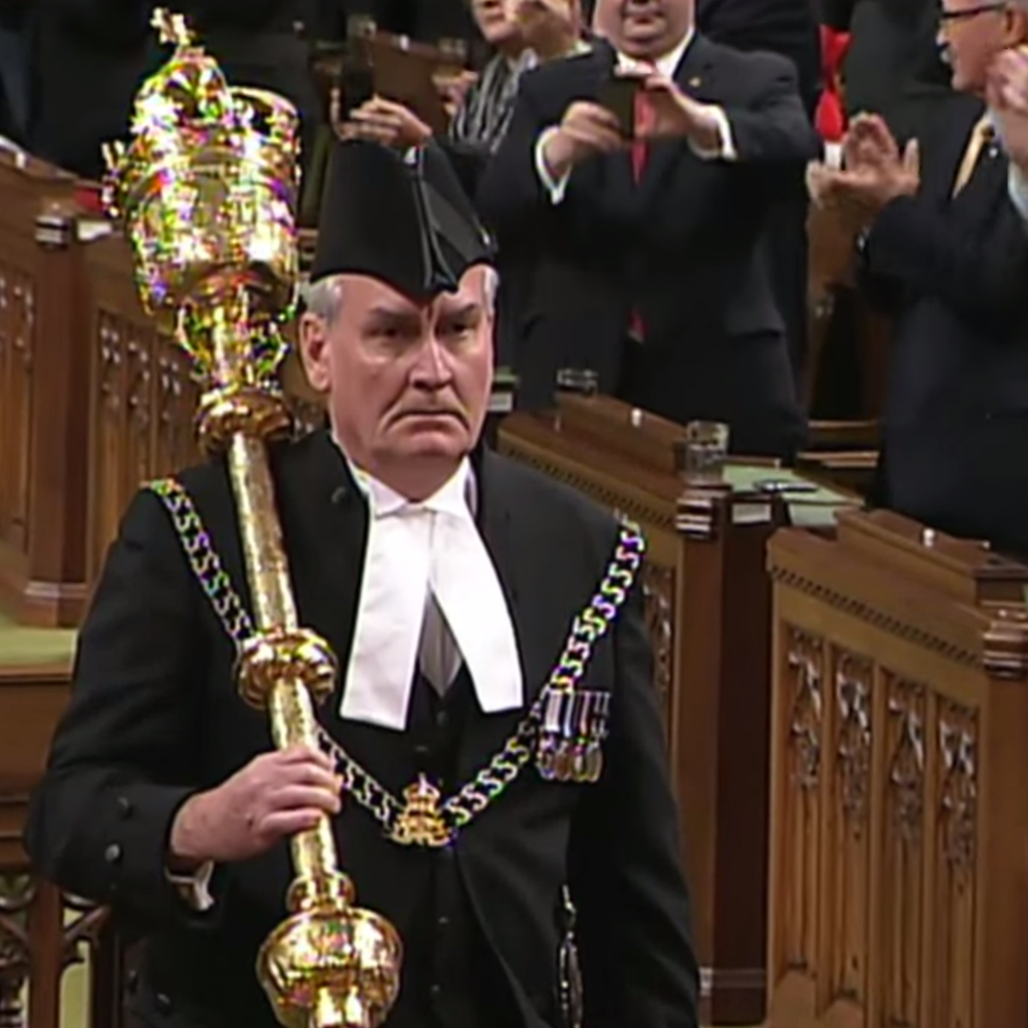
The Mace:
Power of the Crown
The Mace is the official symbol of the Crown’s power.
Originally, it was a weapon used by the King’s Sergeant at Arms to protect his life. It weighs 11 lbs.
This is a replica of the last mace which destroyed in a fire in 1916.
Parliament cannot conduct official business without the ceremonial mace present.
Notes:
The head of the Senate Mace is divided into four panels, the first of which shows the French fleur-de-lis, the second showing the Irish harp, the third showing an English rose and Scottish thistle, and the fourth showing the Great Seal of Lower Canada. In the centre of the Crown is the coat of arms of the United Kingdom.
After the Mace Bearer carries it into the Red Chamber, he or she places it on a red cushion on the Clerk’s Table with the crown facing the Speaker.
The mace must be present on the table for the Senate to conduct its business, and stays in its place until the end of each sitting.
During meetings of the Committee of the Whole, the mace is placed under the table.
During ceremonies of state when the Governor General is present in the Senate Chamber, the mace is held upright by the Mace Bearer near the thrones.
When the monarch is in the Senate Chamber, the mace is covered with a cloth, since it is unnecessary to symbolize the monarch when he or she is present.
When the mace is not in use for Senate proceedings, it is stored in a cabinet in the Speaker's office.
Pictured is Kevin Vickers who protected MPPs during the Parliament Hill Shootings of October 22, 2014. Vickers used his handgun not the mace.

Slide 8
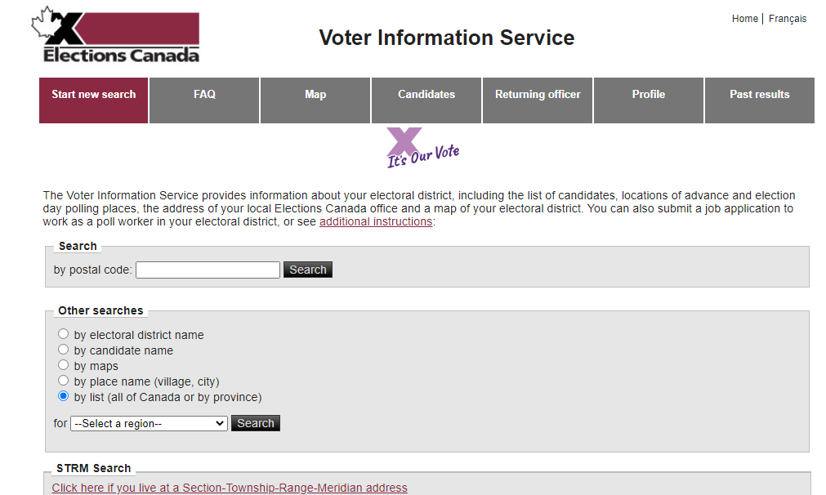
KNOW YOUR LOCAL MP
Each riding in Canada has an MPP, and they are accountable to the citizens
How can you find out who your MPP is?

Slide 9
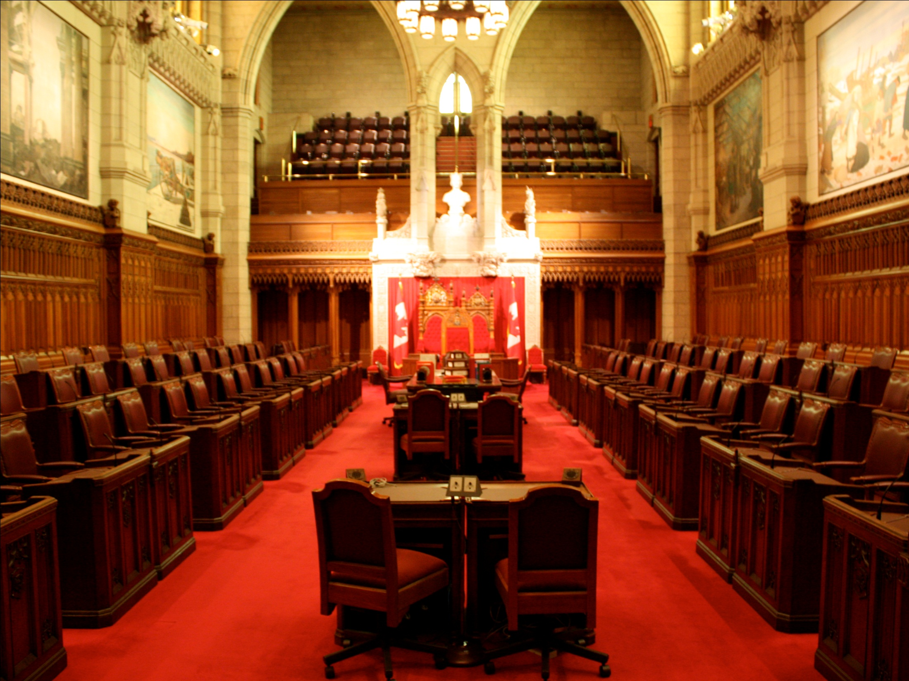
The Senate: The Upper House of Parliament
The Red Chamber

Slide 10
The Senate: The Upper House of Parliament
There are 105 Senators
Senators are Appointed by Prime Minister and serve until age of 75.
Rich and powerful?

Slide 11
Making a Law…
In Canada, both houses of Parliament are needed to pass bills and enact laws.
They also require the cooperation of the Crown.
House of Commons
The Senate
Royal Assent

Slide 12
Making a Law…
The making of laws starts in the Lower House, the House of Commons.
House of Commons
The Senate
Royal Assent

Slide 13
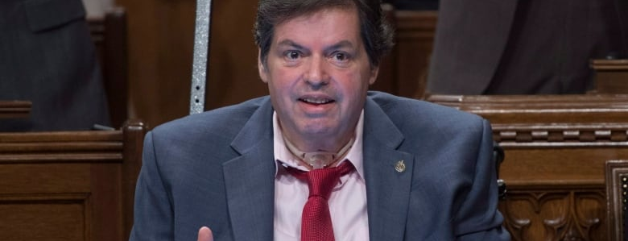

Step 1: Create Bill
A Bill is a proposed law, or a “baby law.”
Usually created by the governing party
Notes:
Ottawa-Vanier MP Mauril Belanger used a text-to-speech program on his tablet to kick off second reading debate on his private member's bill to make O Canada use gender neutral language. This is Bill C-210

Slide 14
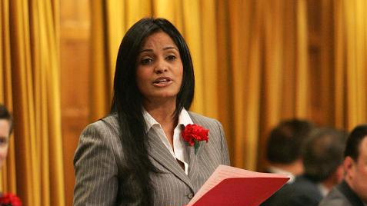
Step 2: First Reading
The Bill is read and printed
No debate yet
MPs Vote
PURPOSE: Formal Public Notice

Slide 15
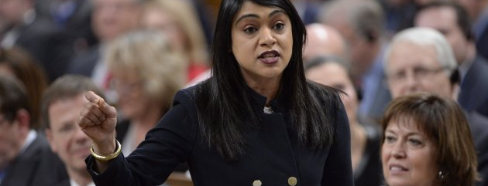
Step 3: Second Reading
MPs debate Bill
Discuss overall ideas
MPs Vote again
PURPOSE: General Strengths vs. Weakness

Slide 16
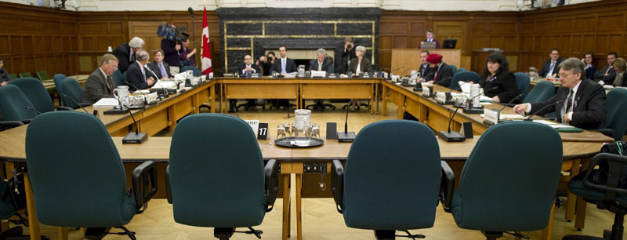
Step 4: Committees
Study / change wording and details
Interview expert witnesses
Vote… again.
PURPOSE: Fix details

Slide 17
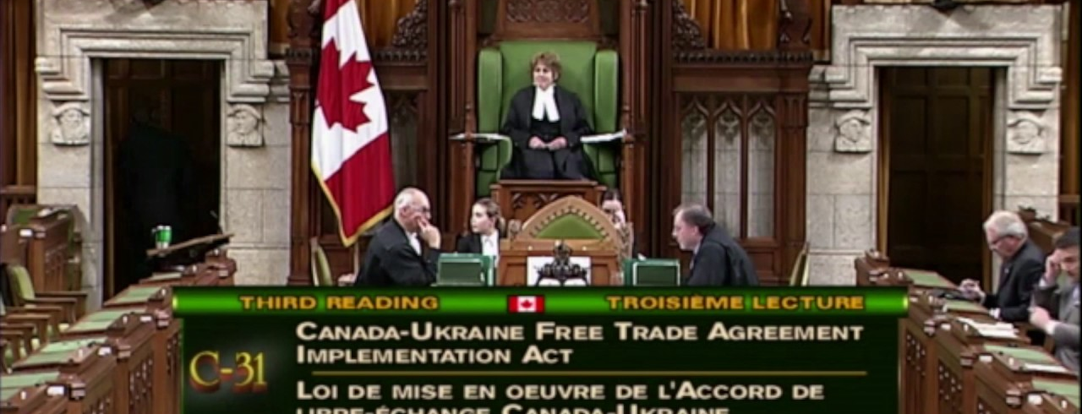
Step 5: Third Reading
Bill read with all changes
Debate final details
Vote one last time.
Bill passes or sent back to Committee
PURPOSE: Discuss final form of bill and send to the Senate

Slide 18
Making a Law…
The making of laws then continues in the Upper House, the Senate
Introduction
First Reading
Second Reading
Committee
Third Reading
The Senate
Royal Assent

Slide 19
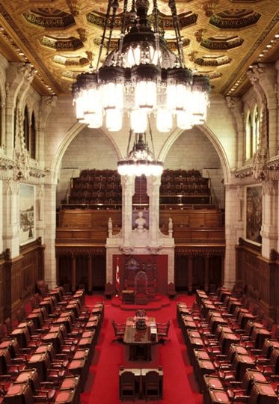
In the senate…
The exact same process happens again
Can send back to Commons if the law is not agreed upon by Senators
If the Senators approve of the law, it can be sent to the Governor General.

Slide 20
Making a Law…
The making of laws then continues with the Crown as assent is required.
Introduction
First Reading
Second Reading
Committee
Third Reading
The Senate
Royal Assent

Slide 21
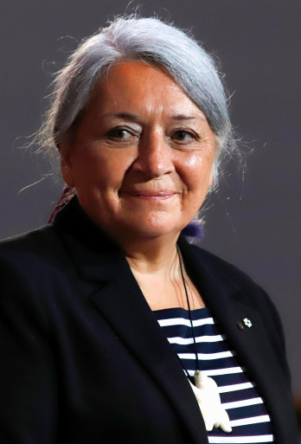
Are we done yet?
Or more steps?
Governor General gives Royal Assent (Permission)
Bill now becomes a law
Mary Simon is the current Governor General Designate. On July 6, 2021, Prime Minister Justin Trudeau announced that she would be the next Governor General of Canada.
She is the first Indigenous Canadian to be named as the representative of the Monarch.

Slide 22
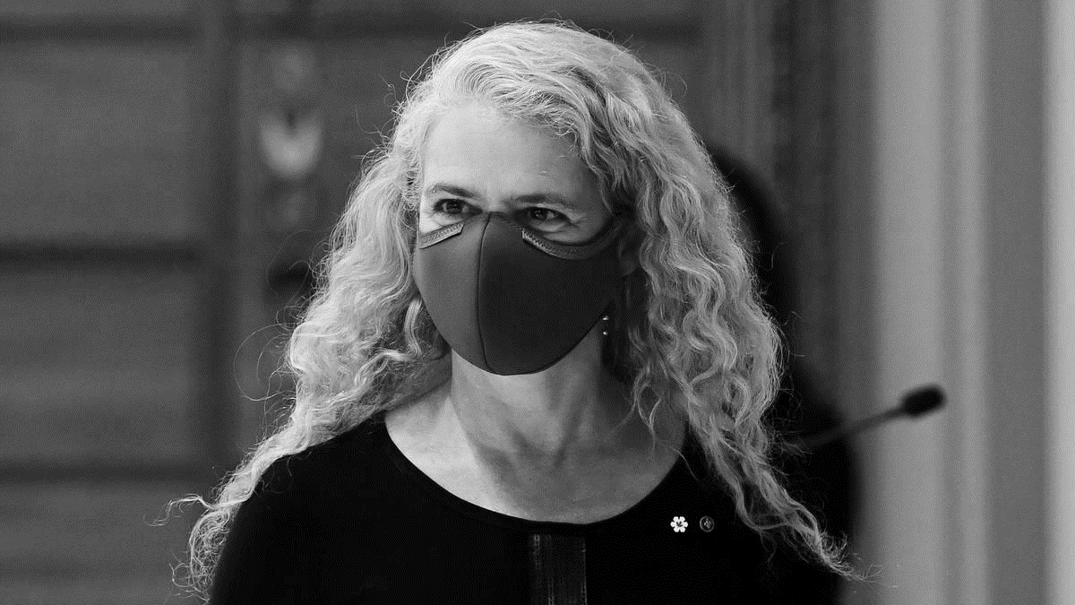
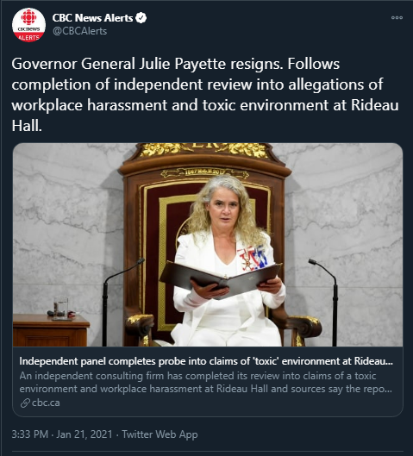
Simon’s announcement followed the troubled tenure of Julie Payette, a former astronaut.
Payette was forced to resign in disgrace after allegations of misconduct on January 21, 2021.
Payette also courted controversy while addressing flat earther and anti-vaccination theorists.
Many claimed that the Governor General must remain neutral and were concerned that it reflected poorly upon the Crown.

Slide 23

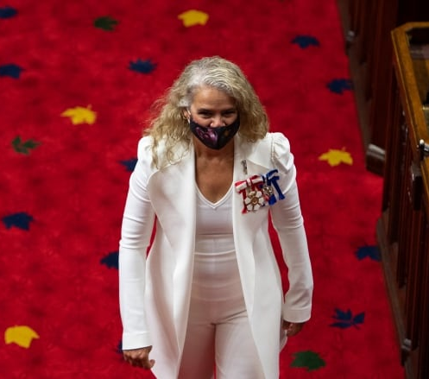
The Role of the Governor General Moving Forward…
The scandal involving Payette has caused much discussion about the role of the Governor General in the 21st Century.
While still mainly a figurehead, the G.G. is still supposed to be someone to inspire Canadians through Civic Action and leading by example.
Her Excellency, The Right Honourable Mary Simon will be expected to restore dignity to Rideau Hall (The home of The G.G.) in the coming years.

