Slide 1


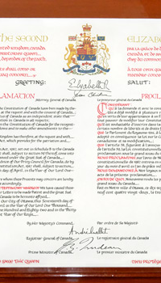
The
Nothwithstanding Clause
Copyright ©2021 Kosowan’s Korner. All rights reserved.

Slide 2
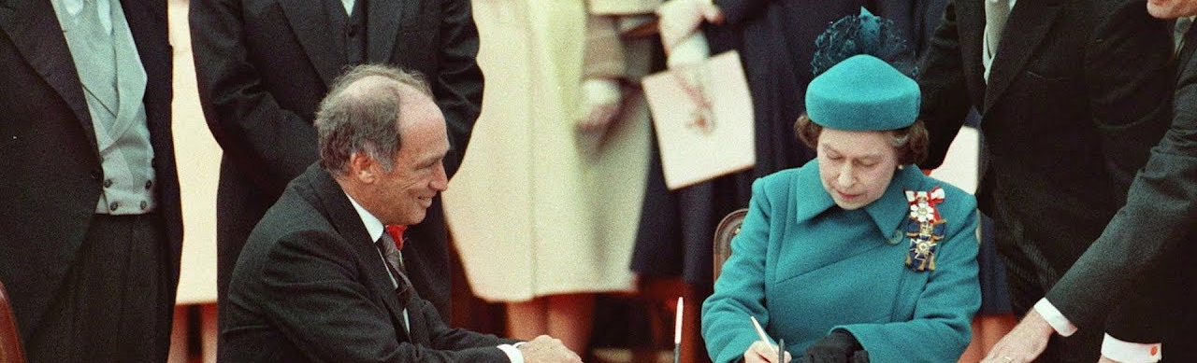
Signing the Constitution Act
Back in 1982, the signing of the Constitution Act and the Charter of Rights and Freedoms came after years of negotiations and discussions between the Federal Government and the Provinces.
Not all the provinces were excited about some of the new powers the Federal government, led by Pierre Trudeau would enjoy.
Copyright ©2021 Kosowan’s Korner. All rights reserved.

Slide 3
Signing the Constitution Act
There were several Premiers who did not care for the idea that provincial laws could be struck down by the judiciary for violating the new Charter of human rights and freedoms being proposed.
Including the Clause was a compromise that ensured the Provinces would agree to the terms of the Constitution Act.
Copyright ©2021 Kosowan’s Korner. All rights reserved.

Slide 4

What does this clause do?
Sometimes laws passed by a government are challenged in court as being unconstitutional.
The Notwithstanding Clause allows a Federal or Provincial/Territorial government to declare that one of its laws can temporarily override the protections of the Charter of Rights.
The Rights being overridden must be a “Fundamental Right” for the Clause to applied.
The clause will only apply for a maximum of five years but can be extended any number of times.
Based on our Election system, why do you think that limit is five years?
Copyright ©2021 Kosowan’s Korner. All rights reserved.

Slide 5


How has it been used?
Only two provinces have used the Clause.
Saskatchewan used it in 1986 to force striking provincial employees back to work, restricting their Freedom of Association rights.
Quebec used it twice. Firstly, enacting its strict language laws in terms of signage and then again to prevent public employees from wearing religious symbols. This restricted citizens Freedom of Expression and Equality Rights.
Copyright ©2021 Kosowan’s Korner. All rights reserved.

Slide 6

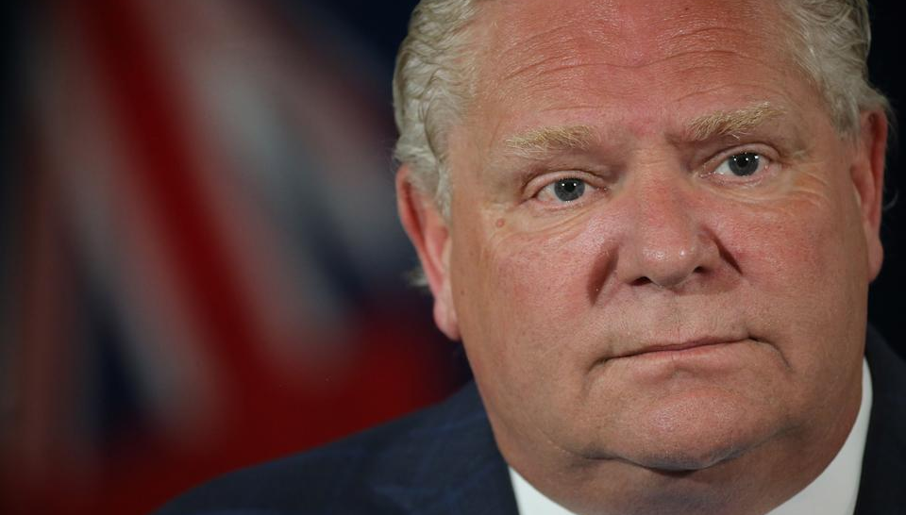
Ford Government’s Plans to Utilize the Clause
The Ontario Government, led by Doug Ford and the Progressive Conservative Party planned to use the Clause in 2018 to push through its electoral system legislation that was being fought in the courts.
In the end, the courts ruled in their favour and they didn’t need to use it.
Copyright ©2021 Kosowan’s Korner. All rights reserved.

Slide 7
Ford Government’s Plans to Utilize the Clause
In 2021, the Judiciary declared that the government’s changes to the Finances Act were unconstitutional, and infringed on the rights of Canadians’ Freedom of Expression.
Reports came out on June 9, 2021 that the Ontario Government would invoke the Clause, which would nullify the Court’s ruling.
Copyright ©2021 Kosowan’s Korner. All rights reserved.

Slide 8

Ontario Election Finances Act
The Act declared that 3rd party spending on advertisements would be severely limited.
Groups such as the Canadian Civil Liberties Association (CCLA) and unions challenged the Government’s legislation and brough the issue to the Courts.
This would stop groups from making large donations to political parties and from advertising during elections.
Copyright ©2021 Kosowan’s Korner. All rights reserved.

Slide 9
Ontario Election Finances Act
Groups that are affected include UNIFOR, Education Unions, Ontario Proud the Ontario Medical Association and the Ontario Real Estate Association.
Many are accusing the Government of trying to silence voices that would be critical of the Progressive Conservatives, accusing them of using the “nuclear option” and ignoring judicial findings.
The government says this is to restrict foreign and “special interest” influence from interfering in Ontario’s Elections and point to interference in other places.
Copyright ©2021 Kosowan’s Korner. All rights reserved.

Slide 10

Concerns About the Use: Nuclear Option
People are upset because using the Clause means that a Government can ignore the findings of the Judicial Branch.
The question boils down to whether a Government should be able to enact any legislation it feels serves its purposes or if the Courts’ authority over the Constitutionality of law takes priority.
Copyright ©2021 Kosowan’s Korner. All rights reserved.

Slide 11
Concerns About the Use: Nuclear Option
In Ontario, the Notwithstanding Clause has never been used by a Provincial Government, although the Ford government came close in 2018.
Moodle Post
Do you think that the Government should be able to ignore the power of Provincial Courts to pass their legislation?
Copyright ©2021 Kosowan’s Korner. All rights reserved.

