Slide 1
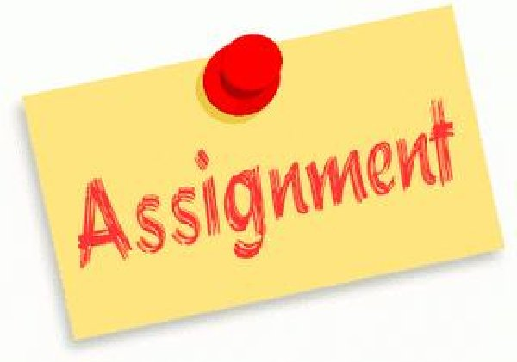
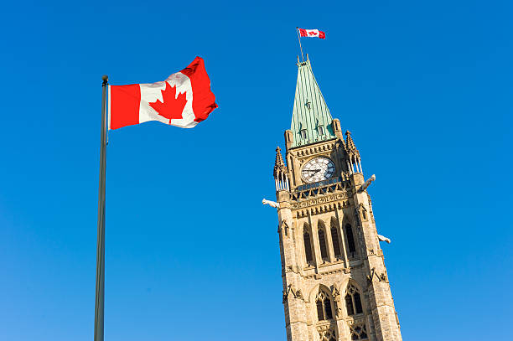

CHV20: Assignment #2
Notwithstanding Clause Paragraph Reflection
Importance of the Notwithstanding Clause
Rights and Responsibilities of Provincial Government
Rights and Freedoms of the Canadian Citizens
Own Opinions and Beliefs

Slide 2
Directions
Review the Resources on the Notwithstanding Clause**See Slide 5.
Prepare ONE FULL PARAGRAPH REFLECTION (8-10 full sentences) explaining the importance of the Notwithstanding Clause in the Canadian Government and how it affects the everyday rights and responsibilities of Canadian Citizens.
Use the Guiding Questions on Slide 4 to help you write your Paragraph.
Use your own words and ideas. DO NOT plagiarize.
Put all sources into APA/MLA Format.
Show your work BEFORE posting for your OF Learning Progress Mark.

Slide 3
Guiding Questions
**Use these questions to shape your Paragraph Reflection. You may change these or adjust them to suit your thinking and opinions.
What is the definition of the Notwithstanding Clause?
Do you believe it fairly protects the rights and freedoms of the Canadian Citizens? Explain with 1-2 real examples
Do you believe it limits and reduces the rights and freedoms of Canadian Citizens? Explain with 1-2 real examples.
Do you believe that the Notwithstanding Clause should still be included in the Charter of Rights and Freedoms? Explain your thinking.

Slide 4
Resources
https://www.thecanadianencyclopedia.ca/en/article/notwithstanding-clause
https://toronto.ctvnews.ca/what-is-the-notwithstanding-clause-an-explainer-on-the-rarely-used-provision-1.6132704
https://www.ola.org/en/legislative-business/bills/parliament-43/session-1/bill-37
https://www.constitutionalstudies.ca/2019/07/notwithstanding-clause-2/
https://c2cjournal.ca/2022/11/doug-fords-use-of-the-notwithstanding-clause-keeping-ontarios-schools-open/

Slide 5
Expectations
A1.1 formulate different types of questions to guide investigations into issues, events, and/or developments of civic importance (e.g., factual questions:
A1.2 select and organize relevant evidence, data, and information on issues, events, and/or developments of civic importance from a variety of primary and secondary sources
A1.3 assess the credibility of sources relevant to their investigations
A1.4 interpret and analyse evidence, data, and information relevant to their investigations using various tools, strategies, and approaches appropriate for political inquiry
A1.5 use the concepts of political thinking (i.e., political significance, objectives and results, stability and change, political perspective) when analysing and evaluating evidence, data, and information and formulating conclusions and/or judgments about issues, events, and/or developments of civic importance
A1.6 evaluate and synthesize their findings to formulate conclusions and/or make informed judgements or predictions about the issues, events, and/or developments they are investigating
A1.7 communicate their ideas, arguments, and conclusions using various formats and styles, as appropriate for the intended audiences and purpose
A1.8 use accepted forms of documentation
A1.9 use appropriate terminology when communicating the results of their investigations

Slide 6
Expectations
B1.2 describe fundamental beliefs and values associated with democratic citizenship in Canada (e.g., rule of law; freedom of expression; freedom of religion; equity; respect for human dignity, the rights of others, and the common good; social responsibility), and explain ways in which they are reflected in citizen actions
B1.3 explain why it is important for people to engage in civic action, and identify various reasons why individuals and groups engage in such action
B1.4 communicate their own position on some issues of civic importance at the local, national, and/or global level
B3.1 demonstrate an understanding that Canada’s constitution includes different elements, and analyse key rights of citizenship in the constitution, with particular reference to the Canadian Charter of Rights and Freedoms
B3.4 analyse rights and responsibilities of citizenship within a global context, including those related to international conventions, laws, and/or institutions

