Slide 1
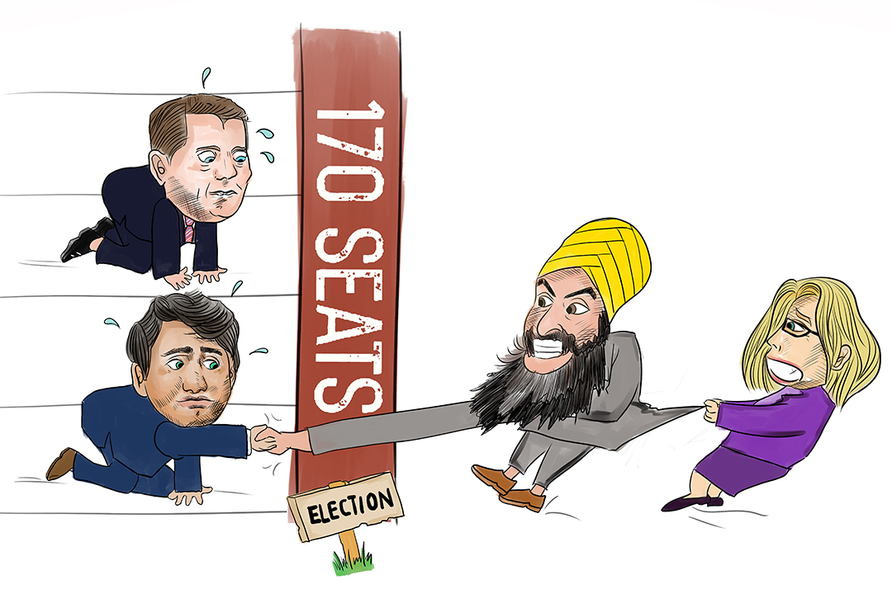
What is a Minority Government?
Copyright ©2020 Kosowan’s Korner. All rights reserved.
Notes:
Copyright @ 2020 Kosowan’s Korner. Some rights reserved.

Slide 2
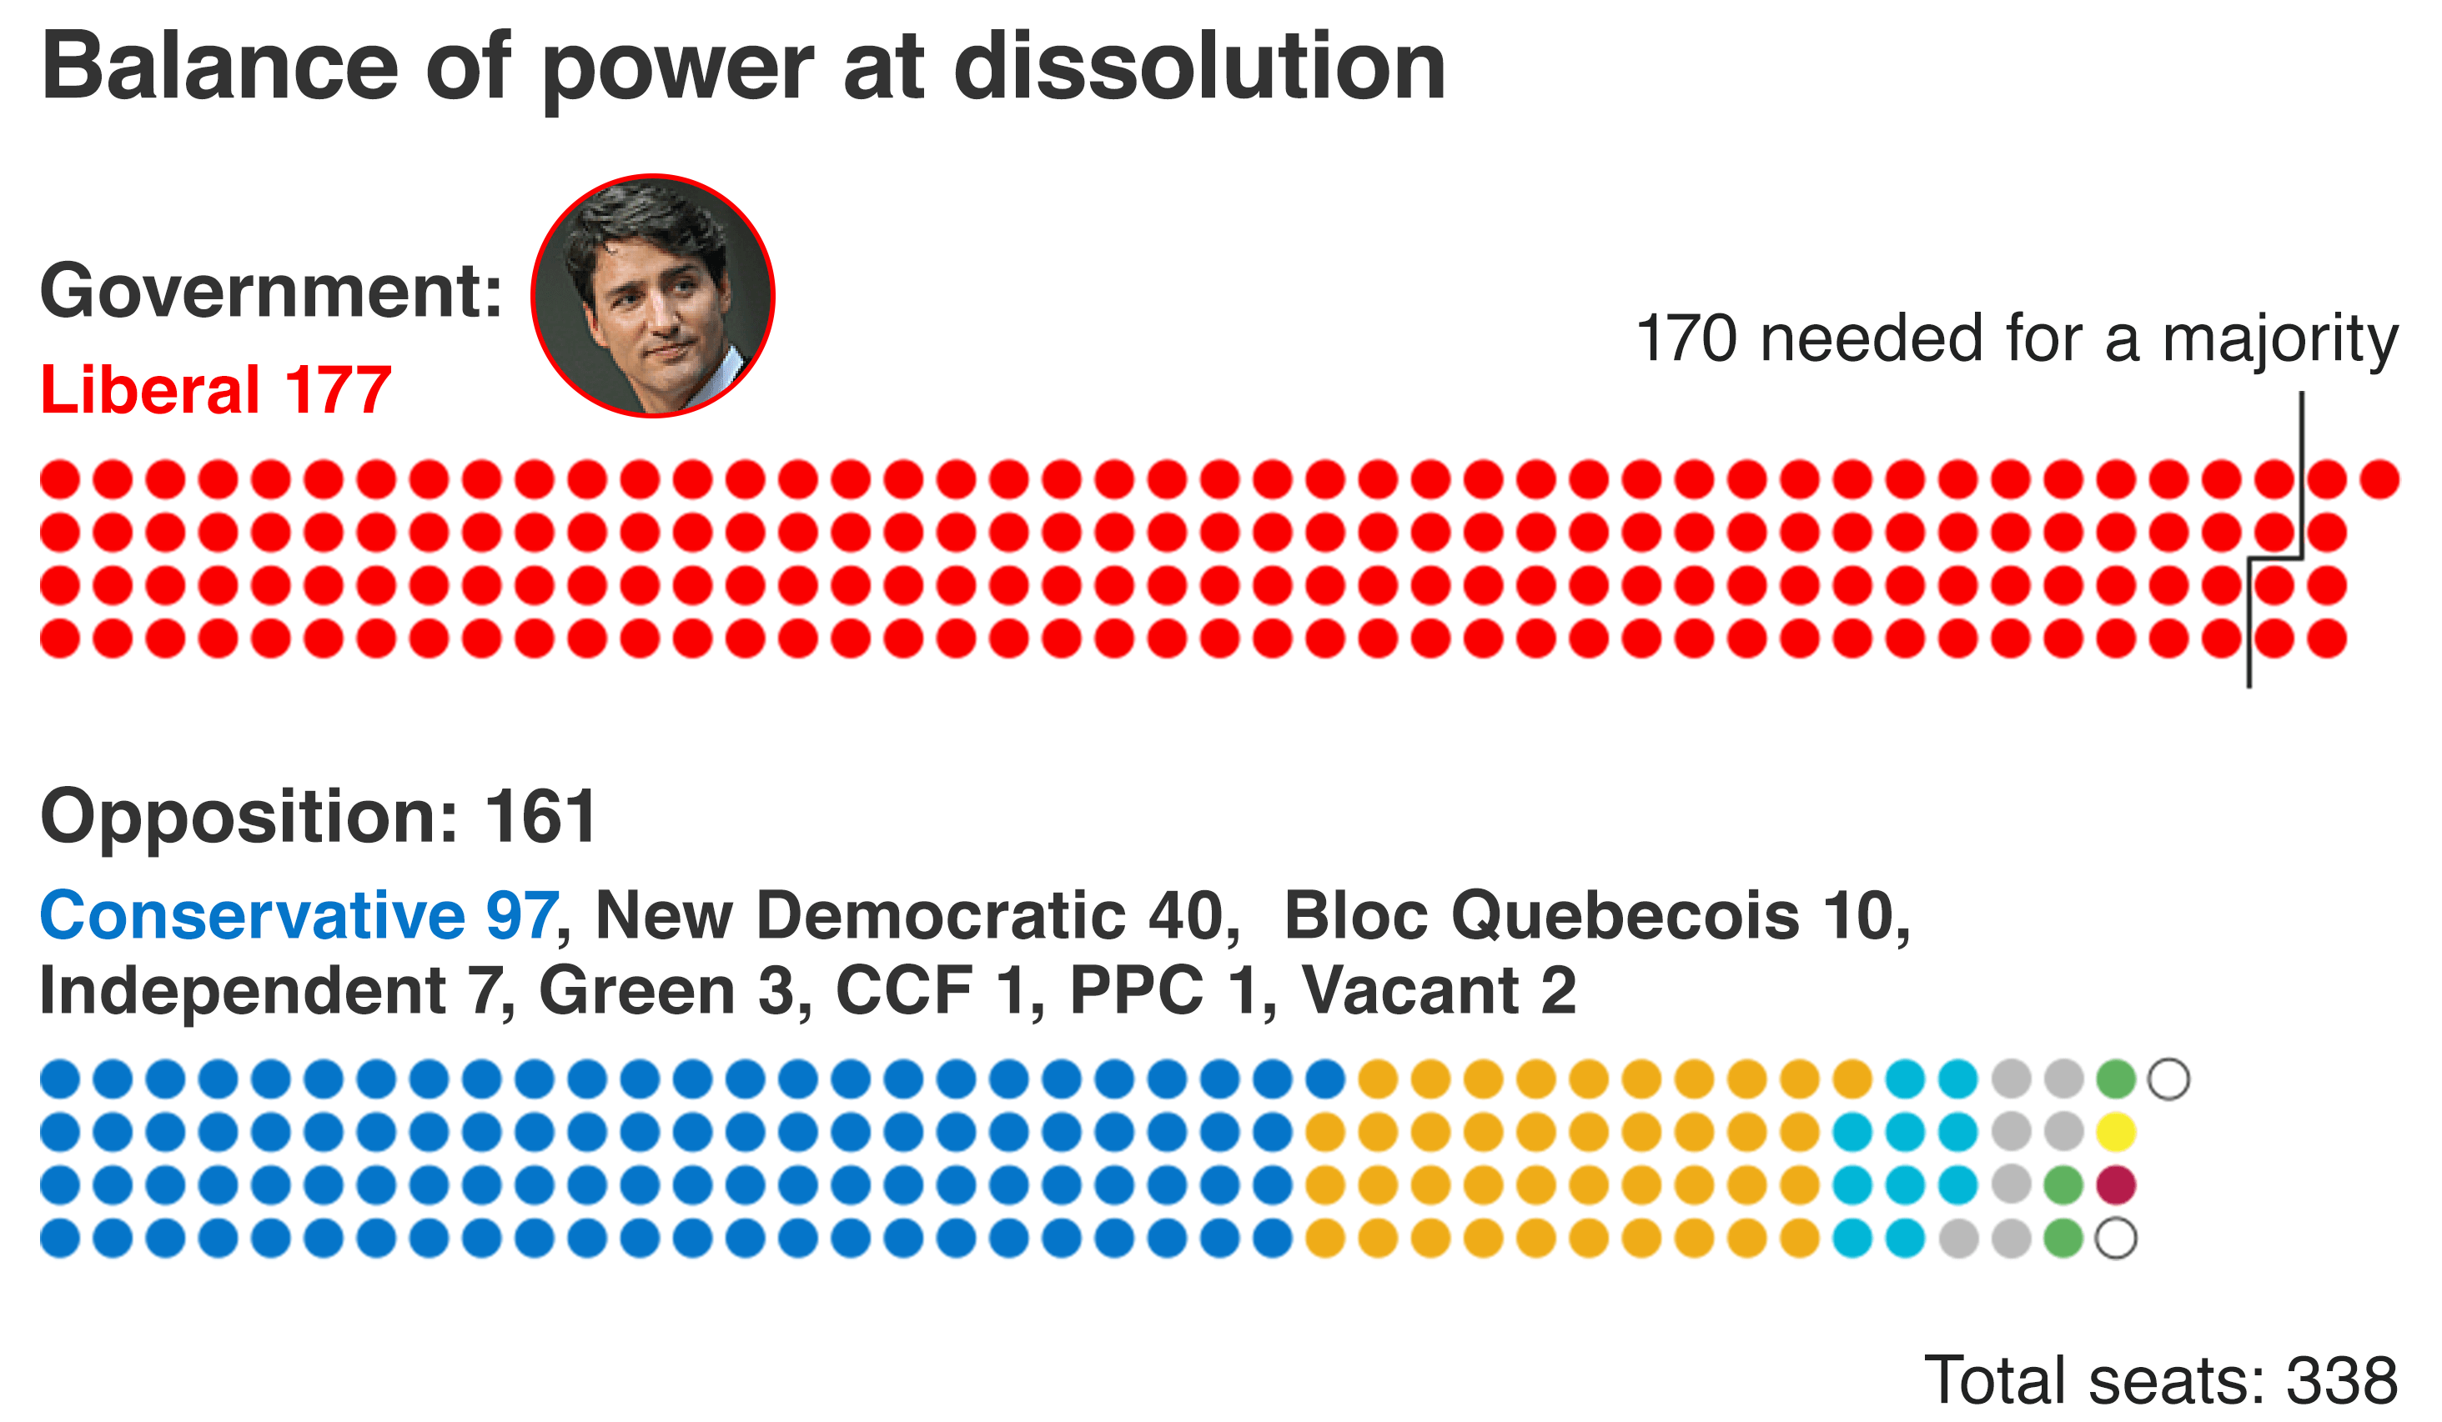
In Canada, most elections end in a Majority Government.
This is when one Political Party wins more than 50% of all the available seats in Parliament (called a plurality).
A majority government can easily pass legislation, as it can win any vote in the House of Commons.
Majority Government in Canada
Notes:
The image included here shows the balance of power at the start of the 2019 Canadian Federal Election.

Slide 3

Sometimes, an election will end and no party has more than 50% of the ridings.
In this case, the party with the most ridings will have to earn the confidence of one or more smaller parties to govern.
Sometimes Minority Governments are called instable or ineffective, but they require parties to work together and collaborate.
Coalition governments are common in Europe.
Minority Government in Canada
Notes:
The image included is of the riding map for the 42nd General Election in Canada.

Slide 4
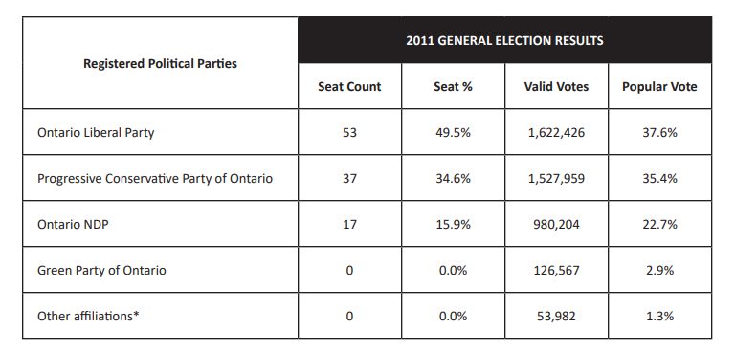
Forming the Coalition Government
In the 2011 Ontario Provincial Election,
no party won 50% of the ridings.
Based on what you know about the political parties, how do you think they formed a government to make things work?
Which combination of parties would make up a majority with 107 available seats?

Slide 5
Forming the Coalition Government
In the 2011 Ontario Provincial Election,
no party won 50% of the ridings.
Based on what you know about the political parties, how do you think they formed a government to make things work?
The Liberal Party of Ontario was supported by the Ontario New Democratic Party, which pushed the Liberals to make more progressive policies.

Slide 6

Who Forms the Government Then?
Canadian tradition dictates that the party with the most seats forms the Government, but it’s not required under the Constitution.
In a close race, a party, even if they win fewer seats, could seek support from other parties to show they have the confidence of the majority of the members of the House of Commons.
In the end, the ruling party is decided based upon how many seats in Parliament can be either controlled or allied with.

Slide 7
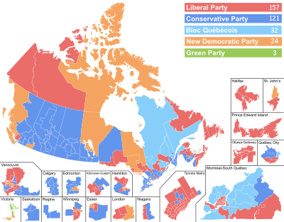
2019 Federal Election
The 2019 election led to a Minority Government situation where the Liberal parties won the majority but not a plurality

Slide 8
How to make it work…
For the Government to continue, it would need to earn the confidence of at least one other party for all major bills.
If the Liberal Party was able to obtain the support of the NDP party, they would have enough votes to pass bills into law.
The Liberal Party’s 157 added to the 24 of the NDP party = 181.
This situation means that the Liberal Party is likely to propose legislation that the NDP would see as beneficial.

Slide 9
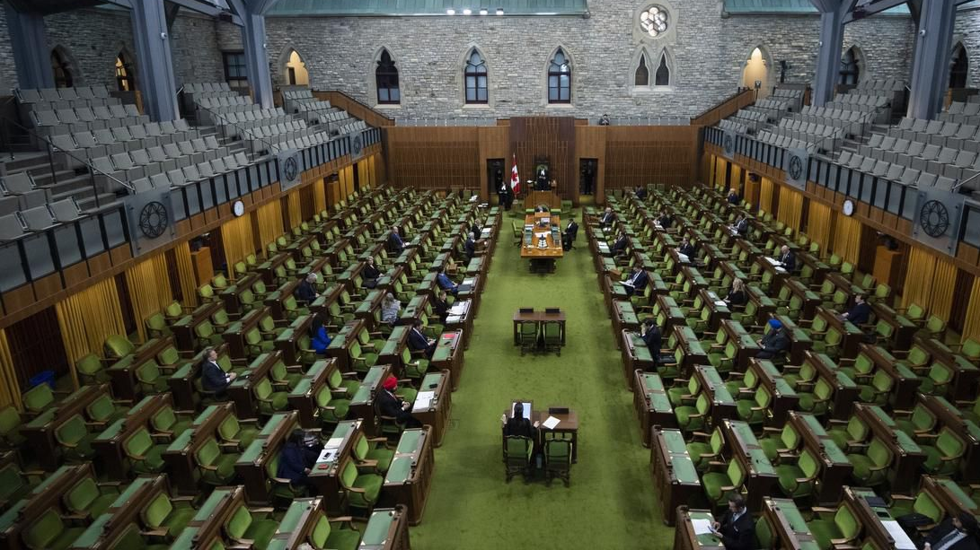
How has it worked so far?
The Liberal government needed to work with parties such as the NDP and Bloc Québécois to maintain power.
Several months later, COVID-19 led to a momentous shift in how public gatherings worked.

Slide 10
How has it worked so far?
Despite vigorous debate over parliamentary procedure, in 2020 some members of all parties sit in the House of Commons to adhere to Social Distancing Protocols with others attending via Video Conferencing.
The NDP supported the Liberals plan to hold these modified Parliamentary sessions.

Slide 11
How has it worked so far?
In the September 2020 Throne Speech, the NDP was able to push the Liberals for guaranteed sick leave for Canadians, which is a left-wing policy.
This compromise by the ruling Liberals satisfies the NDP and also ensures they don’t lose the Confidence of the House.

Slide 12

2021 Federal Election
In the Summer of 2021, the Liberal Party decided to call an election, hoping to earn a Majority.

Slide 13
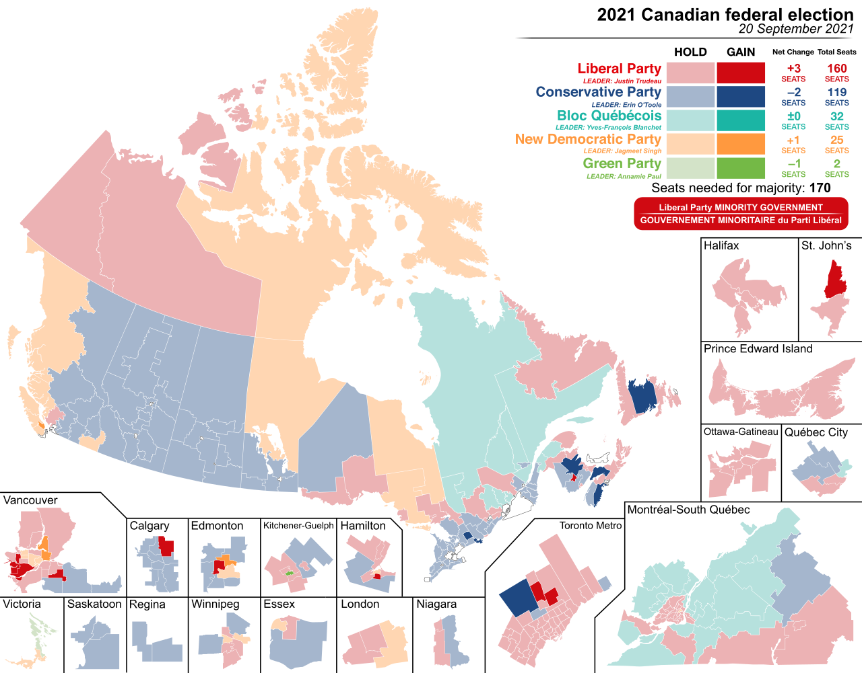
2021 Federal Election
In the end, the results were almost the same, leading to a consecutive Minority Government.

Slide 14
$600 million later, what now?
The 2021 election cost over six hundred million dollars, but the results were nearly identical to the 2019 election.
To avoid another early election, The Liberals will need to work with the other parties to pass legislation and keep government working.

Slide 15

Balance of Power is Delicate
Unless the Liberals are able to increase the number of sitting party members in Parliament, it is unlikely to have a Majority unless it cooperates with the other parties, mainly the NDP.
If the Liberals were to frustrate the NDP, it could lead to a non-confidence vote and therefore… an election.

Slide 16
The Two Sides of Minority and Coalition Governments
Pros
Cons
Collaboration
Different Viewpoints offered
Reduces polarization
Respects the will of the people
If sides don’t cooperate, no bills can be passed
Can result in a shortened government, resulting in another expensive election
If nothing works, can lead to voter fatigue/frustration

Slide 17


Slide 18
Bibliography
“A Canadian Election Looms – seven charts explain all.” BBC. October 18, 2019. https://www.bbc.com/news/world-us-canada- 50003913.
Deng, Iris. “Political Cartoon.” The Varsity. Last modified October 19, 2019. https://thevarsity.ca/2019/10/19/the-varsity-endorses-a- liberal-minority-government-with-an-ndp-green-balance-of-power/.
Elections Ontario. “Handout 6.1: 2011 & 2014 General Election Results.” CiviX. April, 2018. http://civix.ca/resources/wp- content/uploads/2018/04/ON-Secondary-Handout-6.1.pdf.
MacKinnon, Bruce. “Editorial Cartoon.” The ChronicleHerald. September 26, 2018. https://www.thechronicleherald.ca/opinion/local- perspectives/editorial-new-brunswick-election-puzzle-leaves-liberals-on-life-support-244602/
“Minority and Majority Governments.” YouTube Video. 3:03. “TVO.” August 11, 2009. https://www.youtube.com/watch?v=9G_ro- EhW4c.

