Slide 1
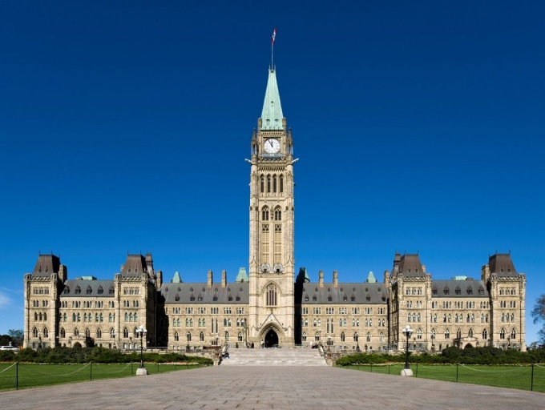


CHV20: Assignment #3
Canadian Government Role and Responsibility Presentation
Using the Political Research and Inquiry Method
Choose a Canadian Government Official
Assess their Performance on the Rights/Responsibilities
Own Opinions and Personal Connections

Slide 2
Directions
Working in groups of 1-3, you will research ONE real Canadian Government Politician (Past or Present) who positively or negatively impacted the rights, freedoms and/or responsibilities of Canadian Citizens. **See Slide 4 for some topic suggestions.
Prepare an Oral and Visual Presentation on 1 Canadian Government Politician (small or large), affecting the rights, freedoms and/or responsibilities of Canadian Citizens. Use the Guiding Questions on Slide 5 to assist you in your Planning.
Choose a format for your Presentation (ex. Google Slides, Prezi, Canva etc.).Be creative! Add pictures, colour, designs to your Presentation!
Remember by add your own beliefs, opinions and values and experience from your own society.
Document your sources at the end of your Presentation using APA/MLA Format

Slide 3
Requirements
Written Section: Key Titles to show each Section; Answers to Guiding Questions in key Points; add pictures, photos, designs etc.
Oral Presentation: Speak confidently and naturally (2-5 minutes); Be ready to answer Discussion Questions
Include your own opinions, feelings, beliefs, experiences and connections to your Politician
Documentation of Sources: Put your sources in APA/MLA Format
Consult the Assignment Directions and Upcoming Success Criteria.
Show your work BEFORE posting for your OF Learning Progress Mark.

Slide 4
Topic Selections
**You may choose any Canadian Government Politician from the Federal, Provincial or Municipal Level.
Possible Topics:
Prime Minister
Leader of the Opposition
Premier
Governor General
Lieutenant Governor
Mayor
Cabinet Minister (pick one)
Member of Parliament (pick one)
Political Party Leader

Slide 5
Guiding Questions
**You may change these or adjust them to suit your presentation and interests. You need a total of 4 Questions. Each question can be on a separate slide
Who is your Government Politician? What role and responsibility do they have? Do they belong to a particular Political Party? Explain.
Did they positively or negatively affect the rights, freedoms and equality of Canadian Citizens? How do their political views impact the rights and freedoms of Canadian Citizens? Explain your thinking with specific examples.
What are your opinions and personal connections to this politician? Do you think this politician is doing a good job of protecting the rights and freedoms of Canadian Citizens? Explain.
Can you connect to his/her work based on your own experiences and thinking? Explain with specific examples.

Slide 6
Expectations
A1.1 formulate different types of questions to guide investigations into issues, events, and/or developments of civic importance (e.g., factual questions:
A1.2 select and organize relevant evidence, data, and information on issues, events, and/or developments of civic importance from a variety of primary and secondary sources
A1.3 assess the credibility of sources relevant to their investigations
A1.4 interpret and analyse evidence, data, and information relevant to their investigations using various tools, strategies, and approaches appropriate for political inquiry
A1.5 use the concepts of political thinking (i.e., political significance, objectives and results, stability and change, political perspective) when analysing and evaluating evidence, data, and information and formulating conclusions and/or judgments about issues, events, and/or developments of civic importance
A1.6 evaluate and synthesize their findings to formulate conclusions and/or make informed judgements or predictions about the issues, events, and/or developments they are investigating
A1.7 communicate their ideas, arguments, and conclusions using various formats and styles, as appropriate for the intended audiences and purpose
A1.8 use accepted forms of documentation
A1.9 use appropriate terminology when communicating the results of their investigations

Slide 7
Expectations
B1.4 communicate their own position on some issues of civic importance at the local, national, and/or global level
B2.1 identify the political parties in Canada and their position on the political spectrum, and explain how the beliefs/values that underpin them may affect their perspectives on and/or approaches to issues of civic importance
B2.2 explain, with reference to issues of civic importance, the roles and responsibilities of different levels of government in Canada
B2.3 describe, with reference to both the federal and provincial governments, the functions of the three branches of government in Canada (i.e., executive, legislative, judicial) and the roles/responsibilities of key positions within governments (e.g., the governor general, a lieutenant governor, the prime minister, a premier, cabinet ministers, a leader of the opposition, a speaker, the chief justice of the Supreme Court of Canada), and explain how the branches help ensure political and social stability in Canada

