Slide 1

Canada’s Parliamentary and
Electoral Systems
Copyright ©2020 Kosowan’s Korner. All rights reserved.

Slide 2


Long Before Canada became a modern nation, there were governmental systems
Indigenous systems of government
The Six Nations Confederacy
The Indian Act of 1876 forever altered Indigenous self-governance

Slide 3
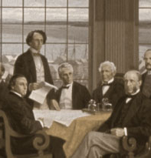
Confederation
Prior to Confederation, two major decisions were made that would shape Canada’s government:
Canada would be a federal union with two levels of government:
    Federal
    Provincial
Canada would have a central Parliament with three parts:
    Monarch
    Senate
    House of Commons
Notes:
Government
The political party with the most members elected to the House of Commons usually forms the Government.
In the federal government, the Prime Minister and the Cabinet decide on policies and priorities, make sure they are put into action, and also guide the Government’s legislation through the House of Commons and the Senate.
Parliament
Canada’s Parliament is composed of the Monarch, the Senate and the House of Commons. Parliament has the power to make laws for Canada in certain areas of responsibility. A Parliament is also the period of time between an election and a dissolution
The Monarch is our Head of State, Queen Elizabeth II, represented in Canada by the Governor General
The Senate is the Upper House of Parliament
The House of Commons is where elected Members of Parliament meet and debate
Source: Library of Parliament, “Our Country, Our Parliament” www.parl.gc.ca/About/Parliament/Education/OurCountryOurParliament/section1-e.aspx

Slide 4
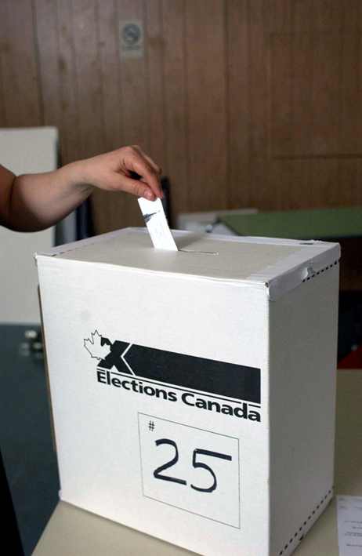
Elections in Canada
Right to vote: every Canadian citizen who is at least 18 years old on election day
First-past-the-post electoral system
Next fixed election date: October 16, 2023
Election campaigns: minimum 36 days
Canada has had 43 general elections since Confederation
Notes:
Obviously, the Next Fixed Election date will change with every new Government Session. There is also a very real chance that an election will be called before 2023.

Slide 5

First-Past-the-Post System
Also known as “single member plurality”
Candidate with the most votes in a riding is elected.
The winning party is the one that elects the most candidates. Its leader becomes Prime Minister.
The party with the 2nd highest number of candidates elected forms Official Opposition in Parliament.

Slide 6
First-Past-the-Post System
This means that a party can win the election by simply winning more seats instead of winning the popular vote.
Proportional representation is a democratic principle that argues people should be represented in proportion to how they voted.
This means the percentage of seats a party has in the legislature should reflect the percentage of people who voted for that party.
Notes:
Organizations like fairvote.ca have great material where you can discuss the idea of PR vs FPTP.

Slide 7
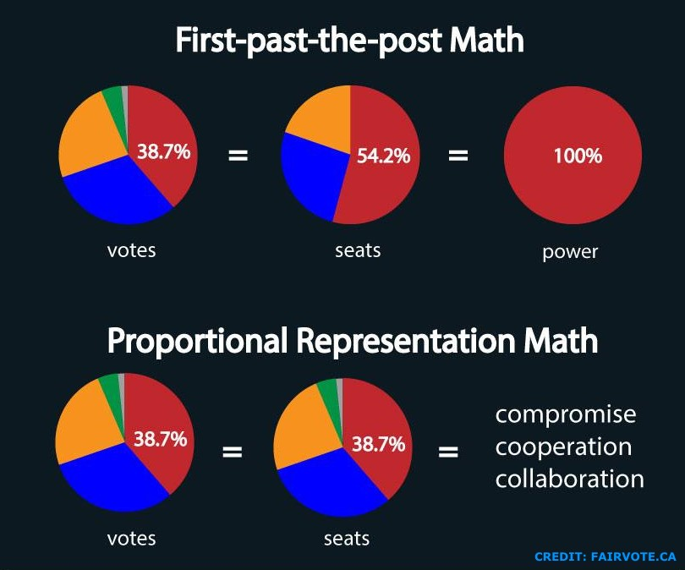
Based on this graphic, which system seems most fair?
Notes:
Credit to Fairvote.ca

Slide 8
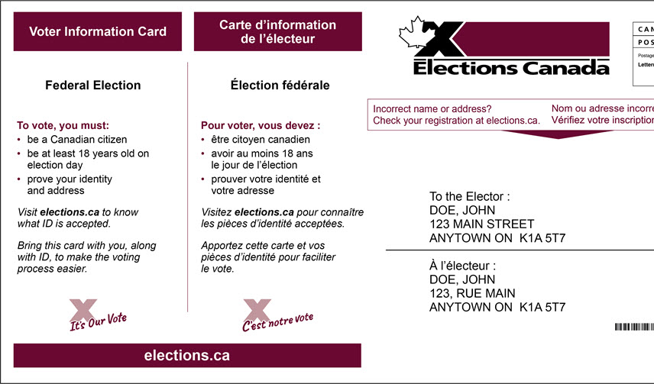
Voting in Canada: Three Easy Steps
Step 1: Register
National Register of Electors: permanent list.
Updated continuously by Elections Canada
Elections Canada sends out forms before each election
TIP: Voting is easier if you’re registered!
Notes:
There are basically three steps involved in voting federally in Canada.
Step 1 – Register
To vote in federal elections, your name must appear on the voters list for the polling division where you live.
Voter registration in Canada is a lot easier than most people think. That’s because Canada has the National Register of Electors.
Elections Canada continuously maintains and updates the Register. To do so, we get information from different government sources. We also mail out registration packages to thousands of potential new electors, and during elections, we go door-to-door in areas like new housing divisions and student residences.
When you turn 18, you will most likely be already registered, but if not, Elections Canada will send you a form like the one on screen.
If you get one, please fill it out – it only takes about five minutes, and you can return it to us for free.
Remember – you will be able to register or update your information at any time by contacting us – you won’t have to wait until an election is called.

Slide 9
Voting in Canada: Three Easy Steps
Step 2: Find out when & where to vote
Voter information card: sent to every
registered elector
The VIC tells people where/when to vote:
  Addresses
  Dates)
  Phone numbers for more info
Even without a card, citizens can vote with valid ID.
Notes:
There are basically three steps involved in voting federally in Canada.
Step 1 – Register
To vote in federal elections, your name must appear on the voters list for the polling division where you live.
Voter registration in Canada is a lot easier than most people think. That’s because Canada has the National Register of Electors.
Elections Canada continuously maintains and updates the Register. To do so, we get information from different government sources. We also mail out registration packages to thousands of potential new electors, and during elections, we go door-to-door in areas like new housing divisions and student residences.
When you turn 18, you will most likely be already registered, but if not, Elections Canada will send you a form like the one on screen.
If you get one, please fill it out – it only takes about five minutes, and you can return it to us for free.
Remember – you will be able to register or update your information at any time by contacting us – you won’t have to wait until an election is called.

Slide 10
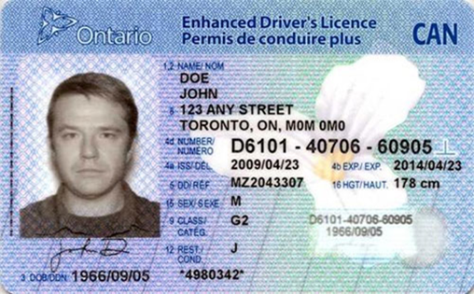
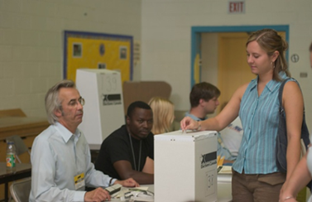
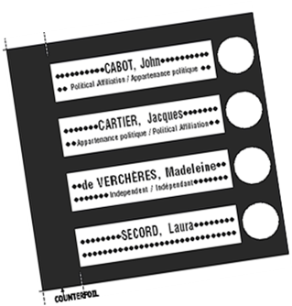
Voting in Canada: Three Easy Steps
Step 3: Go and vote!
On election day, voters go to their assigned poll
The can also vote earlier:
  At advance polls, at any local Elections Canada office or by mail
All voters need to bring proof of identity and their address.
Notes:
There are basically three steps involved in voting federally in Canada.
Step 1 – Register
To vote in federal elections, your name must appear on the voters list for the polling division where you live.
Voter registration in Canada is a lot easier than most people think. That’s because Canada has the National Register of Electors.
Elections Canada continuously maintains and updates the Register. To do so, we get information from different government sources. We also mail out registration packages to thousands of potential new electors, and during elections, we go door-to-door in areas like new housing divisions and student residences.
When you turn 18, you will most likely be already registered, but if not, Elections Canada will send you a form like the one on screen.
If you get one, please fill it out – it only takes about five minutes, and you can return it to us for free.
Remember – you will be able to register or update your information at any time by contacting us – you won’t have to wait until an election is called.

Slide 11
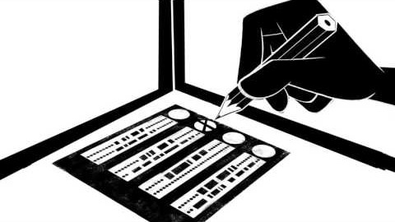
How does the voting process work?
Notes:
Information provided by Elections Canada.

Slide 12
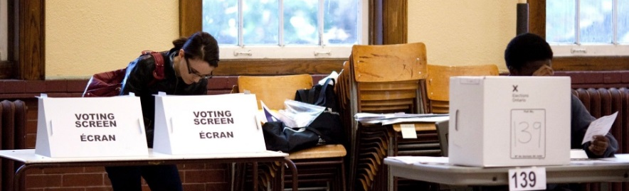
How do voters mark their ballot?
A ballot lists the names of the candidates running in the riding and their party association.
Voting is done by secret ballot. No one except the voter knows the choice that was made.
The voter must clearly mark the ballot with a single preference for it to be valid (e.g., checkmark, X, shading in) .

Slide 13
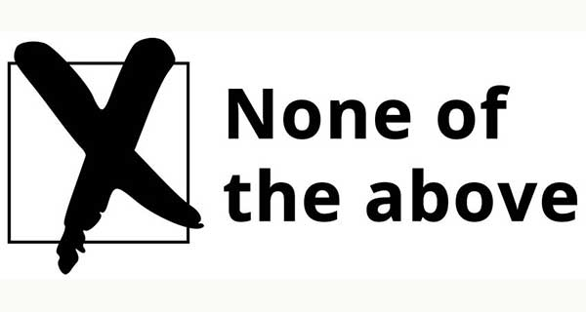
Rejected and Spoiled Ballots
A rejected ballot is a ballot that cannot be counted because it was not properly marked.
A spoiled ballot is one that was kept separate and never placed in the ballot box because it was mistakenly marked or torn and exchanged for a new ballot.
A declined ballot is one that is left blank. It generally is done so out of protest at provincial level. This is not permitted in federal elections.
Notes:
31,000 Ontarians declined their ballot in the 2011 Provincial election.

Slide 14

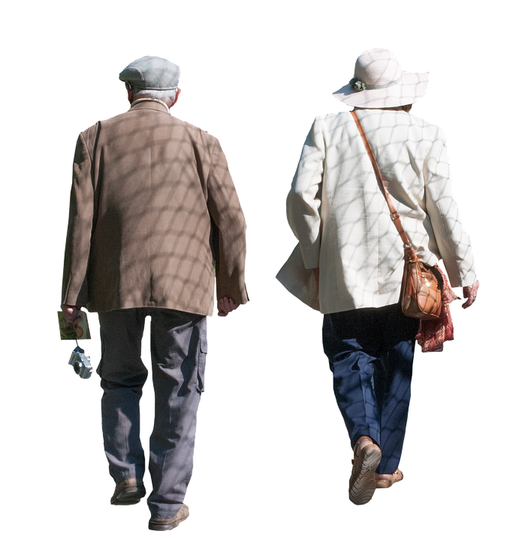
What is advance voting?
Electors who are away, busy or unable to vote on election day have the option of advance voting.
Advance voting is held prior to election day. There are 4 days of advance voting.
Electors can also vote in person at
an Elections Canada Returning Office
or by mail up until the Tuesday
before election day.
Notes:
Historically, senior citizens were the largest demographic of advanced voters.

Slide 15

Why Does Voting Matter?
1. Voting is fundamental to democracy: it’s how citizens choose who governs them.
2. Voting is the only form of participation in which every citizen is equal.
3. It doesn’t take very many votes to make a big difference.
4. Parties pay attention to those who vote.
5. Low/declining turnout is not distributed equally across the population.
Notes:
So – why do you think voting matters?
There are a lot of reasons voting matters. Here are four to think about:
First – Voting is the most fundamental act in a democracy – it’s how we as citizens choose who governs us, and it’s how we hold them to account.
Voting is the only form of participation in which each citizen has an EQUAL say. It doesn’t matter who you are or how much money you have – every vote is equal.
Some people say that one vote can’t make a difference. But I think that’s the wrong way to look at it. Here are some pretty crazy facts from the 2011 federal election:
There were 27 ridings in which the winner was decided by less than 1,000 votes.
There were six ridings where the winner won by less than 100 votes.
There was one riding where the margin of victory was just nine votes!
So it doesn’t take very many votes to make a big difference to the outcome of an election.
4. Parties pay attention to who votes and who doesn’t. And they focus on those who participate.

