Slide 1
Lesson 2.1 Mental Health
4 May 2023

Slide 2
Class announcement
All the marks about Unit 1 has been updated on school website

Slide 3
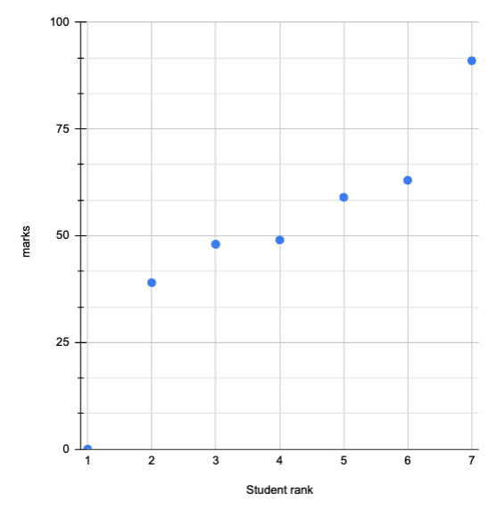
Unit 1 marks

Slide 4

Unit 2: Mental Health (21 hours)
Tentative schedule:
  Lesson 2.1 – Stress (16 May 2023)
  Lesson 2.2 – Happiness (17 May 2023)
  Lesson 2.3 – Relationship (18 May 2023)
  Lesson 2.4 – Purpose (19 May 2023)
  Lesson 2.5 – Mental Illness (23 May 2023)
  Lesson 2.6 - Doctor in the House Episode 2 (24 May 2023)
  Lesson 2.7 – Assignment 2 Presentation (25 May 2023)
  Lesson 2.8 – Midterm test review
  Lesson 2.9 – Midterm test

Slide 5

Today’s lesson plan:
Talk about Assignment 2
Learn about 7 ways to improve stress resistance

Slide 6
Assignment 2
Introduction
  Unit 2 is all about mental health, covering topics such as happiness, relationships, and purpose.
  For this assignment, create a presentation to talk about your mental health plan. You will follow this plan (along with your physical health plan) for at least two weeks.
  In your final summative project (worth 30% of your grade), you will report your results.

Slide 7
Assignment 2
Part 1: Happiness
  In the happiness lesson, we learned about different ways to find happiness rather than just pleasure. Talk about which strategies you will use to add more happiness to your life. Give an example from your own life of how you used it or can use it.
Part 2: Relationships
  In the relationships lesson, we learned how important having quality relationships is for our health. Pick someone you want to improve your relationship with and use class learnings to explain how you will do so. Make sure to mention their primary love language.
Part 3: Purpose
  In the purpose lesson, we learned about how to find a meaningful purpose in life that gives us a long- lasting sense of fulfillment. Talk about what you think your purpose is and how you can connect to that purpose in your daily life right now.

Slide 8
Assignment 2
Presentation Format
  You can make a PPT or a poster. Canva is a great resource: https://www.canva.com/. Another great resource is slidesgo: https://slidesgo.com/.
  You can have 1 to 2 slides for each part.
  The time should be 3 to 4 minutes.
  After your presentation, you may need to answer questions from your classmates or the teacher.

Slide 9
Assignment 2
Overall Expectations:
1. Describe factors that affect personal health and well-being;
Learning Goals:
1. Develop a personal health plan that promotes healthier lifestyle choices and habits;
2. Identify factors that affect the personal health and well-being of children and adolescents;
3. Identify and describe mental health disorders that may affect adolescents;
4. Explain how lifestyle choices can have an impact on an individual’s health and well-being.

Slide 10

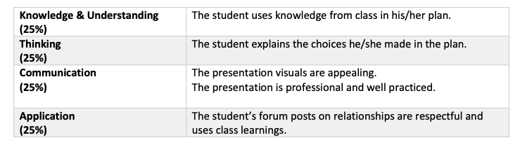
Assignment 2
Grading/ Success Criteria:

Slide 11
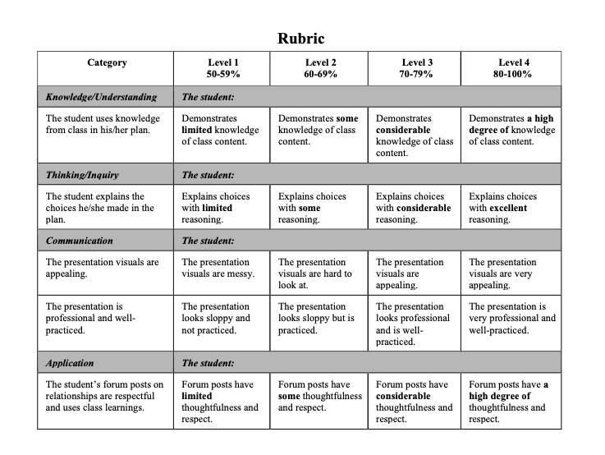
Assignment 2

Slide 12
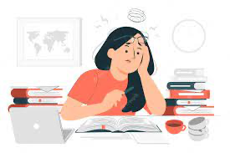
Stress

Slide 13

Classwork 2.1 (part 1)
Can you recall a recent story about yourself being very stressful?
Describe the reason you were stressed; how did you relieve the stress and how did the story end.

Slide 14

How serious does stress is in our society?
The World Health Organization calls stress the health epidemic of the twenty-first century. Most people can probably relate. Stress resistance isn't a nice-to-have, it's a must have.

Slide 15

“As a GP (General Practitioner), about 80% of what I see on any given day is in some way related to stress.” –Dr. Rangan Chaterjee

Slide 16
Quote from 2019 Harvard Business Review
"Workplace stress is estimated to cost the U.S. economy more than $500 billion dollars, and, each year, 550 million work days are lost due to stress on the job. Another study by the APA claims that burned-out employees are 2.6 times as likely to be actively seeking a different job, 63% more likely to take a sick day, and 23% more likely to visit the emergency room."

Slide 17

The big question is: How can we manage our stress better and be more stress- resistant?

Slide 18

Source of stress
Stress comes from three sources: physical, mental, and spiritual. Physical stress occurs when we treat our bodies poorly. Mental stress comes from the way we think. Spiritual stress comes from a lack of connection and purpose.

Slide 19

7 Habits to address stress
The 7 habits mentioned above address stress from all three sources.
  Habits 1 to 3 manages stress physically.
  Habits 4 and 5 approaches stress mentally.
  Habits 6 and 7 overcomes stress spiritually.
The more of these habits you can implement in your own life, the better your stress management will be.

Slide 20

Habit 1: Eat Healthily
The common diet nowadays is no longer healthy.
  In the past, people ate mostly homecooked whole foods, but thanks to the industrial revolution, people now eat lots of processed foods that are made in factories.
  Examples include
    frozen meals
    boxed foods like cereals and pizzas
    wrapped foods like bread, pastries, candy
    reconstituted meats lie sausages, nuggets, and fish fingers
    sodas and other sweetened drinks
    canned foods
    fast food

Slide 21

Habit 1: Eat Healthily
These super processed foods have added sugar and salt, artificial ingredients, refined carbohydrates, and trans fats.
  As a result, they taste great, but they increase inflammation in the body, and inflammation is basically stress for the body.
  Eating processed food feels good temporarily but makes your body feel bad and low-energy afterwards.
The solution? Eat more natural foods in their whole forms.
  Vegetables and fruits in their whole form (not processed) reduce inflammation and heal the body from stress!
  For example, eat raw or steamed vegetables instead of canned vegetable soup. Eat real fruit instead of candy bars and chocolate. Cook your own dinner from raw ingredients instead of microwaving a packaged dinner.

Slide 22
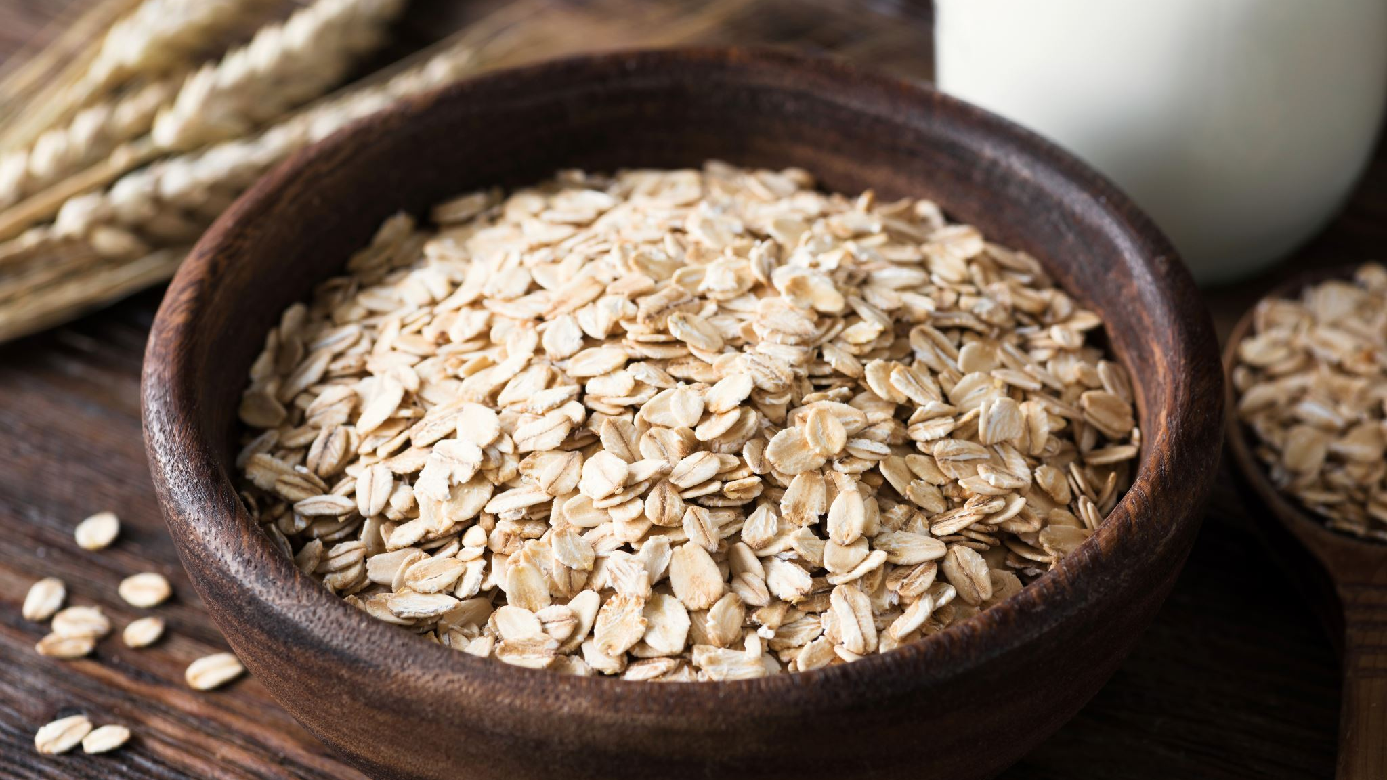
Habit 1: Eat Healthily
The Elimination Diet
  Dr. Daniel Amen is perhaps America's best known brain doctor, and he gives an even more extreme example of the impact of food on our stress and mental health in this interview.
  Basically, one of his patients was having suicidal thoughts, and therapy was not working.
  Hence, Dr. Amen told this person to try the elimination diet for three weeks. The elimination diet is when we remove all possible troublemaker foods for 2-3 weeks, then slowly re-introduce the foods one at a time for 2-3 days at a time.
  Troublemaker foods include gluten (bread), dairy, processed sugar (like candy, but not fruit), corn, soy, eggs, artificial coloring, and preservatives. These things are all extremely common in highly processed foods.

Slide 23
Habit 1: Eat Healthily
The Elimination Diet
  Three weeks later, the patient came back and told Dr. Amen he was feeling dramatically better. Then they added the food items back one at a time.
  Nothing happened with gluten. Nothing happened with dairy. But when the patient ate something with corn, he had suicidal thoughts within 20 minutes.
  So Dr. Amen told him to stop eating corn, and the patient's depression has not come back since.
  While your situation may not be as extreme as that patient, the example highlights how much food affects our mental health. The troublemaker foods mention in the elimination diet are so common in modern society now that most of us don't know what we would feel like if we didn't eat them. If you feel stressed all the time or struggle with mental health, it's highly worth the effort to experiment with the elimination diet.

Slide 24

Habit 2: Exercise Consistently
We all know exercise is good for us. But many of us think we need to work out for 30 minutes a day or 3 hours a week to get any benefits.
While it would be great if you could do that, the reality is that most people feel like don’t have that much time or motivation. Here’s the great news: Even 5-7 minutes of exercise a day can have tremendous benefits!

Slide 25

Habit 2: Exercise Consistently
In his book, Feel Better in 5, Dr. Rangan Chaterjee gives many 5-minute workout routines involving simple exercises like push-ups, lunges, squats, and yoga.
https://www.youtube.com/watch?v=jtZB95-AVZM&t=4s&ab_channel=DrRanganChatterjee

Slide 26

Habit 3: Sleep Well
Getting enough quality sleep is key to restoring our body’s energy and emotional wellbeing. Dr. Chaterjee explains that sleep is like the garbage man taking out the accumulated garbage in our brain and body.
When we lack sleep, our emotional part of the brain (amygdala) goes into overdrive and the logical part of the brain (prefrontal cortex) diminishes. That's why we become more emotionally reactive and unable to concentrate if we lack sleep.

Slide 27
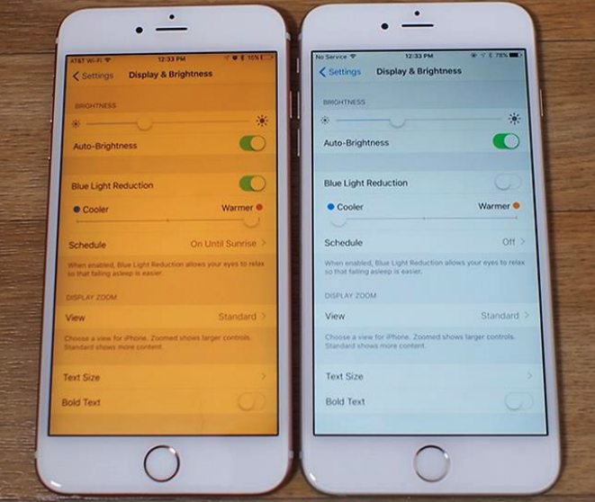
Habit 3: Sleep Well
Tip 1: Avoid blue light and use night shift mode.
  Blue light keeps us awake and reduces the quality of our sleep. We also get stimulated from the activities we do on our devices, so we should stop using our devices 60 minutes before sleep. If you really have to use your device, then at least install a blue light blocker app like f.lux.

Slide 28

Habit 3: Sleep Well
Tip 2: Sleep at the right time
  According to both western scientific research and Ayurvedic medicine, 10PM to 2AM is the most important time to sleep. That's because humans get the most amount of restful recovery sleep.
  One hour of sleep between 10PM - 2AM is worth twice as much as sleep outside those hours.
  Traditional Chinese Medicine (TCM) views 11PM to 3AM as the most important sleep time. If 10PM is too early for you to get to bed, at least try to follow TCM's advice!

Slide 29

Habit 3: Sleep Well
Tip 3: Avoid caffeine in the evenings
  Caffeine is a stimulant drug that energizes us and makes it hard to sleep.
  Moreover, if we sleep with caffeine in our blood, the quality of our sleep is reduced.
  Caffeine is in coffee, tea, chocolate, sodas, and energy drinks.
  The American Academy of Sleep Medicine recommends that people stop consuming caffeine at least 6 hours before bed. The earlier, the better. One study found that even consuming caffeine 6 hours before bedtime still reduced total sleep time by 1 hour.

Slide 30

Habit 3: Sleep Well
Tip 4: Sleep in a completely dark room
  Humans have evolved to sleep better in a dark environment. Even if you can't get your room completely dark, make it as dark as possible. Get some good window curtains or wear an eye mask.
Tip 5: Use your bed only for sleep
  Many people watch TV in bed or play on their phones in bed. As a result, when they get into bed, they don’t feel like sleeping. Their body thinks it’s time to watch TV or play on the time.
  Furthermore, even if you do fall asleep, these electronic devices emit radiation that disrupt sleep quality. So if you use your phone as an alarm clock, make sure to put in on airplane mode before sleeping!

Slide 31

Habit 3: Sleep Well
Tip 6: Calm your mind
  Many people can't fall asleep because they are thinking about too many things. When this happens, it's important to do some relaxation activities rather than just lying there and keep thinking.
  Some good relaxation activities to do before bed include meditation, yoga, taking a shower, and journaling.
Tip 7: Keep cool When we sleep, our body temperatures naturally drop.
  Studies show that the optimal temperature for sleep is around 20 degrees Celsius (68 Fahrenheit). Above 24°C (75°F) or below 12°C (54°F) will make it harder to sleep.

Slide 32

Habit 4: Reframe Stress Stories
When stressful events happen, we justify our stress by pointing to that external event as the reason.
For example, maybe you have an important exam, presentation, or interview coming up, and your partner says, “Geez, you’re so worked up recently!” You might respond by saying, “Of course I’m stressed! I have an important test coming up!”

Slide 33

Habit 4: Reframe Stress Stories
But think about this: How come there are people with even more stressful things happening in their lives that aren’t acting all stressed and worked up like you are?
The secret is that the external events don't cause you to be stressed, but rather the way you view that external event makes you stressed.
When we focus on the things outside of our control, and when we always want things to go our way, then we get stressed.
When we can be proactive by focusing on the things within our control and accept the things outside our control, then we can reframe stress into power.

Slide 34

Habit 4: Reframe Stress Stories
“You will come across obstacles in life — fair and unfair. And you will discover, time and time again, that what matters most is not what these obstacles are but how we see them, how we react to them, and whether we keep our composure.” – Ryan Holiday, The Obstacles is the Way

Slide 35

Habit 4: Reframe Stress Stories
Dr. Chatterjee gives 5 steps to reframe a stressful situation and keep our composure:
  1. Write down the thing you are stressed about.
  2. What is one practical thing you can do to prevent or prepare for it?
  3. What is one reason why it's probably not going to be as bad as you fear?
  4. What's one reason you know you can handle it?
  5. Name one good thing about the situation.

Slide 36

Habit 4: Reframe Stress Stories
Step 1 helps us to get clarity on what exactly is stressing us out. If we aren't even sure what's making us stressed, that uncertainty makes us more stressed! When you write, be as specific as you can. For example, don't just write "School is stressing me out." Write, "The fact that I have two projects due in two days, and I haven't rested enough, is stressing me out."
Step 2 is about being proactive and focusing on what is in your control. Rather than stressing out about the problem, re-direct your energy and attention to solutions. Maybe you can ask the teacher for an extension. Maybe you can get rid of unnecessary time commitments to make more time.
Steps 3 and 4 are about affirming yourself. As the common saying goes, "You have to believe to achieve." Maybe you remember that you've overcome stressful events in the past, or think of all the training and lessons you had that prepared you for this event.
Finally, step 5 forces us to think positively about the situation. Think about what you can learn from the situation and what you can be thankful for. No matter the situation, we can always improve our humility, self-control, and gratitude.

Slide 37
Habit 5: They Meditate
Tim Ferriss has interviewed hundreds of the world’s top performers in all areas ranging from business to sports to science to writers. He noticed that 80 to 90% of the world’s top performers all have some sort of meditation practice.
Ferriss explains meditation as training the mind to have control over emotions and to reduce emotional reactivity. He says, “I find that meditation is very helpful for avoiding anxiety and it’s the reset button for the rest of the day… it’s basically a warm bath for your brain.”

Slide 38

Habit 5: They Meditate
Four Common Meditation Methods
  1: Mindfulness meditation is when you focus on being aware of what you’re sensing and feeling in the moment, without judgment.
    It helps center the mind on the present rather than thinking about the past or future.
    For example, a mindfulness meditation you can do before bed is to lie down and really notice the sensations in your body from toe to head, then mindfully let each body part relax.
  2: Mantra meditation, also known as Transcendental Meditation (TM), is when you repeatedly recite a series of sounds called a mantra.
    There's usually a meaning behind the mantra. You can recite silently in your head or out loud with your voice. People often do it for 15-20 minutes twice a day while sitting with their eyes closed.
    For example, a common mantra is "om", which can mean infinite knowledge or “the sound by which the Lord is praised.”
    Another popular mantra in Buddhism is to recite Amitabha (ah-mee-tah-bah), which means infinite life and infinite enlightenment. When you understand the meaning, you're more willing to recite it. Who wouldn't want to have more life and enlightenment?

Slide 39

Habit 5: They Meditate
3: Breathing exercises use conscious breathing to center the mind.
  https://www.youtube.com/watch?v=_QTJOAI0UoU&t=253s&ab_channel=TEDxTalks (starting from 4:13)
  Lucas Rockwood explains that our breath affects of nervous system, and conscious breathing can help us to reset our nervous system from stress back to normal.
  To do that, we simply need to breathe in through the nose for 4 seconds, then out through the nose for 4 seconds. Do that 10 times. If we want to really relax and calm down, we can breathe in for a count of 4 and out for a count of 8. Do it 10 times, and you should feel much more relaxed.

Slide 40
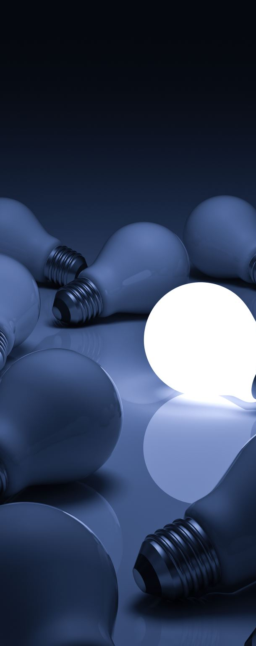
Habit 5: They Meditate
4: Visualization is when you imagine a positive emotion in great detail.
  For example, you can close your eyes and visualize love and gratitude for someone you love as a ball of energy, and then imagine sending that energy to that person.
  Another example is to imagine the future event you’re anticipating and how you will act as your best self in that event. Then when the actual event comes, your mind will feel calm and prepared like it did during the visualization meditation.

Slide 41

Habit 6: They Nurture Relationships
Professor Robert Waldinger is the fourth and current direct of the Harvard Study of Adult Development, which tracked the lives of 724 men over 75 years. It is the longest study done on researching what makes a happy and healthy life, and Waldinger shares the results in his TED Talk.
https://www.ted.com/talks/robert_waldinger_what_makes_a_good_life_lessons_from_the_longest_study_on_happiness/c?language=en
“The clearest message that we get from this 75-year study is this: Good relationships keep us happier and healthier. Period.” –Robert Waldinger

Slide 42

Habit 6: They Nurture Relationships
The study found that people who are more socially connected to family, friends, and community, are happier, physically healthier, and live longer than those who are less well connected. But it’s not about the number of social connections, but rather about the quality.
Waldinger explains that good relationships aren’t necessarily relationships where people never have conflicts. Some healthy couples do bicker with each out a lot. The important thing is that you feel you can really count on the other person to be there for you when things get rough. That’s a good relationship.

Slide 43

Habit 6: They Nurture Relationships
On the other hand, relationship conflicts are extremely stressful and toxic to the body.
“Our most happily partnered men and women reported, in their 80s, that on the days when they had more physical pain, their mood stayed just as happy. But the people who were in unhappy relationships, on the days when they reported more physical pain, it was magnified by more emotional pain.” –Robert Waldinger
If you have great relationships with family and friends, you can turn to them to help you during stressful times. If you have bad relationships with them, then they will be a source of stress, and you should work on improving those relationships.

Slide 44
Habit 7: They Connect to a Strong Purpose
In this context, purpose means serving others.
When we are serving others, we are motivated by gratitude and love.
  These two motivations give us a strong purpose.
  If we only think about our own selfish desires, then we will live a stressful life.
  As Seneca said, ”It is inevitable that life will be not just very short but very miserable for those who acquire by great toil what they must keep by greater toil."

Slide 45
Habit 7: They Connect to a Strong Purpose
Dr. Karl Menninger was a leading psychiatrist in the US, and one time, he was giving a keynote speech to 5000 psychologists and psychiatrists.
After the presentation was the Q&A period. Somebody asked, “Dr. Menninger, if you were to meet a person about to have a nervous breakdown, what would you advise them to do?”
The audience all thought he might say get some professional help since they all are in that profession. But Dr. Menninger surprised them. He said, “Lock up your house, go across the railway tracks, find someone in need and do something to help that person. You’ll almost always get healthy."

Slide 46

Classwork 2.1 (part 2)
What kinds of foods cause stress to the body?
Use the 5 steps for reframing a stressful situation into something stressful in your life.
Explain four common types of meditation.
What makes a good relationship?
How does a sense of purpose relate to stress?

Slide 47

Homework today
Reflect on yourself:
  If I feel stressed, what food should I eat to make myself happy?
  If I feel stressed, what is the best exercise that I can do to relieve it?
  If I feel stressed, how should I help myself to sleep better.
  Practice reframe your stress stories: write down your 5 steps
  Practice the breathing exercise again: How do you feel different after the breathing exercise?
  Is there any toxic relationship around you right now? How to turn them into a healthy one?
  Does helping others a great purpose for you to become happy?

Slide 48
See you all!

