Slide 1
Lesson 2.4 Purpose
19 May 2023

Slide 2

2.4 Check your understanding quiz
When you are ready, I will give you the password to enter the quiz

Slide 3

Class announcement
Pay attention to Assignment 2 deadlines
Word counts and plagiarism in homework and classwork

Slide 4

Unit 2: Mental Health (21 hours)
Tentative schedule:
  Lesson 2.1 – Stress (16 May 2023)
  Lesson 2.2 – Happiness (17 May 2023)
  Lesson 2.3 – Relationship (18 May 2023)
  Lesson 2.4 – Purpose (19 May 2023)
  Lesson 2.5 – Mental Illness (23 May 2023)
  Lesson 2.6 - Doctor in the House Episode 2 (24 May 2023)
  Lesson 2.7 – Assignment 2 Presentation (25 May 2023)
  Lesson 2.8 – Midterm test review (26 May 2023)
  Lesson 2.9 – Midterm test (29 May 2023)

Slide 5

Today’s lesson plan:
Learn how to Find a Meaningful Purpose

Slide 6

Classwork 2.4 (part 1)
You have to go to school every day. You are required to attend school everyday. However, can you find your own purpose of going to school?
Talk about one of your hobbies, perhaps your favorite one. What is your purpose of that?
Write about 100 words.

Slide 7

Why do you wake up in the morning?
Do you have a strong sense of purpose that gets you up?
Or are you going through life without a clear purpose?
If you already have a strong sense of purpose, that's fantastic!
If not, you're not alone.

Slide 8
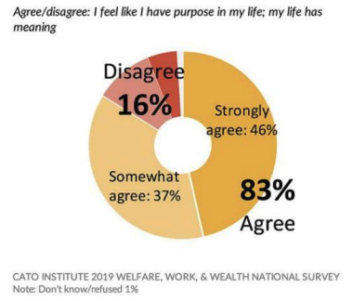
The Cato 2019 Welfare, Work, and Wealth National Survey asked Americans if they believe their life has meaning and purpose, and it found that 46% strongly agreed, 37% somewhat agreed, and 16% disagreed.
That means around half the population could use some help with having a more meaningful purpose in life!

Slide 9

Having a strong purpose isn't just a nice-to-have thing. It's extremely important for our mental AND physical health.
Dr. Rangan Chaterjee explains how lacking a meaningful purpose is inherently stressful, while people with a meaningful purpose have much better health, including lower chances of heart disease, strokes, and depression.

Slide 10

In the five Blue Zones (areas of the world where there's the most number of healthy centenarians), people all have a strong purpose that they can articulate clearly.
That means having a strong purpose and being clear on it helps us live longer, healthier lives.
The Journal of Research in Personality even found that a strong purpose is linked to greater economic success.

Slide 11

Now that we recognize the importance of purpose, the big question is, How do we get a strong, meaningful purpose? This article will go over four steps:
1. Know the difference between a meaningful and non-meaningful purpose.
2. Self-reflect to learn more about yourself.
3. Experiment with purposes to confirm if they resonate with you.
4. Find meaning in whatever you are doing now.

Slide 12

Step 1: Know the difference between a meaningful and non-meaningful purpose.
1.1 A Meaningful Purpose
A meaningful purpose is something that the world around you needs, which you also enjoy providing. Notice there are two key parts:
  1. Other people benefit from it
  2. You enjoy it.
In his book, Principles, Ray Dalio explains how both neuroscientists and spiritual leaders agree that the human brain is evolutionarily programmed to try to help the group and build meaningful relationships. That's why helping others is key to a meaningful purpose.

Slide 13

Step 1: Know the difference between a meaningful and non-meaningful purpose.
Notice that whether or not you are good at something does not make it meaningful.
There are many people in the world who do things they are talented at but don't feel fulfilled from it.
But if you discover a purpose that is meaningful to you, then even if you are not good at it, you will have the drive and perseverance to get good at it.

Slide 14

Step 1: Know the difference between a meaningful and non-meaningful purpose.
Also, just because you enjoy something does not mean it will be meaningful and fulfilling.
If you really enjoy something such that you could do it all day without getting bored, we call that a passion.
Being able to spend time on your passion is already a great blessing that not everyone gets. But even higher than passion is a meaningful purpose.

Slide 15

Step 1: Know the difference between a meaningful and non-meaningful purpose.
A meaningful purpose has to be something that you enjoy which also makes a positive difference in the lives of others. As Gandhi once said,
"The best way to find yourself is to lose yourself in the service of others.”

Slide 16
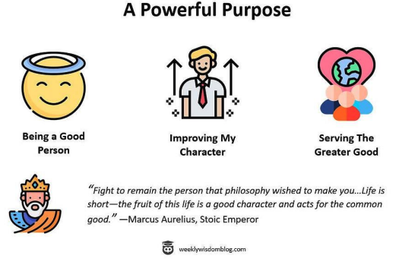
Step 1: Know the difference between a meaningful and non-meaningful purpose.
The Stoic Emperor, Marcus Aurelius, explained that a meaningful purpose has three parts: being a good person, improving my moral character, and helping the greater good.

Slide 17

Step 1: Know the difference between a meaningful and non-meaningful purpose.
These three things all benefit others and bring ourselves long lasting joy. Moreover, we can fulfill these three goals no matter what role we have, whether it is as a child, parent, friend, spouse. We can also do these three goals no matter what career we choose.

Slide 18

Step 1: Know the difference between a meaningful and non-meaningful purpose.
1.2 The Four Levels of Motivation
In his book, Think Like a Monk, Jay Shetty explains how to live with peace and purpose every day. One of the key ideas in the book is the four levels of motivation:
  1. Fear — being driven by negative things like sickness, poverty, and death
  2. Desire — being driven by personal gratification through wealth, success, and pleasure
  3. Duty — being motivated by gratitude, responsibility, and doing the right thing
  4. Love — being motivated by helping and caring for others

Slide 19
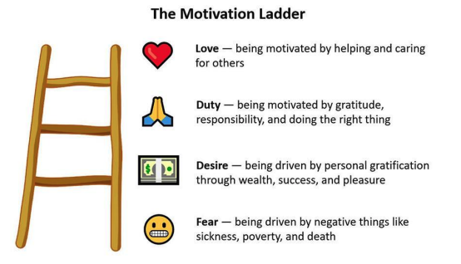
Step 1: Know the difference between a meaningful and non-meaningful purpose.

Slide 20

Step 1: Know the difference between a meaningful and non-meaningful purpose.
Being motivated by fear is obviously not a happy place to be. Many people are motivated by desire, but the problem with desire is that there's always more to want, and the selfish nature of desire makes it non-meaningful.
The great stoic philosopher Seneca said, "It is inevitable that life will be not just very short but very miserable for those who acquire by great toil what they must keep by greater toil."

Slide 21

Step 1: Know the difference between a meaningful and non-meaningful purpose.
When we have a strong desire for something, we either end up stressed or end up stressed. That's not a typo.
  If you don't get what you desire, then you're stressed.
  If you do get what you desire, you get a temporary sense of relief, but then you're afraid losing it or stressed about the next bigger desire.

Slide 22

Step 1: Know the difference between a meaningful and non-meaningful purpose.
Being motivated by duty and love is a strong purpose, and it will lead to much more happiness and fulfillment than being motivated by fear or desire. For example, Lewis Howes is former pro-athlete and the host of The School of Greatness.

Slide 23

Step 1: Know the difference between a meaningful and non-meaningful purpose.
"Most of my life, one of my main motivation was desire: seeking personal gratification through success, wealth, and pleasure…In the last seven years, it's been more duty and love…And there's an amount of happiness I've never felt before until I reached practicing duty and love. I remember I was never able to fall asleep at night until about 7 or 8 years ago without an hour or hour and half of just anxious anxiety, stress, concern, worry. And when I shifted from seeking personal gratifications to being motivated by a mission and love and gratitude, I started to fall asleep within minutes."

Slide 24
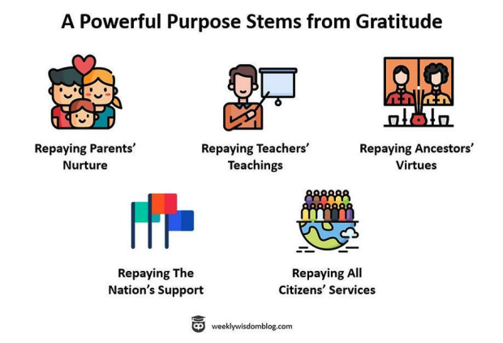
Step 1: Know the difference between a meaningful and non-meaningful purpose.
We mentioned early that a powerful purpose includes being a good person, improving our moral character, and serving the greater good. Why? Because it is our duty. We received a lot of gratitude and kindness from our parents, teachers, ancestors, nation, and the world, so the least we could do is be a good person and help them back.

Slide 25

Step 1: Know the difference between a meaningful and non-meaningful purpose.
Our parents and teachers all hope for us to be a useful member of society, to give more than we take.
Our ancestors have advanced the world for us, so we should leave the world better than when we arrived.
The nation and all citizens support our daily lives, so we should contribute something back.
When we think about all the gratitude we received, we will naturally feel motivation to improve ourselves and serve the greater good.

Slide 26

Step 2: Self-reflect to learn more about yourself.
2.1 Ask yourself some deep questions
Recall that a meaningful purpose is something that benefits others and that you enjoy providing. In other words, it is the combination of service (helping others) and passion (what you enjoy).

Slide 27

Step 2: Self-reflect to learn more about yourself.
Here are some questions to reflect on regarding passion:
  • If I had all the money and time in the world, what would I do (after I've travelled and bought all the stuff I want)?
  • What excites me? What am I happily willing to do even when I am exhausted?
  • What could I talk about for hours without getting bored?

Slide 28

Step 2: Self-reflect to learn more about yourself.
Here are some questions to reflect on regarding service:
  • What problems do I like to help people with?
  • What am I most grateful for? How can I provide that to others or repay that gratitude?
  • What is my biggest pain? How can I help prevent that pain for others?

Slide 29
Step 2: Self-reflect to learn more about yourself.
2.2 Vedic Personalities
A useful tool to help with self-awareness is personality tests. When it comes to helping you find your purpose, Jay Shetty uses the Four Vedic Personalities:
• Guides are compelled to learn and share knowledge. They value wisdom more than fame or money. Their purpose can be to share useful knowledge or to use knowledge to help people.
• Leaders like to influence and provide. They are led by morals and seek to inspire cooperation and support society long-term. Their purpose can be to maintain order and stability or to help those in bad circumstances.
• Creators like to make things happen, and they are good at innovating and networking. Their purpose can be to create new and useful things for society.
• Makers like to see things tangibly being built. They are good at inventing, supporting, and implementing. They are motivated by stability and security, as well as supporting those in need. Their purpose can be to make useful things or art and beauty

Slide 30

Step 2: Self-reflect to learn more about yourself.
https://s.surveyanyplace.com/dharmatype

Slide 31

Step 2: Self-reflect to learn more about yourself.
2.3 16 Personalities Test
Another useful personality test is the 16 Personality Tests. You can read a detailed explanation of the 16 Personalities here, but for this article, we'll just look at the four categories of personalities:
• Analysts are driven by logic and ideas, so their purpose can be to solve big problems for society and innovate new ideas.
• Diplomats are driven by compassion and ideals, so their purpose can be to advocate for an important cause and to help those in bad circumstances
• Sentinels are driven by duty and morals, so their purpose can be to maintain order and stability in the world.
• Adventurers are driven by novelty and fun, so their purpose can be to entertain others, whether that be through films, music, art, or sports.

Slide 32
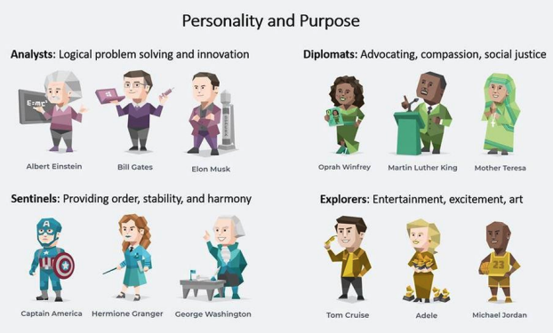
Step 2: Self-reflect to learn more about yourself.

Slide 33

Step 2: Self-reflect to learn more about yourself.
The 16 Personalities website provides many famous examples of people from each category.
We can see that Analysts include famous logical thinker sand innovators like Albert Einstein, Bill Gates, and Elon Musk.
Diplomats include famous social advocates and compassion people such as Oprah Winfrey, Martin Luther King Junior, and Mother Teresa.
Sentinels have less famous people because they tend to support others from the background rather than being in the center of attention, but some well-known ones include Captain America, Hermione Granger, and George Washington.
Explorers include famous actors, singers, and athletes such as Tom Cruise, Adele, and Michael Jordan.

Slide 34
Step 2: Self-reflect to learn more about yourself.
An important note to make here is that personality does not define your best career choice, but rather your purpose for choosing that career.
For example, a Diplomat could choose to work in the technology industry for the purpose of using technology for social good.
A Sentinel could choose to work in the entertainment industry for the purpose of using media to bring more stability in society.

Slide 35

Step 3: Experiment with purposes to confirm if they resonate with you.
A 2017 Statistica survey showed that the average person worldwide spends 134 minutes a day using online entertainment. That's over 2 hours a day, 15.6 hours a week! We may use online entertainment to destress, but it's just temporary pleasure.
Online entertainment doesn't provide us with long-lasting happiness and peace, whereas working on your purpose does. For most of us, we could probably replace some entertainment time with time spent experimenting with purpose.
Once we've confirmed our purpose, we would naturally want to work on that more and spend less time on entertainment.

Slide 36

Step 3: Experiment with purposes to confirm if they resonate with you.
For example, if you think taking care of others might be meaningful to you, try volunteering at a food shelter or senior home.
If you think entertaining others might be meaningful to you, try joining a comedy club or making online videos.
If you think advocating might be meaningful to you, try joining a local government organization or attending community events.
If you think creating new things is meaningful to you, try making stuff in your free time.

Slide 37

Step 4: Find meaning in whatever you are doing now.
"You can't find positivity in everything, but you can find meaning in everything."
—Jay Shetty
While you are experimenting with your purpose, you can also find meaning in whatever you are doing now. When you can link what you are doing to your purpose, you will naturally feel more satisfaction and fulfillment in life.

Slide 38
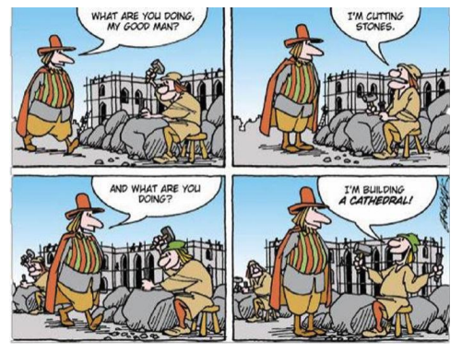
Step 4: Find meaning in whatever you are doing now.
Example 1: Building a Wall versus Building a Cathedral

Slide 39

Step 4: Find meaning in whatever you are doing now.
Example 2: Student in School
Let's say you are a student in school, and you feel school is so burdensome and tiring. You especially find math class boring, but you have to pass math class to go to university.
You can reflect on the questions in Step 2, such as "What am I most grateful for? How can I repay that gratitude?" and "What could I talk about for hours without getting bored?"

Slide 40

Step 4: Find meaning in whatever you are doing now.
You reflect that you are very grateful to your parents and teachers because without them, you'd be nothing.
You also reflect that you love art and design, and maybe you want to be an architect.
Now, you can find meaning in your math class.
  Firstly, your parents and teachers hope you will do well in school, so doing your best in the class is repaying their gratitude.
  Secondly, math is needed for you to study architecture in university, so even if it's boring right now, it is needed for your future goals.

Slide 41

Step 4: Find meaning in whatever you are doing now.
Example 3: Typical Office Worker
Let's say you're a typical office worker. You just do your job to earn a pay cheque to pay your bills. You don't feel a strong purpose at work. You reflect that two of your biggest pains growing up was not having financial stability and family time.
You could see your job as contributing to the success of the company, which provides a stable pay cheque for hundreds of employees. You could also use your lunch hours to chat with colleagues, encourage them to prioritize family, and give them recommendations for family activities.
Doing these two things would give you new meaning to your current job.

Slide 42
Classwork 2.4 (part 2)
What's the difference between a meaningful purpose and a non-meaningful one?
What are the four levels of motivation, and which ones are meaningful?
Give eight examples of common purposes people have.
How do personality test help with finding your purpose? Give an example.
How can people find meaning in something that they don't enjoy right now?

Slide 43

Homework 2.4
Find out your Vedic personality type:
  https://s.surveyanyplace.com/dharmatype
Then post your results and comment on what you think about your results.
Write no less than 250 words.

Slide 44
See you all!

