Slide 1
Lesson 2.5 Mental Illlness
23 May 2023

Slide 2

2.5 Check your understanding quiz
When you are ready, I will give you the password to enter the quiz

Slide 3

Class announcement
Pay attention to Assignment 2 deadlines
Word counts and plagiarism in homework and classwork

Slide 4

Unit 2: Mental Health (21 hours)
Tentative schedule:
  Lesson 2.1 – Stress (16 May 2023)
  Lesson 2.2 – Happiness (17 May 2023)
  Lesson 2.3 – Relationship (18 May 2023)
  Lesson 2.4 – Purpose (19 May 2023)
  Lesson 2.5 – Mental Illness (23 May 2023)
  Lesson 2.6 - Doctor in the House Episode 2 (24 May 2023)
  Lesson 2.7 – Assignment 2 Presentation (25 May 2023)
  Lesson 2.8 – Midterm test review (26 May 2023)
  Lesson 2.9 – Midterm test (29 May 2023)

Slide 5

Today’s lesson plan:
Learn about what is mental illnesses

Slide 6

Classwork 2.4 (part 1)
What is the difference between physical illness and mental illness?
Why would people avoid seeing a doctor when they might have mental illness?
Write about 100 words.

Slide 7

What is mental illness?
In the past, mental illness was a taboo topic. If you have to see a therapist, people thought something was wrong with you.
While that stigma isn’t completely gone yet, nowadays, mental health and illness are becoming talked about more and more. Just like how no one looks down on you if you go to the doctor for a physical illness, no one should look down on you for seeking help for a mental illness.

Slide 8
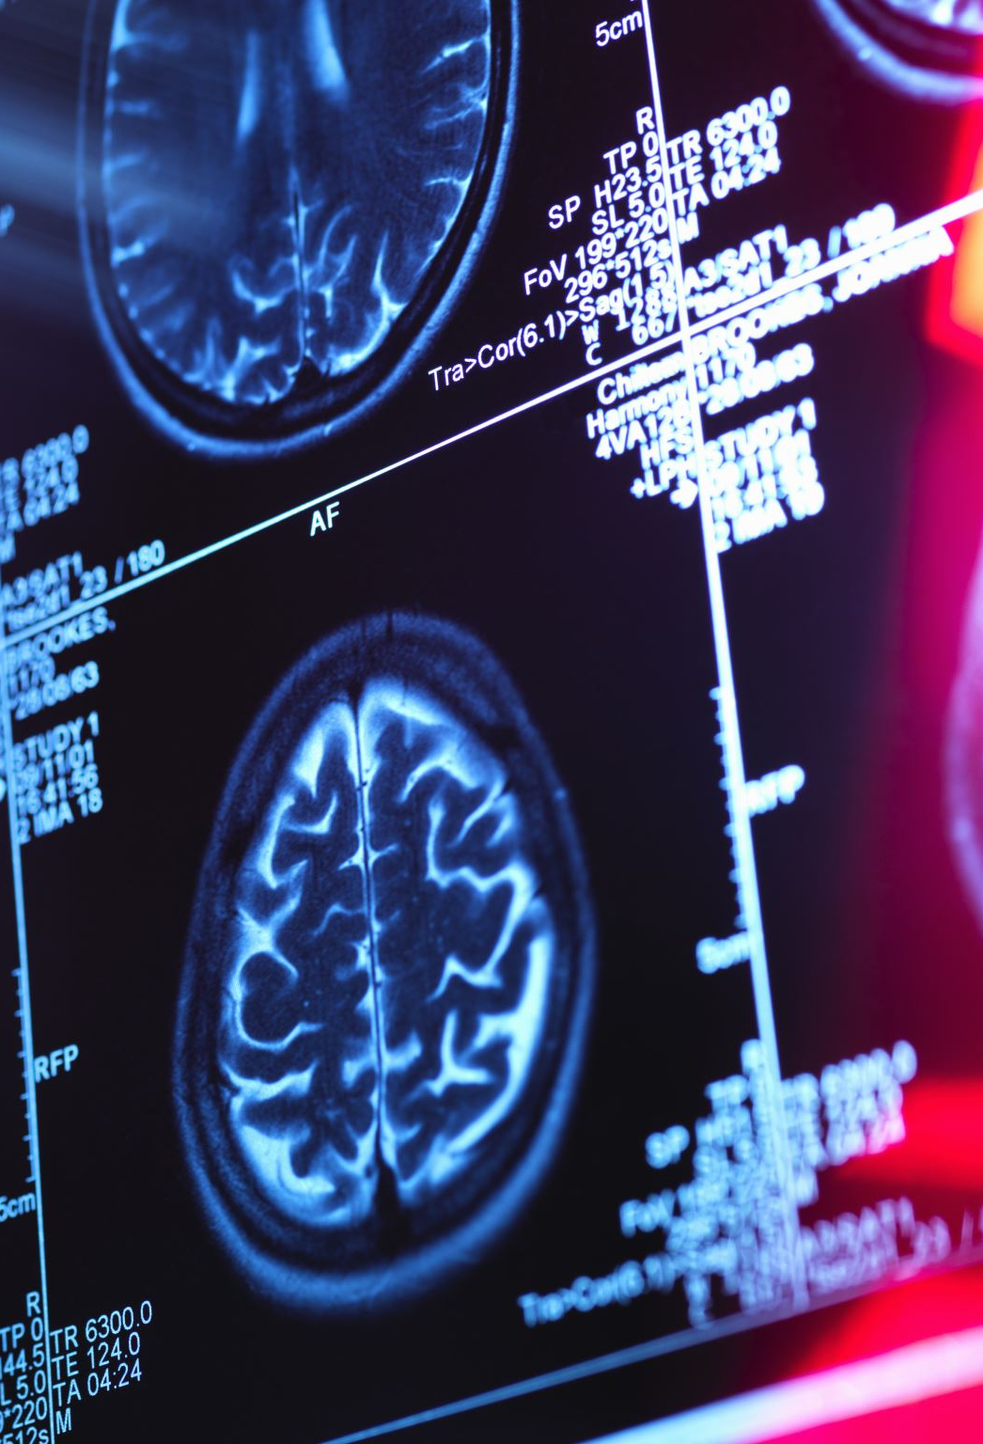
What is mental illness?
Mental illnesses are far and wide, and their causes and treatment and still being researched.
This lesson will talk about four major mental illnesses:
  1. Stress and Burnout
  2. Trauma and PTSD
  3. Depression
  4. Addiction

Slide 9

1. Stress and Burnout
Stress has been deemed the health epidemic of the twenty-first century by The World Health Organization. According to the American Institute of stress, 73% of people say stress impacts their mental health, and 77% for physical health. Clearly, stress is a big and wide problem.

Slide 10
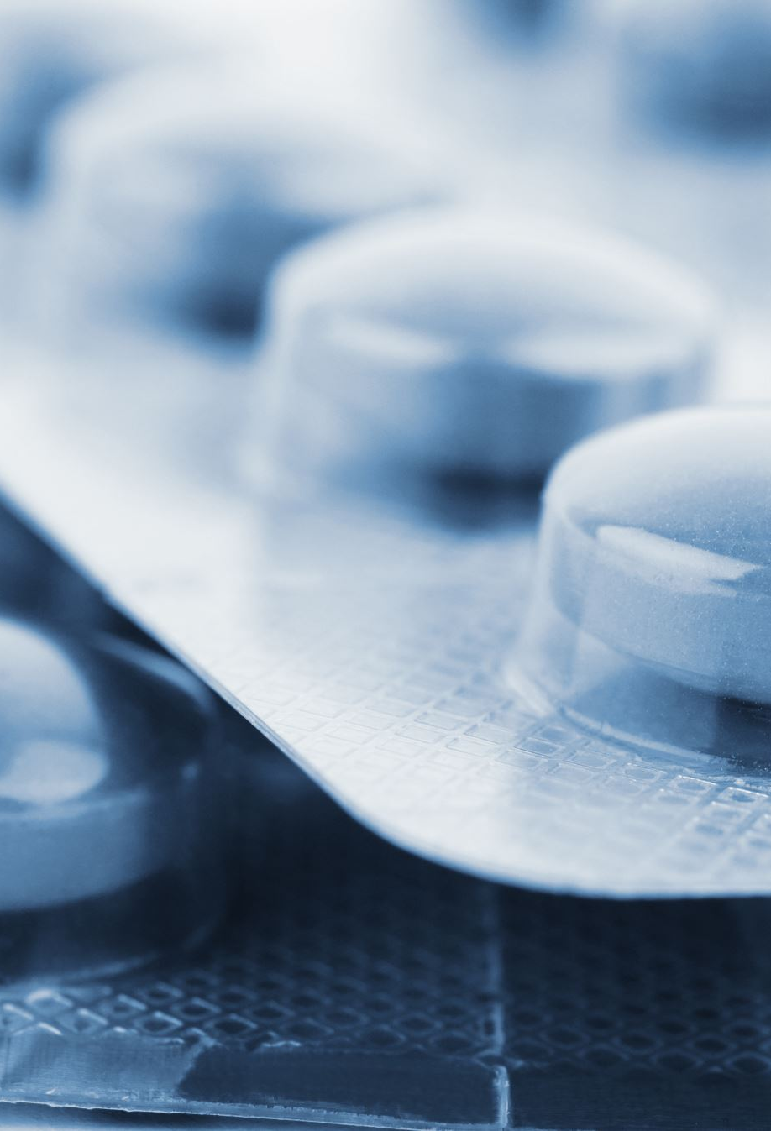
Our Adrenal Addicted Culture
When we get stressed, our fight-or-flight response turns on, and our adrenal glands release adrenaline into the body, which prepares us for danger.
This was useful in the past when humans were hunter gatherers. But in our modern age, we get triggered into stress by so many more things, whether it be the news, our unread messages, a mean colleague, or a fight with the spouse.
As a result, the adrenal glands get worn out. The Medical Medium refers to this as adrenal fatigue.

Slide 11

Our Adrenal Addicted Culture
Adrenaline is an addictive drug, and it’s made within our own bodies.
Like other addictive drugs, our body can become numb to it over time. We get so used to this hormone being in our blood that we forget what a normal, healthy life feels like.
The moment people get a chance to relax, they feel less “alive”, so then they go back to trying to be over-busy and overstimulated. They go back to their overflowing inboxes, never-ending to-do lists, and fears about their lives to get that adrenaline going again.

Slide 12
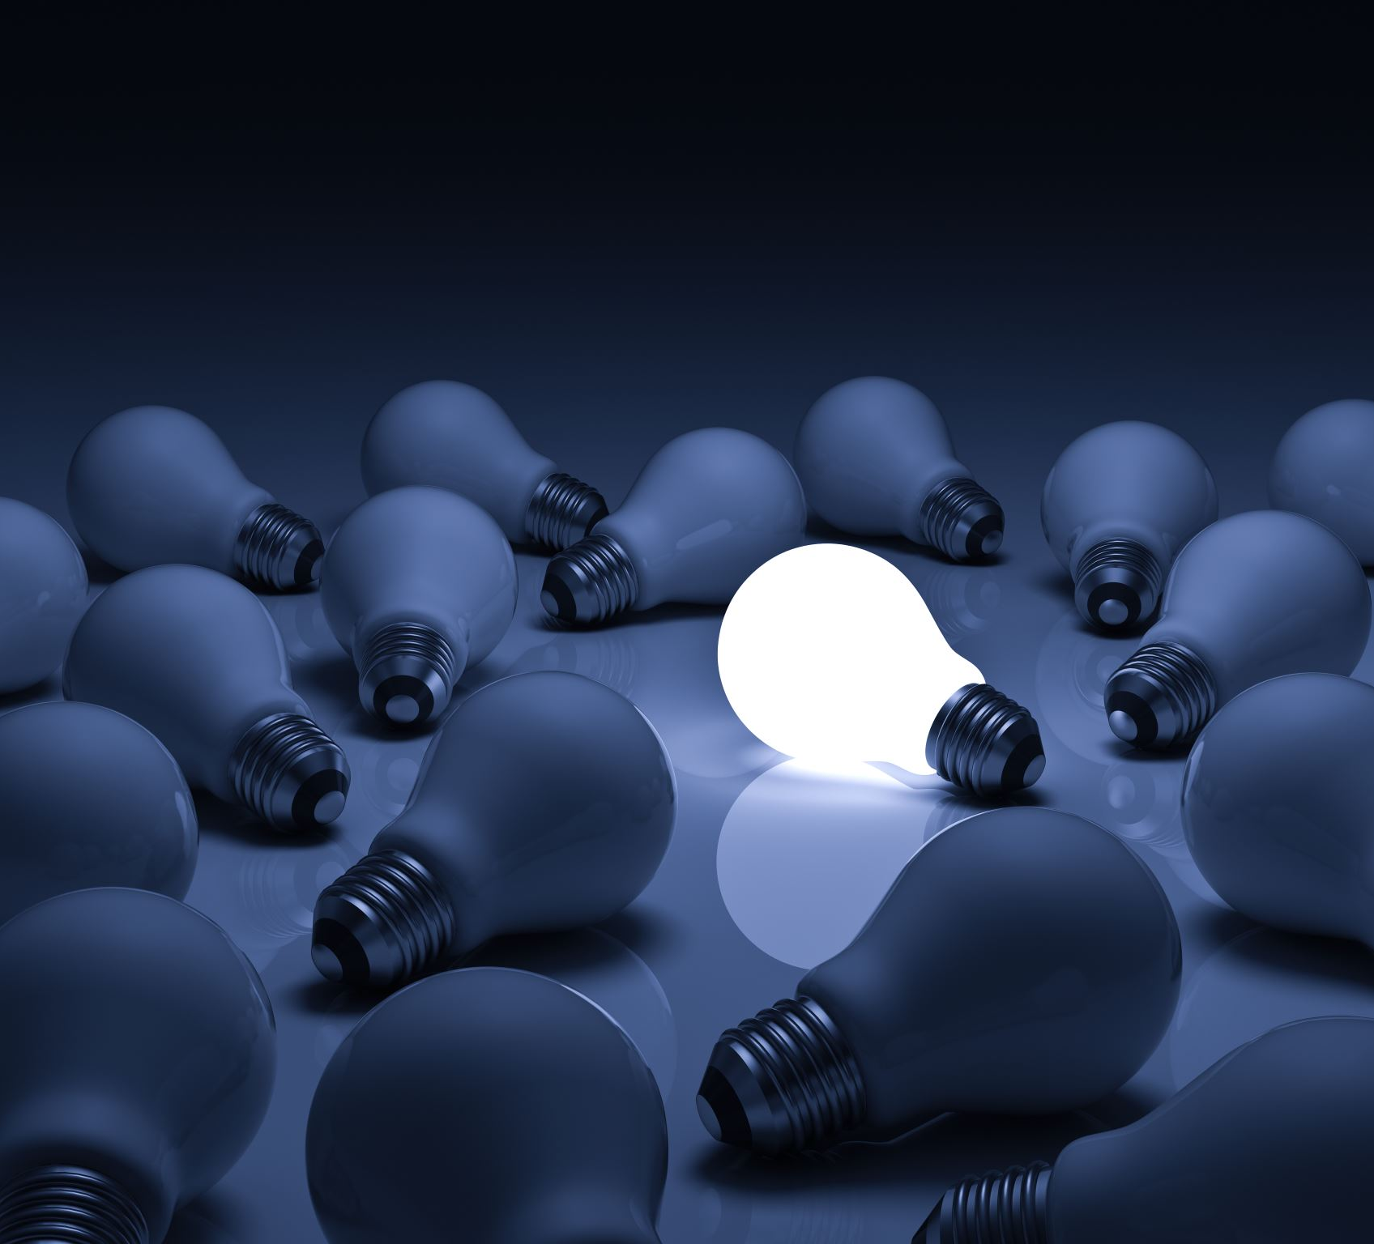
Our Adrenal Addicted Culture
Adrenal to the brain is like lighter fluid to a fire. If you want to get a fire burning, lighter fluid will give it a boost. But as a result of the lighter fluid, the fire will burn really intensely and die out faster.
The same is true for our brains. Adrenaline helps us accomplish more faster, but people are burning out faster too.
  All that constant adrenaline in the brain burns out neurotransmitters, electrical nerve impulses, and neurons before their limit.
  That’s a big reason why so many people are getting Alzheimer’s, brain fog, memory loss, depression, forgetfulness, insomnia, and dementia.

Slide 13

Handling Stress
Different people have different coping methods, such as exercise, meditation, and prayer. These are all helpful.
Someone people find ways to cut back on responsibilities and to-dos; that’s another great way.
But many people cannot cut back on their responsibilities, and that’s where making friends with stress becomes critical.

Slide 14
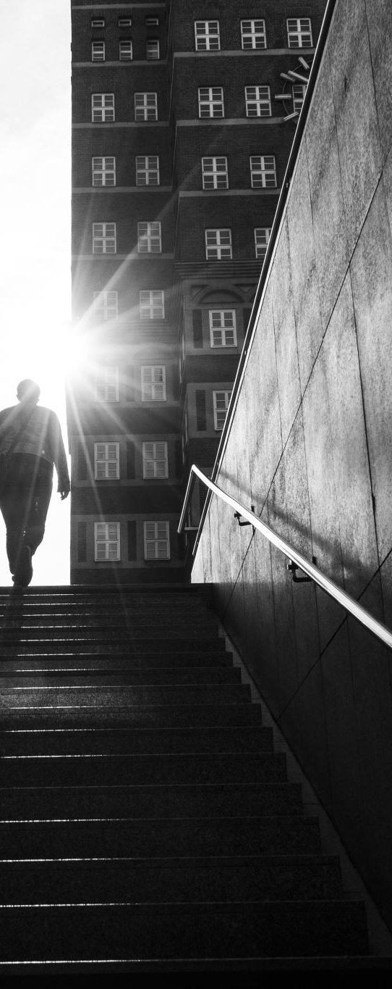
Handling Stress
You can learn to stop the adrenaline rush by viewing stress as a messenger. When you feel stress, ask yourself, “What is this stress trying to tell me?”
Instead of trying to “manage” your stress, try to communicate with it. Maybe it’s trying to tell you that something in your life can be improved.
Or it’s telling you that you are needed, that you have a purpose in this world.
When we view stress as a messenger, friend, and teacher, it becomes less stressful. When we appreciate it and recognize its impermanence, it doesn’t send the same jolt of excess adrenaline.

Slide 15
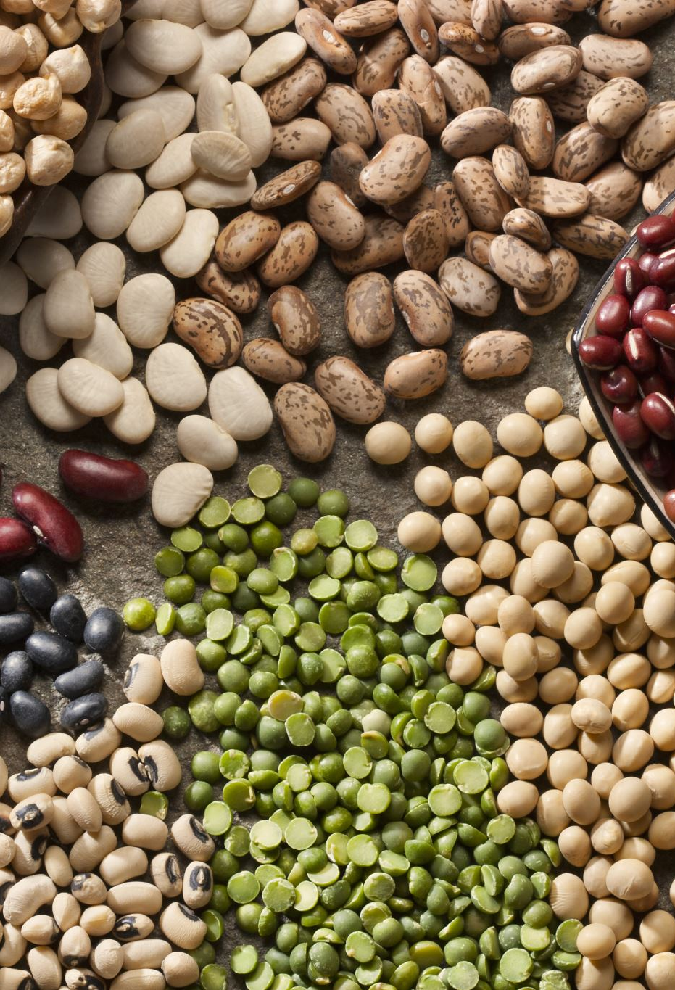
Stress and Food
A lot of people reach for a snack when stressed. It’s not a bad instinct, but the key is to eat the right things.
Don’t eat highly processed foods or high-protein and high-fat foods. These will only add more stress to the body. Instead, eat healing foods such as fruits and vegetables.
Examples of great foods that support adrenal function are sprouts, asparagus, wild blueberries, bananas, garlic, broccoli, kale, raspberries, blackberries, lettuce, and redskinned apples.

Slide 16

2: Trauma and Post Traumatic Stress Disorder (PTSD)
PTSD is when someone experiences the lingering of negative feelings that resulted from a difficult time in the past. These feelings include fear, doubt, insecurity, worry, panic, anger, defensiveness, sadness, frustration, resentment, shame, powerlessness, lack of self-worth, and distrust.

Slide 17
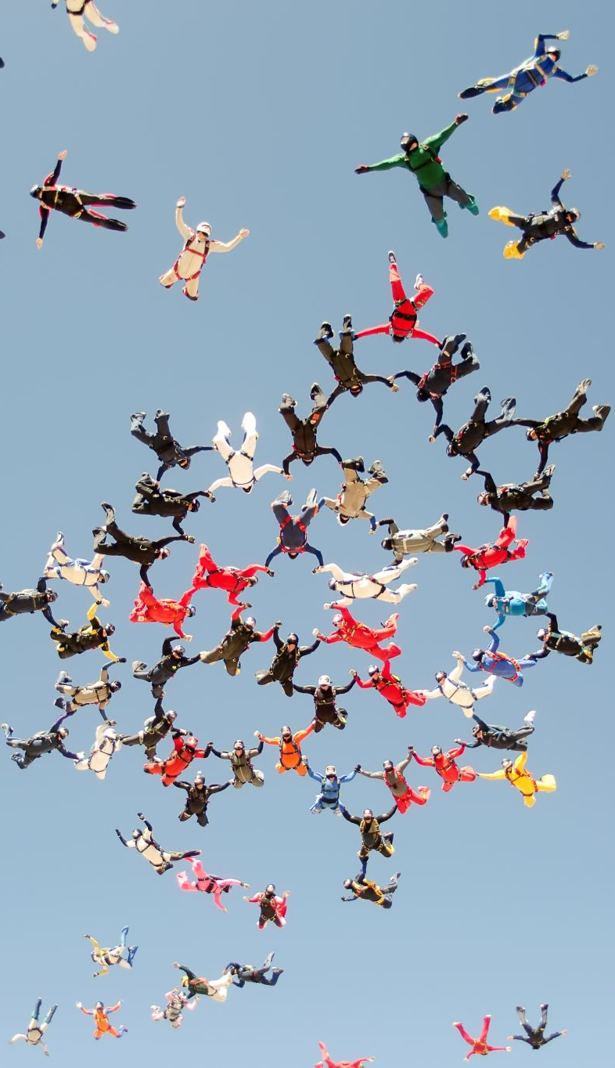
Causes
Severe cases are commonly reported by soldiers who experienced war. But PTSD can also happen from things like
  • A child’s parents divorcing
  • A teenager who can’t find a prom date
  • Extremely turbulence on a plane
  • Getting fired from a job
  • Having a bad breakup
  • Illness
There are no limitations to what can cause PTSD.

Slide 18
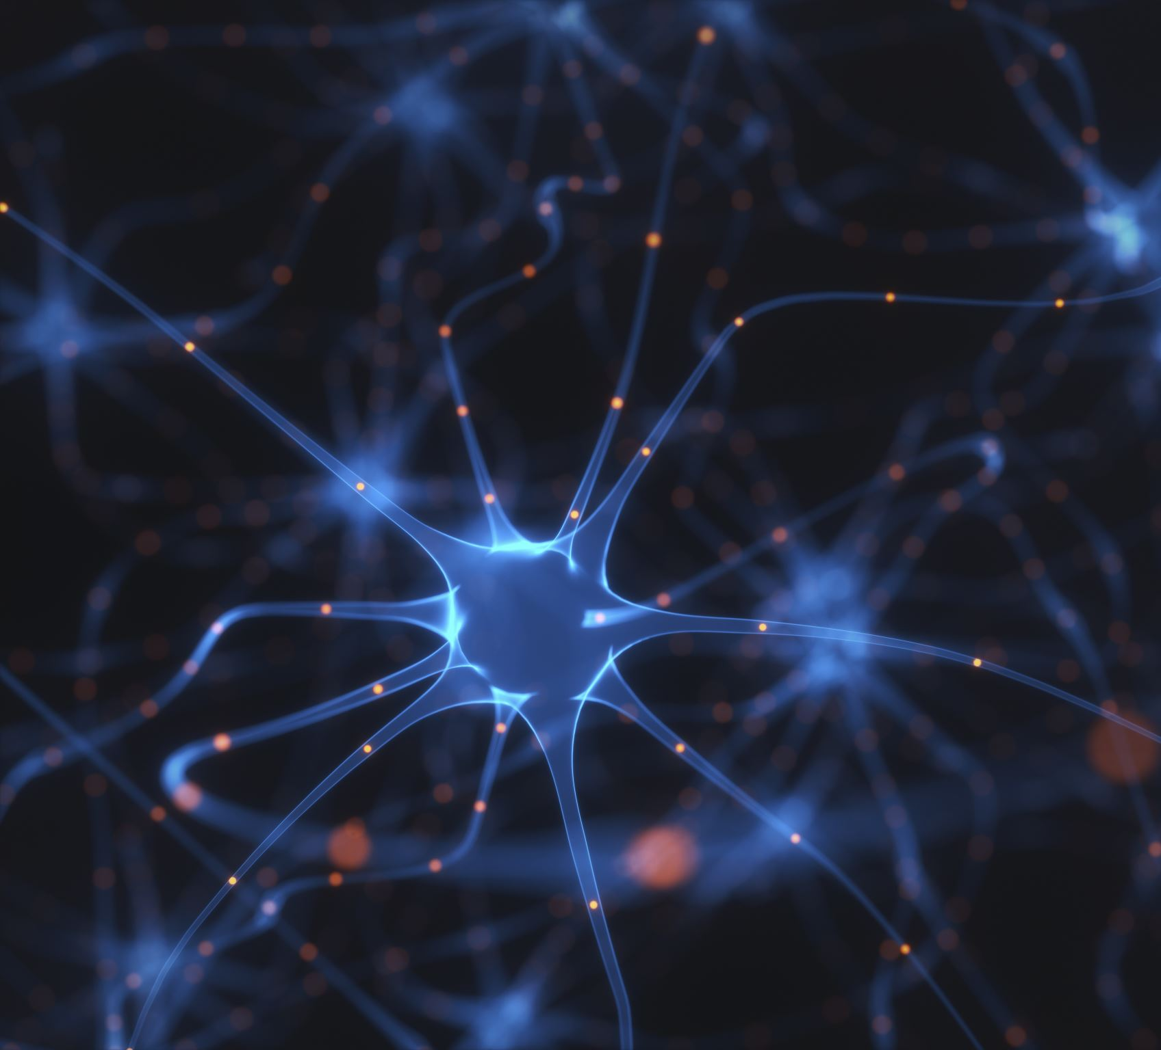
Causes
When someone experiences a traumatic event, their brain has a chemical imbalance.
If the brain doesn’t have enough glucose (sugar) reserves, then that trauma can have a lasting effect on the brain.
Glucose is a protective biochemical for our brain’s tissue. It neutralizes the acidity of adrenaline and cortisol, which get released from feelings of stress, anger, fear, frustration, and hopelessness.
It also neutralizes the electrical storms that happen in the brain during a traumatic event.

Slide 19
Causes
If glucose were compared to money, then a traumatic event would be like buying a new car. And a long-term trauma, like an abusive relationship, could have the same effect on your glucose reserves as buying a new house.
Humans intuitively understand sugar as a calming device. It’s why the doctor gives a child a lollipop as a reward for sticking through a needle shot. The problem is, our society is full of bad sugar with no nutritional value.

Slide 20
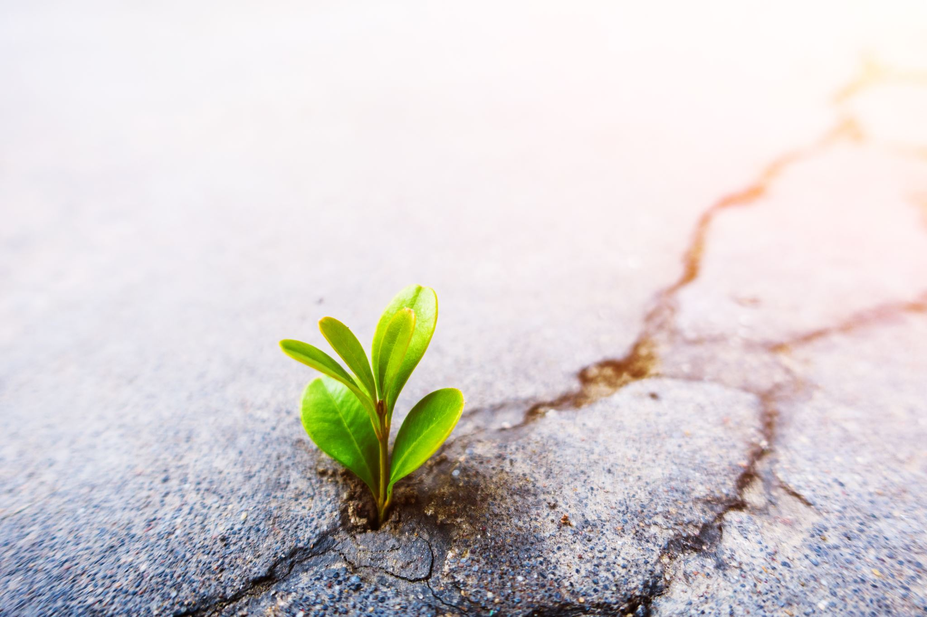
Healing PTSD
One of the most powerful ways to heal PTSD is to create new experiences that serve as positive reference points in your life.
  When you accumulate positive experiences, it will help you put the negative ones behind.
These positive experiences don’t have to be big.
  It can be a nice peaceful walk in the park. The important thing is how you perceive each new adventure.
  For example, did you see any birds on your walk? Was it sunny? How did you feel? Keep a journal to record all your new positive experiences.
  Journaling will help you become aware of all the goodness life brings even when you’re not looking for it, and it will help your mind put the negative experiences behind.

Slide 21
Healing PTSD
Think of your mind as a garden. Those negative experiences are weeds.
Every time you recognize a positive experience and journal about it, it’s like plucking out a weed and planting a seed. It can take three to four months of doing this to feel like yourself again, so patience is key.
We can also eat healing foods to restore glucose to the brain and build up our glucose reserves. Some great foods are wild blueberries, melons, beets, bananas, persimmons, papayas, sweet potatoes, figs, oranges, mangoes, apples, and dates.

Slide 22
3: Depression
Real clinical depression is completely different from just feeling down or low in energy. Telling someone with depression to just “cheer up” isn’t helpful.
A person with depression told the Medical Medium that depression felt like someone dropped her off a train in the middle of nowhere, then the train left her all alone, with no way home.
Someone who is clinically depressed may have symptoms such as
  • Sadness
  • Loss of interest in activities that used to provide pleasure
  • Slow thinking, speaking, or movement
  • Thoughts of self-harm
Depression can be caused emotionally or physically.
  From an emotional perspective, depression might get caused by traumatic loss and long-term stress.
  From a physical perspective, depression might get caused by heavy metals and the Epstein-Barr Virus (EBV).

Slide 23

Traumatic Loss
Traumatic loss is the most obvious reason for depression
  Loss of a loved one: The death of a family member or other loved one
  Loss of trust and close relationship: Finding out your spouse cheated on you
  Loss of security and identity: Getting fired from a job that was the center of your life
  Loss of faith: Suffering a huge injustice that makes you decide the universe is cruel
  Loss of your future: Having reason to believe you will die soon (loss of your future)

Slide 24
Traumatic Loss
These traumatic emotions can create micro-strokes in the brain, which scar the brain tissue on a level so small that current brain scans cannot detect them.
The news of a traumatic loss makes our brain shut down the emotional center as a way to protect us from too much pain at once. It’s kind of like putting up a wall against an attack. This is why depressed people also feel numb and pessimistic.
The good news though is that we can rebuild our mental resources and heal our depression.

Slide 25
Traumatic Stress
Another major cause of depression is severe stress sustained over long periods of time. Examples include:
  Being unemployed for many months and constantly worrying about how you will pay the bills
  Going through a combative divorce
  Enduring a major illness that makes you feel afraid and helpless
Well-intentioned people might tell to a depressed person “have perspective”.
  For example, they might tell you that there are starving children in Arica, or that at least you still have your arms and legs.
  But logic like this doesn’t always help with our emotional experience of a situation.

Slide 26
Traumatic Stress
These stressful events trigger the fight-or-flight response in our body, which sets our adrenal glands to flood the blood with adrenaline.
That would be good if you had to run away from a tiger, but when we are constantly stressed and unable to turn off those adrenal glands, then our blood gets saturated with adrenaline.
Too much adrenaline in the blood damages our organs, especially the brain. The adrenaline destroys neurotransmitters and lowers melatonin production, which makes you feel depressed and lost.

Slide 27

Heavy Metals and Other Toxins
Another type of depression happens to people where it seems like everything is perfect. They have a loving family, a great job, a beautiful house, and they feel gratitude for all of it.
Yet, somehow, an unexplainable cloud of depression arrives and looms over everything. It makes them feel like something is missing, and they feel unable to get out of bed.
The people around them can’t understand, saying things like “You’ve got everything so good! How can you be depressed?”

Slide 28

Heavy Metals and Other Toxins
This type of depression is due heavy metals, such as mercury, aluminum, and copper, being in the central area of the brain.
People accumulate heavy metals through daily life. Seafood often contains mercury, soda cans have aluminum, and your tap water might come from copper pipes.
When these heavy metals are in the brain, and the person also eats a high-fat high-protein diet, then the metals will start oxidizing, which disrupts the brain’s electrical impulse activity, which can then create depression.
The oxidizing isn’t continuous either, which means you might episodes of depression randomly, with no apparent reason for each episode.

Slide 29
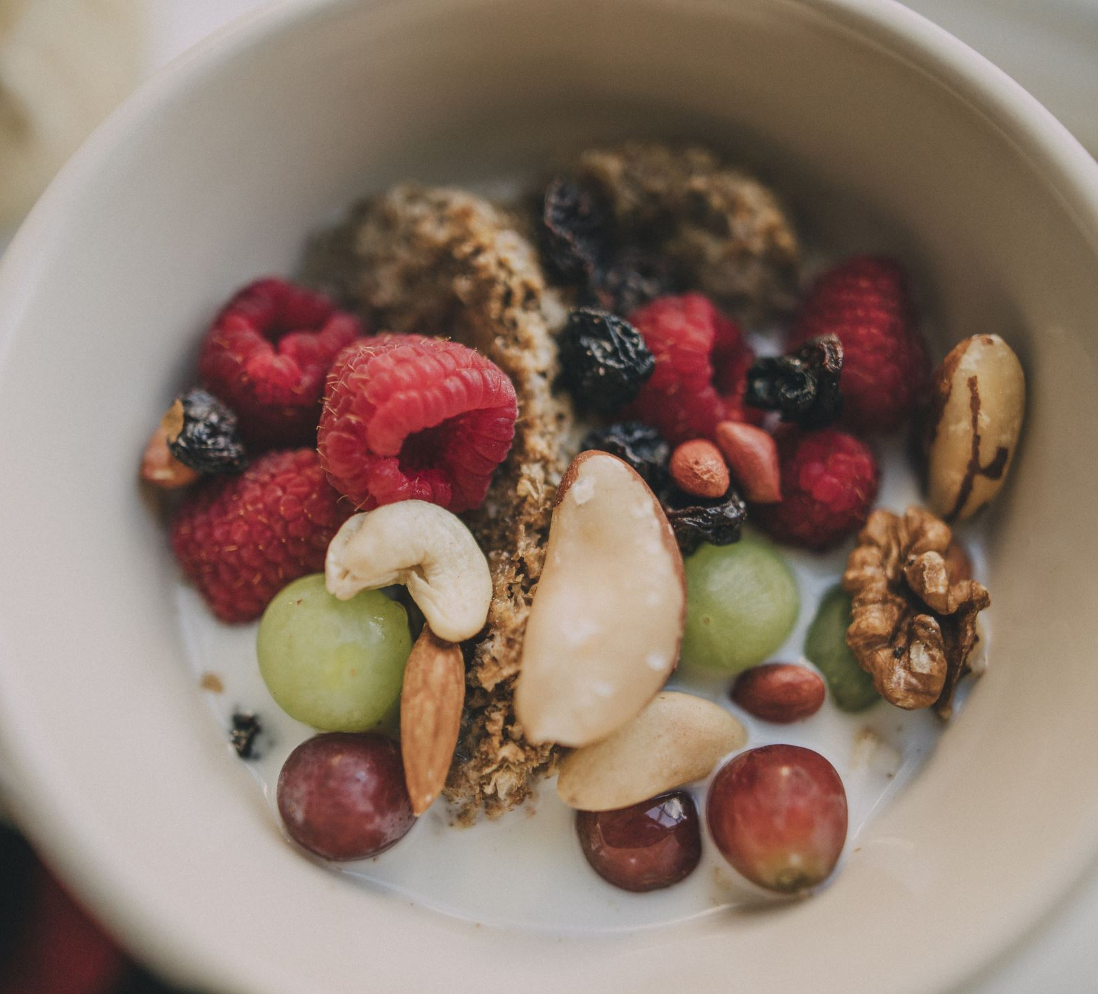
Heavy Metals and Other Toxins
Non-metal toxins can also do the same thing, and they include
  Pesticides and herbicides: These in are the air near a farm, non-organic food, parks
  Formaldehyde: This chemical is in thousands of household products and also used as a food preservative
  Solvents: These are in household cleaning products
  Food additives: sulfites (a preservative in dried fruit), aspartame

Slide 30
Viral Infection
Millions of people suffer from depression as a result of a virus such as EBV.
The viruses attaches onto nerves and continually inflames them.
They also release a poison, called neurotoxin, which inflames brain cells and disrupt the electric signals in the brain, which can lead to depression.

Slide 31
Healing from Depression
The first step is to identify your cause of depression, then address that cause. Just knowing what’s behind your depression can have an enormously validating and healing effect.
If it’s a traumatic loss, then healing it would be similar to healing PTSD.
If it’s traumatic stress, then healing it would be similar to handling burnout.
If it’s toxins or viral infections, then eat healing foods to strengthen your brain tissue and detoxify your brain.
  The best foods to add to your diet to help with depression are wild blueberries, spinach, hemp seeds, cilantro, walnuts, coconut oil, sprouts, kale, apricots, and avocados. Medical Medium also has a heavy metal detox smoothie.

Slide 32

4: Addiction
We probably all know people who have some sort of addiction, whether it be to cigarettes, alcohol, drugs, video games, shopping, or sweets.
Addictions can be one of the hardest battles we fight in our lives. According to the Medical Medium, there are actually two different roots behind addiction: glucose deficiency and adrenaline dependency.

Slide 33
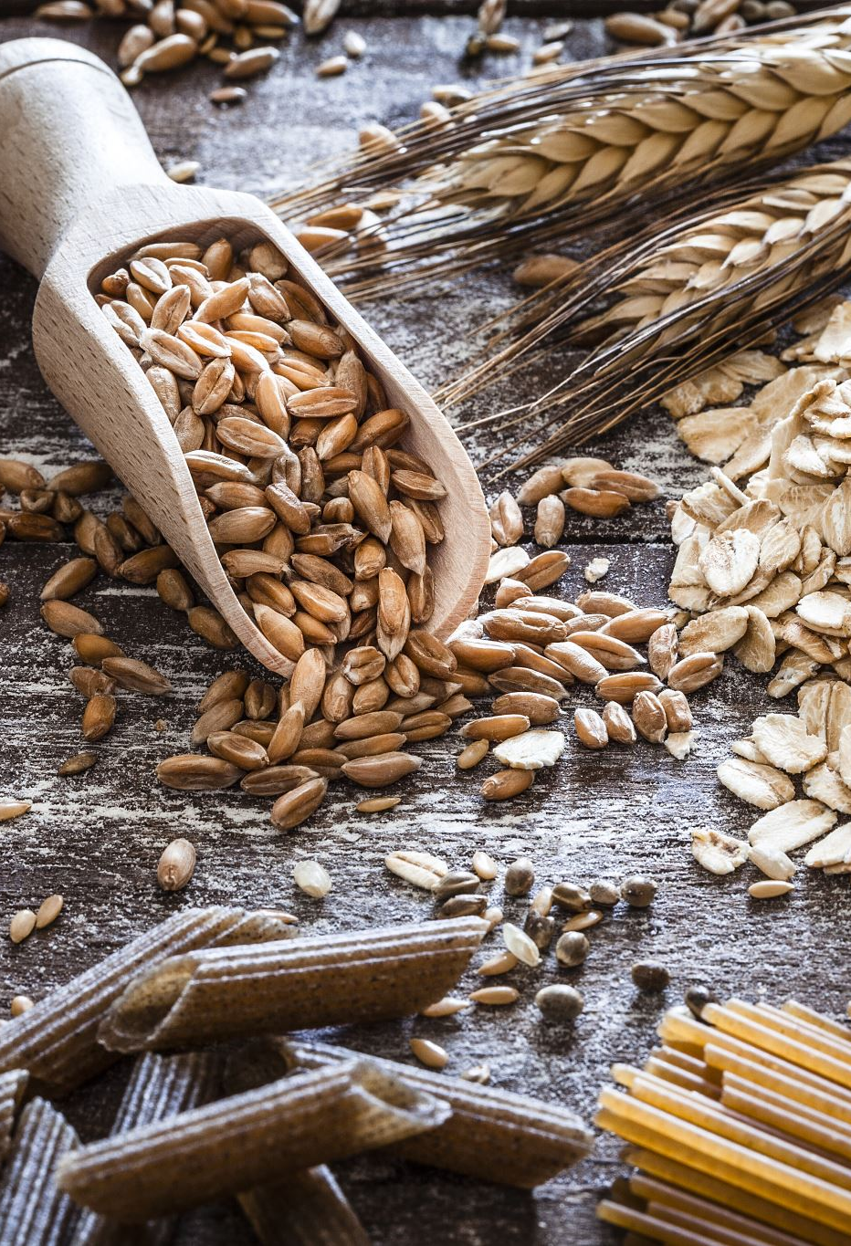
4: Addiction
Cause 1: Glucose Deficiency
Glucose is a sugar found in fruits and starchy vegetables. The brain needs enough glucose to function.
  When we’re lacking glucose, we might crave a sugary treat or bread or pasta, but what our body really needs is glucose from fruits and vegetables.
  Glucose deficiency in the brain contributes to 90% of addictions. Almost everyone has depleted glucose reserves, and that’s due to a high fat diet (meat and other animal products are high in fat).
  When our blood has too much fat, it’s hard for the glucose in the blood to move around. Then the body needs more insulin to move transport the glucose and push it into our cells, which creates insulin resistance.
  If you’re trying to break any addiction, then keep the fats low, whether you’re a meat eater, vegetarian, or vegan. That means limit the meat, dairy, oils, nuts, and seeds. Even though nuts and seeds are healthier fats, they are still fat and need to be limited.

Slide 34
4: Addiction
Cause 2: Adrenaline Dependency
When our glucose levels get depleted, that opens the door to addictions, and that sets us up for adrenaline addiction.
If our glucose reserves are empty, then the adrenal glands will begin pumping adrenaline into the body so that we can get through our day. That adrenaline surge should feel like a rush of energy, almost like you’re shaking inside.
But nowadays, people are always running on adrenaline that they don’t even notice it. Becoming hooked on the feeling of adrenaline usually happens unconsciously, and it contributes to almost all addictions.

Slide 35
Addressing Addictions
Most people nowadays have some kind of issue with food. Some eat too much; others eat too little, still others are always concerned about what to eat, while others forget to eat altogether.
Many people use food to cope with emotionally difficulty. People often grab sugary foods like candy, cakes, sodas, processed foods, and even alcohol.
But these foods give the wrong type of glucose, and as a result, we can get addicted to the wrong kind of sugar. What the body is really craving is the natural glucose from fresh fruits, leafy greens, and starchy vegetables (like potatoes). These foods having healing glucose that support neurotransmitters and keep addiction away.

Slide 36
Addressing Addictions
If we lack glucose reserves, then our adrenal glands will make adrenaline even in anticipation of whatever you’re addicted to.
For example, if you’re addicted to alcohol, you can feel the adrenaline rush before you even drink the alcohol. That’s why it’s so hard to break an addiction cycle once it begins, and why it’s so important to supply your body with lots of natural glucose from fresh fruits and vegetables.

Slide 37
Specific Addiction Examples
Alcohol
  If you’re addicted to alcohol, then your brain is desperate for glucose.
  The sugar in alcohol gets into the brain quickly, but it is very harmful.
  Replace your wine and vodka from the actual fruit that the drinks come from: grapes and potatoes. You can also eat snacks between meals like dates, dried mango, and fresh papaya.
Drugs
  If you’re addicted to any kind of drug, then you’re probably suffering both glucose deficiency and adrenaline addiction.
  To break a drug addiction, you need lots of mineral salts from vegetables, leafy greens, and fruits. A glass of lemon water in the morning is a great way to get mineral salts.
  You also need to get healing glucose from fruits like wild blueberries, apples, melons, mangoes, and papaya. Celery juice is another great tool to heal from all addictions, but especially drug addictions, because it detoxifies the body.

Slide 38
Specific Addiction Examples
Salt
  If you’re addicted to salty foods, it’s likely that your body lacks mineral salts needed for your brain’s neurotransmitters and for the adrenal glands.
  This addiction happens when someone overuses their adrenals. Mineral salts do not come from the refined salt, sea salt, or Himalayan salt that we add to food for flavor.
  Mineral salts come from fruits, leafy greens, vegetables, and celery juice. Supporting our adrenal glands with mineral salts is a critical first step to break or prevent an addiction.
Sugar and Fat
  If you’re addicted to sugary processed foods, it’s a sign of glucose deficiency. Your brain and liver need the natural glucose from fruits and vegetables to survive, not the refined sugar from processed foods.
  Processed foods are addictive because of the combination of unhealthy sugars and unhealthy fat, which make them taste so great. A prime example is ice cream. But foods high in unhealthy fat don’t allow the sugar to go into the body’s cells and organs. So even after eating those sugary foods, you still don’t feel satisfied.
  If you swap your unhealthy sugars for healthy sugars from foods like dates, apples, honey, dried apricots, or figs, then your addiction to the bad sugar will disappear.

Slide 39
Specific Addiction Examples
Cigarettes
  Yes, nicotine is an addictive drug, and it’s one of the reasons why smokers are addicted to cigarettes. But another reason is because of the adrenaline that floods your blood when you’re an active smoker.
  Before you even smoke that cigarette, that anticipation already causes an adrenaline rush. When people try to quit smoking, their appetite ramps up. That’s because when the adrenaline surge finally calms down, they can feel the low.
  One way to help fight a cigarette addiction is to use high-quality chocolate. Chocolate isn’t great for all addictions, but it can be good to fight smoking.
  Get two packs of cigarettes. Empty the first box and take some cigarettes out of the second box. Break a part off a highquality chocolate bar, and put it in the empty box. Keep the two boxes next to each other. Since nicotine is aromatic, the chocolate pieces will soak up some nicotine.

Slide 40

Specific Addiction Examples
When you feel the urge to smoke, take a piece of chocolate and put it in your mouth. Don’t chew or swallow; just let them melt in your mouth completely. Then the next time, take a cigarette from the box with cigarettes. Over time, reduce the amount of cigarettes at a pace that feels manageable.
Another way is to only smoke when you’re walking outside. Walking will help you take in more oxygen, and you may feel more calm due to the gentle movement. The adrenaline form your body is also better used when you’re walking compared to when you’re just standing and smoking.
Finally, it’s more challenging to walk and smoke, which might make you less tempted to smoke.

Slide 41
Classwork 2.5 (part 2)
What does adrenaline do and what is adrenal fatigue?
How can we deal with stress in a healthy way?
How does a traumatic event lead to a lasting impact on a person’s brain?
How can people heal from PTSD?
What are symptoms of clinical depression?
What are four causes of depression? How can people heal from each cause?
What are two causes of addiction? Explain them.
How can people break addictions? Give two examples.

Slide 42

Homework 2.4
Imagine your best friend has developed one of the four mental illness discussed in class today.
Write a letter to your friend to:
  Suggest what he/she should do to alleviate the condition of the mental illness.
  Encourage him/her to consult professional help.
Write no less than 500 words.

Slide 43
See you all!

