Slide 1
Lesson 3.1 TCM: Introduction and Foundation
30 May 2023

Slide 2
Class Announcement
Implementation of the Seating Plan
  Every day when you enter the classroom, you will be assigned with a new seat in the way of a lucky draw
  Remember to charge all your device properly starting from tomorrow as you might not have a seat next to the socket

Slide 3
Class Announcement
Assignment 3 arrangement:
  We will talk about how to finish assignment 3 tomorrow

Slide 4
Midterm test result
Average mark: 47.29
Standard Deviation: 18.86
4+ (98) | 4 (91) | 4- (83) | 3+ (78) | 3 (75) | 3- (71) | 2+ (68) | 2 (65) | 2- (61) | 1+ (58) | 1 (55) | 1- (51)
89 | 83 | 77 | 71 | 65 | 59 | 53 | 47 | 41 | 35 | 29 | 23

Slide 5
Classwork 3.1 (part 1)
Talk about one experience of you with traditional Chinese medicine.
  You can describe your story by:
    Who?
    What?
    Where?
    Why?
    How?

Slide 6
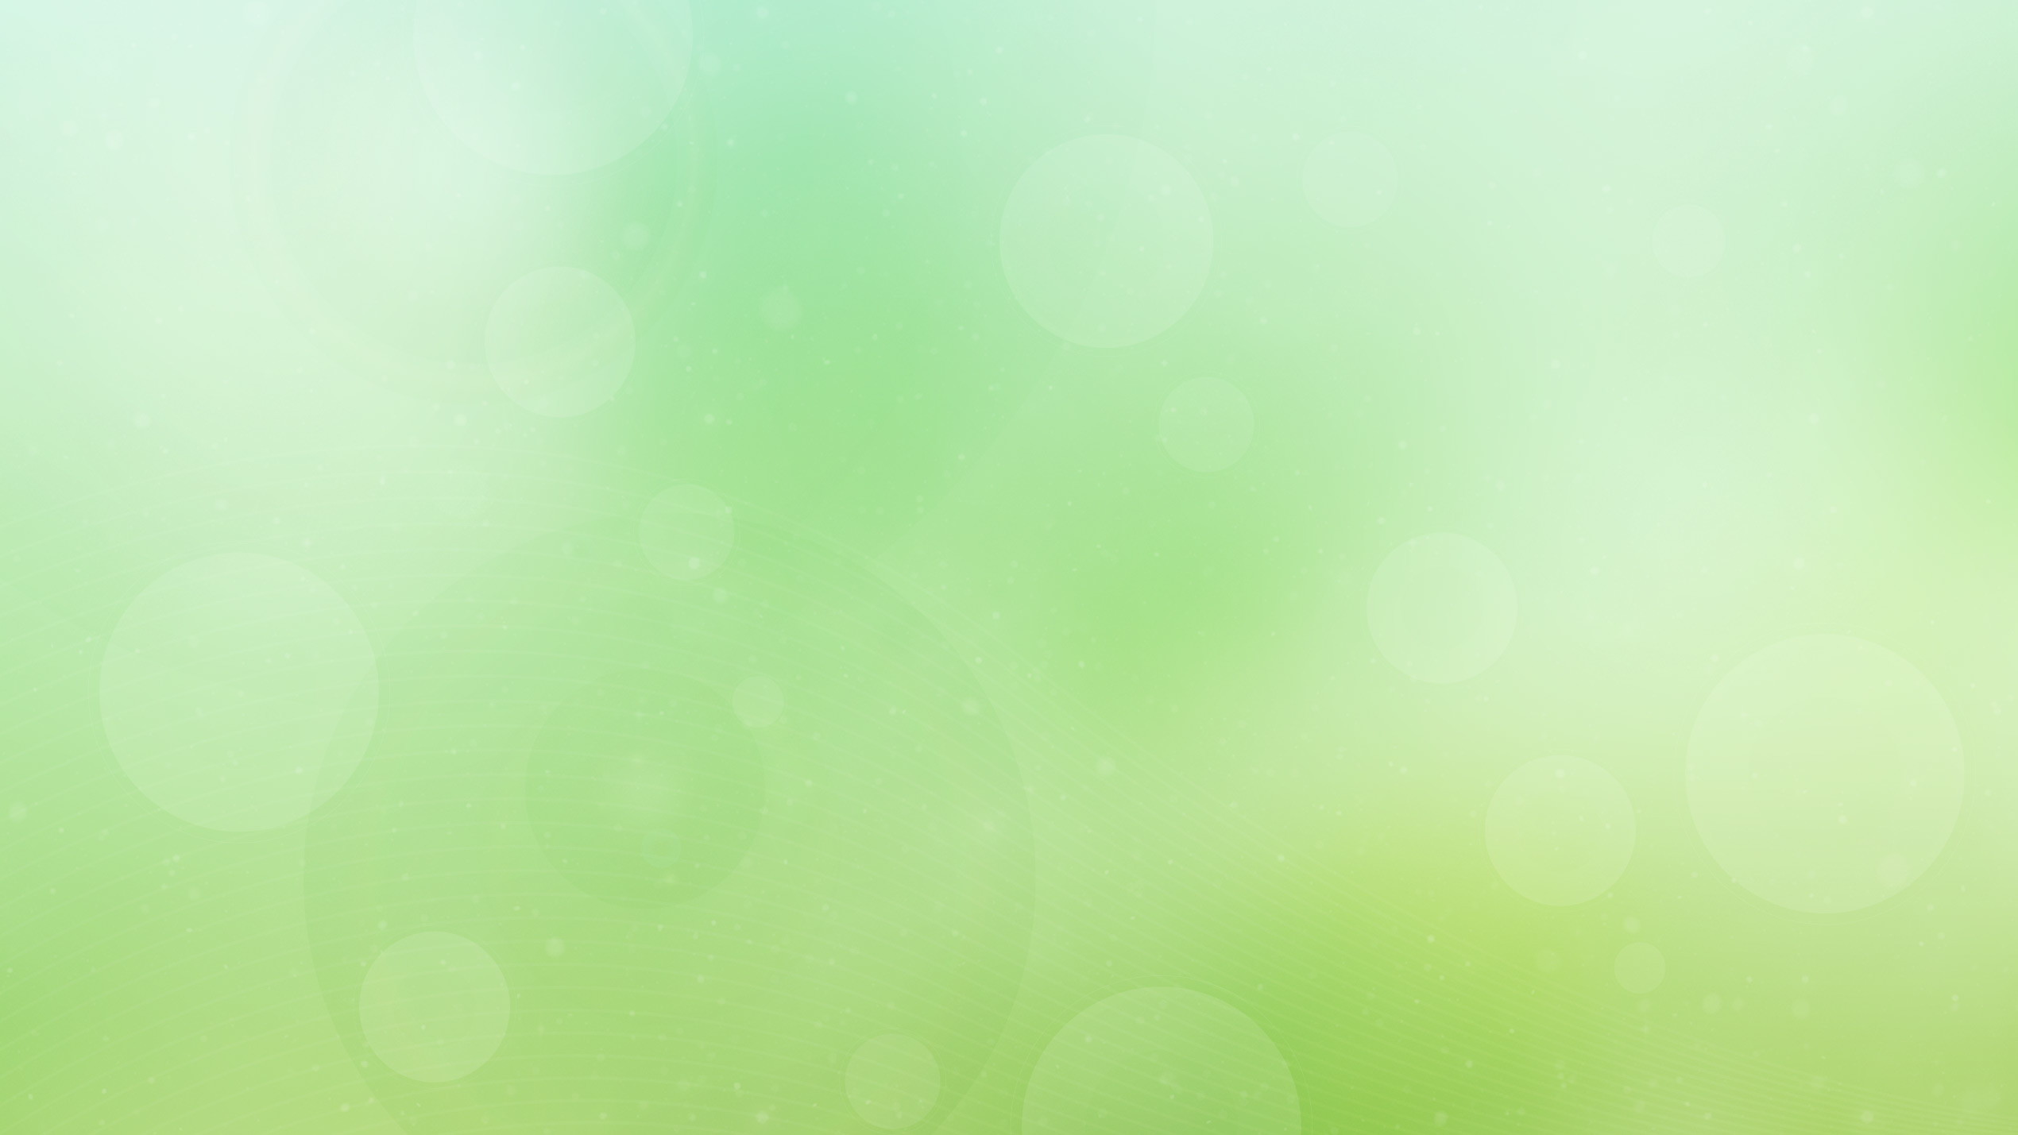



Traditional Chinese Medicine (TCM)
Traditional Chinese Medicine (TCM) is a body of medical knowledge and practice that has been passed down generation after generation for at least 2500 years in China.
This long history assures us that it has great value, as it has been scrutinized and tested for literally thousands of years. Moreover, doctors in ancient China healed patients for free.
In other words, people became doctors purely to help others, so we can be assured they would only pass down the best information.

Slide 7
Different medicine systems are like different languages in the world.
Different languages use different sounds, grammar, and thinking.
Different medical systems use different terms, ideas, and tools.
Regardless of the language, the goal of communication is achieved.
Regardless of the medical system, the goal of health is achieved.
Some languages are more similar, while other languages are very different. The same for medical systems.
For example, TCM shares many similarities with Ayurveda (Traditional Indian Medicine), while it seems very different from western medicine. But in essence, eastern and western medicine do talk about many of the same things, just using different terms.

Slide 8
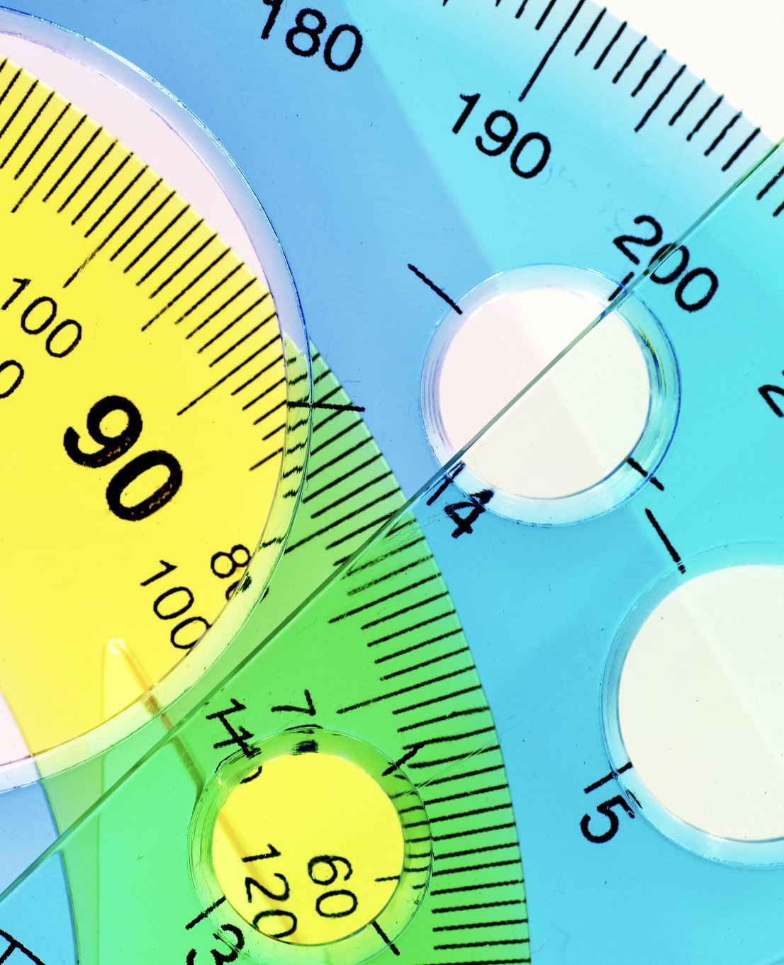
Yin and Yang
In TCM, the concept of yin yang is about relativity and maintaining balance.
  A simple example is temperature. Temperature is relative: there is no hot without cold, and there is no cold without hot.
  Temperature also needs balance: we don’t want to be too hot nor too cold. It’s similar to the idea of homeostasis in western medicine, but TCM relates yin yang more towards the broader natural environment.

Slide 9
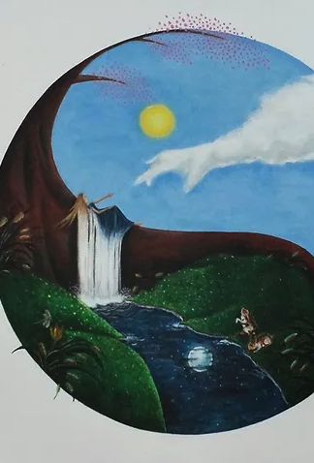
Yin and Yang
“Yin” literally means “the shady side of the mountain”, while "yang" literally means “the sunny side of the mountain.”
We can think of “yin” as anything related to the shady side, such as dark, hidden, damp, cold, and sinking energy. We can think of “yang” as anything related to the sunny side, such as light, visible, dry, heat, and lifting energy.

Slide 10
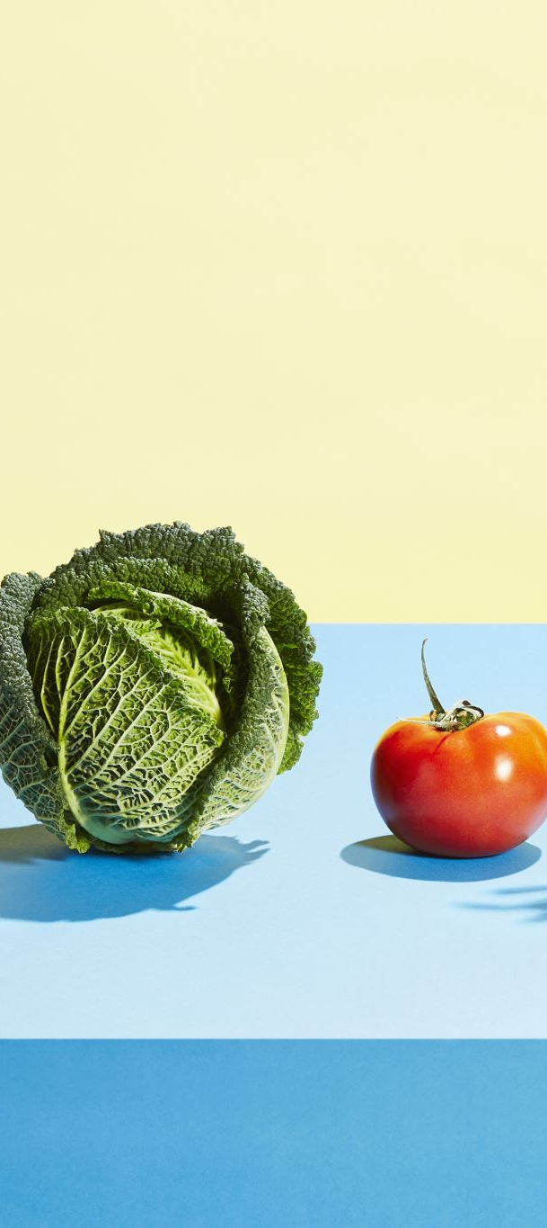
Yin and Yang
Our balance of yin and yang changes moment to moment, just like how the sunlight moves through different parts of the mountain throughout the day. Hence, the goal of staying in balance is never ending.
To give some health examples, we can look at food, exercise, and rest. Some foods are yin, while some foods are yang. Even if we hear a certain food is highly nutritious, we shouldn’t overeat it. Overeating a certain food may lead to imbalance of yin or yang. Exercise is yang, while rest is yin; we need a balance between the two; an excess of either creates health problems.

Slide 11
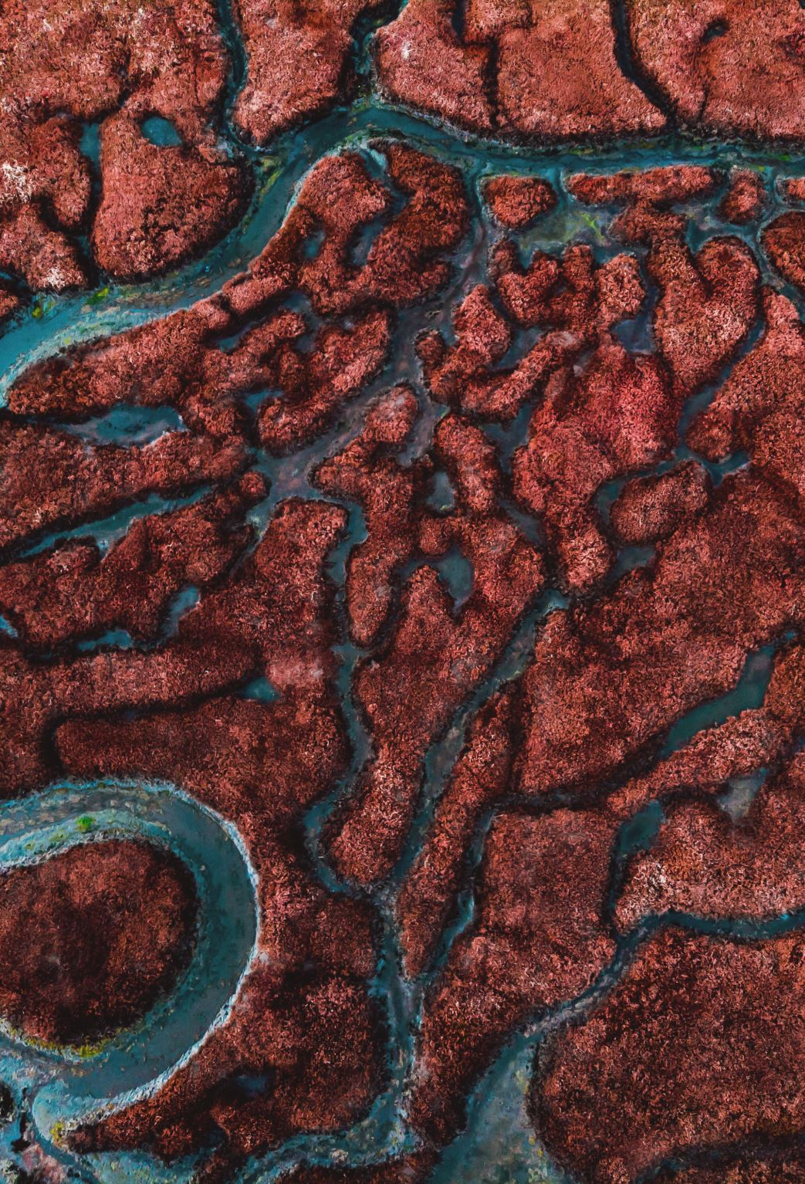
Qi and Blood
In TCM, qi means energy or life force. From a western medicine perspective, qi sounds like some mystical thing that can’t be proven to exist. If you really want to think of qi in a more western-medicine way, you can think of it as the level of oxygen and glucose, which determine our energy, that is moving through our body.

Slide 12
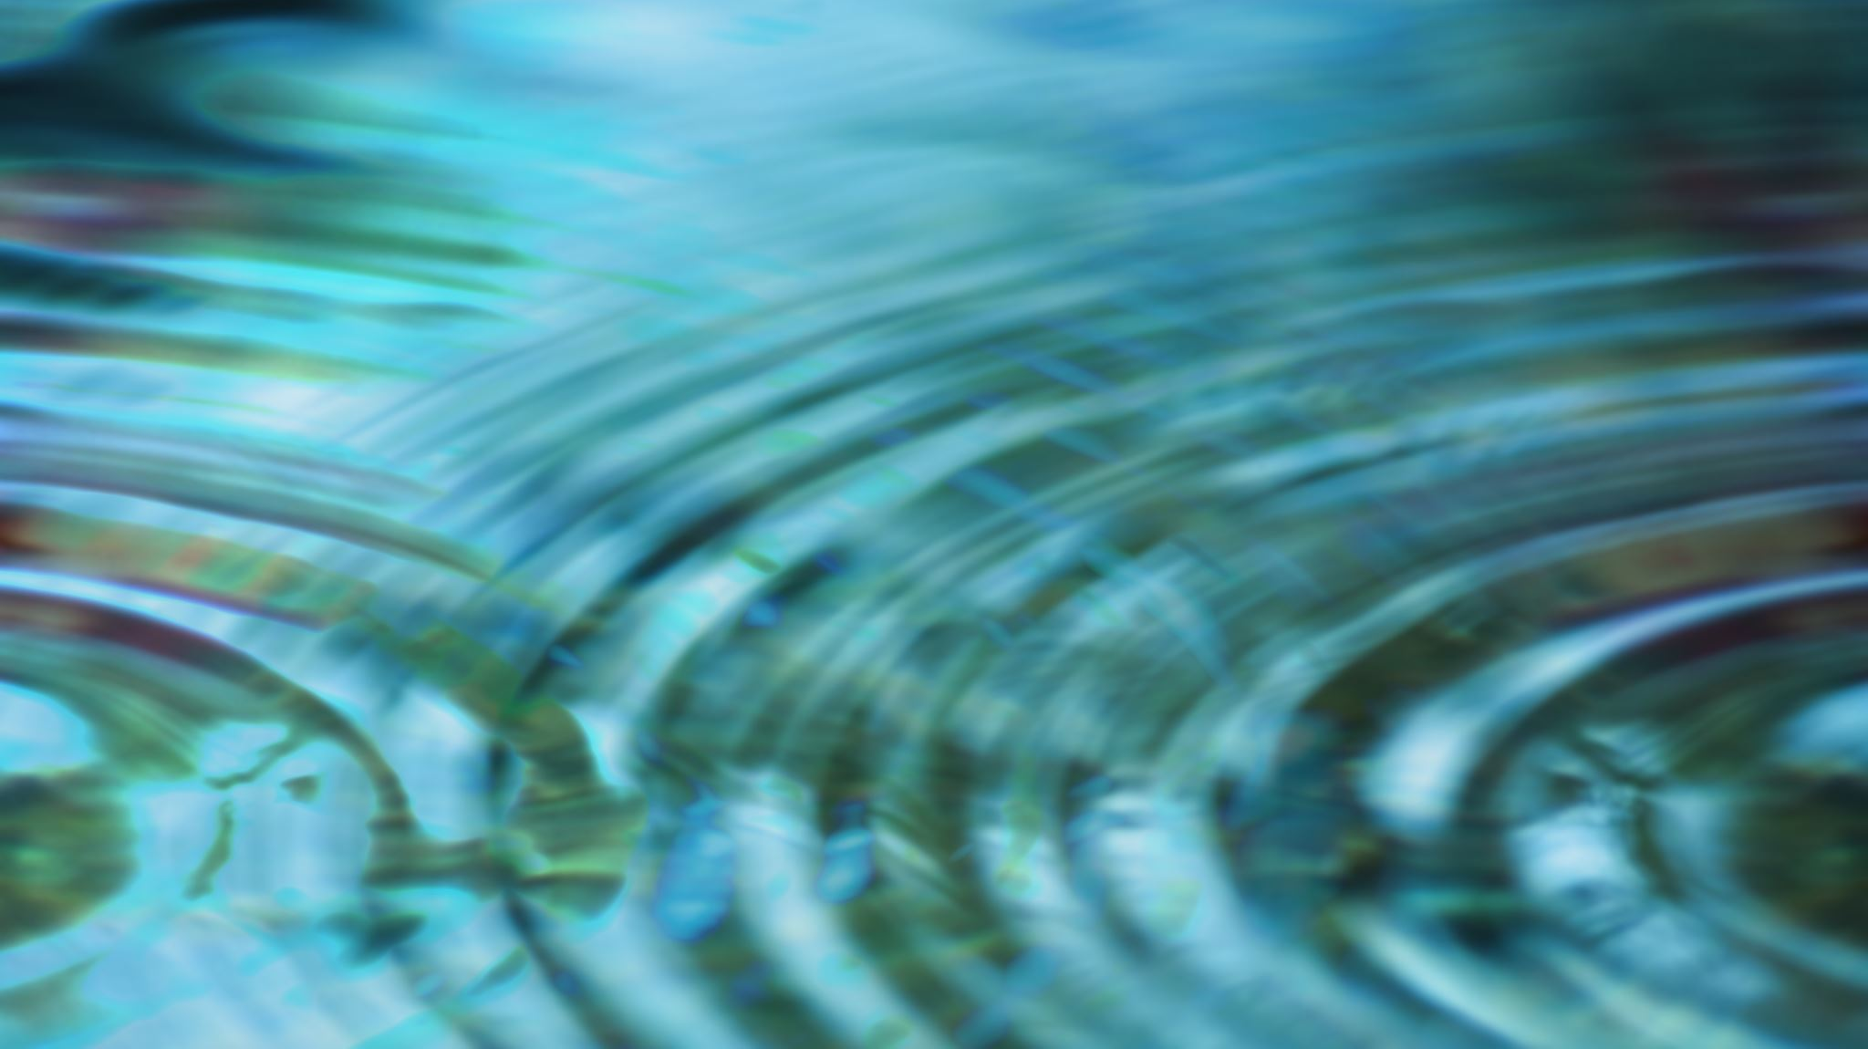
Qi and Blood
But qi is more than just energy. Qi is also about the qualities and transformations of a thing.
  For example, the qi of water is soft, wet, smooth, pliable, and sinking.
Different organs also have different qi, which they use to perform their respective functions. In TCM, blood refers to not just the red liquid but also nutrients in the blood. So if someone has a “blood deficiency” in TCM, it means they’re lacking the red liquid and/or nourishment in the red liquid.

Slide 13
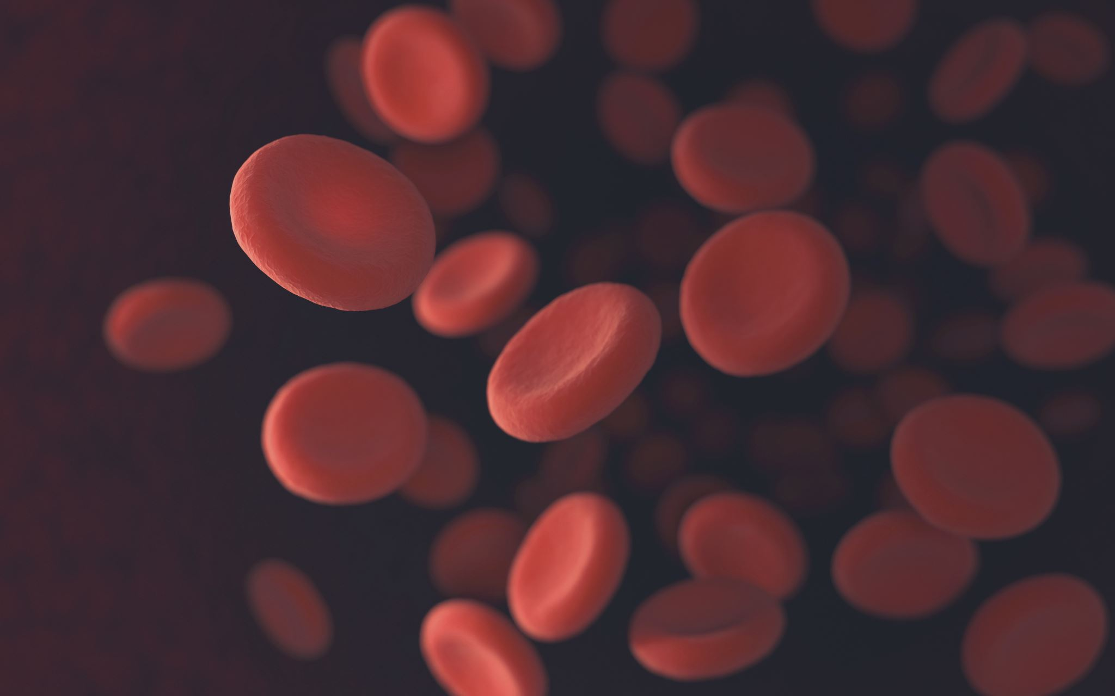
Qi and Blood
Blood and qi together make up the essence of the human body, and we need to have enough of them for good health.
We also need blood and qi to flow properly throughout the body, and any obstructions in their flow will lead to problems.

Slide 14
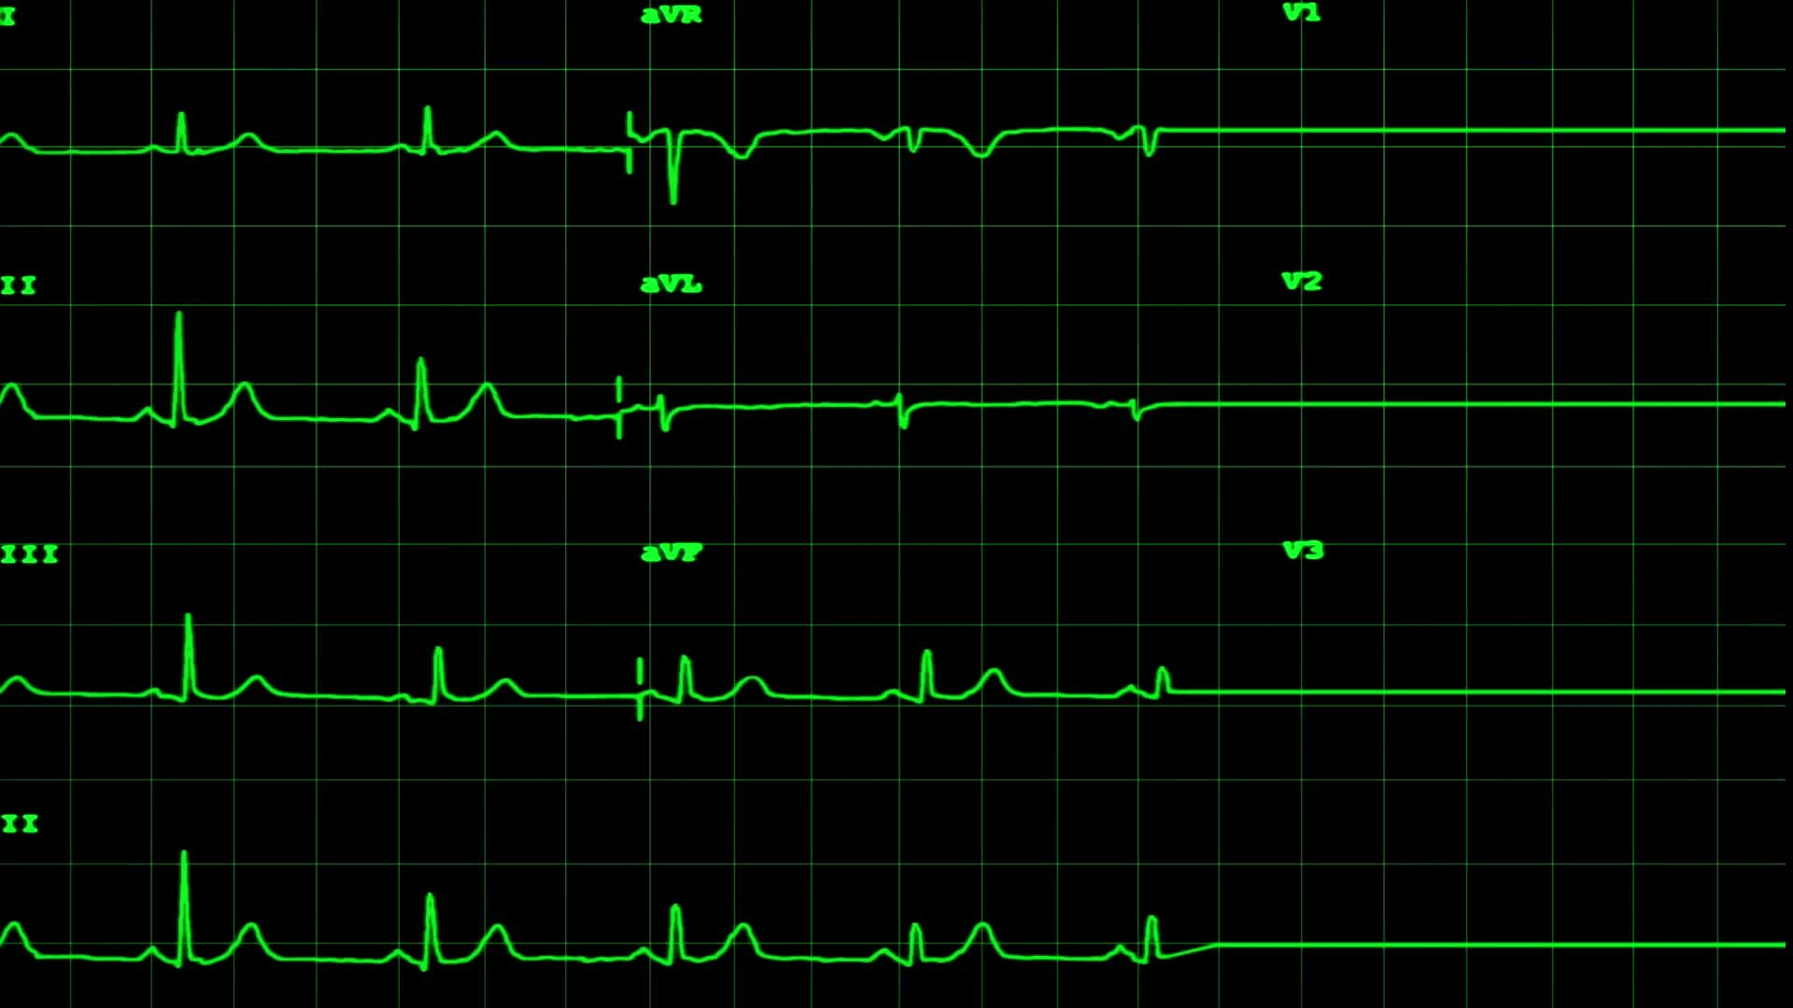
Meridians and Acupoints
In TCM, meridians refer to the channels through which qi flows. Just like how blood has to flow through arteries and veins, qi has to flow through meridians.
Each meridian is also linked to specific organs. If there’s a block or partial blockage in a meridian, that can lead to problems in the corresponding organ, which then lead to health problems related to that organ.
There are 12 main meridians in the body, and they typically run along tendons that we can feel and massage ourselves.

Slide 15
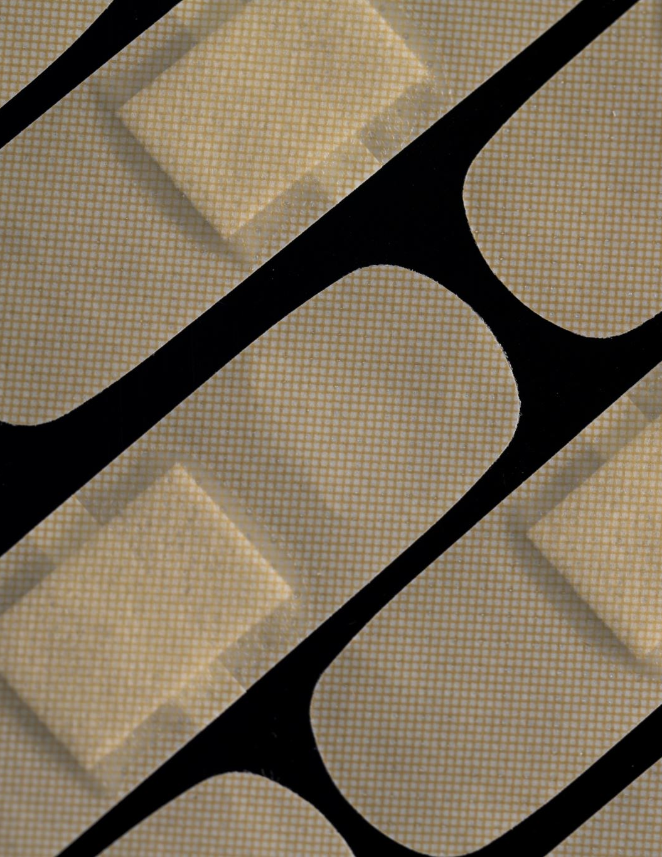
Qi and Blood
Acupoints are specific points on meridians. They are also called acupuncture points since acupuncturists use them, as well as acupressure points since massage therapists use them too.
Each acupoint is linked to a specific part of the body.
  For example, let’s say you have digestion problems. A TCM doctor would inspect the meridians related to your digestive organs and try to find the specific acupoint that is blocked along those meridians.
Typically, that blocked acupoint will feel very painful if you put pressure on it. The TCM doctor will then help unblock that acupoint through treatments such as acupuncture (inserting small needles), moxibustion (applying heat), acupressure (applying pressure) or Tui Na massage (massaging the point).

Slide 16
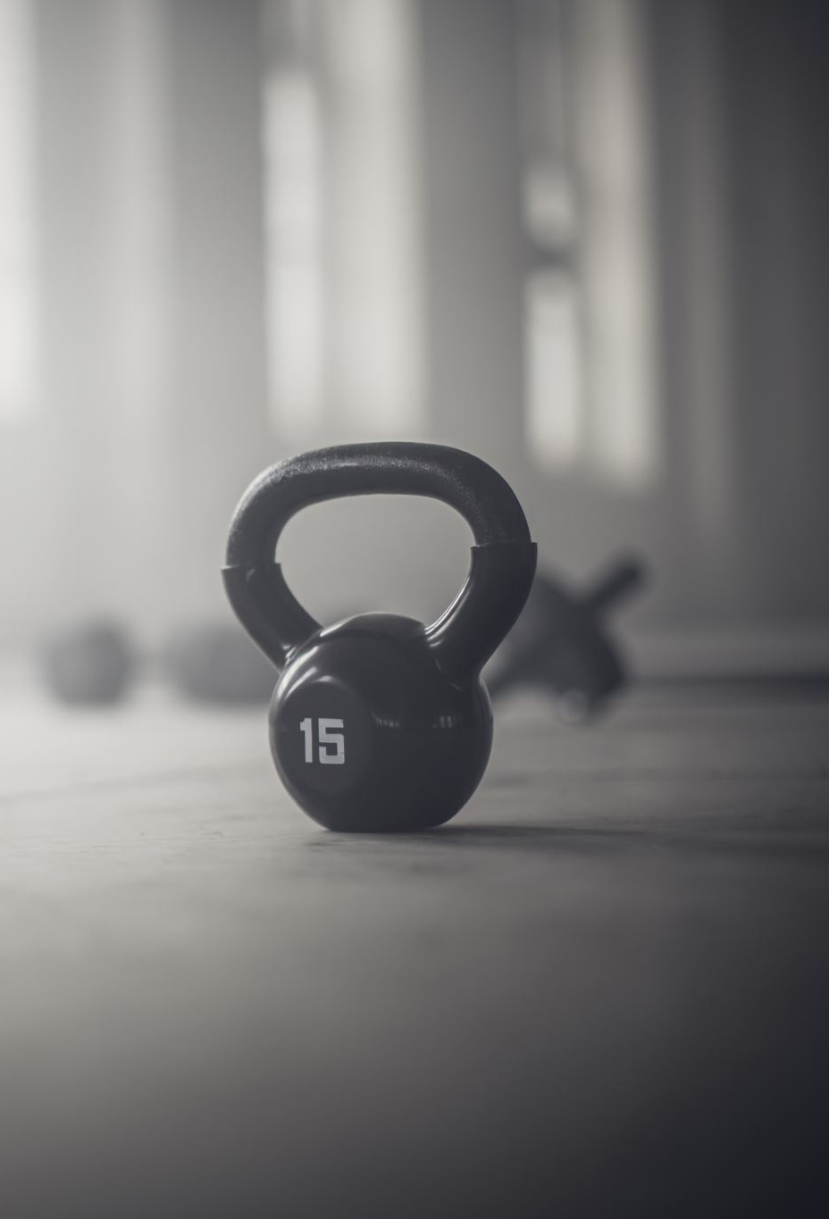
Massaging Acupoints at Home
Acupoints are an amazing tool for maintaining our health because if we know just some major acupoints, we can massage those points ourselves at home. This form of health maintenance is simple, convenient, cheap, and effective.
Acupoints are also very clever. If there’s a problem in that acupoint (indicated by pain when pressed), then massaging it will help you heal that problem and remove the blockage.
If there’s no problem there, then massage it will help you prevent problems from arising. Either way, massaging acupoints and meridians help our health. Don’t be afraid if there’s pain. Massage it daily with as much force as you can tolerate, and it will get better and less painful over time.

Slide 17
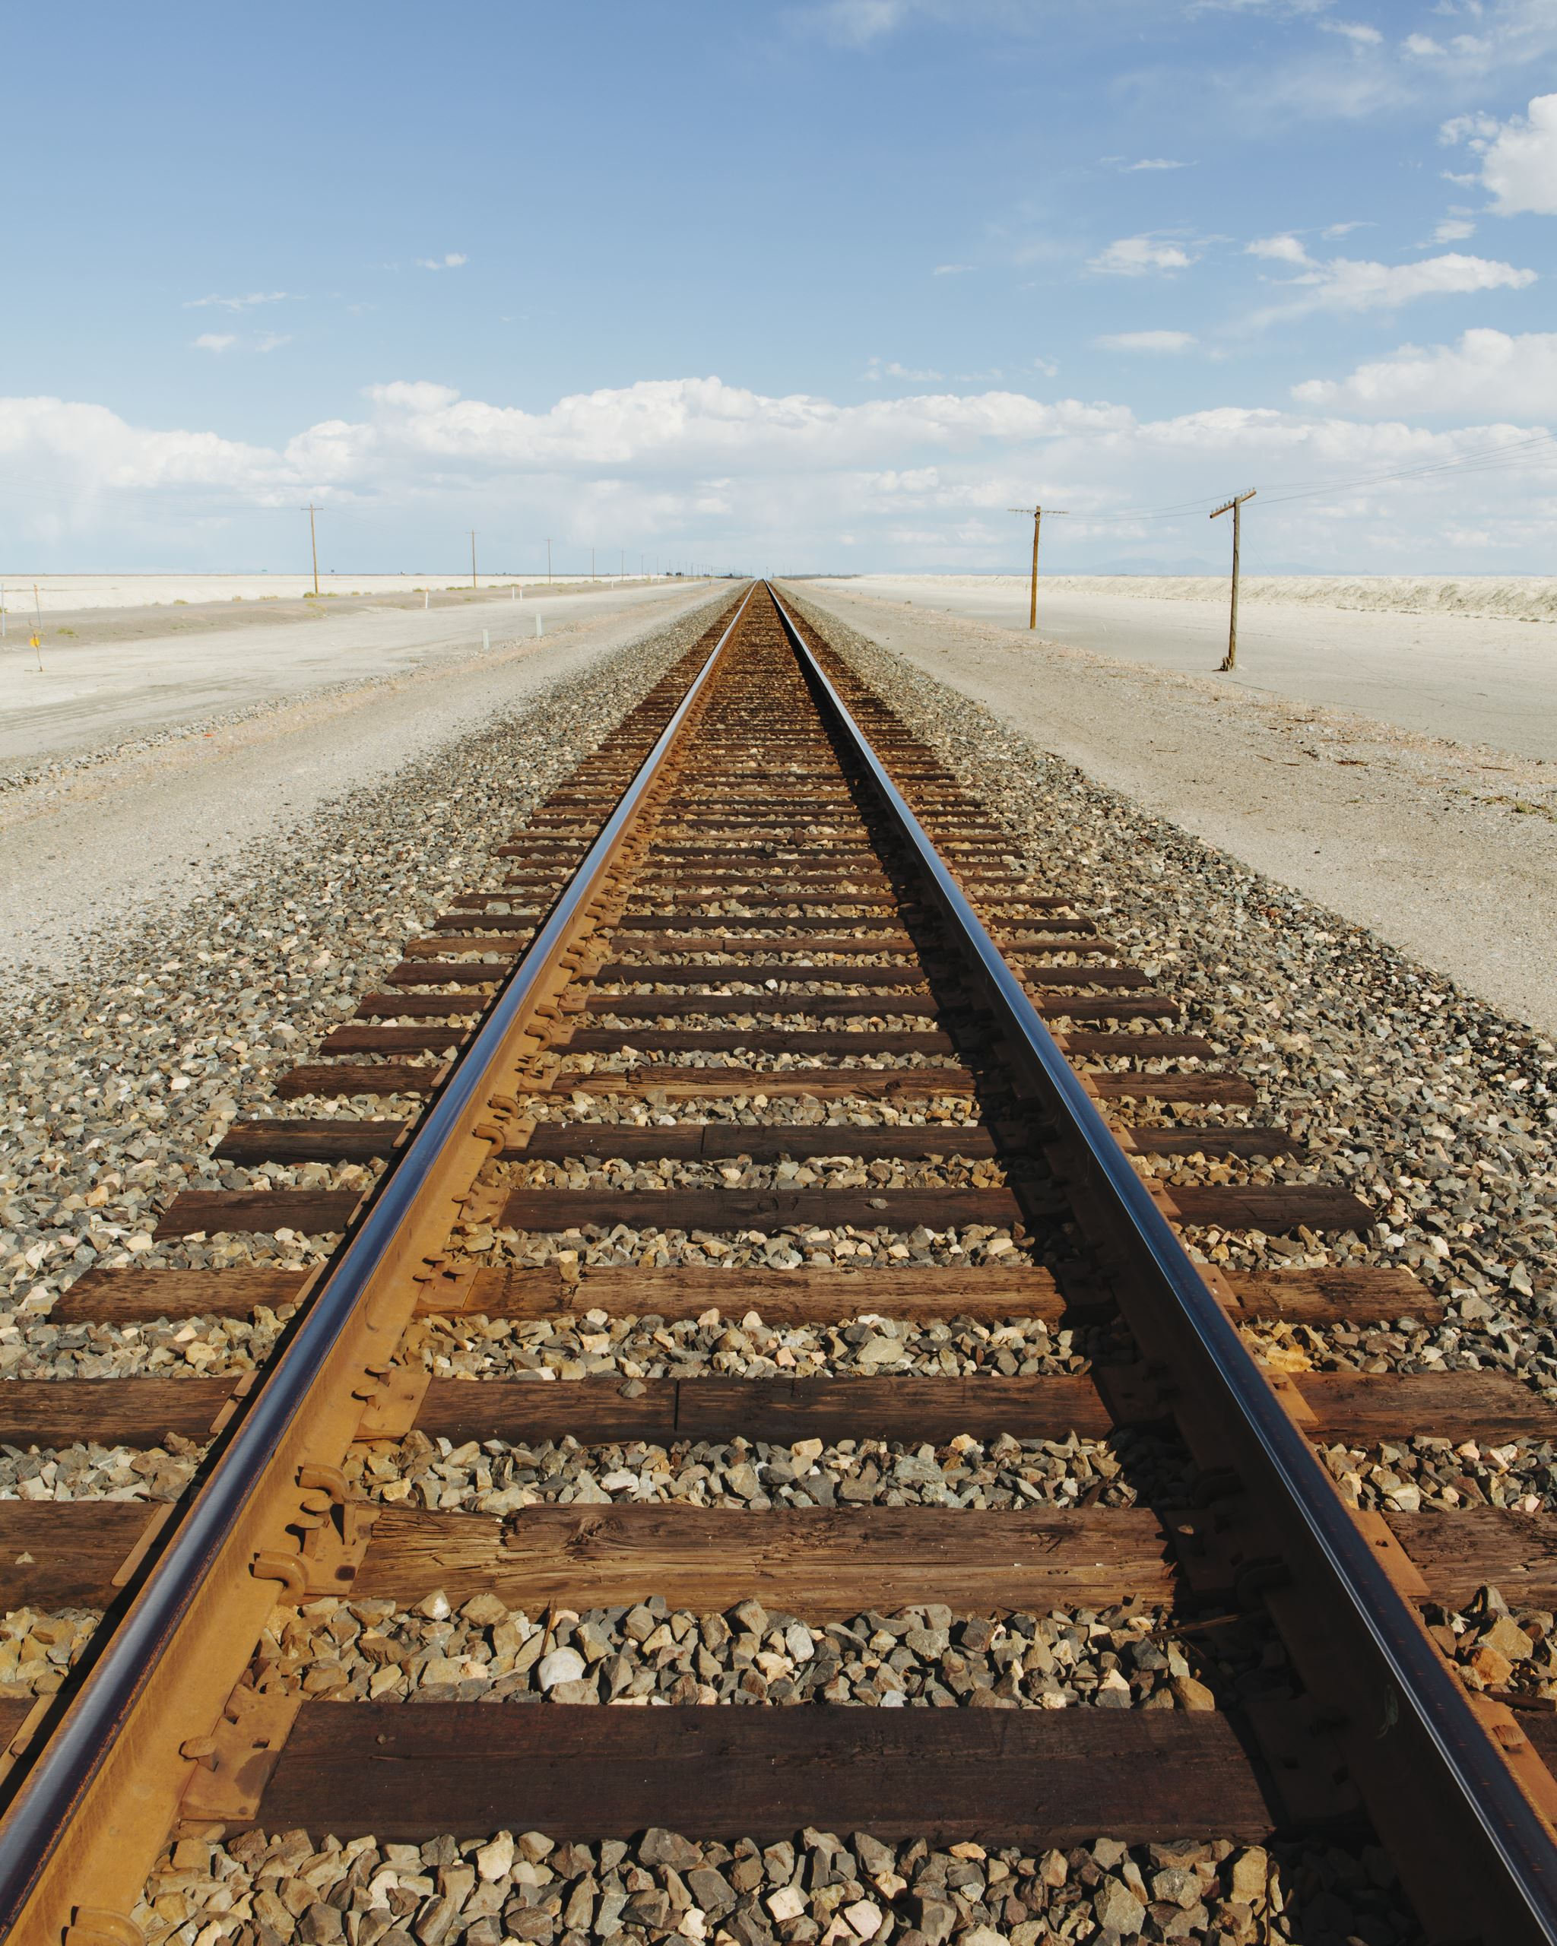
Massaging Acupoints at Home
In terms of how to massage, there are a few ways.
One simple way is to use your thumb or fingers to push on the point back and forth parallel to the tendon.
Another way is to do it clockwise and then counter-clockwise. Yet another way is just to push down on the point, applying pressure.
You should massage the point for at least 5 minutes if you can. If you’re short on time, then you could do 30 times clockwise, then 30 times counter-clockwise.

Slide 18
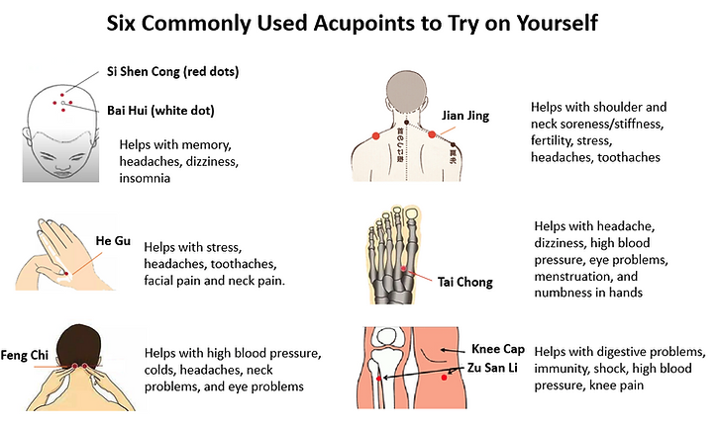

Slide 19
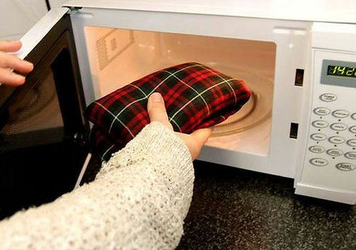
Applying Heat on Acupoints
In addition to massaging acupoints, we can apply heat on those acupoints using microwavable heat bags and wraps that people like to use in the winter.
This is especially helpful after massaging the acupoint, but you could do it without massaging as well.

Slide 20
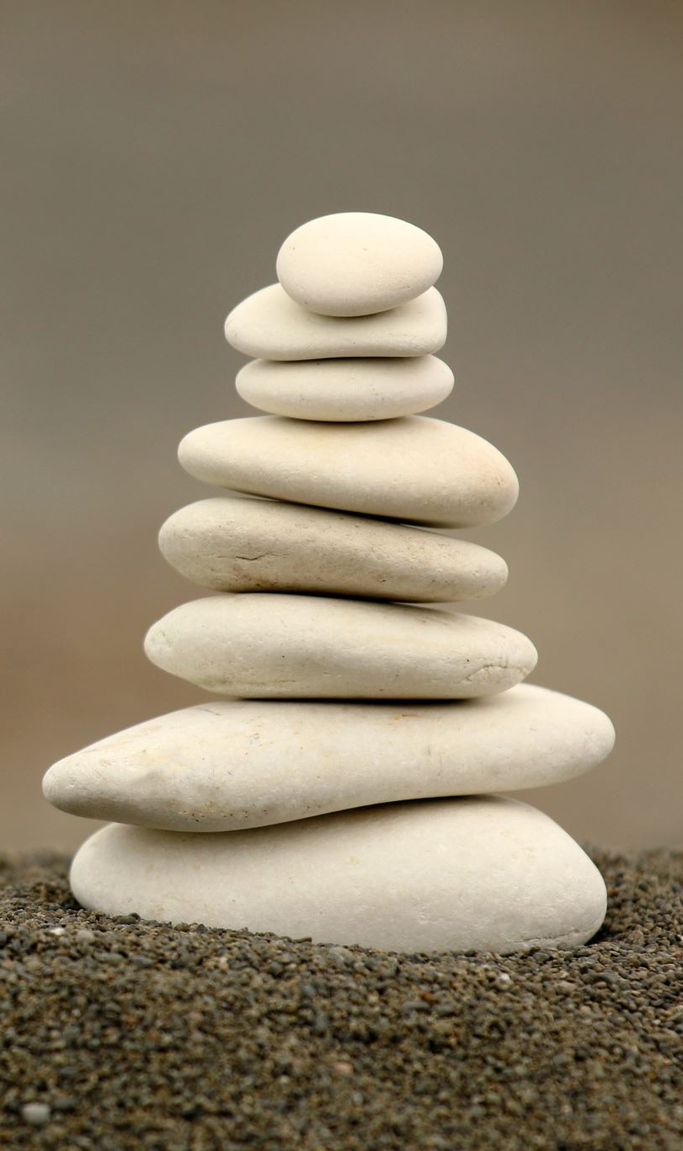
Five Elements (Five Phases)
Apart of Yin Yang, the five elements (also called the five phases) is another foundational concept in TCM.
TCM doctor Lee Smith explains the five elements as “a map to understand change in Chinese medicine through observation of how the seasons change and how our body changes within those seasons.” He also comments that the five elements framework is so insightful yet simple that it probably took a group of Elon Musk level geniuses in ancient China to create.
This framework links nature to our health, organs, emotions, and food. The five elements are wood, fire, earth, metal, and water.

Slide 21
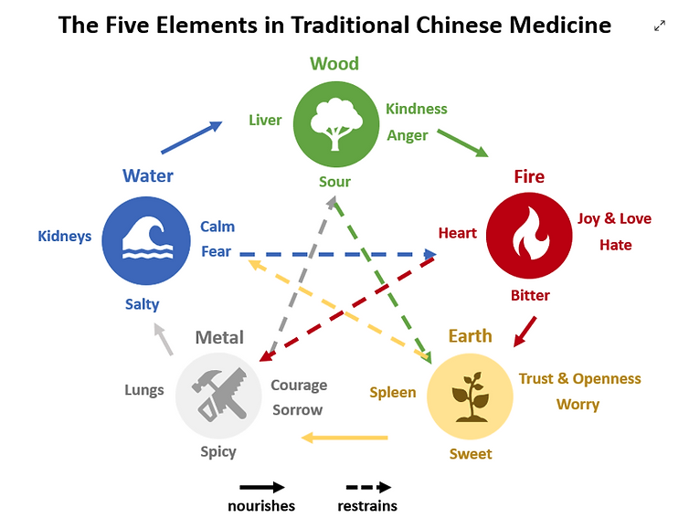

Slide 22
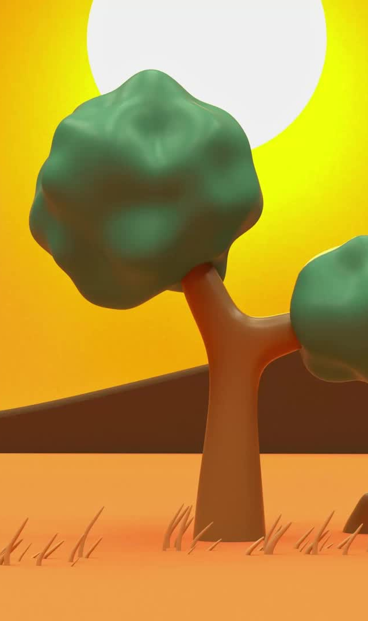
The Nourishing Cycle
To explain the nourishing cycle of the five phases, think of life starting in Spring. There’s a lot of growth; that’s wood. Then comes summer, when there’s a lot of heat; that’s fire. Then comes late summer, when it’s very hot and humid; that’s earth. Then comes autumn, when it’s very dry and airy; that’s metal (similar to the element of air in Ayurveda). Metal is able to shape the other elements, kind of like how a metal knife can cut food. Finally comes winter, when it’s very cold and heavy; that’s water.

Slide 23
The Nourishing Cycle
So how does this relate to health? Well, if one element gets really weak, then it might steal energy from the mother element. For example, let’s say you have a bad diet for a long time, so now your digestive organs (spleen and stomach) are weakened. Since your digestive organs are earth, they might steal energy away from the heart, which is fire. So over time, that might lead to heart palpitations.

Slide 24
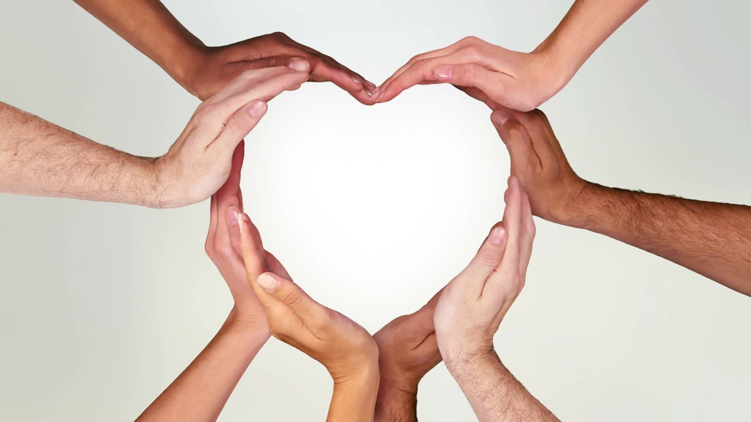
The Nourishing Cycle
Another application of the nourishing cycle is in emotions. Looking at the positive emotions, kindness creates joy and love. When we feel joy and love, we naturally feel trust and openness towards life and people. That then makes us feel courage to do scary things. Courage helps us stay calm.

Slide 25
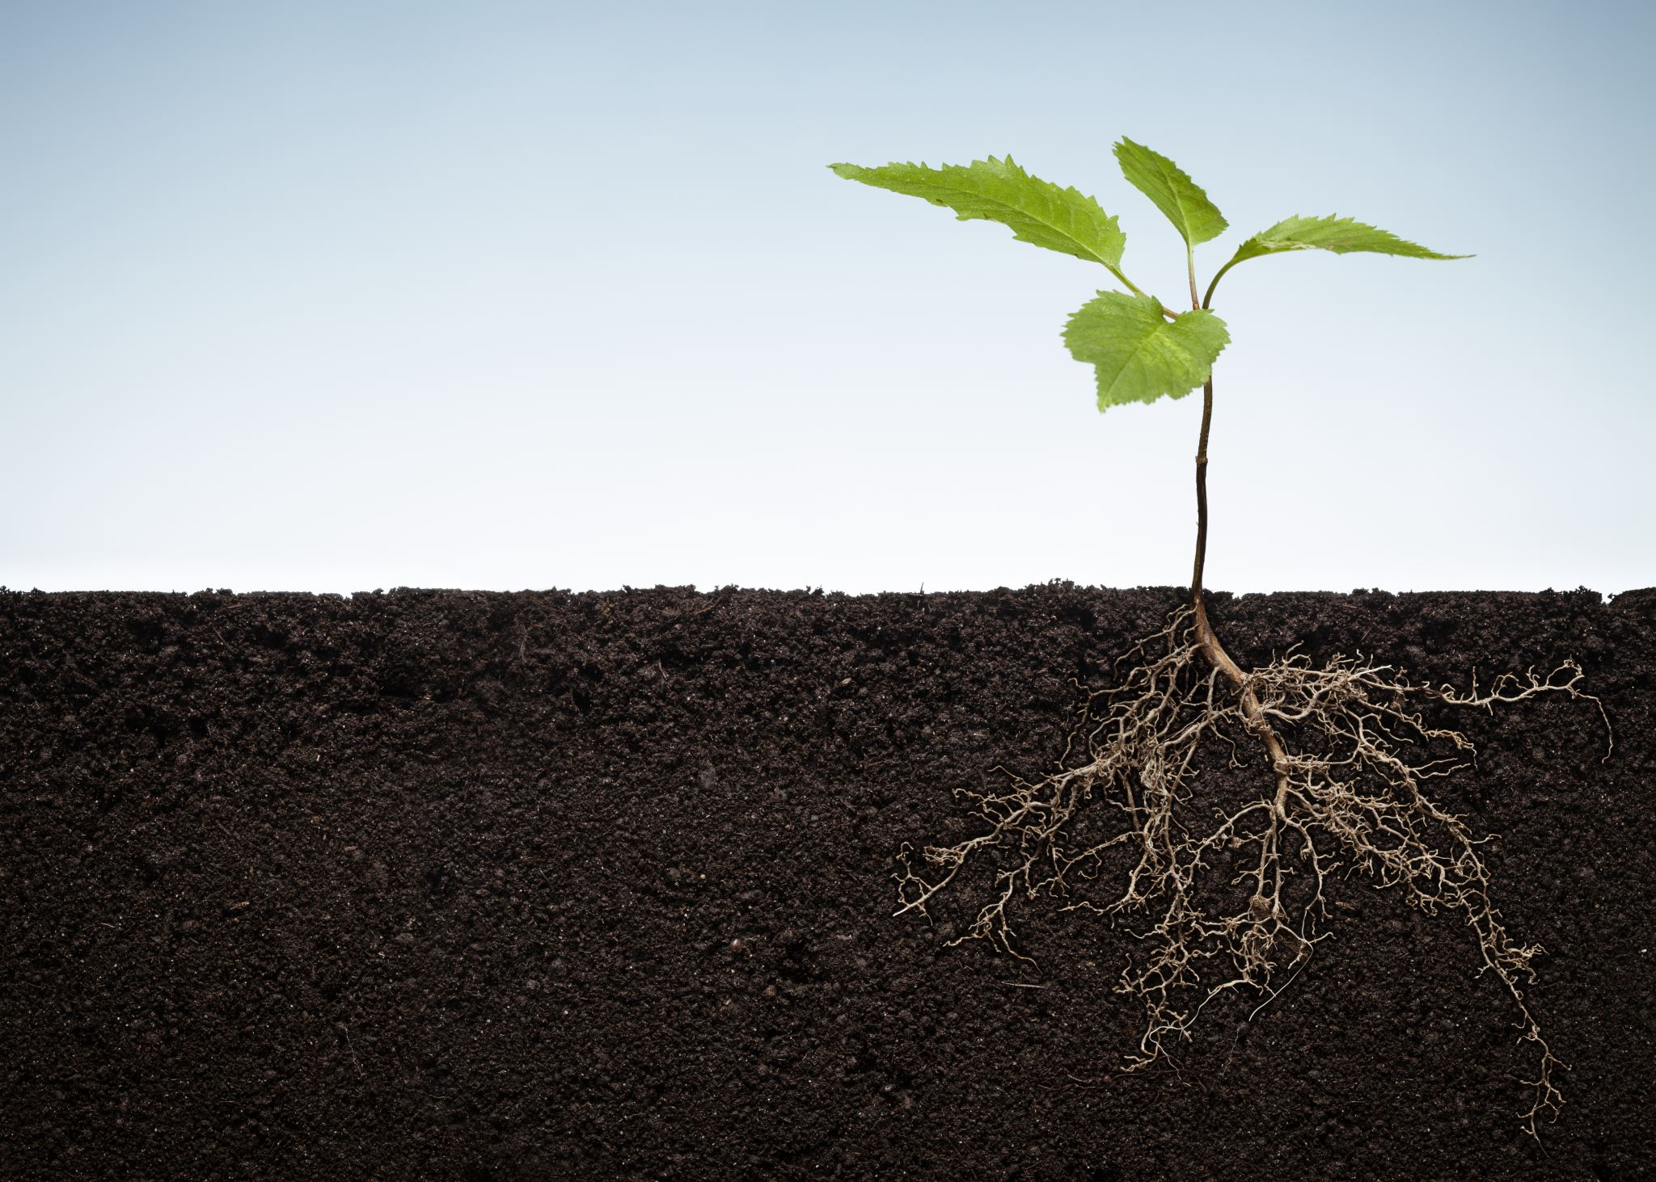
The Restraining Cycle
The restraining cycle, also called control cycle, explains which element restrains which element. The explanations are quite intuitive. Fire controls metal because fire can melt metal. Metal controls wood because a metal ax can chop down wood. Wood controls earth because the roots of a tree can dig into the earth. Earth controls water because the earth absorbs and holds water. Water controls fire because water puts out fire.

Slide 26
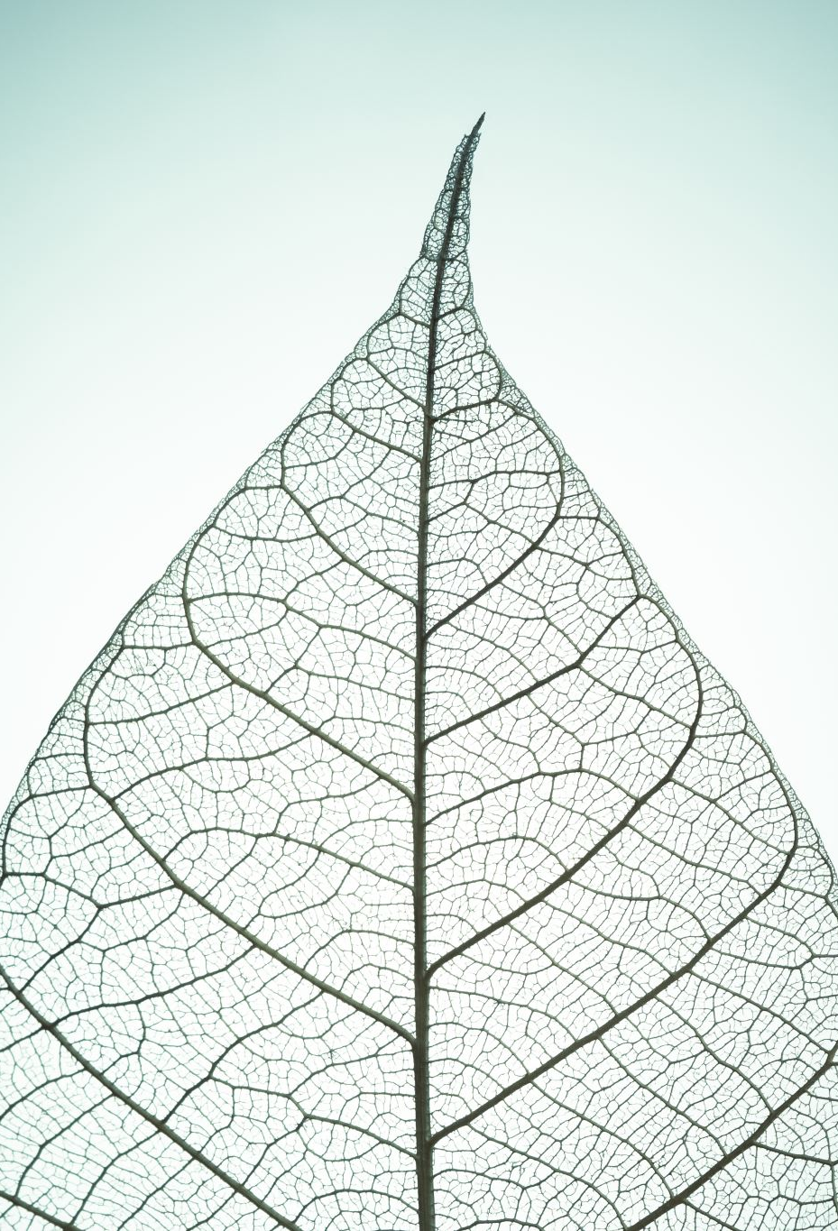
The Restraining Cycle
So how does the restraining cycle relate to health? To give an example, the lungs (metal) suppress the liver (wood). Normally, when we get angry or stressed (two emotions that really affect the liver), taking some deep breaths can calm us down. That’s a healthy relationship of the lungs (metal) suppressing the liver (wood). An unhealthy situation would be if you got so angry or stressed that the lungs are unable to suppress the liver, and then even damages the liver. Indeed, too much stress and anger does damage the liver.

Slide 27
Another application of the restraining cycle can be found in emotions.
  Sorrow (metal) overcomes anger (wood): When people are too sad, they can’t feel anger
  Anger (wood) overcomes worry (earth): When people are too angry, they don’t worry about anything before acting out in rage
  Worry (earth) overcomes fear (water): When people are too worried, they get mentally exhausted and no longer feel fear
  Fear (water) overcomes joy (fire): When people are too fearful, they can’t feel joy
  Joy (fire) overcomes sorrow (metal): When people are very joyful, they obviously don’t feel sad

Slide 28
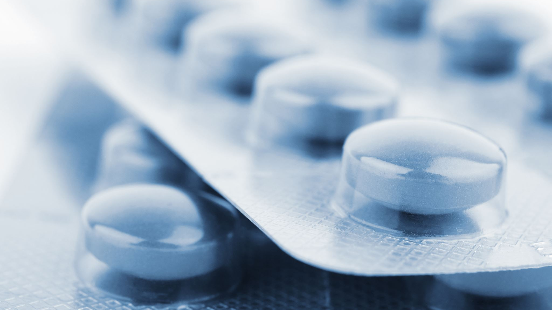
Classwork 3.1 (part 2)
What is “yin yang” and how does it relate to health?
What is “qi” and “blood” in TCM?
What are acupoints and how can we use them for our health?
What are the five elements and how do they relate to health?
How do the five elements relate to our emotions?

Slide 29
Homework 3.1
Discuss these questions:
Knowledge: For each element, list the associated flavor and emotions.
Thinking: If someone eats too much salty food, predict what will happen to their health according to the Five Elements Framework.
Communication and Application: Joe gets angry often, even at small things in life. He often craves sour food too. Explain to Joey how his anger and cravings for sour food are related. What should he do to reduce his anger according to TCM?

Slide 30
See you all!

