Slide 1
Subject-Specific Literacy Test
Short Answer Examples

Slide 2
Table of Contents
Who Ate Pasta First?…………………………………………....slides 3 - 7
How an Eco-Friendly Fish Farm Operates................slides 8 - 10
Simon Jackson: Saving the Spirit Bear………….………slides 11 - 14
New Discoveries: Dinosaur Capital of the World ...slides 15 - 19
I’ll Be Your Server Tonight……………………………..……..slides 20 - 27
Writing, Grammar and Sentence Structure…..…….. slides 28 - 33

Slide 3
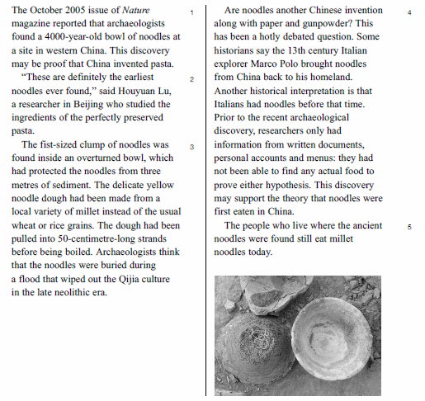
Who Ate Pasta First?

Slide 4
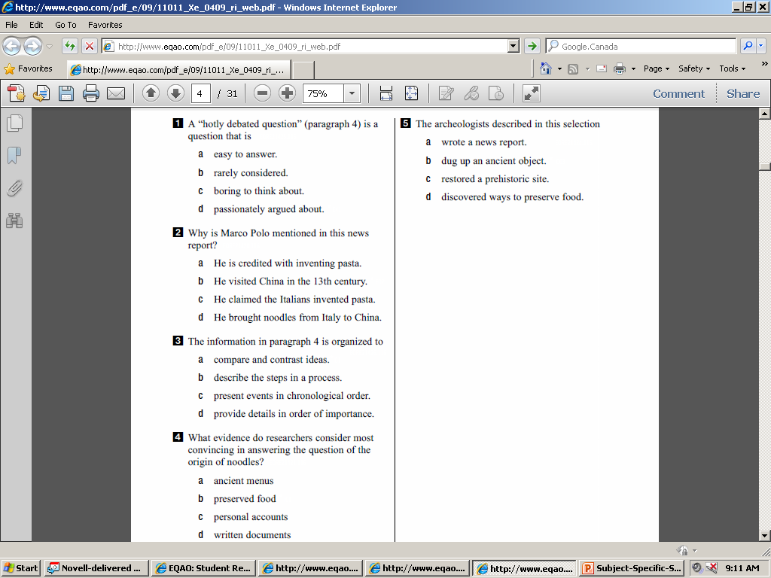
Who Ate Pasta First?

Slide 5
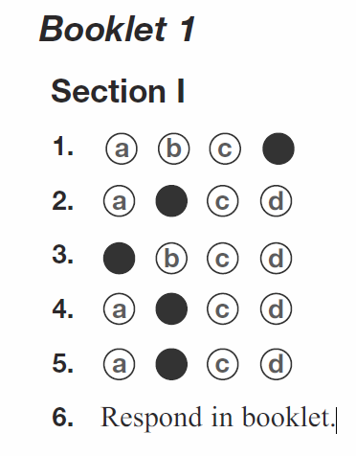
Who Ate Pasta First?

Slide 6
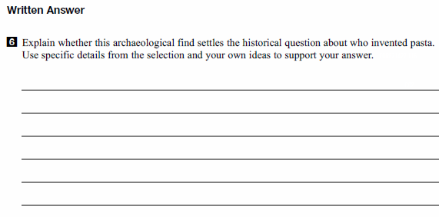
Who Ate Pasta First?

Slide 7
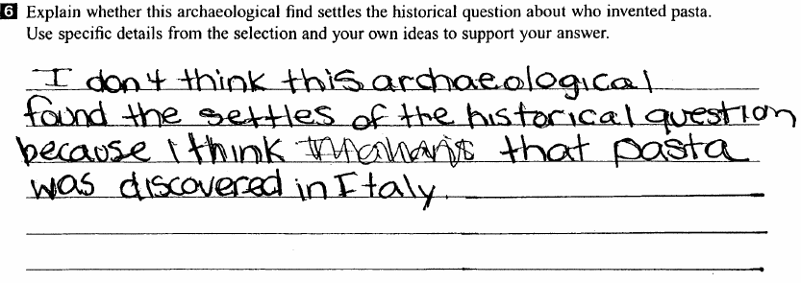
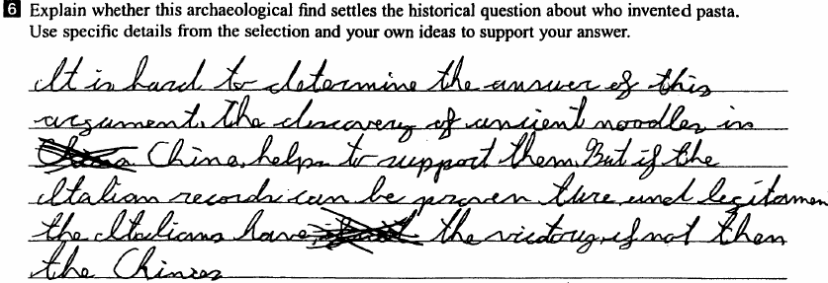
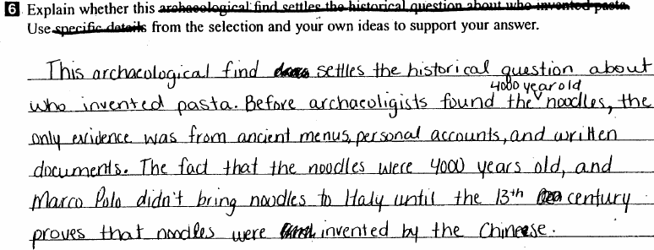
Who Ate Pasta First?
10 points
20 points
30 points

Slide 8
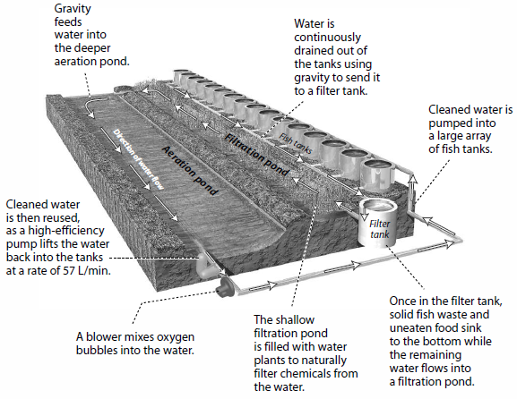
How an Eco-Friendly Fish Farm Operates

Slide 9
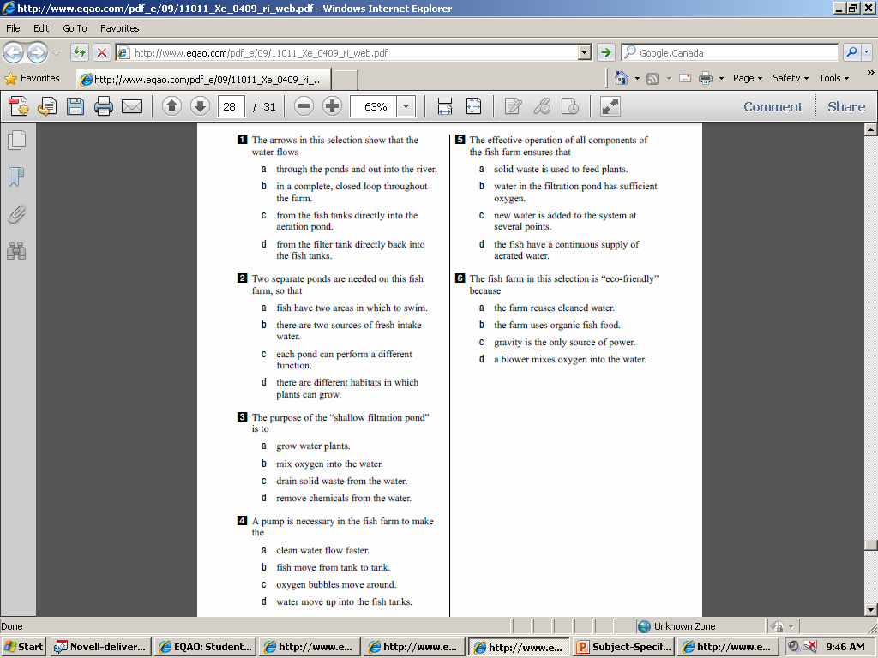
How an Eco-Friendly Fish Farm Operates

Slide 10
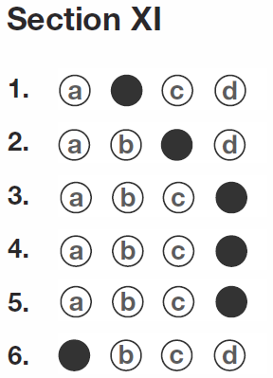
How an Eco-Friendly Fish Farm Operates

Slide 11
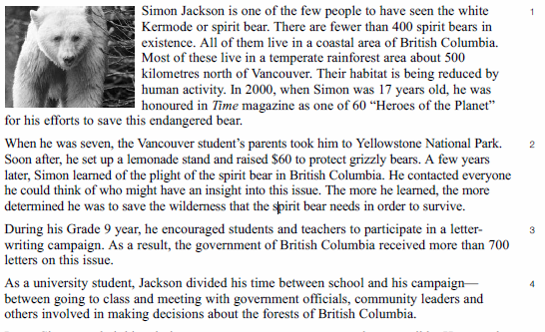
Simon Jackson: Saving the Spirit Bear
Continued…

Slide 12
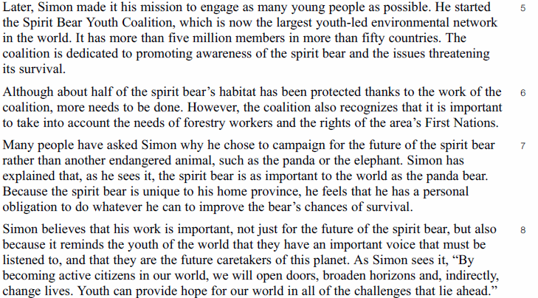
Simon Jackson: Saving the Spirit Bear
Continued….

Slide 13
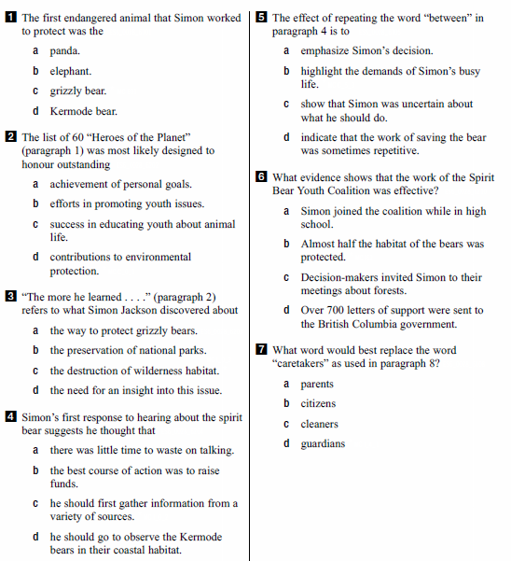
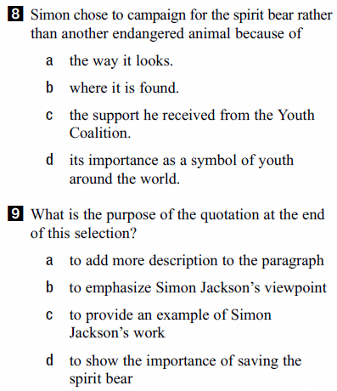
Simon Jackson: Saving the Spirit Bear

Slide 14
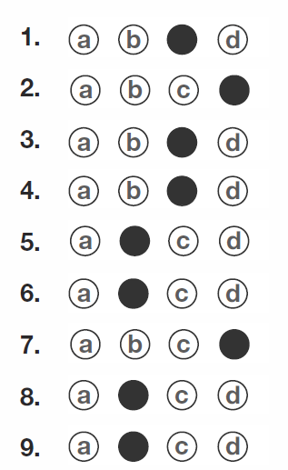
Simon Jackson: Saving the Spirit Bear
Answers

Slide 15
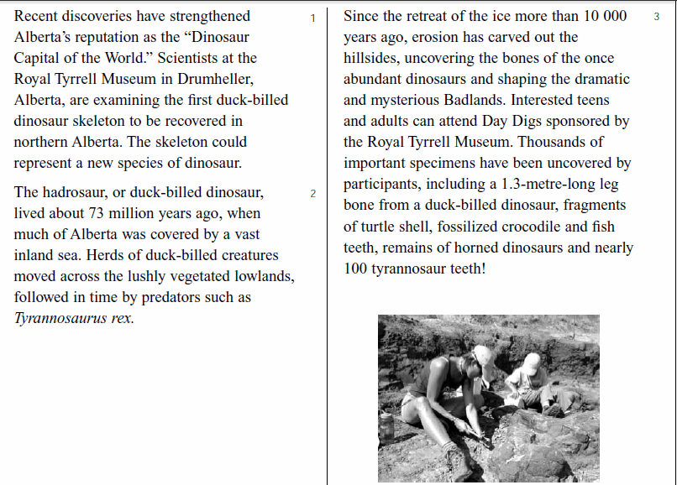
New Discoveries at the Dinosaur Capital of the World

Slide 16
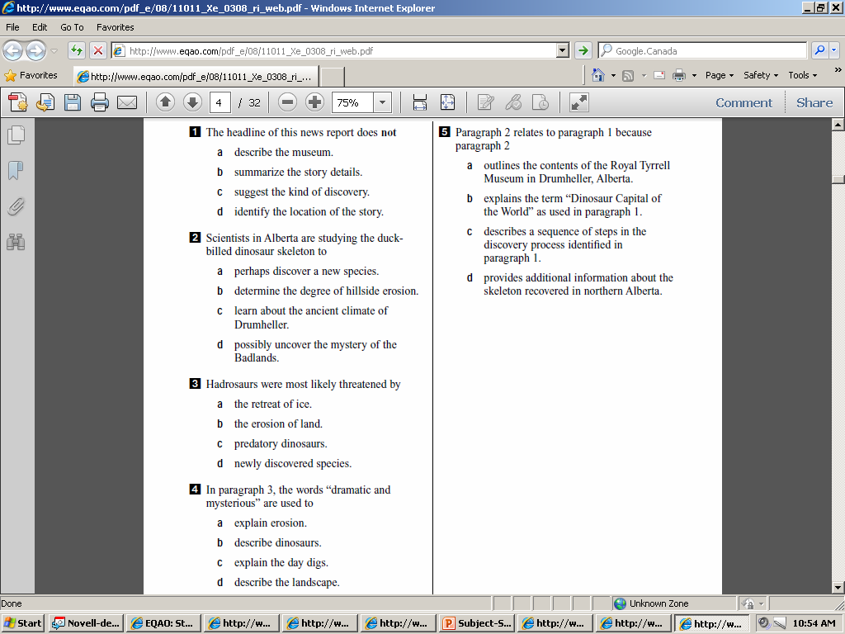
New Discoveries at the Dinosaur Capital of the World

Slide 17
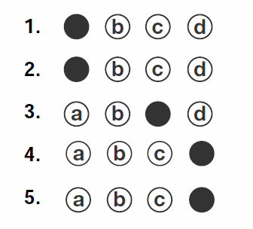
New Discoveries at the Dinosaur Capital of the World

Slide 18
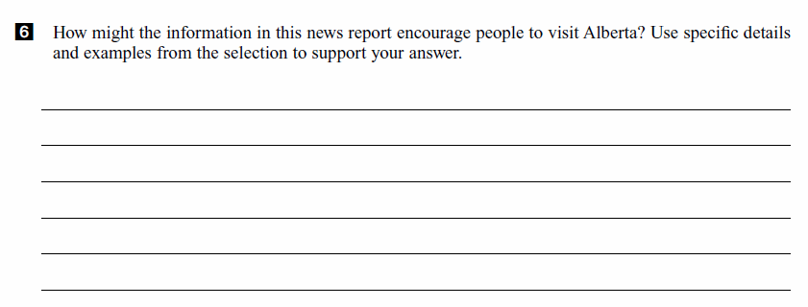
New Discoveries at the Dinosaur Capital of the World

Slide 19
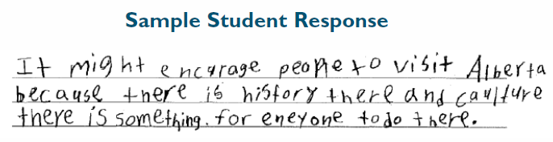
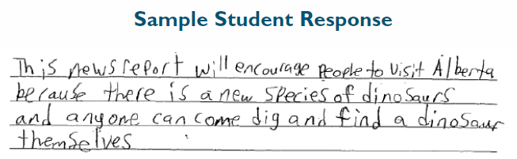
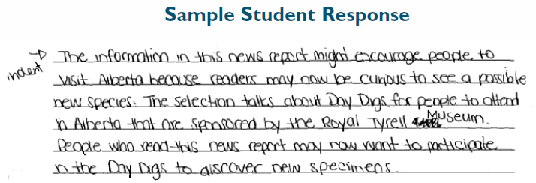
New Discoveries at the Dinosaur Capital of the World
10 points
20 points
30 points

Slide 20
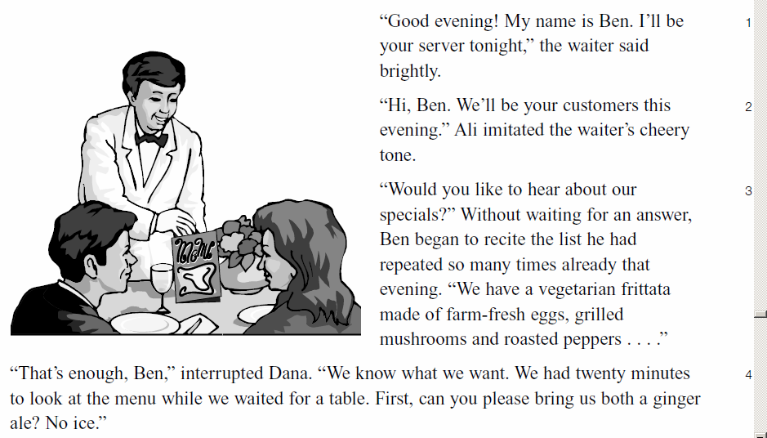
I’ll Be Your Server Tonight
Continued…

Slide 21
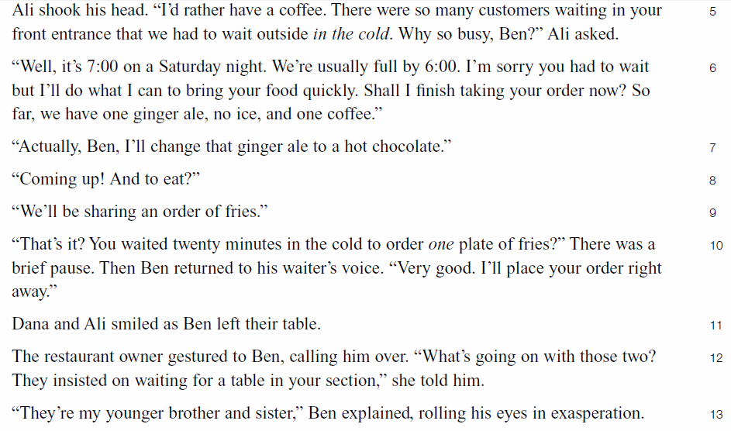
I’ll Be Your Server Tonight

Slide 22
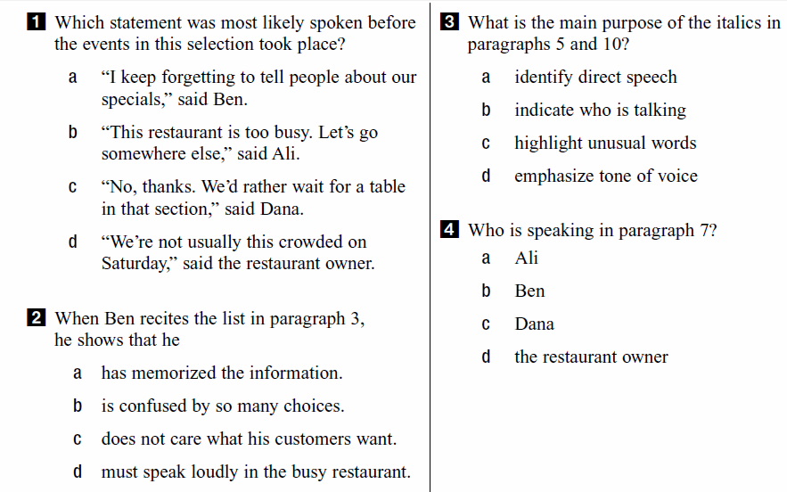
I’ll Be Your Server Tonight

Slide 23
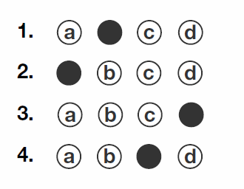
I’ll Be Your Server Tonight

Slide 24
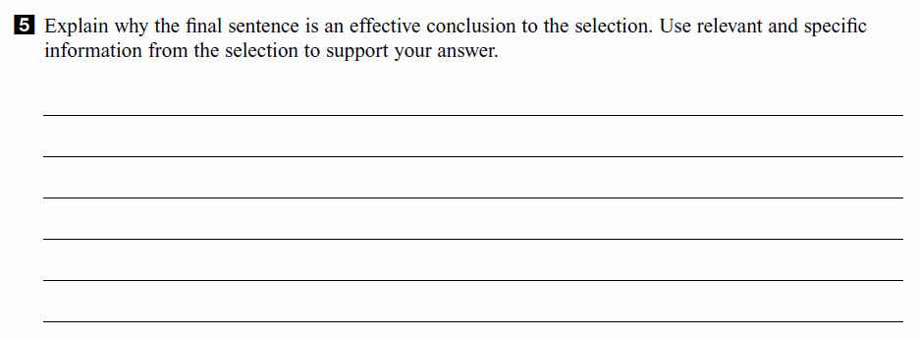
I’ll Be Your Server Tonight

Slide 25
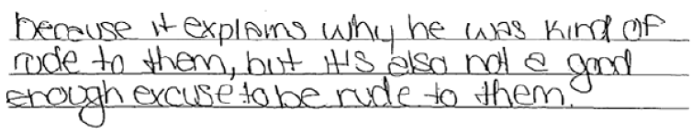
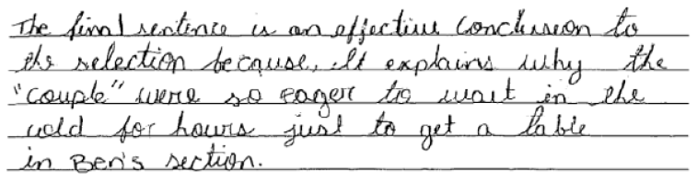
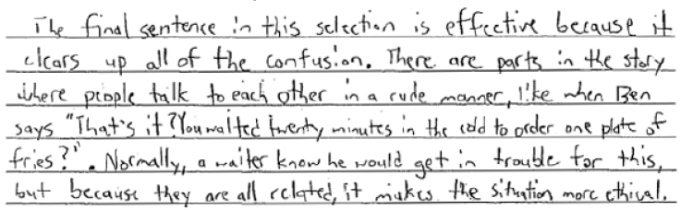
I’ll Be Your Server Tonight
Code 10
Code 20
Code 30

Slide 26
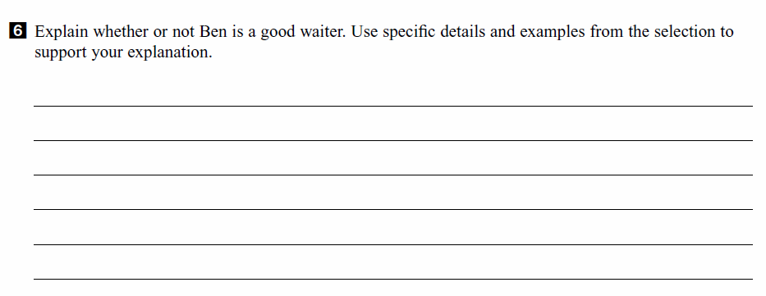
I’ll Be Your Server Tonight

Slide 27
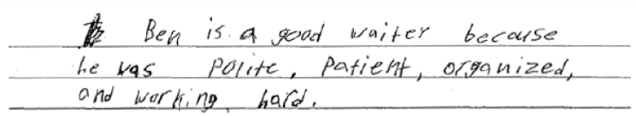
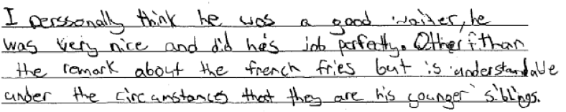
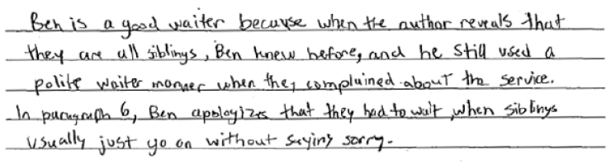
I’ll Be Your Server Tonight
Code 10
Code 20
Code 30

Slide 28
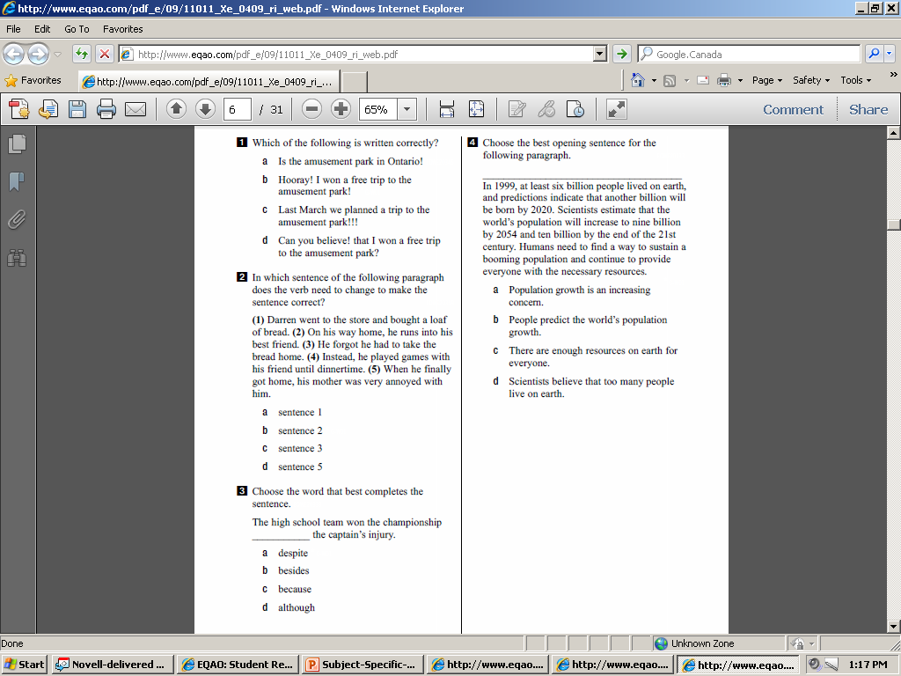
Writing, Grammar and Sentence Structure

Slide 29
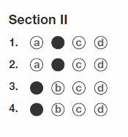
Grammar Answers

Slide 30
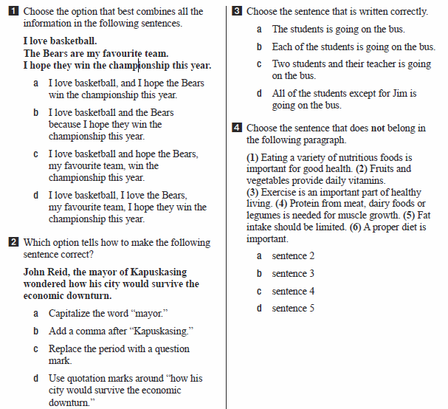
Writing, Grammar and Sentence Structure

Slide 31
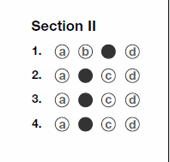
Grammar Answers

Slide 32
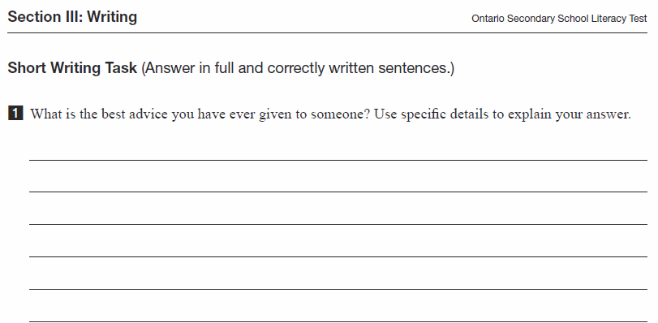
Writing, Grammar and Sentence Structure

Slide 33
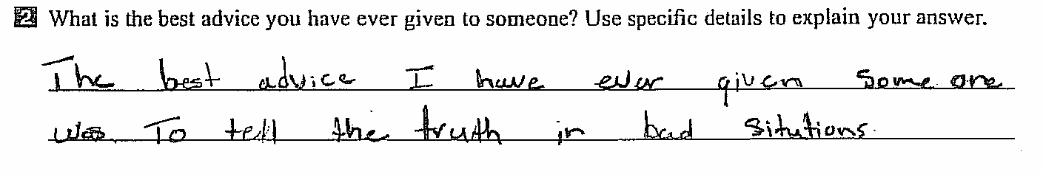
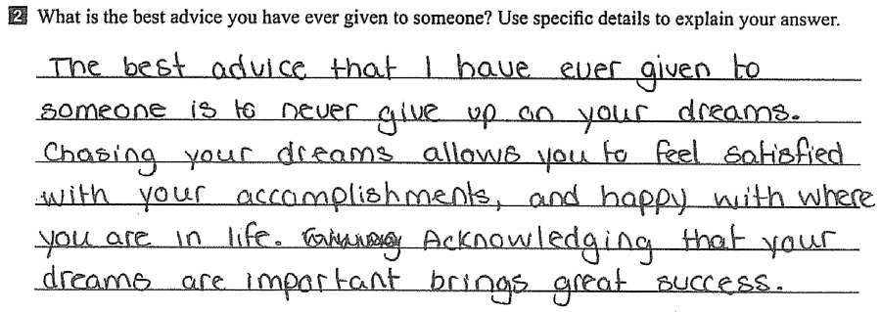
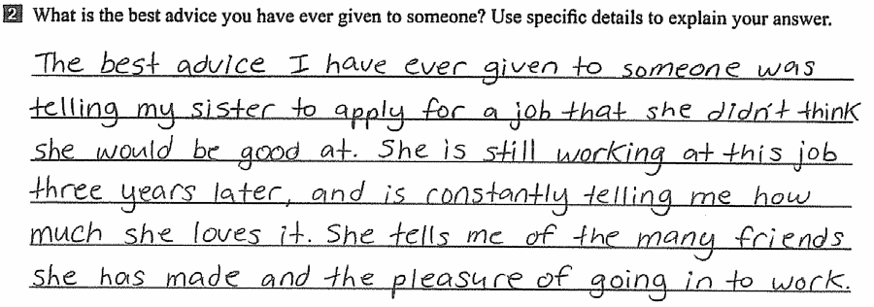
Writing, Grammar and Sentence Structure Answers
10 points
20 points
30 points

