Slide 1
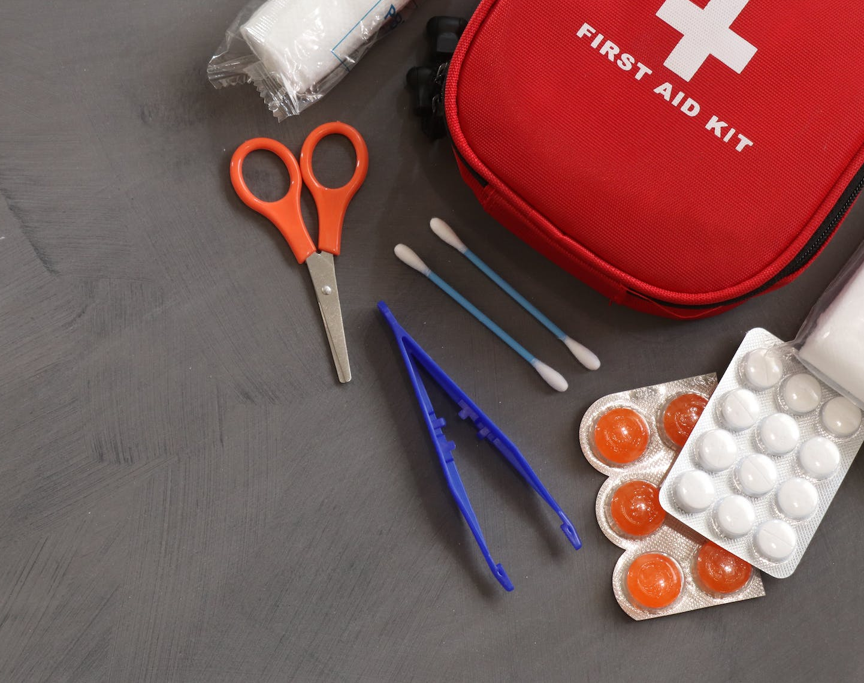
First Aid!

Slide 2

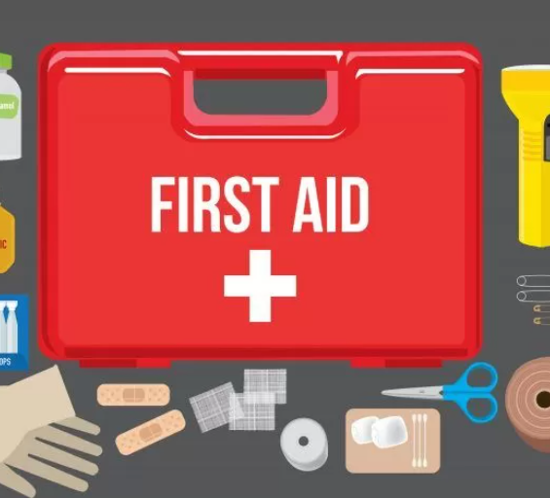
What is First
Aid?
First aid should be used any time there is an illness, injury, or emergency situation that requires treatment and emergency personnel have not arrived.
In some cases, the situation and resulting first aid may be minor - some antibiotic ointment and a bandage for a small cut, for example.
In other cases, it may be an emergency that could save a life, such as performing CPR. You should only administer first aid in more serious cases if you are trained to do so.

Slide 3
What are the ABCs of First Aid?
Airway
Try to find out whether someone is breathing. If not, clear the person’s airway
Breathing
Even after clearing the airway, if a person is not respiring, give rescue breathing.
Circulation
With rescue breathing, do chest compressions to restore blood circulation. Still, if the person is not responsive, check the pulse. If the patient’s heart has stopped, perform chest compressions.

Slide 4
Types of First Aid Emergencies
Bleeding
Choking
Burns
Broken Bone/Fracture
Stopped Heart

Slide 5
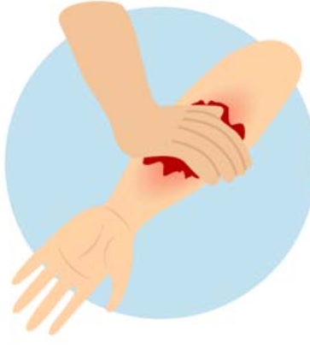
Condition 1: Bleeding
If the injured person is bleeding, first try to figure out the color of the blood and the origin of the bleeding. Bleeding can be from:
Capillaries: Bleeding from these is like a trickle. Such bleeding stops on its own.
Veins: Bleeding from veins is continuous and of dark red color. It can be anything from mild to severe.
Arteries: In arterial bleeding, bright red color spur out. Blood loss can be huge by arterial bleeding.

Slide 6
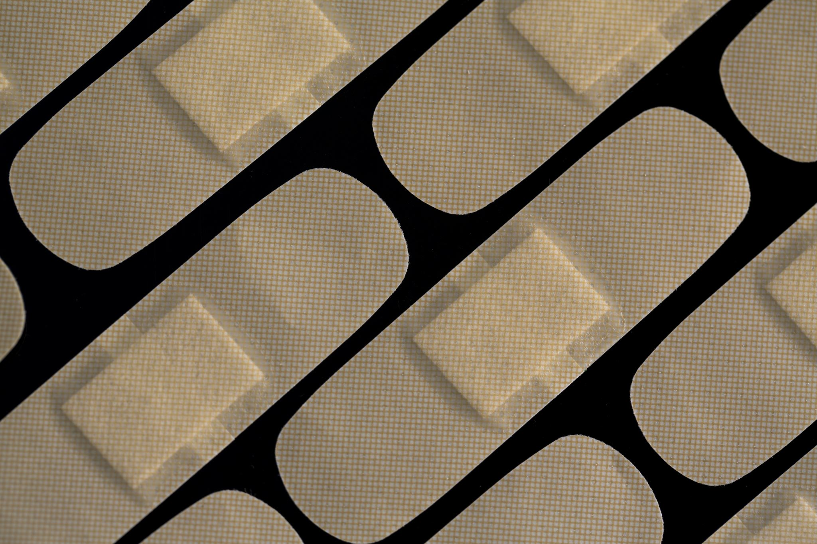
Bleeding-Cont.
Follow these steps to control bleeding:
Wear disposable gloves
Rinse the wound
Cover the wound with a clean cloth or gauze
To stop the blood flow, apply direct pressure on the wound
Elevate the bleeding part above the patient’s head if possible
If the bleeding stops, Put a bandage on the wound

Slide 7
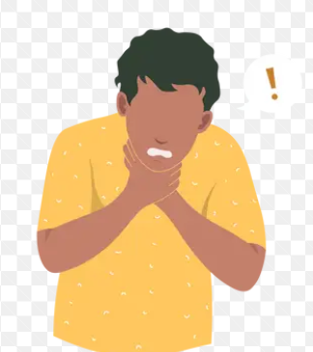
Condition 2: Choking
When any food or object blocks the trachea, choking may happen. Choking can cause sudden unconsciousness or even death. Some common signs of choking are:
Gagging
Gasping
Wheezing
Inability to talk
Bluish discoloration of the face
Grabbing the throat
Use the Heimlich maneuver if a person is choking. Remember, if a person is talking or coughing, they are not choking.

Slide 8
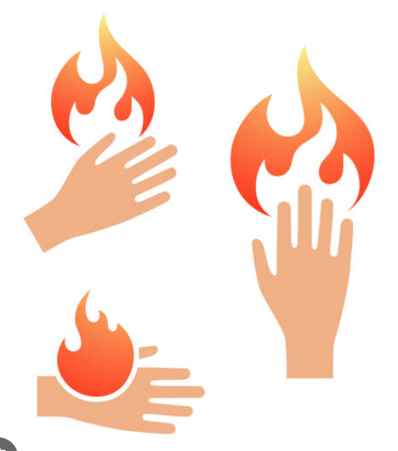
Condition 3-Burns
First, stop the burning process by identifying the type of burn and take the actions such as:
Clean the chemical in case of chemical burning
Turn off electricity in case of electric burn and so on.
For mild burns:
Flush the burned area with running water. Avoid using ice.
Put a light gauze bandage on the burnt area if it is minor.
Never break any blisters formed by burning.

Slide 9
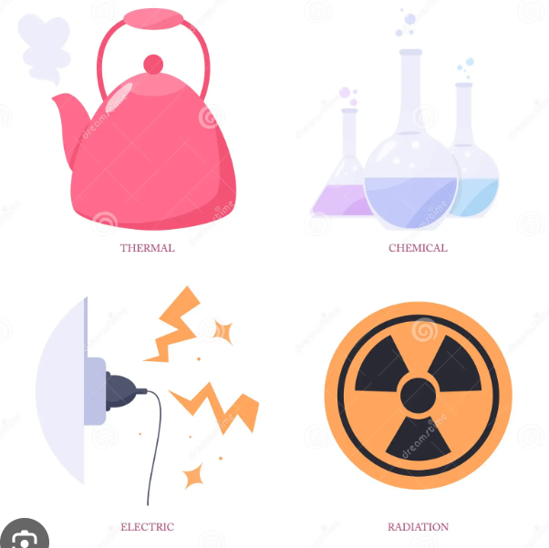
Types of Burns
Thermal burns. These burns are due to heat sources which raise the temperature of the skin and tissues and cause tissue cell death or charring. Hot metals, scalding liquids, steam, and flames, when coming into contact with the skin, can cause thermal burns.
Radiation burns. These burns are due to prolonged exposure to ultraviolet rays of the sun, or to other sources of radiation such as X-ray.
Chemical burns. These burns are due to strong acids, alkalies, detergents, or solvents coming into contact with the skin or eyes.
Electrical burns. These burns are from electrical current, either alternating current (AC) or direct current (DC).

Slide 10
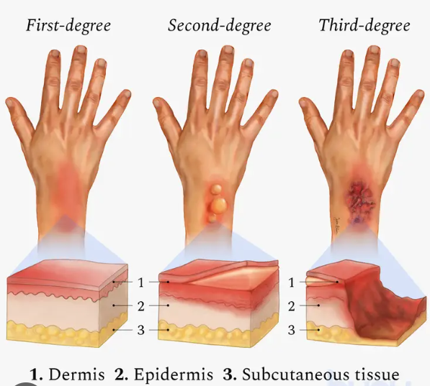
Burn Degrees
First-degree (superficial) burns
First-degree burns affect only the epidermis, or outer layer of skin. The burn site is red, painful, dry, and with no blisters. Mild sunburn is an example. Long-term tissue damage is rare and usually involves an increase or decrease in the skin color.
Second-degree (partial thickness) burns
Second-degree burns involve the epidermis and part of the dermis layer of skin. The burn site appears red, blistered, and may be swollen and painful.
Third-degree (full thickness) burns
Third-degree burns destroy the epidermis and dermis. Third-degree burns may also damage the underlying bones, muscles, and tendons. When bones, muscles, or tendons are also burned, this may be referred to as a fourth-degree burn. The burn site appears white or charred. There is no feeling in the area since the nerve endings are destroyed.

Slide 11

How do we treat burns?
For minor burns:
Cool the burn. Hold the area under cool (not cold) running water for about 10 minutes. If the burn is on the face, apply a cool, wet cloth until the pain eases. For a mouth burn from hot food or drink, put a piece of ice in the mouth for a few minutes.
Remove rings or other tight items from the burned area. Try to do this quickly and gently, before the area swells.
Don't break blisters. Blisters help protect against infection. If a blister does break, gently clean the area with water and apply an antibiotic ointment.
Apply lotion. After the burn is cooled, apply a lotion, such as one with aloe vera or cocoa butter. This helps prevent drying and provides relief.
Bandage the burn. Cover the burn with a clean bandage. Wrap it loosely to avoid putting pressure on burned skin. Bandaging keeps air off the area, reduces pain and protects blistered skin.
If needed, take a nonprescription pain reliever, such as ibuprofen (Advil, Motrin IB, others), naproxen sodium (Aleve) or acetaminophen (Tylenol, others).

Slide 12
How do we treat MAJOR burns?
Until emergency help arrives:
Protect the burned person from further harm. If you can do so safely, make sure the person you're helping is not in contact with the source of the burn. For electrical burns, make sure the power source is off before you approach the burned person. Don't try to remove clothing stuck in the burn.
Make certain that the person burned is breathing. If needed, begin rescue breathing if you know how.
Remove jewelry, belts and other tight items, especially from the burned area and the neck. Burned areas swell quickly.
Cover the burn. Loosely cover the area with gauze or a clean cloth.
Raise the burned area. Lift the wound above heart level if possible.
Watch for signs of shock. Signs and symptoms include cool, clammy skin, weak pulse and shallow breathing.

Slide 13
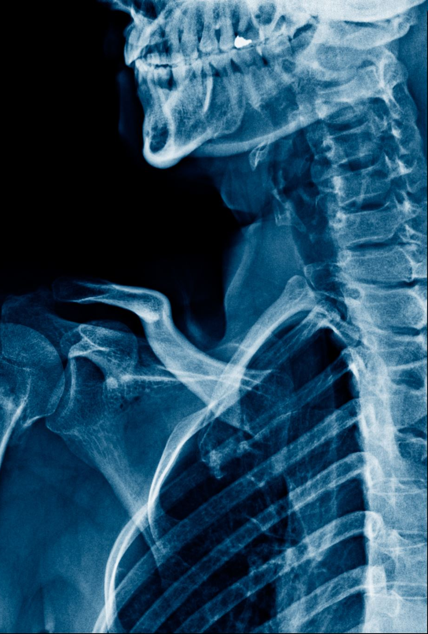
Condition 4-Broken Bone/Fracture
We should consider any injury causing pain and swelling in limbs, hands, and feet as a potential broken bone until the X-ray says otherwise. A prompt first aid can help stabilize the broken bone till you are not reaching the hospital.
Remember whatever the condition is it is always better to call medical helpline in case of any emergency.
It is always better to receive formal training in first aid techniques. First aid training may help you make the right choice if you or your loved ones encounter any medical emergency. Even if you do not have any first aid training, it is always better to learn ABC and how to perform CPR.
First aid techniques can be a lifesaver, and we should be aware of these.

Slide 14
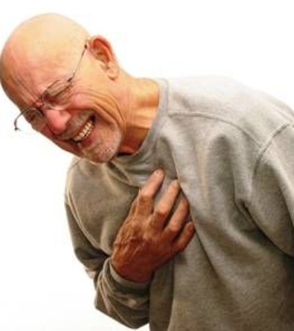
Condition 5:Stopped Heart
Cardiopulmonary resuscitation (CPR) is the most critical emergency medical procedure that everyone should know.
If a patient’s heart is not beating, performing CPR can save that life

Slide 15
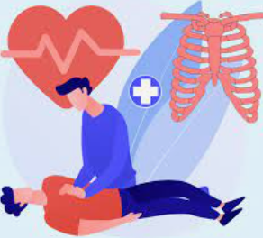
CPR
CPR stands for Cardiopulmonary Resuscitation
This is a surefire method to try and get the heart to continue beating!

Slide 16

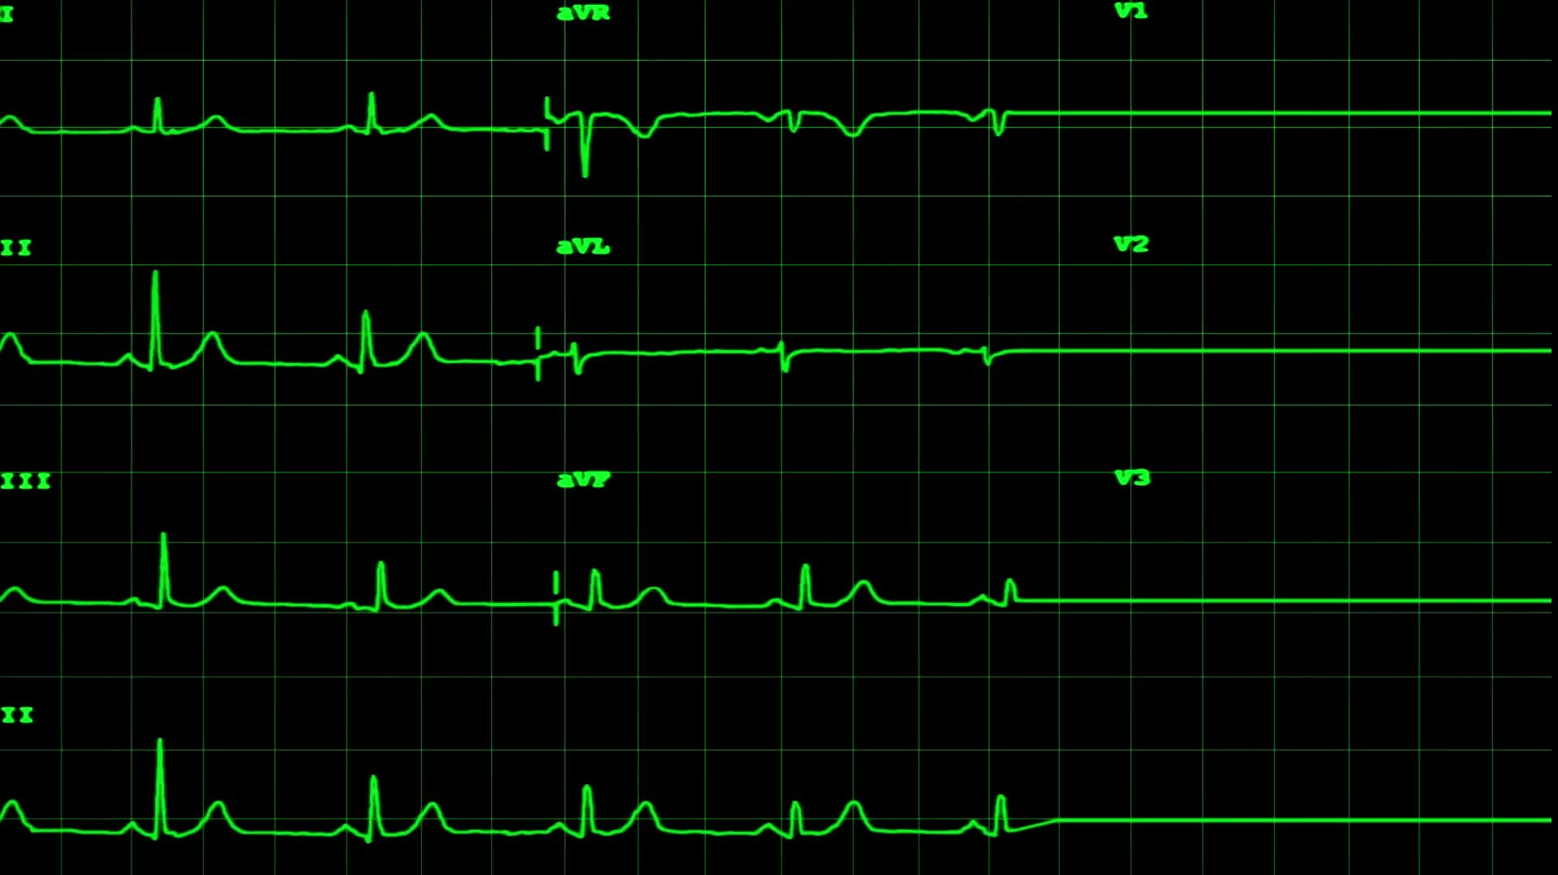



How do you perform CPR?
According to the American Red Cross, there are 7 steps involved in CPR:

Slide 17
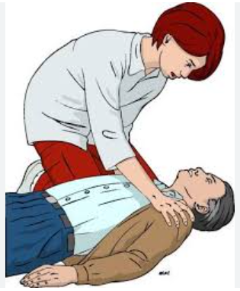
1. CHECK the scene for safety, form an initial impression and use personal protective equipment (PPE)
2. f the person appears unresponsive, CHECK for responsiveness, breathing, life-threatening bleeding or other life-threatening conditions using shout-tap-shout
3. If the person does not respond and is not breathing or only gasping, CALL 9-1-1 and get equipment, or tell someone to do so
4.Kneel beside the person. Place the person on their back on a firm, flat surface

Slide 18
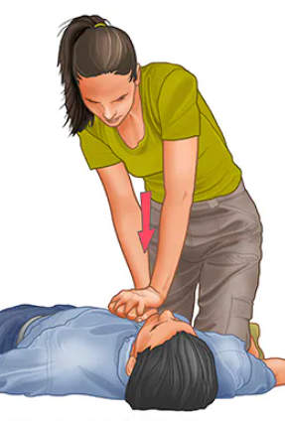
5. Give 30 chest compressions
Hand position: Two hands centered on the chest
Body position: Shoulders directly over hands; elbows locked
Depth: At least 2 inches
Rate: 100 to 120 per minute
Allow chest to return to normal position after each compression

Slide 19
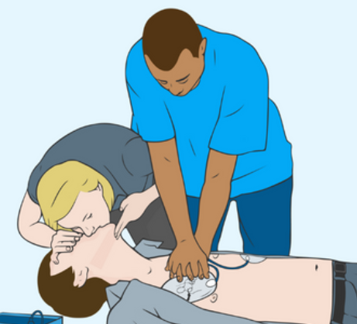
Give 2 breaths
Open the airway to a past-neutral position using the head-tilt/chin-lift technique
Pinch the nose shut, take a normal breath, and make complete seal over the person’s mouth with your mouth.
Ensure each breath lasts about 1 second and makes the chest rise; allow air to exit before giving the next breath
Note: If the 1st breath does not cause the chest to rise, retilt the head and ensure a proper seal before giving the 2nd breath If the 2nd breath does not make the chest rise, an object may be blocking the airway

Slide 20
Continue giving sets of 30 chest compressions and 2 breaths. Use an AED as soon as one is available! Minimize interruptions to chest compressions to less than 10 seconds.

