Slide 1
Food Safety

Slide 2
Food poisoning symptoms
The most common symptoms of food poisoning are:
Diarrhea
Stomach pain or cramps
Nausea
Vomiting
Fever

Slide 3

If you have diarrhea or vomiting, be sure to drink plenty of fluids to prevent dehydration (not having enough water in your body).

Slide 4

Should I see a Doctor for Food Poisoning?
See a doctor if you have any symptoms that are severe, including:
Bloody diarrhea
Diarrhea that lasts more than 3 days
High fever (temperature over 102°F)
Vomiting so often that you cannot keep liquids down
Signs of dehydration, which include not urinating (peeing) much, a dry mouth and throat, feeling dizzy when standing up
See your doctor if you are pregnant and have a fever and other flu-like symptoms. Some mild infections can cause problems with pregnancy.

Slide 5
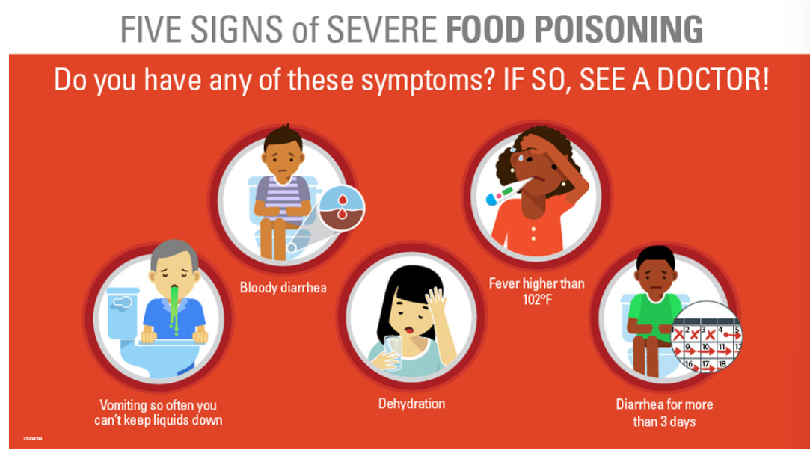

Slide 6

4 steps to prevent food poisoning
Clean
1
Wash your hands and work surfaces before, during, and after preparing food. Germs can survive in many places around your kitchen, including your hands, utensils, cutting boards, and countertops.
Separate
2
Separate raw meat, chicken and other poultry, seafood, and eggs from ready-to-eat foods. Use separate cutting boards and keep raw meat away from other foods in your shopping cart and refrigerator.
Cook
3
Cook food to the safe internal temperature to kill harmful bacteria. Use a food thermometer.
Chill
4
Keep your refrigerator 40°F or below. Refrigerate leftovers within 2 hours of cooking (or within 1 hour if food is exposed to a temperature above 90°F, like in a hot car).

Slide 7
Discussion time!
When buying raw meat, where should it be stored in the fridge? Why?
Should you wash your veggies? (Why? How should you wash them?)
What should you do if you have food poisoning (what to eat, drink)
Why is personal hygiene important? How does that relate to cooking?
What kinds of food are at higher riks of causing food poisoning?

Slide 8
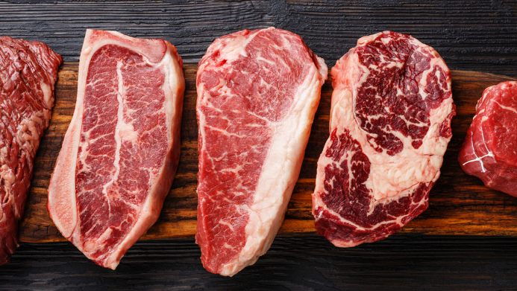
How to handle food-raw meat
Don’t leave raw meat out at room temperature. Always store it in the fridge or freezer.
Store raw meat away from any cooked food or food that doesn’t get cooked (like raw fruit, vegetables, and salad).
The best place to store raw meat is at the bottom of your fridge. This stops any leaking juices (which may contain harmful bacteria) from dripping onto other foods.
Storing raw meat in containers will catch any juices and save unnecessary cleaning up. Make sure containers are cleaned after use.
When you marinate meat, keep it in the fridge in a sealed container

Slide 9
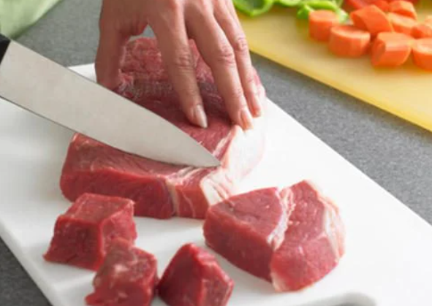
Prepping the raw meat
Ensure meat juices do not drip onto other foods.
Completely defrost frozen meat before cooking to make sure it cooks evenly. Don’t defrost it at room temperature on the benchtop – prepare ahead and defrost it overnight in your fridge. If you forget or are short on time, use the defrost setting on your microwave.
Ideally, use separate chopping boards, utensils, and serving plates for raw meat. If you only have one board or knife, make sure to clean it with hot, soapy water after using it for meat.
Wash your hands with soap and hot water immediately after handling raw meat to prevent any cross-contamination with other surfaces or foods.

Slide 10
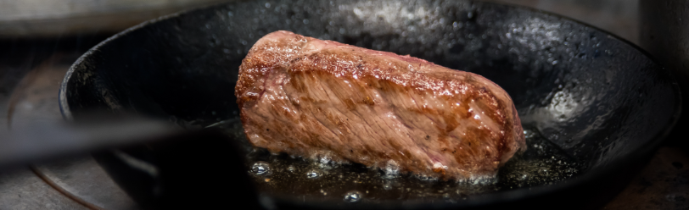
Cooking meat and meat prodicts
Usually when meat is available in whole pieces, like fillets or cuts, bacteria only sits on the surface. As soon as it is minced, bacteria gets transferred throughout the product. Therefore, minced meat needs to be cooked thoroughly.
Intact steaks only need surface cooking (searing or flame grilling).
All other meat and meat products need to be cooked through. This includes blade-tenderized steaks (often pre-marinated), poultry meat, and all minced meat products (like beef, pork, chicken, or lamb burgers, and sausages and dumplings).
Cook meat all the way through, until juices run clear.

Slide 11

Meat (cont.)
if you can, use a meat thermometer to check it’s cooked through. Insert it into the middle of the thickest part of the meat. It should read an internal temperature of 75 degrees Celsius for 30 seconds after cooking, 70 degrees Celsius after 3 minutes, or 65 degrees Celsius after 15 minutes.
Convenience foods that contain minced meat might look cooked, but the meat in the centre could still be undercooked. In particular, be mindful with frozen products like chicken nuggets or dumplings.
Never place cooked meat or meat products onto the same dish or board that held raw meat.
Do not serve cooked meat with the same utensils used for raw meat.

Slide 12
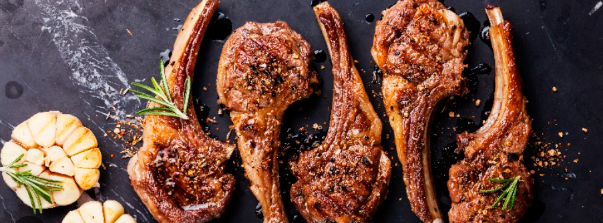
Leftovers!
Heat leftover marinade to boiling before pouring it onto cooked meat and meat products.
Reheat leftovers thoroughly – until steaming hot (over 75 degrees Celsius) – and do not reheat more than once.
If in doubt, cook the meat or meat products for longer or throw it out.

Slide 13
Here are 6 Extra Tips for Food Safety!
Refrigerate your leftovers
Did you know that perishable food should not be left out for more than two hours at room temperature
Wash your hands before or after handling raw meat
To reduce the growth of bacteria and cross-contamination, wash your hands, utensils and cooking surfaces.
Check your refrigerator temperature
Make sure the fridge is set to no more than 4 degrees Celsius, and the freezer to -18 degrees Celsius.

Slide 14
Be cautious about at risk food
Many people consume undercooked food, which increases the risk for pathogens. At risk food may include eggs, soft cheeses, cured meats and seafood.
Check expiration dates
You must check the "best before" date indicated on the packaging and make sure to cook or freeze meat, fish and seafood before this date.
Be aware of pathogens
Surveys have shown that older adults are generally aware of E. Coli and salmonella, but not Listeria. Since older adults constitute a high-risk population for listeriosis, family members, friends or health and social services professionals should not hesitate to provide them with information on food safety practices.

Slide 15
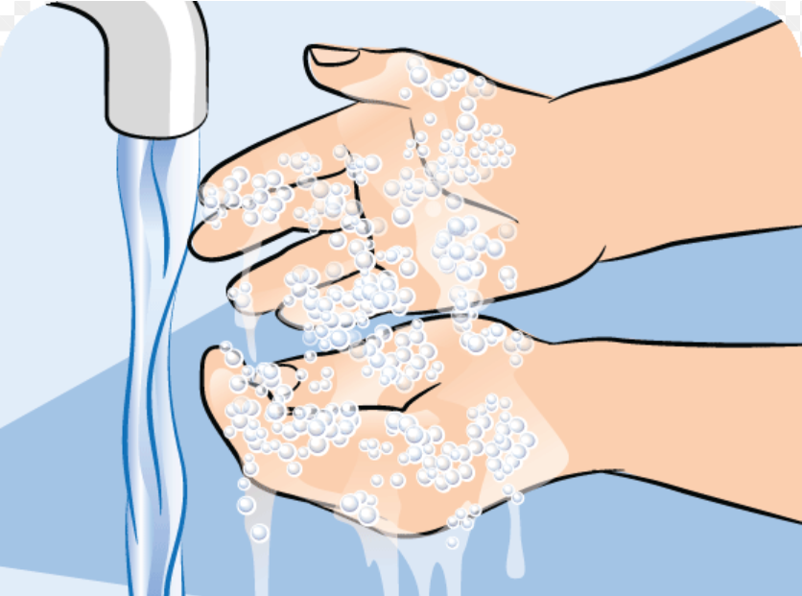
Personal Hygiene
Personal hygiene is how you care for your body. This practice includes bathing, washing your hands, brushing your teeth, and more. Every day, you come into contact with millions of outside germs and viruses.
How does this relate to cooking?

Slide 16
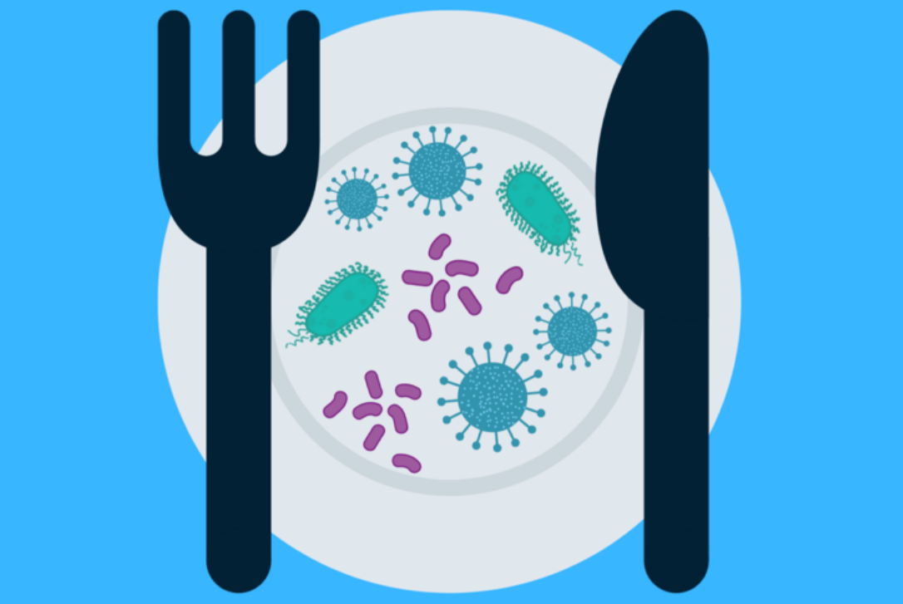
Cross Contamination

Slide 17
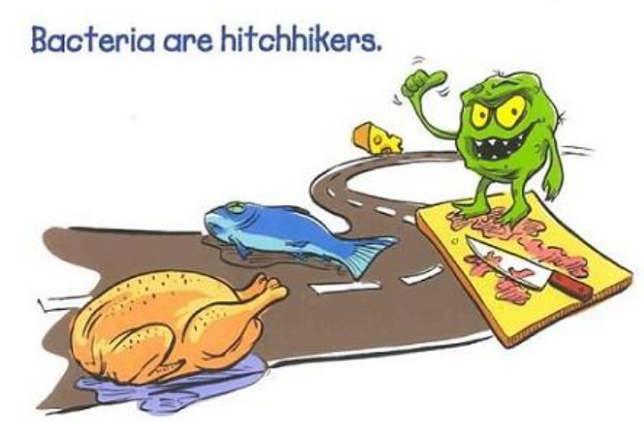
What is cross contamination?
the process by which bacteria or other microorganisms are unintentionally transferred from one substance or object to another, with harmful effect.
There are three main types of cross contamination: food-to-food, equipment-to-food, and people-to-food. In each type, bacteria are transferred from a contaminated source to uncontaminated food

Slide 18
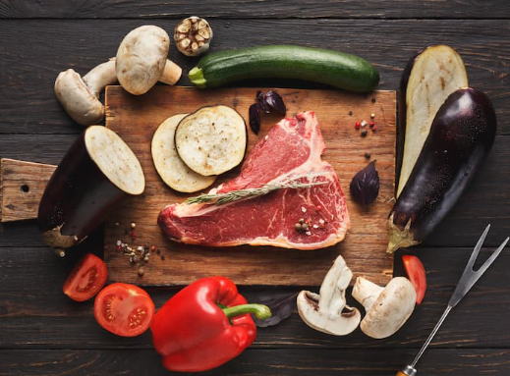
What’s wrong with this photo?

Slide 19
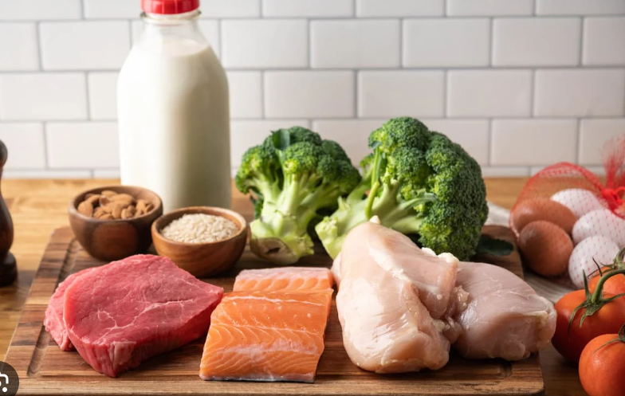

Slide 20
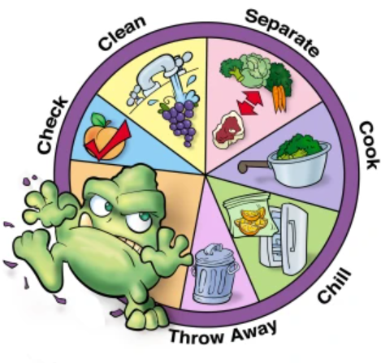
How do we prevent Cross Contamination?

Slide 21
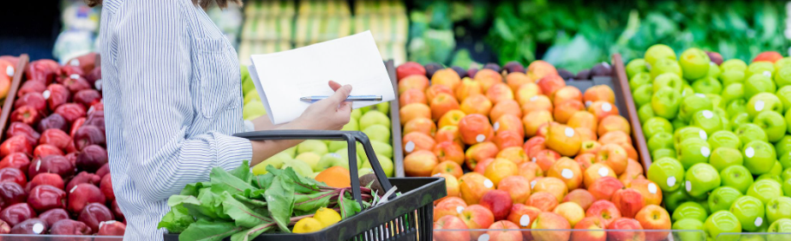
When Shopping:
Separate raw meat, poultry, and seafood from other foods in your grocery-shopping cart.
Place these foods in plastic bags to prevent their juices from dripping onto other foods.
It is also best to separate these foods from other foods at check out and in your grocery bags

Slide 22
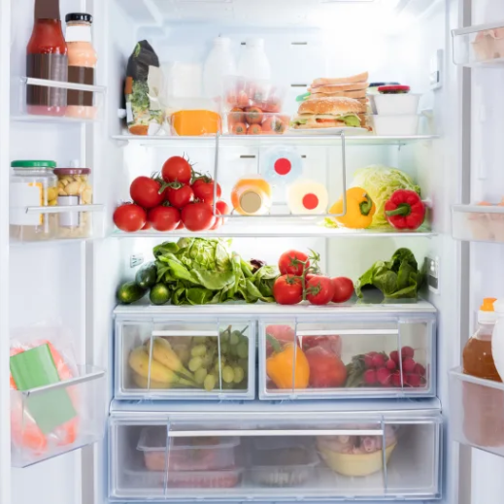
When refrigerating food:
Place raw meat, poultry, and seafood in containers or sealed plastic bags to prevent their juices from dripping onto other foods. Raw juices often contain harmful bacteria.
Store eggs in their original carton and refrigerate as soon as possible.

Slide 23
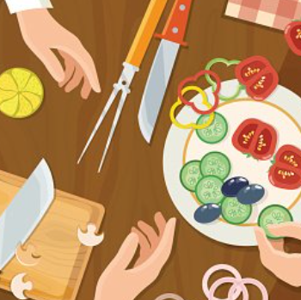
When preparing food:
Keep it clean:
Wash hands and surfaces often. Harmful bacteria can spread throughout the kitchen and get onto cutting boards, utensils, and counter tops. To prevent this:
Wash hands with soap and hot water before and after handling food, and after using the bathroom, changing diapers; or handling pets.
Use hot, soapy water and paper towels or clean cloths to wipe up kitchen surfaces or spills. Wash cloths often in the hot cycle of your washing machine.
Wash cutting boards, dishes, and counter tops with hot, soapy water after preparing each food item and before you go on to the next item.

Slide 24
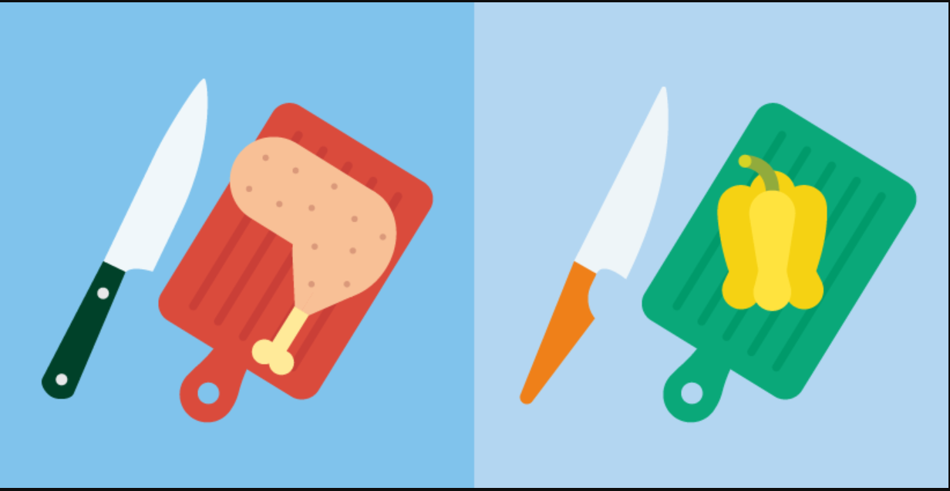
When using Cutting Boards:
Always use a clean cutting board.
If possible, use one cutting board for fresh produce and a separate one for raw meat, poultry, and seafood.
Once cutting boards become excessively worn or develop hard-to-clean grooves, you should replace them.

Slide 25
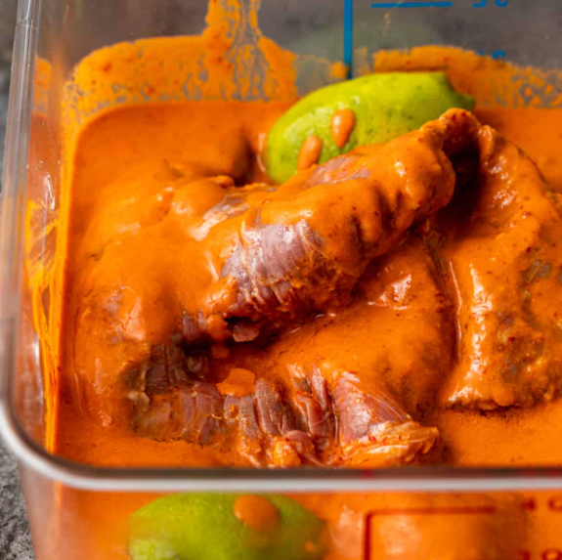
When Marinating Food:
Always marinate food in the refrigerator, not on the counter.
Sauce that is used to marinate raw meat, poultry, or seafood should not be used on cooked foods, unless it is boiled just before using.

Slide 26
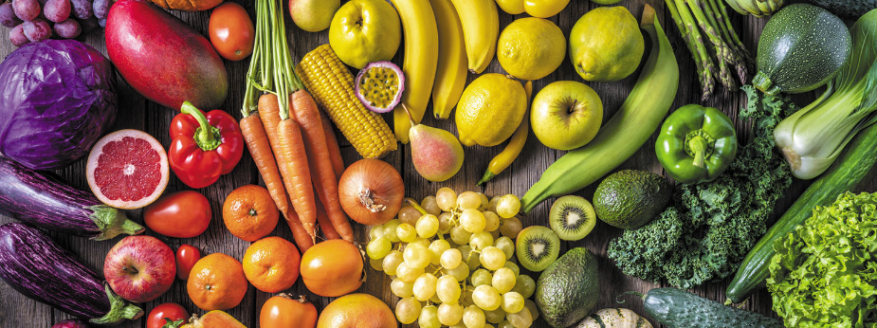
Fruits and Vegetables:
Rinse fresh fruits and vegetables in running tap water to remove visible dirt and grime.
Remove and discard the outermost leaves of a head of lettuce or cabbage.
Because bacteria can grow well on the cut surface of fruit or vegetables, be careful not to contaminate these foods while slicing them up on the cutting board, and avoid leaving cut produce at room temperature for many hours.

Slide 27
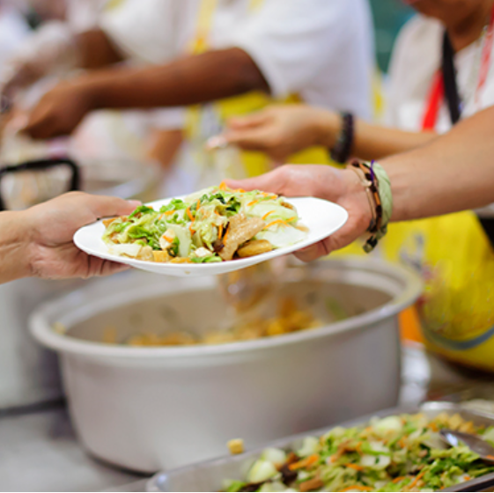
When Serving Food
Always use a clean plate.
Never place cooked food back on the same plate or cutting board that previously held raw food.

