Slide 1
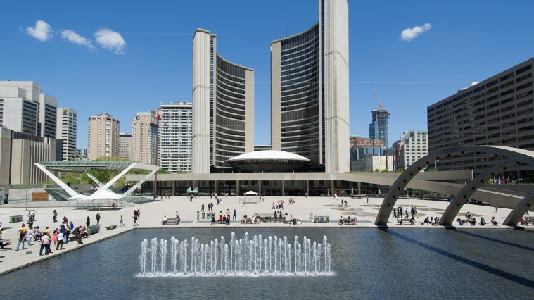
Municipal Governments and Councils
Copyright ©2020 Kosowan’s Korner. All rights reserved.

Slide 2
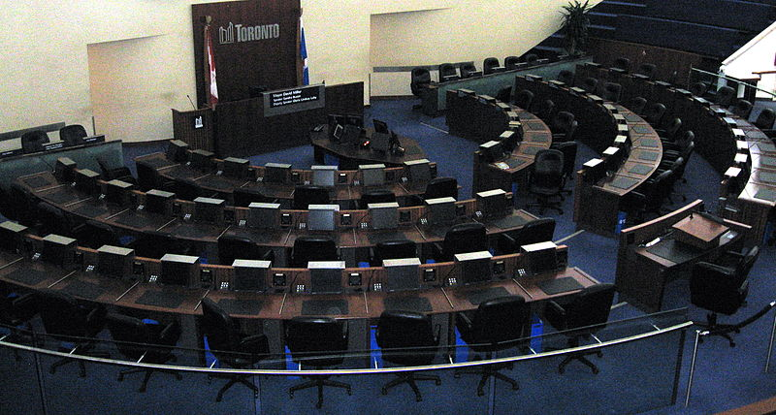
Branches of Municipal Government
There are two branches of the Municipal Government.
The Legislative and the Executive branches
Yes, this should look pretty similar…

Slide 3
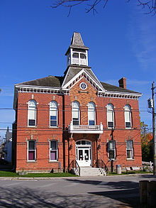
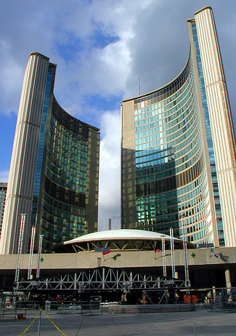
Municipal Government structure
A municipal elected representative is called a councillor or alderman.
The leader of the government is called a mayor or reeve.
The size of the council differs from city to town.
Councillors debate and pass legislation in the Council Chambers
(city hall/municipal office).

Slide 4
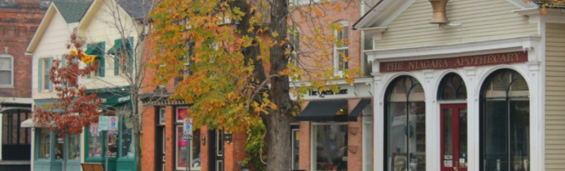
Ontario Municipalities
Ontario is separated into 444 different communities called municipalities.
A municipality can be called a city, town, village, township, county or region.

Slide 5
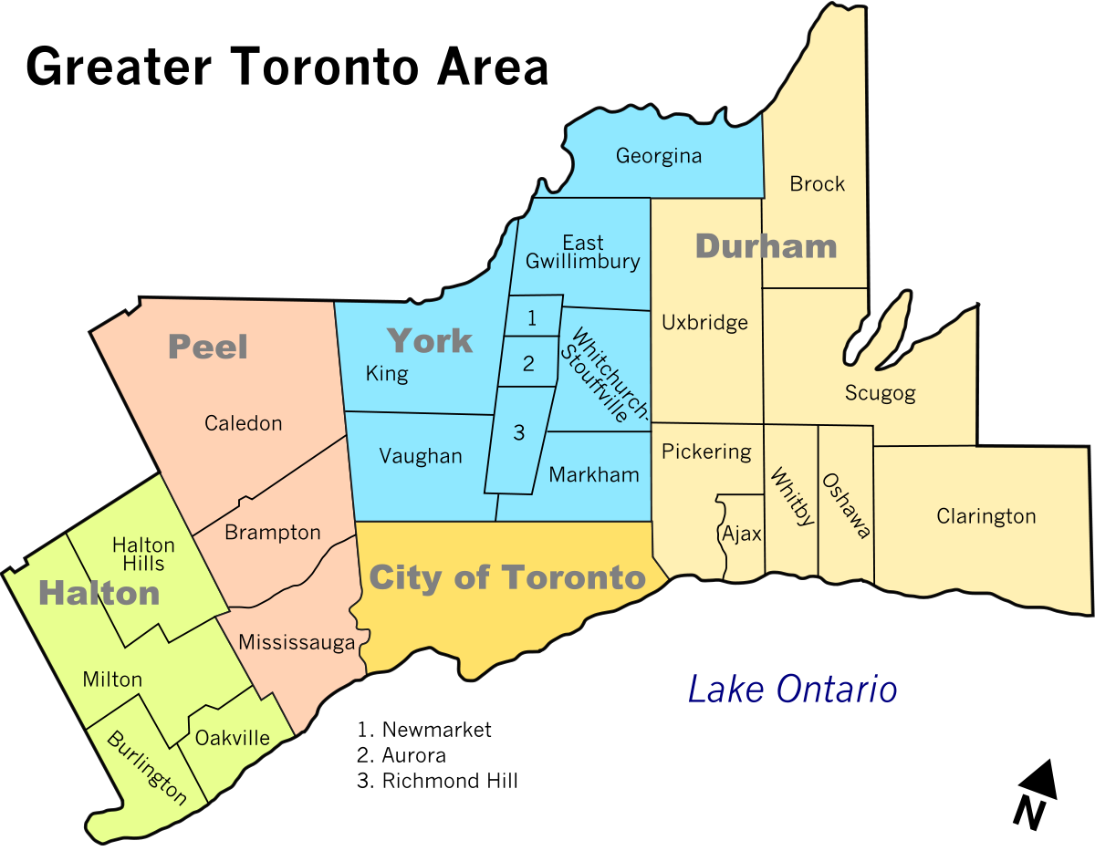

Key Features of Municipalities
Municipalities share several main features:
A defined geographic area
The power to tax
An elected council

Slide 6
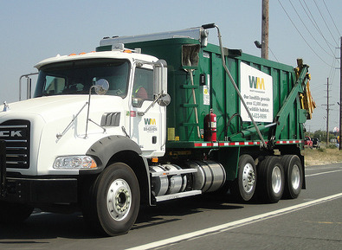
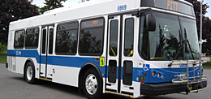
Municipal Powers & Responsibilities
Municipalities are given their powers and responsibilities by the provincial government.
Examples are: Roads and sidewalks, transportation systems/public transit, social housing, waste removal, community centres, and water and sewage.

Slide 7
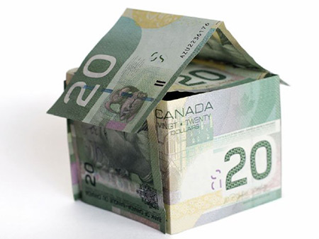
The Power to Raise Taxes
Municipalities use Property taxes to generate revenue.
Homeowners pay a tax based on home value every year.
This money is used to pay for services that benefit the community such as police and the building and maintenance of roads, sidewalks and parks.

Slide 8
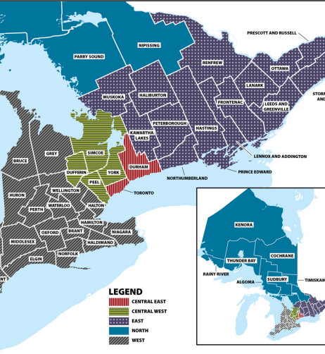
Municipal Branches –
Single-Tier or Two-Tier
Municipalities in Ontario are either part of a single-tier or two-tier system.
A single-tier municipality has one government and local council and it operates on its own.
A two-tier system involve two layers of government and two councils. (Like York Region, Essex County or Lanark County)

Slide 9
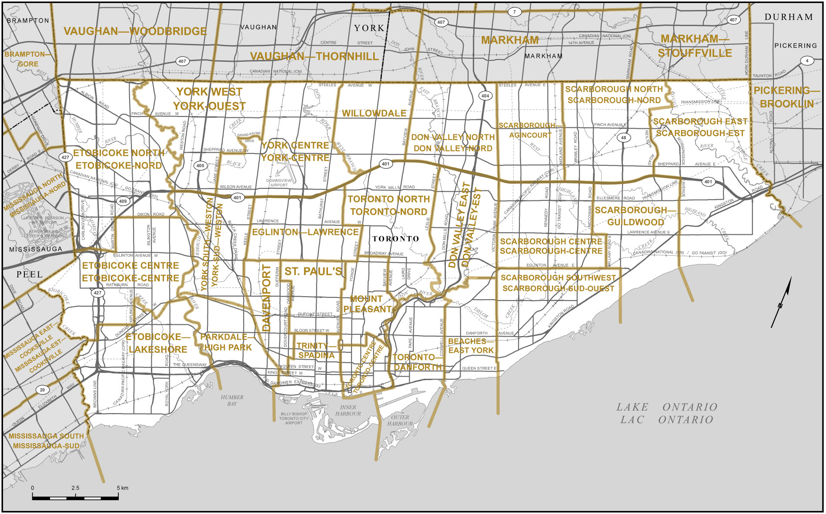
City of Toronto Regional Boundaries

Slide 10

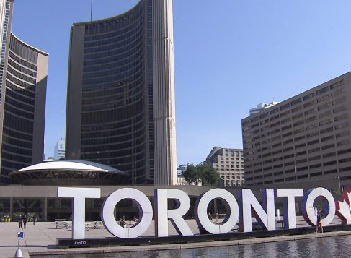
Toronto’s City Hall
The current City Hall is the 4th in the city’s history is at Nathan Phillips Square.
It has unique architecture, even being featured in action films like Resident Evil and Star Trek: The Next Generation.

Slide 11

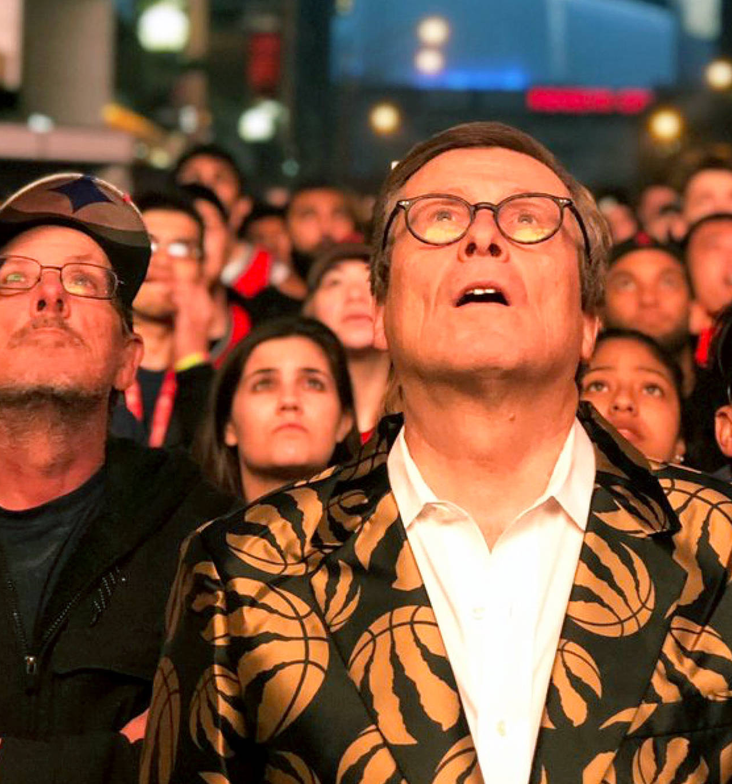
Toronto’s City Council and Mayor
His Worship,
John Tory
Toronto’s City Council is made up of
the mayor, who is elected city-wide
and 25 councillors who are elected in each ward across the city.
The mayor provides leadership to City Council and:
represents Toronto across Canada and around the world
works with different levels of government

Slide 12
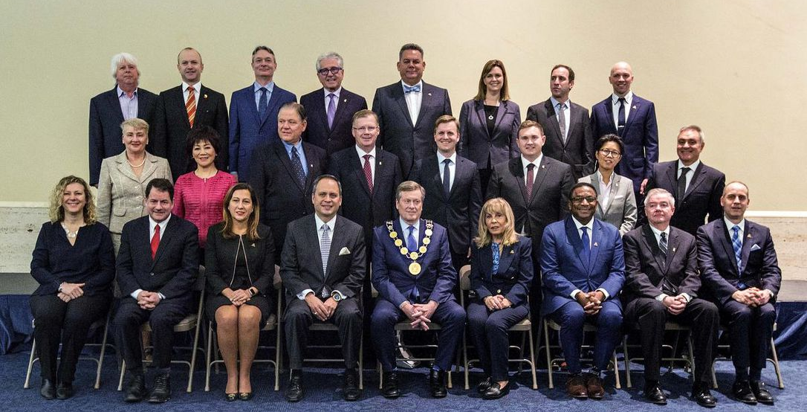
How does City Council Work?
City Councillors:
attend City Council and committee meetings
sit on the boards of City agencies and corporations
propose changes to the decisions City Council makes
make motions for actions or raise awareness of issues
hold/attend community meetings to get public input
host or get involved in community events
help people access City services

