Slide 1
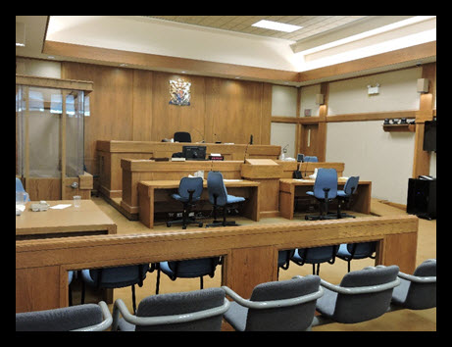
Criminal Trials in Canada
Copyright ©2020 Kosowan’s Korner. All rights reserved.

Slide 2
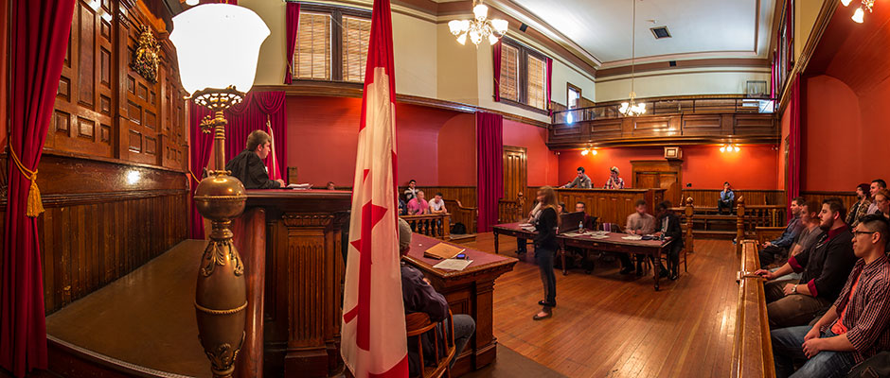
Criminal Trial Principles
In Canada we have a set of principles that are designed to guarantee fairness and promote a balance between the power of the Crown and the civil liberties of the accused.
Notes:
It is better to let 99 guilty people go free than convict one innocent person.
The burden on the Crown is to prove the guilt of the accused, beyond a reasonable doubt.

Slide 3
Criminal Trial Principles #1 – The Rule of Law
The rule of law means that people can be punished only for breaking the law, not for thinking about it.
The rule of law provides that all citizens are equal before the law.

Slide 4
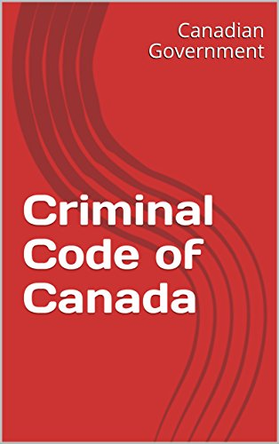
Criminal Trial Principles #2 – Specific Allegation
Individuals need to know exactly which Criminal Code offence they are charged with, and what specific circumstances are alleged to make up the offence.
Notes:
Make sure the Crown speaks about the actual CC charges ie that is why we are here!

Slide 5
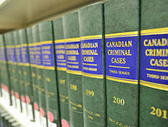
Criminal Trial Principles #3 – Case to Meet
Accused individuals don’t have to explain themselves in court until the Crown presents a plausible case against them.
This is known as a “Case to Meet”, which is a case for the Crown that is sufficiently strong to support a conviction.
If the Crown cannot establish enough evidence to bring a case to trial, then it is dropped.

Slide 6
Criminal Trial Principles #3 – Case to Meet
Rules in place to balance the power and resources the Crown enjoys
Crown always presents evidence first in criminal trial
The Crown bears the burden of proof
Crown must prove the accused is guilty
Crown can’t force accused to testify

Slide 7
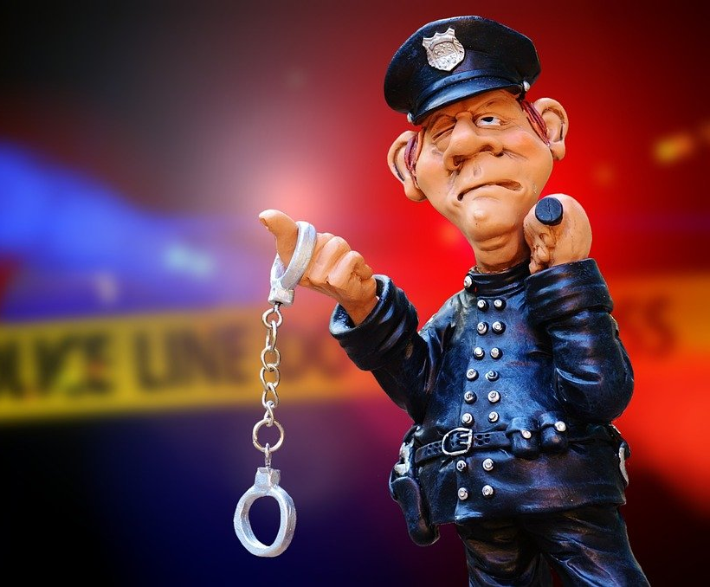
Criminal Trial Principles #4 – Innocent until proven Guilty
The Crown must establish the guilt of the accused.
Therefore the accused is considered innocent until proven guilty.
The Crown also must prove their case beyond a reasonable doubt.

Slide 8
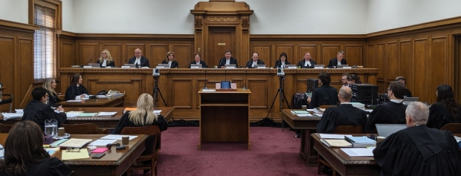
Criminal Trial Principles #5 – Open and public trial
By law, criminal trials must be open to the public and to the media.
A reasonable person, observing a trial, should perceive it as fair and unbiased

Slide 9
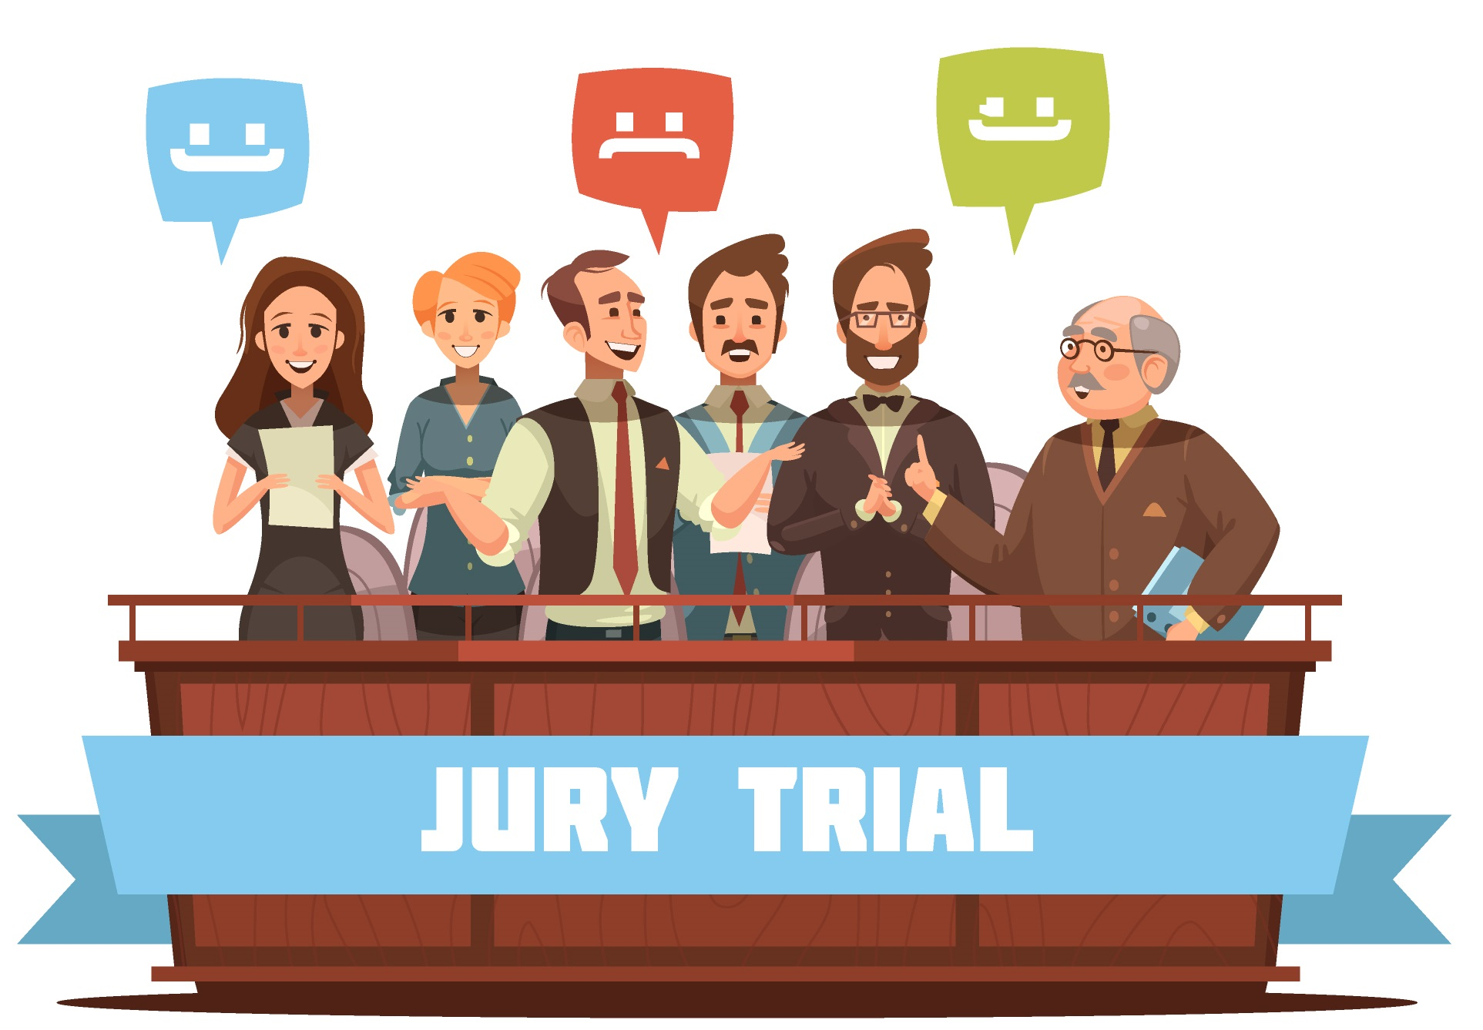
Criminal Trial Principles #6 – Independent and impartial adjudication
Judges must be impartial and have no personal interest in the outcome of a trial.
Juries must also be impartial.
The process of jury selection ensures that this is met.
Notes:
<a href='https://www.freepik.com/vectors/people'>People vector created by macrovector - www.freepik.com</a>

Slide 10
Discuss with a partner
Which of the 6 criminal trial principles are most important?
Why do you think is so?
Rule of Law | Specific Allegation | Case to Meet
Presumption of Innocence | Open and Public Trial | Independent & Impartial Adjudication

Slide 11
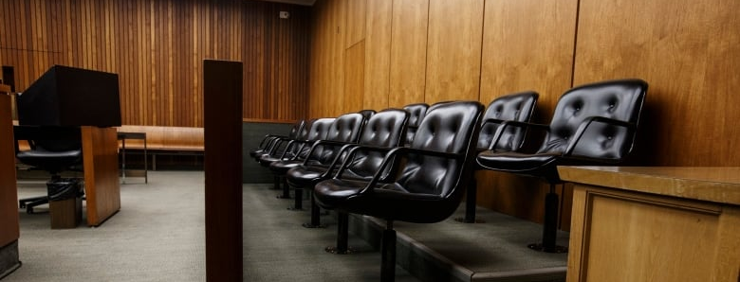
The Jury
Why would an individual charged with an indictable offence choose to be tried in front of a jury instead of a judge?

Slide 12
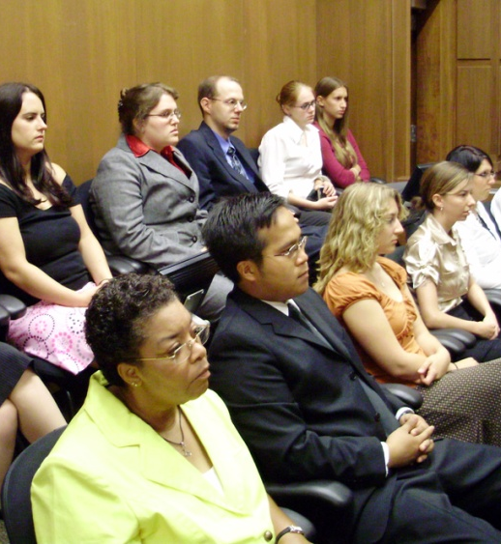
The Jury
Individuals charged with a serious indictable offence have the option of trial before a judge and jury
It is up to the jury to determine the facts of the case.
At the end of the case the judge instructs the jury how to apply the law, based on the facts.

Slide 13
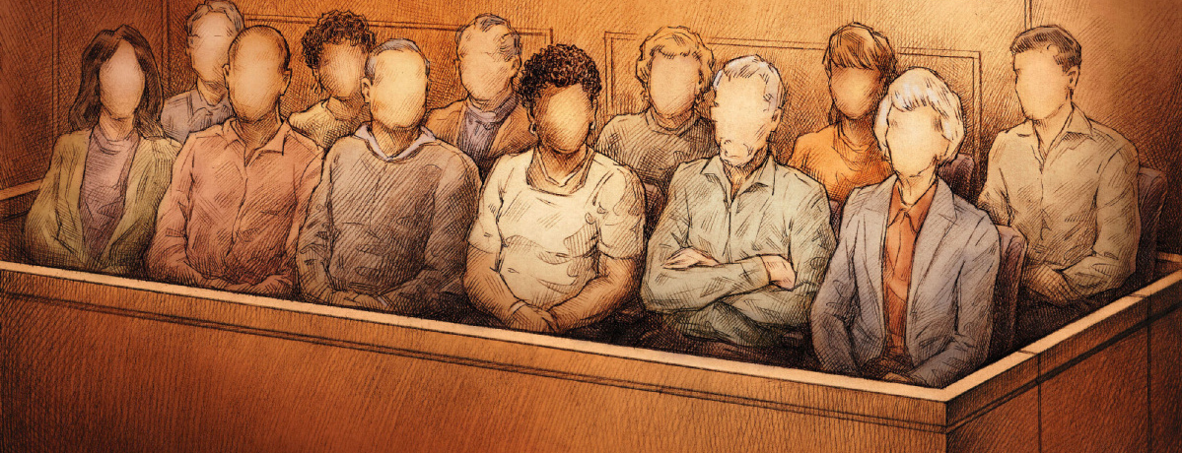
Jury in Canada
In Canada, the jury in a criminal trial comprises of 12 members, chosen by both the Crown and the Defence.
Selecting a jury uses a pool of people created by the Provincial Government.
This is called a Jury Array. The Government uses a survey to sort potential jurors before calling them to court.
Notes:
Here you can find the link for the Jury Questionnaire.
http://ontariocourtforms.on.ca/en/juries-act-forms/

Slide 14
Who can serve on a jury…
The Ontario Juries Act outlines the rules and procedures the juries and courts must follow…
In Ontario, Canadian citizens who 18 years of age or older are generally eligible to serve as jurors.
However, individuals in certain occupations are excluded from participating in a jury.
These occupations include, lawyers, law students, doctors and people working in law enforcement

Slide 15
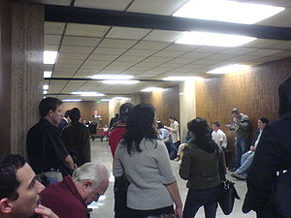
Jury Selection
Once potential jury members are selected from a pool of jurors they are organized in court for jury selection.
This process is known as empanelling a jury
This can take days and usually means needing to select hundreds of people to find enough potential jurors for a trial.

Slide 16
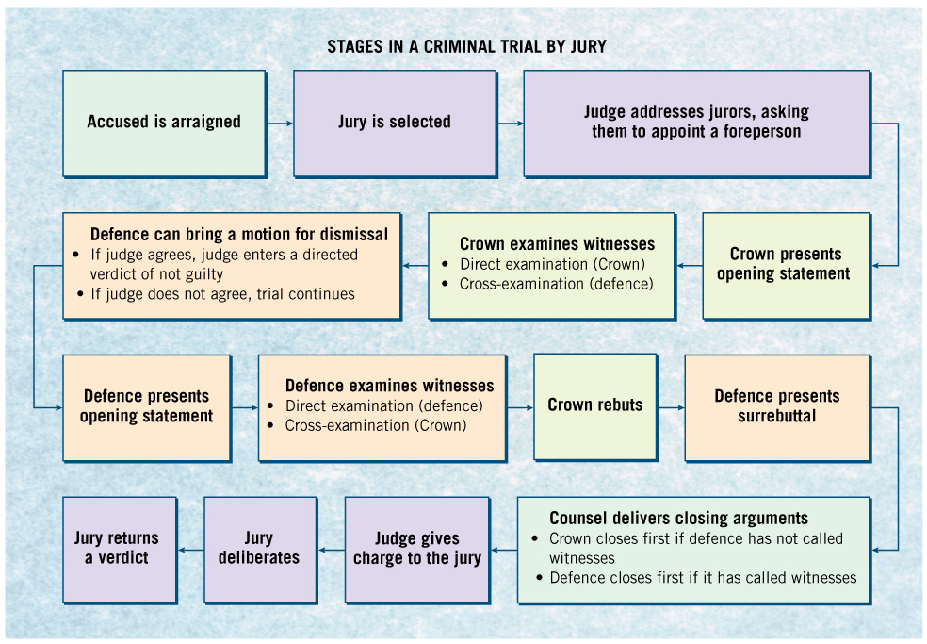
Figure 7.10 Trial by Jury, p. 183

Slide 17
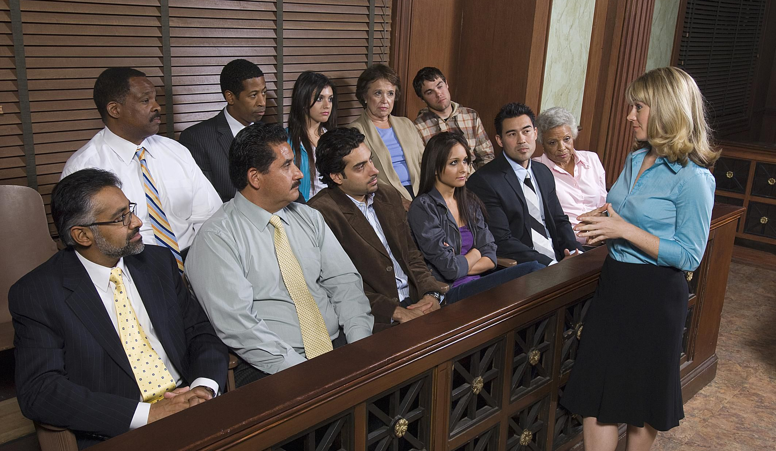
Jury Challenges
Both the defense and the Crown have the right to challenge potential jurors.
This means either side can remove a potential juror if they want to.
Why would both lawyers want to challenge jurors?
The purpose of challenges is to create an impartial jury and to give the Crown or the defence equal opportunity to participate in the selection.

Slide 18
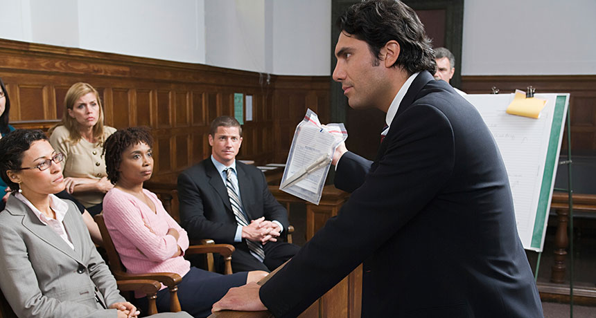
The Criminal Trial

Slide 19
Evidence at Trial
In a criminal trial, only relevant evidence is admissible.
Rules of Evidence In a criminal trial, there are many rules relating to evidence designed to ensure that judge or jury are not being misled from the facts
For instance, Hearsay evidence is not admissible in court. Here a witness cannot testify about indirect knowledge that they might have obtained

Slide 20
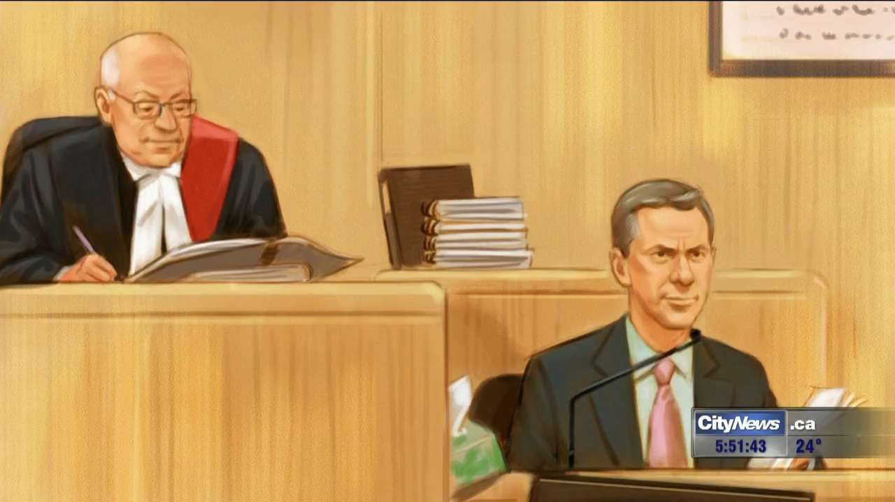
Questioning the Admissibility of Evidence
When the admissibility of evidence comes into question the court engages in a hearing known as a Voir Dire
The Jury is excluded from the process…
Voir Dire – a trial within a trial to determine whether evidence is admissible

Slide 21
Rules Of Evidence
During a trial, the Crown or the defence may object to questions asked or the answers provided by witnesses.
When an objection is made the judge rules on whether the evidence in question is admissible or accepted by the court.
Common grounds for objection include:

Slide 22
Rules Of Evidence
Leading questions Suggests to a witness a particular answer. This is not allowed during direct examination.
Hearsay statements Evidence given by witness based on info received from someone else rather than personal knowledge.
Opinion statements A witness cannot be asked their opinion on something unless they are qualified as expert witness.
Immaterial/Irrelevant questions This has no bearing on case or is off topic

Slide 23
Basic Types of Evidence
Direct evidence Eyewitness testimony by a witness to prove an alleged fact.
Circumstantial evidence Indirect evidence that help erase doubt of the defendant’s guilt.
Character evidence Makes it appear likely that the defendant is the type of person who either would or would not commit a certain offence. There are rules around how this is used.
Notes:
<a href='https://www.freepik.com/vectors/glass'>Glass vector created by balintseby - www.freepik.com</a>

Slide 24
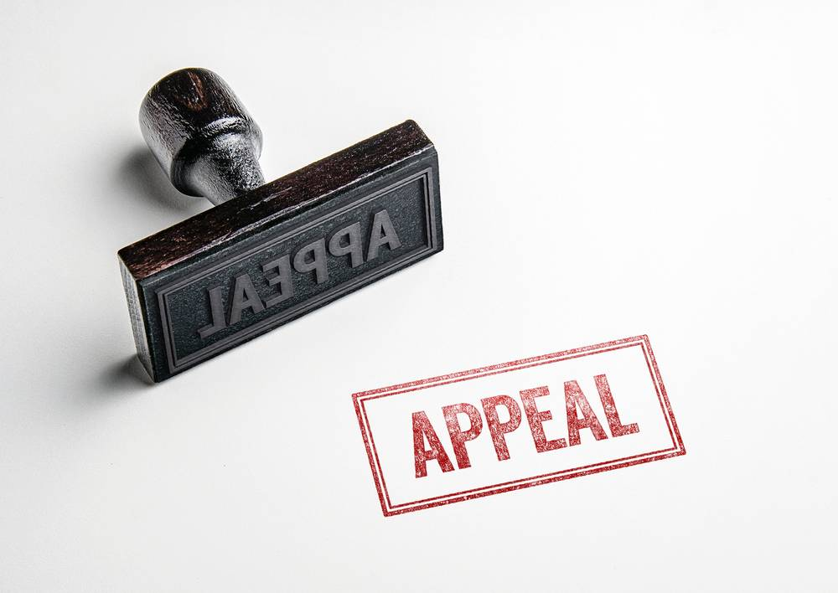
Appeals
If either side is not happy with the result of a trial, they can appeal to have it looked at again.
An appeals court hearing the case can affirm the lower court’s decision, reverse it or order a new trial.
Both the Defence and the Crown can appeal a case it considers improper. They can appeal the decision or the sentence.
The side that files the appeal is called the appellant; the responding side is called the respondent.
The appeal is usually heard by a panel of 3 to 5 judges, who only have to reach a majority decision.

