Slide 1
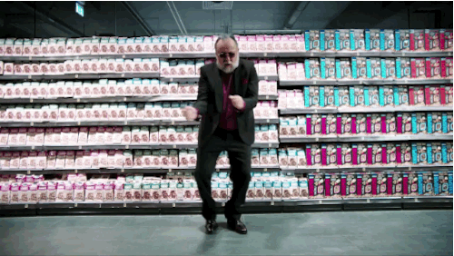
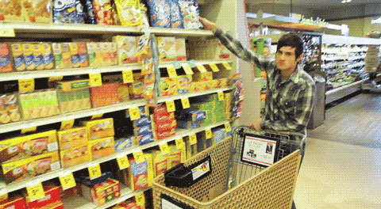
The
PSYCHOLOGY
GROCERY
OF
Design
STORE

Slide 2
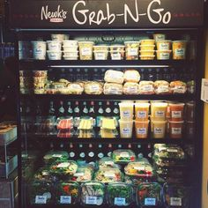
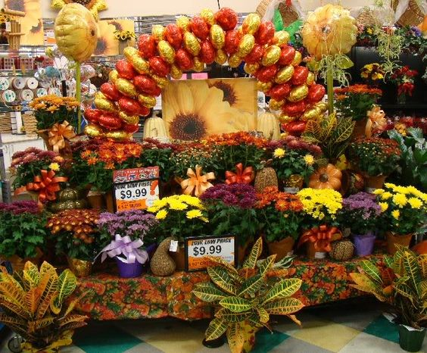
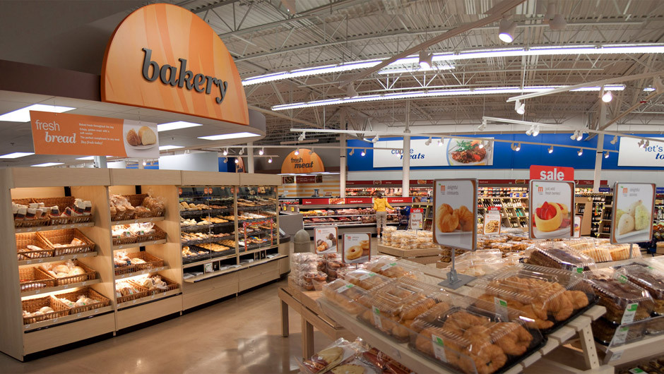
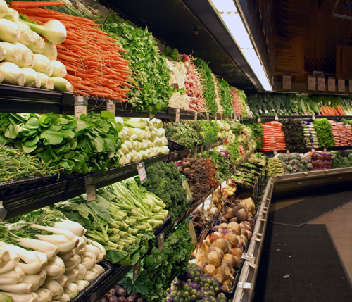
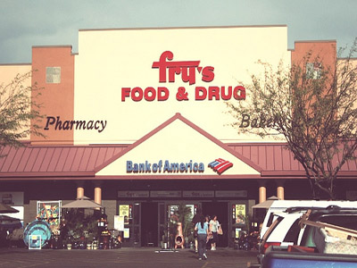
ENTRY
GRAB ‘N GO
FLOWERS
BAKERY
PRODUCE
To get back business lost to convenience stores.
“The bakery gets your salivary glands going, this makes you feel hungry, and the hungrier you are the more you buy.”
To create a tempting sensory experience. “Stores need to communicate to shoppers that produce is fresh or people won’t buy anything.
BANK
They enhance the image of a store, consumers walk in to something that is pretty, smells great and builds the notion of freshness.
To get more money in the hands of the customers so they will shop more.

Slide 3
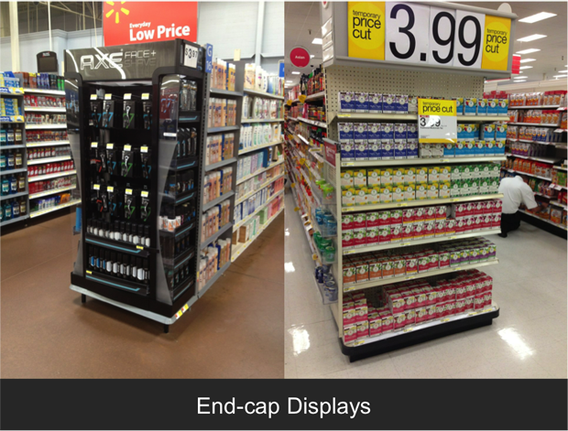
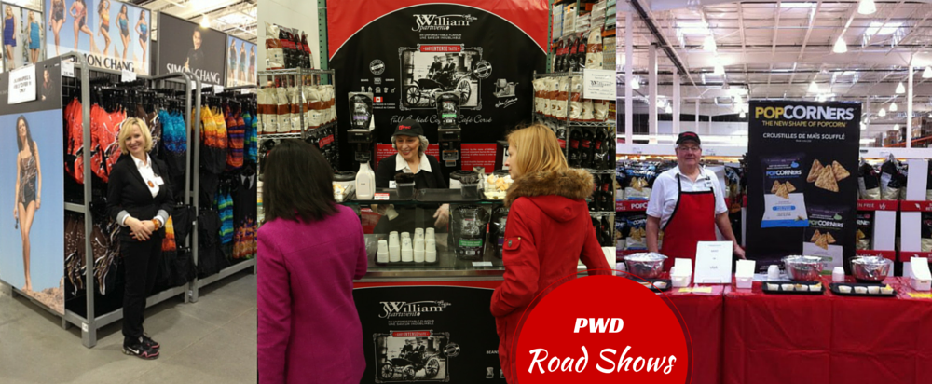
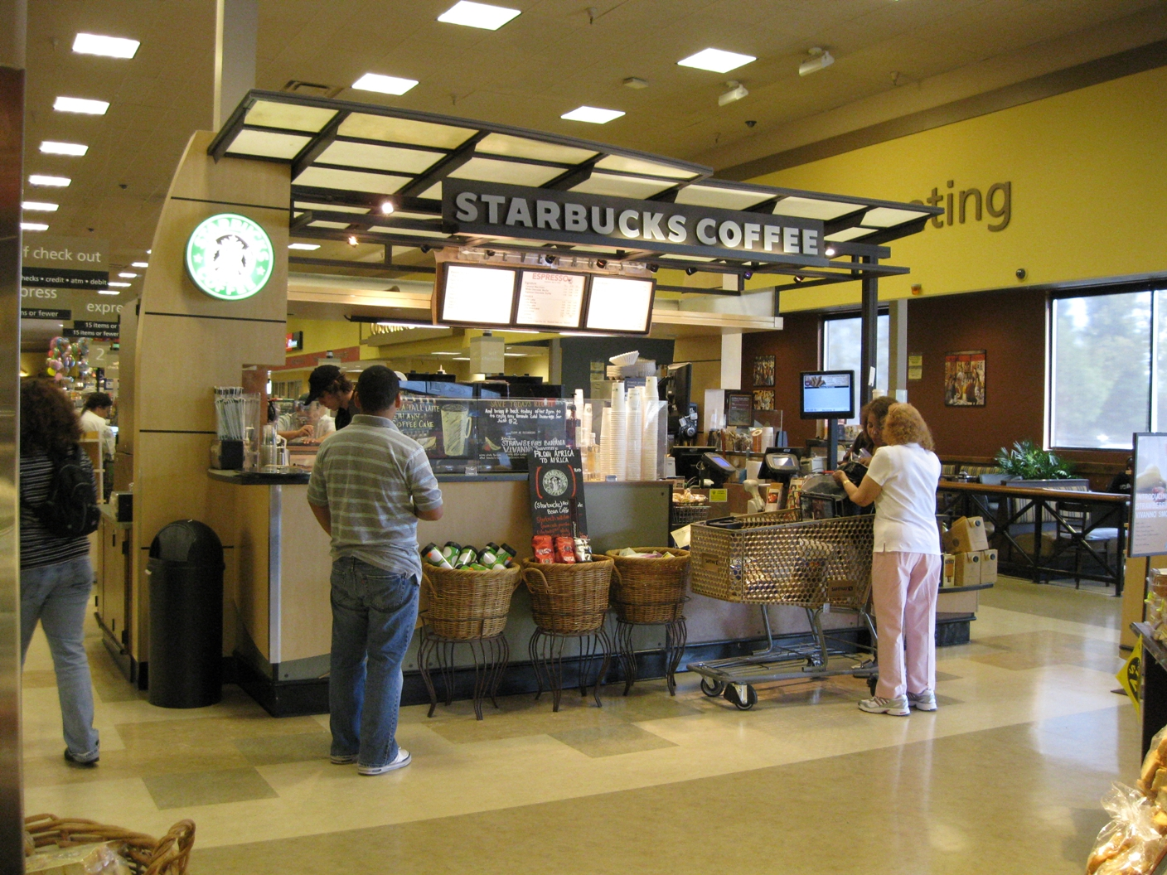
PERIMETER
ENDCAP DISPLAYS
“RETAIL-TAINMENT
DELI/COFFEE BAR
PHARMACY
Free sample stations, demonstrations and displays, slow you down while also exposing your to new products.
If you're hungry for lunch, you will shop in a hurry, but if you have lunch in the store you will stay and relax, thus going back to buy a little more.
If you are filling a prescription, you need to wait, spend more time, and pickup another item to purchase.
Product manufacturers pay for prominent "endcap" placement- on the ends of the aisles- to advertise a new or popular product.

Slide 4
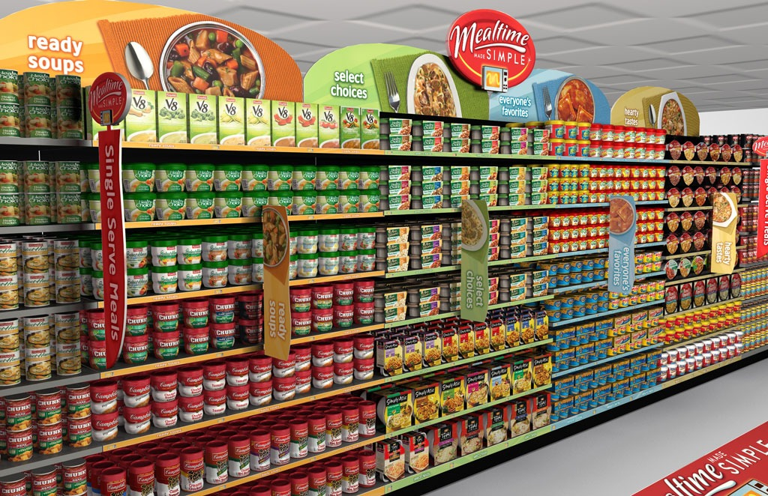
CENTER AISLE
GENERAL MERCHANDISE / CANNED GOODS
They draw the shopper deeper into the store and expose them to nonessential items along the way.

Slide 5
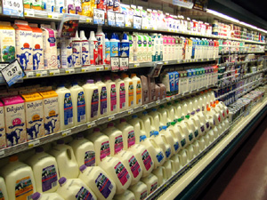
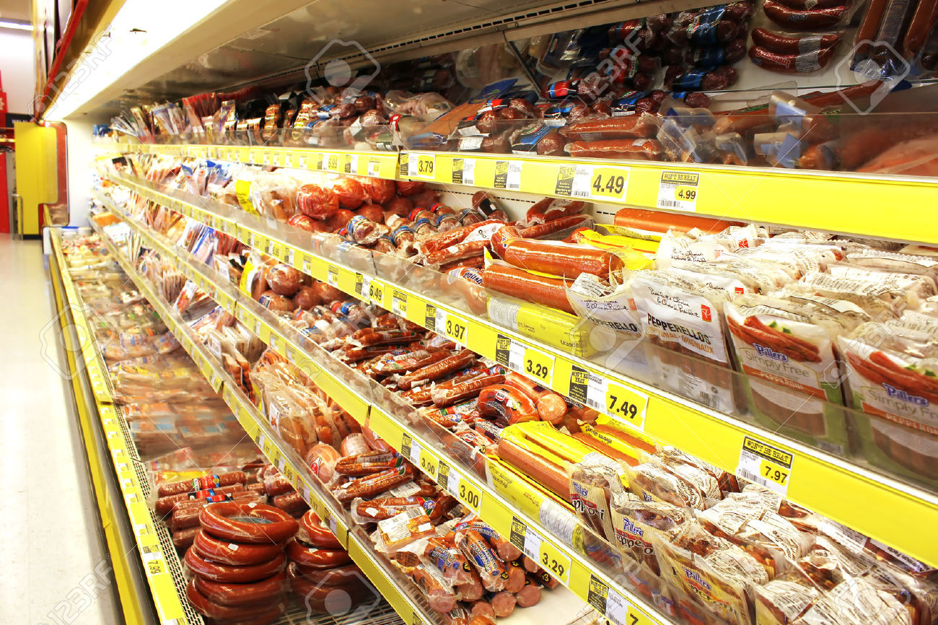
BACK OF THE STORE
DAIRY PRODUCTS/EGG/MEAT
Stores typically put these items in the farthest reaches of the store to expose shoppers to the maximum amount of product on their "quick trip" so they will buy impulsively.

Slide 6
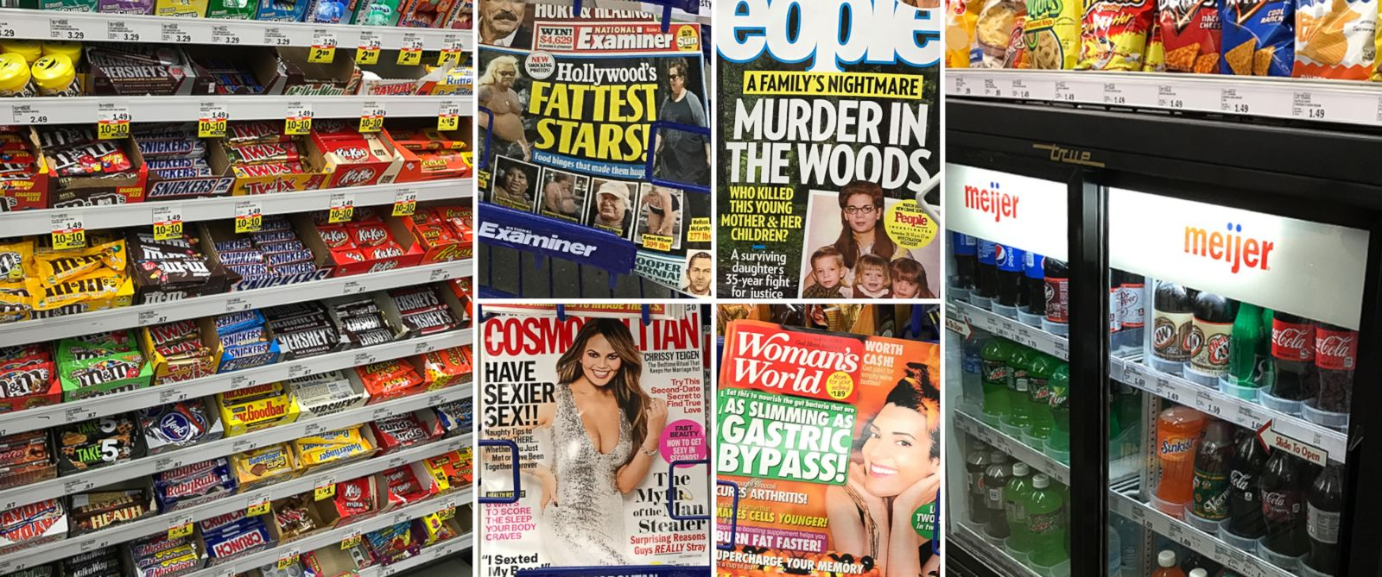
REGISTERS/EXITS
To turn waiting time into buying time. this is the most profitable area of the store.

Slide 7
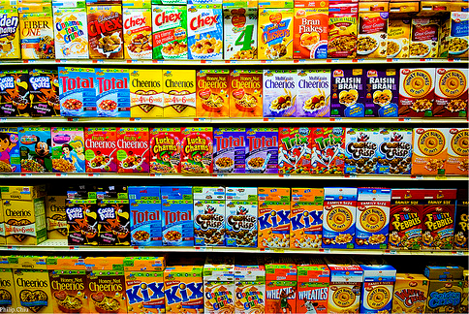
SHELF LAYOUT
TOP
Smaller brands, regional brands and gourmet brands. The top shelf is usually chosen by the store management.
SHELF ⅔ DOWN
Best sellers and other leading brands. This is the "bulls-eye" zone and the manufacturer's may have paid for this space. There's no advantage for the supermarket to show your the lowest-priced item in the most effective spot.
KID EYE LEVEL
Products with kid appeal are here.

Slide 8
MY GROCERY SHOPPING LIST
Imagine you are staying a week at a cottage for vacation. You will not be able to shop again this week. Pick out what you would buy for an entire week.
OPTIONAL - Copy + paste pictures of the products you would purchase; these slides are to show you what you have to buy. Then complete the next step of the assignment, which is on Moodle.
FROZEN FOODS
BEVERAGES
BREAD/ BAKERY

Slide 9
CEREAL/ BREAKFAST
PASTA/RICE
DAIRY

Slide 10
DELI
MEATS
PRODUCE

Slide 11
SNACKS
SPICES

Slide 12
CLEANING SUPPLIES
HEALTH/ BEAUTY
PET PRODUCTS

