Slide 1

7
Microeconomics:
The Basics

Slide 2
Learning Goals
Once you have completed this chapter, you should be able to:
Understand the meaning of demand and supply
Understand how the forces of demand and supply set prices
Predict why prices for particular goods or services might change
Read and construct your own demand and supply graphs
Calculate price elasticities of demand and supply

Slide 3
Key Terms
Demand
law of demand
ceteris paribus
demand curve
market demand schedule
Supply
law of supply
supply schedule
equilibrium price
non-price factors
substitute goods
complementary goods
perfect (or pure) competition
dynamic pricing
price elasticity of demand (PED)
price inelastic
price elastic
sales revenue
elastic coefficient
unitary coefficient
inelastic coefficient
elasticity of supply
price elasticity of supply (PES)

Slide 4
Demand
Demand: The quantity of a good or service that buyers will purchase at various prices during a given period of time.
Demand exists only for those goods and services that you both want and can afford to buy. If you have both the desire and the financial resources, then it is likely you will make the purchase.
The quantity of a product that a consumer will purchase depends on its price. Generally speaking, the higher the price of a product, the less it will be purchased; the lower the price of a product, the more it will be purchased.
Law of Demand: The quantity demanded of a good or service varies inversely with price, as long as other things do not change.
Ceteris Paribus: Latin for “other things being equal” or “as long as other things do not change”; an assumption made when economists want to understand the cause-and-effect relationship between any two factors and want other factors affecting that relationship to be held constant.

Slide 5
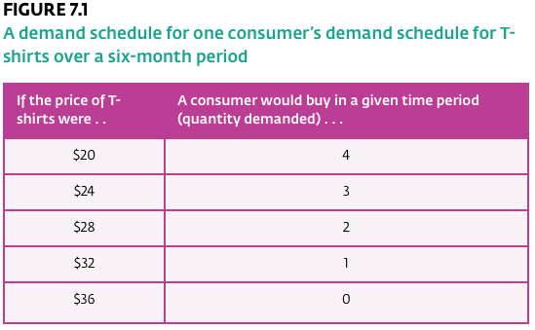
Demand Schedule
One method of portraying the relationship between the price and the quantity demanded of a particular product. It is usually presented as a table showing the quantities demanded at specific prices.

Slide 6
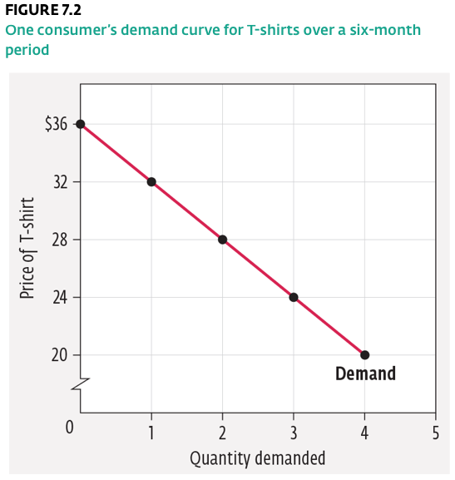
Demand Schedule
As Figure 7.2 shows, on a graph, price is measured on the vertical axis (y-axis), while quantity demanded is measured on the horizontal axis (x-axis).
Demand Curve: A straight line or curve on a graph illustrating the demand schedule for a product.
This inverse relationship between price and quantity demanded holds for the majority of goods we buy.

Slide 7
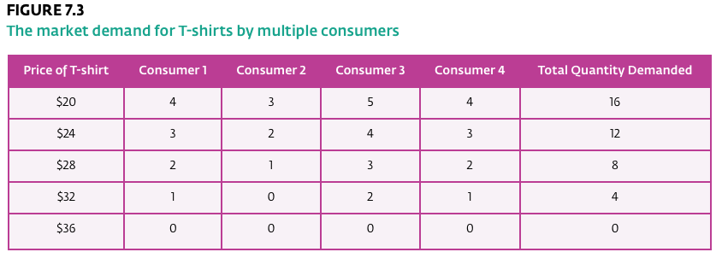
Market Demand
Market Demand Schedule: The sum total of all the consumer demand for a product.

Slide 8
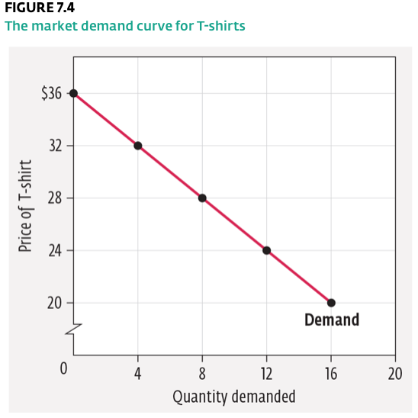
Market Demand
The term demand refers to the entire series of price–quantity relationships, as shown in our demand schedule for T-shirts in Figure 7.1.
Quantity demanded refers to the amount of a product that people are willing to buy at a specific price.

Slide 9
Supply
Supply: the quantities that sellers will offer for sale at various prices during a given period of time.
Like consumers, sellers react to price changes but in the opposite way; that is, as the price for a product rises, sellers want to supply more, while consumers, as we learned, want to purchase less.
Sellers are in business to make a profit. If their costs of doing business remain unchanged, their profits will increase as the price of their product rises. Consequently, they want to supply more of their product at higher prices because they can make more money this way.
Law of Supply: The quantity supplied of a good or service will increase if the price increases, and it will fall if the price falls, as long as other things do not change.

Slide 10
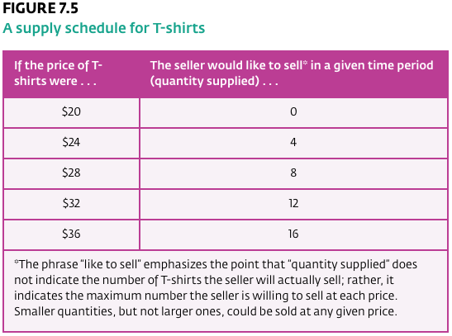
Supply Schedule
Supply Schedule: A table showing the quantities of a product supplied at particular prices.

Slide 11
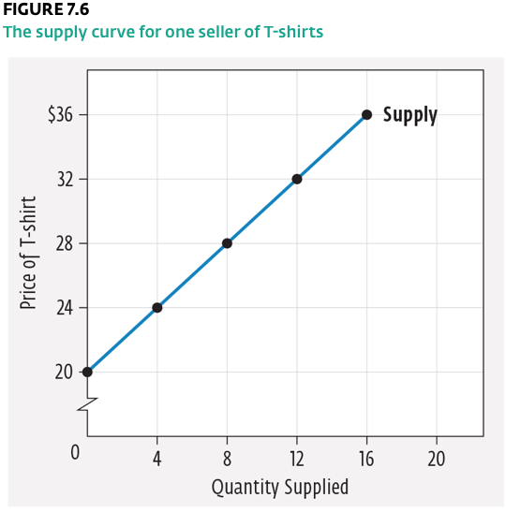
Supply Schedule
The term supply refers to the entire series of price–quantity relationships, as shown in our supply schedule for T-shirts in Figure 7.5.
Quantity supplied refers to the amount of a product or service that suppliers are willing to sell at a specific price.

Slide 12
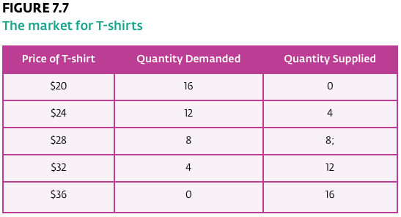
Market Equilibrium
Equilibrium price: A price set by the interaction of demand and supply in which the absence of surpluses or shortages in the market means there is no tendency for the price to change.

Slide 13
Market Equilibrium
THE DETERMINATION OF PRICE
At this point, we have the tools we need to examine how the actual prices we pay for a product are determined. You have probably guessed by now that, in the real world, the prices that consumers pay and sellers receive are determined by the interaction of demand and supply. If we combine our two schedules for T-shirts, we can see how this occurs.

Slide 14
By examining Figure 7.7, we can see that only at $28 does the quantity demanded for T-shirts equal the quantity supplied. When the price is set lower than $28, the quantity demanded for T-shirts will exceed the quantity supplied, and a shortage will occur. For example, if the price is set at $24, then 12 T-shirts will be demanded, but the seller will supply only four, creating a shortage of eight T-shirts. In this situation, the seller will then raise the price, since the T-shirts are selling so quickly.
Price of T-shirt | Quantity Demanded | Quantity Supplied
$20 | 16 | 0
$24 | 12 | 4
$28 | 8 | 8;
$32 | 4 | 12
$36 | 0 | 16

Slide 15
The question becomes: To what level should the price of T-shirts be raised? Suppose that the seller raises the price of T-shirts to $32. The seller wants to sell 12 T-shirts, but consumers are only willing to purchase four. Now there is a surplus of eight T-shirts, and the seller will have to lower the price to persuade consumers to buy. The price of $28 is the only price where no shortage or surplus occurs. Economists call this price the equilibrium price because supply equals demand; and when the market for a product or service is at equilibrium, there is no tendency for it to change. The equilibrium price is the only acceptable compromise between consumers who want the lowest prices possible and sellers who want the highest.

Slide 16
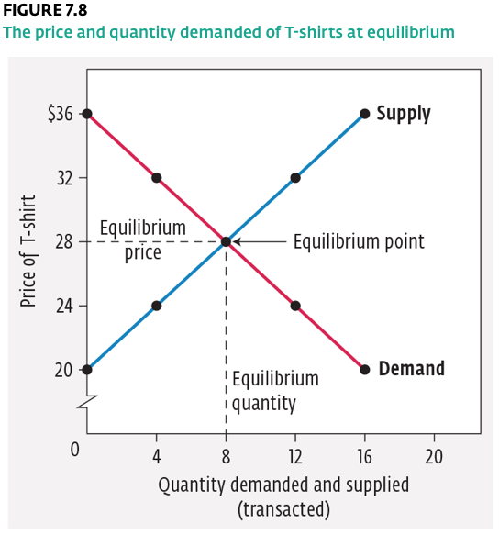

Slide 17
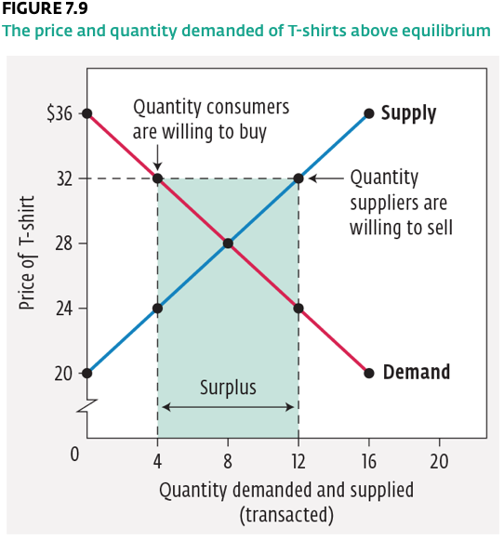
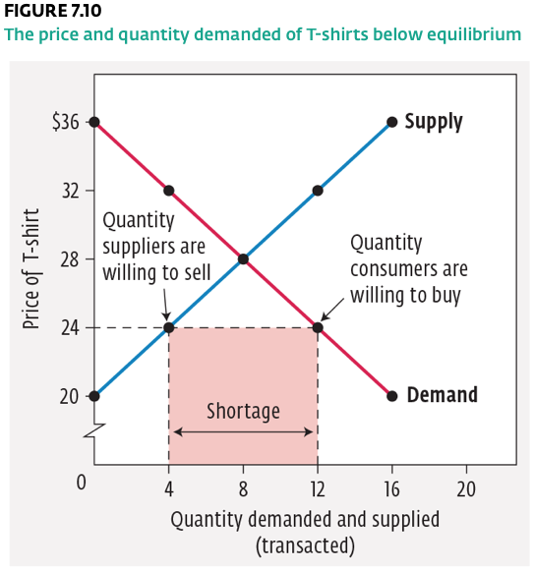
A price above the equilibrium price will result in a surplus of goods (Fig. 7.9)
A price below the equilibrium price will result in a shortage of goods (Fig. 7.10)

Slide 18
Suppose that we wanted to use this graph to indicate what would happen if the selling price of a T-shirt were set above the equilibrium price.
In Figure 7.9 a horizontal dashed line is drawn across the graph from the $32 point on the vertical axis. Then vertical lines are drawn downward from the points at which the horizontal line intersects the demand and supply curves.
These vertical lines provide us with a pictorial representation of the information in Figure 7.7: at a price of $32, the quantity demanded is 4 T-shirts and the quantity supplied is 12 T-shirts.
In other words, a price of $32 will result in a surplus of eight T-shirts.

Slide 19
Changes in Demand
We emphasized that the quantity demanded and the quantity supplied changed only because price changed. We saw on the graphs in Figures 7.2 and 7.6 that these changes are represented by movements along the curves.
In contrast, Non-price factors cause the whole curve to shift, by affecting a product’s demand or supply as opposed to its quantity demanded or quantity supplied.
This distinction between movements along a curve and a shift in the whole curve is one of the most important distinctions in the entire field of economics.
Non-price factors: A factor held constant in the relationship between price and quantity demanded and supplied. Non-price factors include, on the demand side, income, population, tastes and preferences, expectations, and prices of substitute and complementary goods; and on the supply side, costs, number of sellers, technology, nature and the environment, and prices of related goods.

Slide 20
Changes in Demand
Other non-price factors:
Population: similar to increases in income, an increase in the number of customers would translate into a increase in demand, causing the equilibrium price to increase. A decrease in the number of customers would have the opposite effect.
Tastes and Preferences: Changes in taste for a product cause increases or decreases in demand for it. If consumer preferences for T-shirts increase, demand overall will increase, the demand curve shifts up to the right, and the equilibrium price rises.
Expectations: If consumers believe that the price of a particular product is going to rise in the future, they may decide to purchase it immediately, thereby increasing the demand for the product.

Slide 21
Changes in Demand
Other non-price factors:
The Price of Substitute Goods: If the price of good B (a substitute for good A) increases, the demand for good A will increase.
  Substitute Goods: Goods that are similar to other goods and that serve as an alternative if the price of a particular good rises.
The Price of Complementary Goods: If the price of good B (a complement for good A) increases, the demand for good A will decrease.
  Complementary Goods: Goods that are interrelated and used together (for example, gasoline and automobiles).

Slide 22
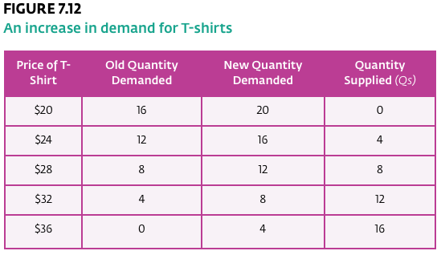
Changes in Demand: Income

Slide 23
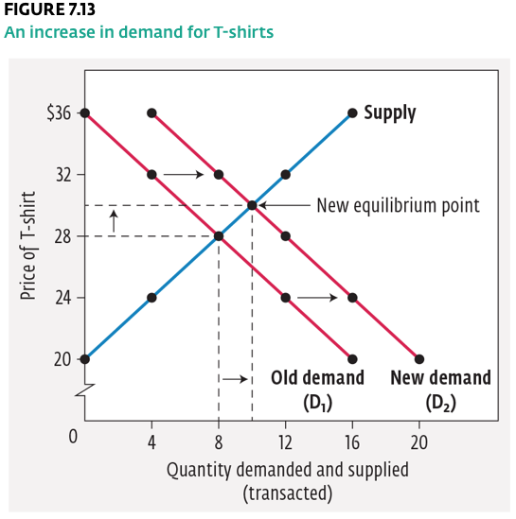
Changes in Demand: Income

Slide 24
Changes in Supply
A shift of the whole supply curve can be caused by a number of factors.
A change in any of these factors will cause the supply curve to move either to the right (to indicate an increase in supply) or to the left (to indicate a decrease in supply).

Slide 25
Changes in Supply
Other non-price factors:
Number of Sellers: If the number of sellers in a market increases, the quantity supplied of a product at any given price will increase, shifting the supply curve to the right.
Technology: An improvement in technology will decrease the cost of production, and this, in turn, will enable manufacturers to supply more of a product at any given price.
The Environment: Something as simple as a change in the weather can have an enormous impact on the supply of certain products, particularly agricultural products.

Slide 26
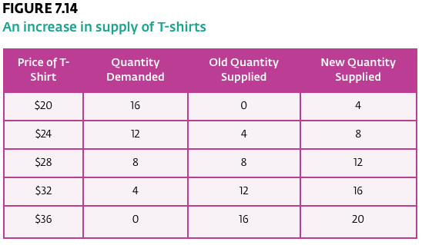
Changes in Supply: Costs
An increase or, as shown below, a decrease in production costs will affect the quantities that sellers are willing to supply because a change in costs affects profits.

Slide 27
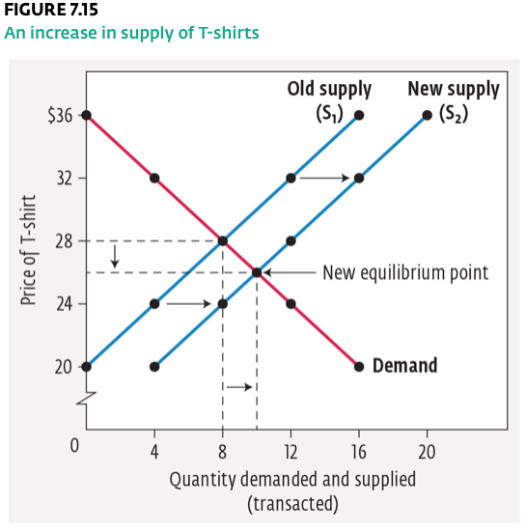
Changes in Supply: Costs

Slide 28
The Determination of Price in a Competitive Market
Perfect (or pure) Competition: A rare market structure characterized by many sellers (selling exactly the same product) and many buyers, no barriers to entry into the market for new firms, and perfect knowledge of prices (so there are no price differences and no individual can influence them).
Characteristics of a perfectly competitive market:
It has many producers or sellers, with no single seller large enough to dominate the market.
It has many consumers, with no single consumer large enough to dictate price to sellers.
Each seller’s product is exactly the same as that of the others so that no seller can increase price based on having a higher-quality product than another seller.
All sellers and consumers know what the prices and conditions are throughout the entire market, thereby eliminating the possibility of any price differences.

Slide 29
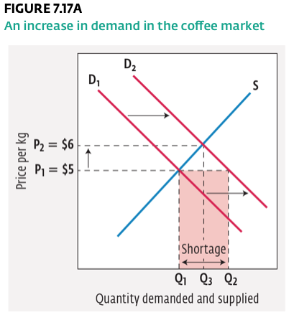
The Coffee Market in North America
An increase in demand:
D1 and S show coffee at the old equilibrium price of $5 per kilogram. Q1 shows the quantities demanded and supplied at that price. The increase in demand to D2 causes an excess demand, or shortage (Q2 – Q1 ), to occur. This excess demand will cause the price to rise to $6 at P2 ; the quantity demanded and supplied will be equal at Q3.

Slide 30
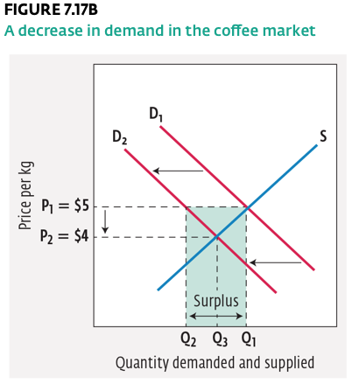
The Coffee Market in North America
A decrease in demand:
D1 and S show coffee at the old equilibrium price of $5 per kilogram. Q1 indicates the quantities demanded and supplied at that price. The decrease in demand to D2 causes excess in supply, or surplus (Q1 – Q2), to occur. This excess in supply causes the price to fall to $4 at P2; the quantity demanded and supplied will be equal at Q3.

Slide 31
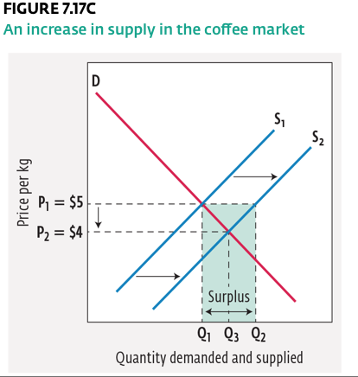
The Coffee Market in North America
An increase in supply:
D and S1 show coffee at the old equilibrium price of $5 per kilogram. Q1 indicates the quantities demanded and supplied at that price. The increase in supply (S2) causes an excess supply, or surplus, (Q2 – Q1) to occur. This will cause the price to fall to $4 at P2 and the quantity demanded to rise to Q3.

Slide 32
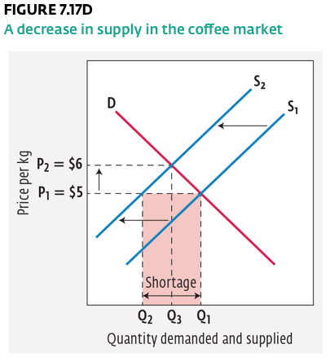
The Coffee Market in North America
A decrease in supply:
D and S1 show coffee at the old equilibrium price of $5 per kilogram; Q1 shows the quantities demanded and supplied at that price. This decrease in supply to S2 causes an excess demand, or shortage (Q1 – Q2), to occur. This will cause the price to rise to $6 at P2; the quantity demanded and supplied will be equal at Q3.

Slide 33
The Elasticity of Demand
Price Elasticity of Demand (PED): An expression of how much more or less consumers will buy of a product if its price changes.
If the quantity bought of a good does not increase or decrease much when price changes, it is said to be price inelastic. That is, it is less responsive to price changes.
  Price inelastic: If the quantity of a good or service bought does not change much when price rises or falls, it is said to be price inelastic.
If the quantity bought of a good does increase or decrease when price changes, it is said to be price elastic. That is, it is more responsive to price changes.
  Price elastic: If the quantity of a good or service bought changes a lot when price rises or falls, it is said to be price elastic.

Slide 34



Calculating the Price Elasticity of Demand
By convention, we use the absolute value of the PED coefficient, so the minus sign is dropped.
If the PED coefficient is greater than 1.0, then the product is classified as price elastic.
If the PED coefficient is less than 1.0, then the product is classified as price inelastic.

Slide 35
The Total Revenue Approach to Elasticity of Demand
If demand is elastic, sales revenue will rise as price falls, and fall as price rises.
If demand is inelastic, sales revenue will fall as price falls, and rise as price rises.
If demand is unitary, sales revenue will be unaffected by price increases or decreases.

Slide 36
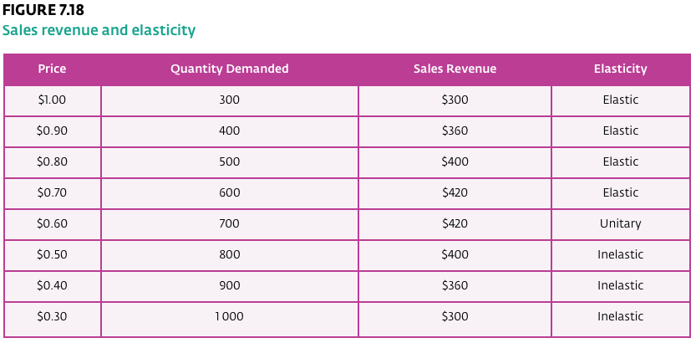
The Total Revenue Approach to Elasticity of Demand

Slide 37
Factors Affecting the Elasticity of Demand
Availability of Substitutes: Goods that have substitutes tend to be more elastic than goods that do not.
Nature of the Product: Goods that are necessities tend to be more inelastic than goods that are considered luxuries.
Fraction of Income Spent on the Product: Goods that are expensive and, therefore, take up a large part of the household budget, will be elastic.
Amount of Time Available: Over time, some goods may become more elastic because consumers eventually find substitutes for them. In the short run, however, demand for these same goods can be quite inelastic because consumers may not know what substitutes are available immediately after the price rises.

Slide 38



The Elasticity of Supply
Price Elasticity of Supply (PES): An expression of how responsive the quantity supplied by a seller is to a rise or fall in the price of a product.
PES will result in positive coefficients whether the price for a product rises or falls. By convention, the positive sign is dropped.
If the PES coefficient is greater than 1.0, then the product is supply elastic.
If the PES coefficient is less than 1.0, then the product is supply inelastic.

Slide 39
Factors Affecting the Elasticity of Supply
Time: The longer the time period a seller has to increase production, the more elastic the supply will be.
Ease of Storage: When the price of a product drops, sellers have two options. They can either sell the product at the new low price, or they can put some of their inventory into storage and sell it after the price rises again. The steel industry enjoys high supply elasticity because it is easy to store steel and, therefore, ride out price changes.
Cost Factors: Supply is more elastic in industries that have lower input expenses. Car manufacturers may be able to increase production in the short term by requiring workers to put in more overtime. A permanent increase in production, however, may entail building new factories, which is a far more costly move on the part of the manufacturer.

