Slide 1
16 The Role of Government

Slide 2
Learning Goals
Once you have completed this chapter, you should be able to:
Explain the different roles that government performs in the Canadian economy: as a provider of goods and services, a supplier of infrastructure (roads, schools, etc.), an employer of resources, a regulator of competition and aggregate demand, and a redistributor of income
Evaluate the effectiveness of government programs designed to increase the economic security and welfare of Canadians
Identify the most important sources of local, provincial, and federal government revenues and classify government spending by purpose
Use supply and demand curves to explain the impact of taxation on different markets
Identify the economic benefits of competition and explain how the Canadian government seeks to regulate competition and business practices compared with other countries

Slide 3
Key Terms
welfare state
social welfare safety net
Unemployment Insurance (UI)
Employment Insurance (EI)
Family Allowance
Child Tax Credit
Old Age Security (OAS)
Guaranteed Income Supplement (GIS)
Canada Assistance Plan (CAP)
Canada Pension Plan (CPP)
Quebec Pension Plan (QPP)
medicare
transfer payments
marginal tax rate
Universality
means testing
Bureaucracy
progressive tax
regressive tax
proportional tax
direct tax
indirect tax
personal income tax
corporate income tax
sales tax
Provincial Sales Tax (PST)
Goods and Services Tax (GST)
Harmonized Sales Tax (HST)
excise tax
custom duty
property tax
mill rate
brain drain
Combines Investigation Act (1889)
Competition Act (1986)
Competition Bureau Canada
Competition Tribunal
American antitrust law
Swedish Competition Authority (Konkurrensverket)
cartel

Slide 4
Economists distinguish between depressions and recessions based on the length and severity of the decline. A recession usually lasts less than one year. When it lasts longer and the economic decline is severe, it can be called a depression. It is generally a long period of mass unemployment, falling prices and low incomes.
The Great Depression of the early 1930s was a worldwide social and economic shock. Few countries were affected as severely as Canada. Millions of Canadians were left unemployed, hungry and often homeless.
The Depression triggered the birth of social welfare .
It also led the government to take a more activist role in the economy.

Slide 5
The Canadian Welfare State
During the second half of the twentieth century, Canada transformed itself into a welfare state.
welfare state A philosophy that government should intervene to help people who are poor, sick, or unemployed as well as provide equal access to education, health care, and social services.
In a welfare state, the government plays a significant role in attempting to ensure the economic well-being of its residents.
Figure 16.1 outlines the principal components of Canada’s social welfare safety net today, where government spending on social services, health care, and education represent the three main pillars of the Canadian social welfare system.
social welfare safety net Government programs, such as Employment Insurance and the Child Tax Credit, established to help vulnerable members of the population.

Slide 6
Canada’s Social Welfare Safety Net
Social Services:
Unemployment Insurance (UI): A federal program started in 1942 to assist those temporarily out of work due to job loss, illness, or birth or adoption of a child; it was renamed Employment Insurance (EI) in 1996.
Employment Insurance (EI): A federal program to assist those temporarily out of work due to job loss, illness, or birth or adoption of a child.
Family Allowance: A program of monetary support, started in 1942, for all Canadian households with children under 18; replaced by Child Tax Credit in 1978.
Old Age Security (OAS): A program whereby all Canadians are paid a monthly benefit after the age of 65.
Canada Assistance Plan (CAP) / Canada Social Transfer (CST): A federal transfer of money to the provinces to help fund welfare programs for Canadians.
Canada Pension Plan: A pension paid to all retired workers who have made compulsory payments to the plan during their working years.

Slide 7
Canada’s Social Welfare Safety Net
Health Care:
Medicare: Canada’s national health care program, which is administered by the provinces and territories. It covers all Canadians and is funded by taxation.
Education:
Publicly Funded Education: Primary and secondary education are financed entirely by tax revenues.

Slide 8
A Critical Look at the Welfare State
Critics of the welfare state and of transfer payments —the transfer of monies primarily from the federal government to the provinces to help fund health care and programs for disadvantaged individuals and households—generally point to three main problems, as outlined below:
Incentive to Work: One major criticism of Canada’s social welfare programs is that they often reduce an individual’s incentive to work and, therefore, to be self-supporting.
Inequities, abuses, and inefficiencies: Some disadvantaged Canadians fail to receive enough assistance while billions of dollars of benefits are paid out, instead, to less disadvantaged people. This outcome is a direct result of universality a long-standing principle of the Canadian welfare system. It recognizes that some benefits, such as EI, Old Age Security (OAS), and medicare, should be available to all Canadians, regardless of income.
Effectiveness and cost: Despite the spending of billions of dollars annually on social welfare programs, the distribution of income in Canada has remained virtually unchanged, even as the welfare system has expanded over the past 40 years.

Slide 9
Taxation
The main purposes of taxation are as follows:
(a) To finance state activity (such as national security and social welfare)
(b) To promote income equity
(c) To influence conditions in specific markets
Three Categories of taxes:
Progressive tax: A tax (such as income tax) in which the tax rate increases as an individual’s income increases.
Regressive tax: A tax rate that takes a proportionally lower percentage from higher-income earners.
Proportional tax: A tax that takes a constant percentage for all income earners.
Burden of Payment:
Direct tax: A tax (such as income tax) whose burden cannot be passed on to others by the taxpayer.
Indirect tax: A tax (such as sales taxes) whose burden is passed on by the seller to the buyer of the good.

Slide 10
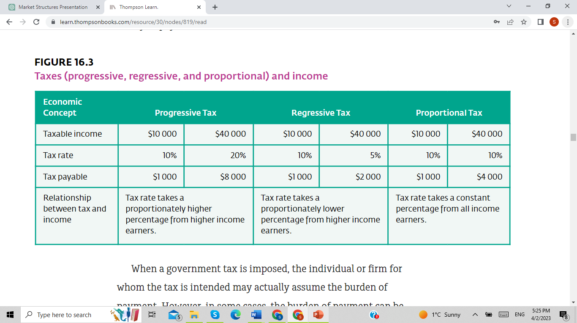

Slide 11
Types of Taxes
Personal Income Tax: A tax paid to the federal and provincial governments by individuals on their income.
Corporate Income Tax: A tax paid to the federal and provincial governments by corporations as a percentage of their profits.
Sales Tax: A tax (such as the Goods and Services Tax or the Provincial Sales Tax) paid to the federal and provincial governments on the purchase and consumption of goods and services by the end user.
Provincial Sales Tax (PST) A Canadian provincial government sales tax levied on a range of goods and services.
Goods and Services Tax (GST) A Canadian federal government sales tax levied on a range of goods and services.
Harmonized Sales Tax (HST) A single tax that blends together the federal goods and services tax with the provincial sales tax.

Slide 12
Types of Taxes
Excise Tax A tax paid to the federal and provincial governments, as a set dollar amount per unit, on items such as liquor, gasoline, and tobacco.
custom duty A tax charged on foreign goods entering the country; also called tariff.
Property Tax A tax paid to local governments (such as cities and towns) by holders of houses and commercial properties.
mill rate The property tax rate; a percentage of the value of a property as assessed by the local tax authorities.

Slide 13
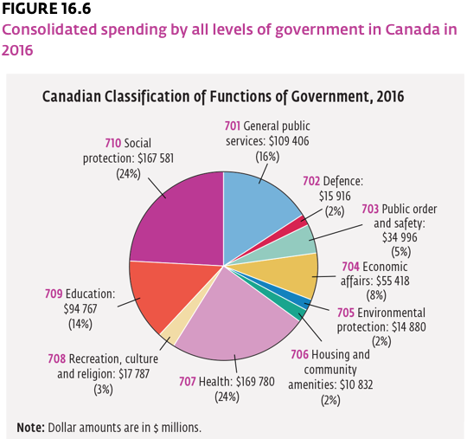
How Tax Dollars are Spent

Slide 14
Regulation of Competition in the Economy
Competition is seen as a positive factor in a market economy for the following reasons:
Competition increases consumer choice
Competition increases entrepreneurial freedom
Competition encourages investment and growth
Competition keeps prices down and product quality high
Competition improves resource allocation and efficiency

Slide 15
Competition Legislation
When one or more firms are able to influence the marketplace by using misleading advertisements, fixing prices, limiting production, or controlling distribution to limit competition to the detriment of consumers, they are engaging in “restraint of trade.”
Competition Act (1986): The act that replaced the old Combines Investigation Act to address problems caused by business mergers, acquisitions, and price fixing.
The three main goals of the act are as follows:
To expand opportunities for Canadian firms to compete in global markets while recognizing the role of foreign competition in Canada
To ensure that small and medium-sized businesses have an opportunity to participate fairly in the Canadian economy
To provide consumers with competitive prices and quality product choices

Slide 16
Competition Legislation
The act is administered by Competition Bureau Canada, which is attached to Innovation, Science and Economic Development Canada.
Most concerns are dealt with through negotiations between the Bureau and the corporations involved. When the parties are unable to reach an agreement, the matter is taken to the Competition Tribunal. Tribunal decisions may be appealed to the Federal Court of Canada.
Competition Tribunal: The board empowered to make decisions on disputes between corporations and Competition Bureau Canada that cannot be decided through negotiation.

Slide 17
Business Regulation in Different Countries
The American Antitrust Model
American antitrust law is a collection of federal and state laws that collectively regulate the conduct and organization of businesses in the United States. The Sherman Act of 1890, the Clayton Act of 1914, and the Federal Trade Commission Act of 1914 are the three main pieces of legislation. These acts prohibit the following actions, which constitute exploitative abuses of corporate freedoms:
Collusion and the creation of any groups restraining trade to the detriment of consumers
Any mergers and acquisitions that substantially lessen competition
Monopoly creation and the abuse of power by monopolies

Slide 18
Business Regulation in Different Countries
The Swedish Competition Authority (Konkurrensverket)
The Swedish Competition Act (2008) and some articles from the Treaty on the Functioning of the European Union (TFEU) are the main tools used by the Swedish Competition Authority (Konkurrensverket) to regulate competition and fair business practices. Anti-competitive behavior includes the following:
Directly or indirectly fixing prices or other trading conditions
Limiting output to the detriment of consumers (for example, controlling production, markets, technological development, or investment)Dividing markets or sources of supply
Discrimination (for example, by applying dissimilar conditions to equivalent transactions with other parties, thereby placing them at a competitive disadvantage)
Tie-ins (for example, making the conclusion of contracts subject to acceptance of extra obligations that have no connection to the subject of the contracts)

Slide 19
