Slide 1
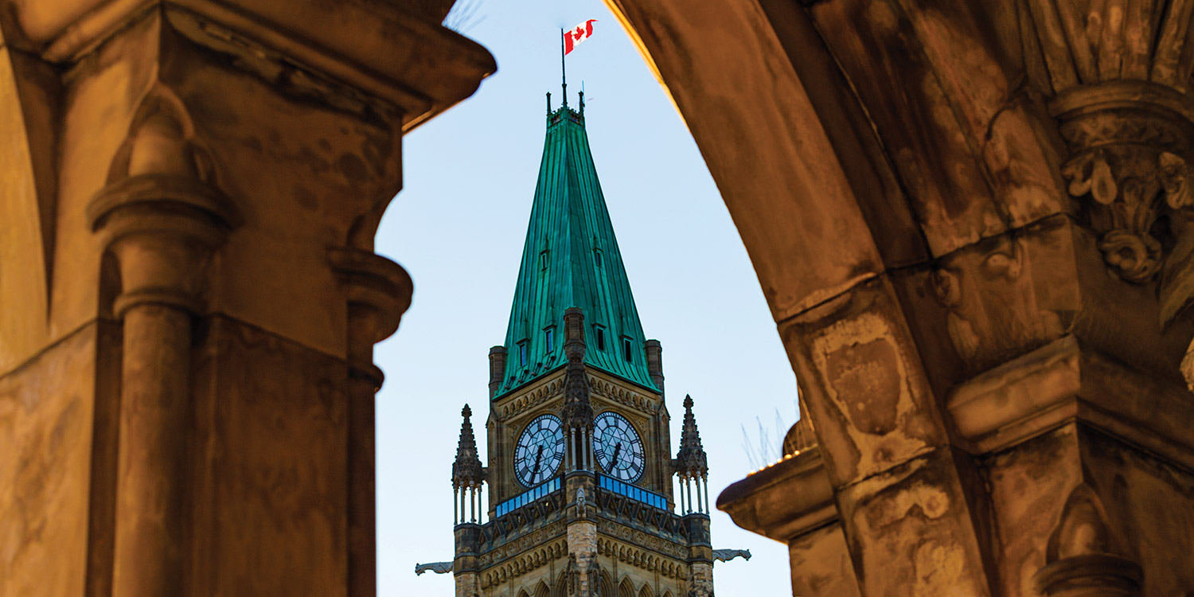
13 Business Cycles and Fiscal Policy

Slide 2
Learning Goals
Once you have completed this chapter, you should be able to:
Explain the macroeconomy through aggregate demand and supply analysis
Demonstrate an understanding of the fluctuations of the economy as explained by the business cycle
Use an aggregate supply and demand model to analyze how government fiscal policy can be used to achieve economic goals
Explain how fiscal policies influence the economic decisions of individuals and organizations, and analyze the consequences of these policies
Analyze the factors that influence fiscal policy decisions in Canada
Describe the challenges of using fiscal policy to manage the economy

Slide 3
Key Terms
stabilization policies
fiscal policy
expansionary fiscal policy
contractionary fiscal policy
automatic stabilizers
progressive tax
discretionary fiscal policy
Infrastructure
multiplier effect
marginal propensity to consume (MPC)
marginal propensity to withdraw (MPW)
deficit budget
surplus budget
balanced budget
debt
cyclical deficit
structural deficit
recognition lag
decision lag
implementation lag
impact lag
crowding out
aggregate demand (AD)
aggregate supply (AS)
full-employment equilibrium
recessionary gap
inflationary gap
business cycle
prosperity cycle
Recession
Depression
circular flow of income
Leakage
injection

Slide 4
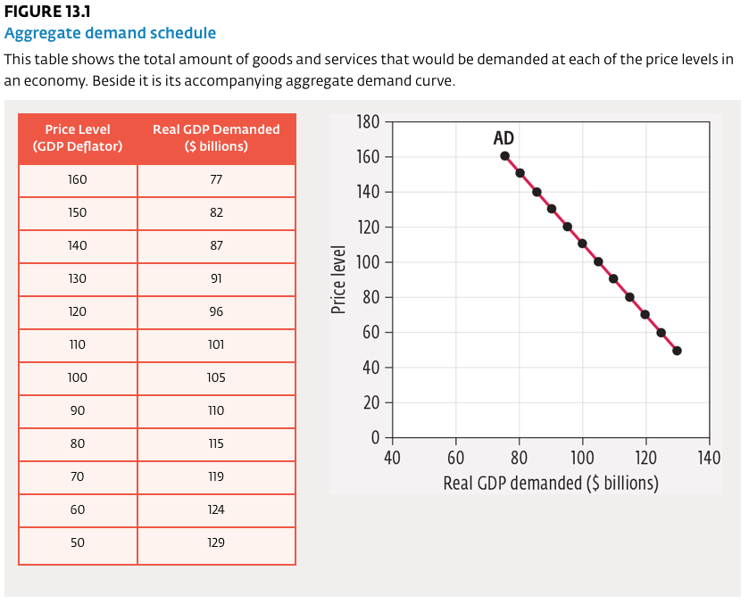
Aggregate Demand
Aggregate demand (AD) is the total demand for all goods and services in an economy.
In constructing the AD schedule, instead of examining individual prices (as in the microeconomic concept of demand) we will use the GDP deflator.

Slide 5
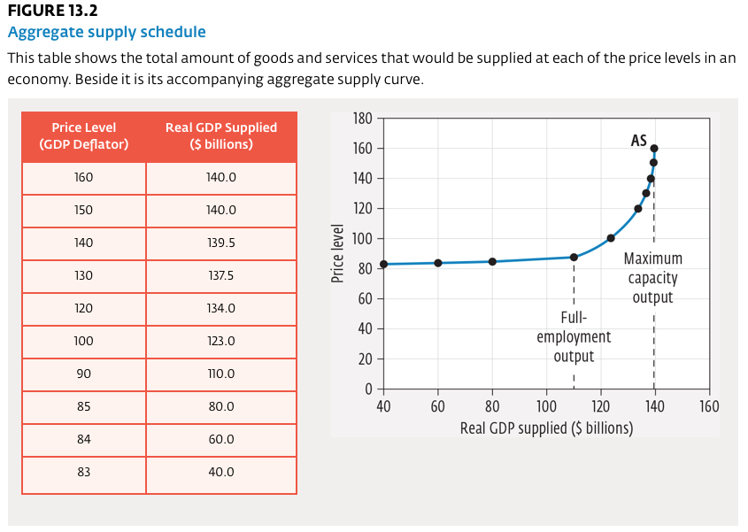
Aggregate Supply
Aggregate supply (AS) is the total supply of all goods and services produced in an economy.
The AS curve displays the total amount of goods and services that would be supplied at each price level, as measured by the GDP deflator, in an economy.

Slide 6
Business Cycles
A business cycle is a period of swings in national economic performance as measured by changes in real GDP. It is characterized by four distinct phases: expansion, peak, contraction, and trough.
Business Cycle: A rise and fall in national economic performance characterized by four phases: peak, contraction, trough, and expansion.
A business cycle represents the ups and downs of the economy. The duration of a business cycle and its size (in loss or gain of real GDP) vary from one cycle to the next and are very difficult to predict. Business cycle occurs because of the fluctuations (expansion and contraction) that economies experience over time.

Slide 7
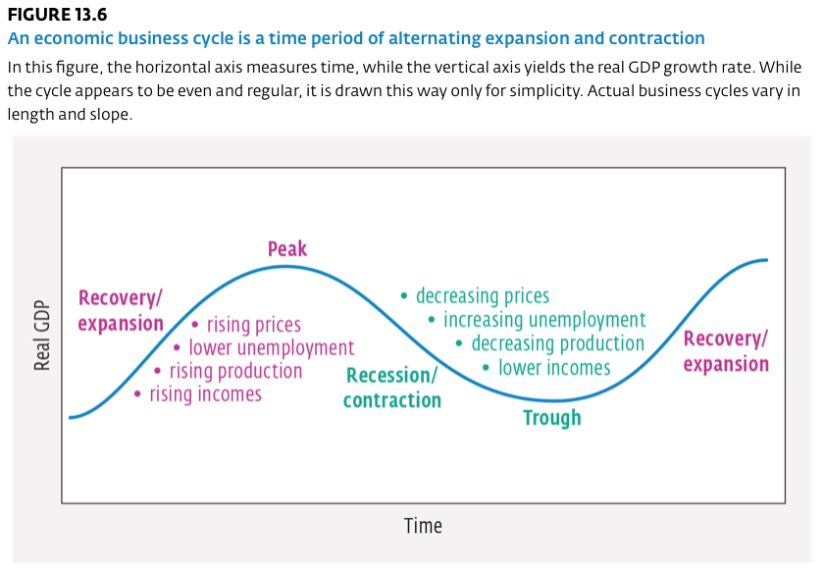
Business Cycles

Slide 8
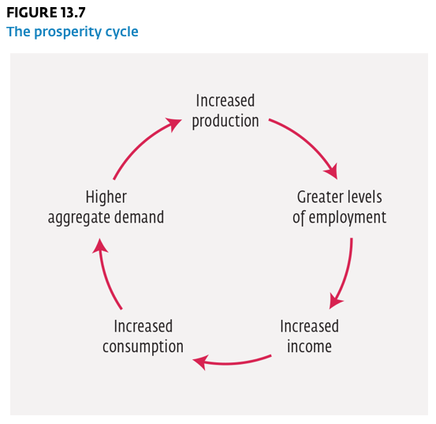
Business Cycles - Expansion
An expansion period begins when consumer spending increases and production increases. As Figure 13.6 shows, expansion is represented by an upward trend in the business cycle.
Generally, increased production leads to more workers being hired. New employment leads to a general rise in consumer incomes, which, in turn, generates increased levels of consumption spending.
Increased spending translates into an increase in the demand for goods and services. This higher demand leads to increased production, more workers being hired, and so on.

Slide 9
Business Cycles - Contraction
The contraction begins as the business cycle passes its peak. Consumers may simply have exhausted the purchasing patterns that pushed up aggregate demand. Demand begins to decrease when many consumers’ wants are satisfied.
Frequently, peaks are created by “bubbles.” A bubble is characterized by a rapid increase in the value of assets such as stocks, bonds, precious metals, or land. These bubbles are often caused by irrational expectations that an increase in asset values will continue.
A contraction can also be the result of producers competing for capital funds to support business expansion, which tends to put upward pressure on interest rates. When interest rates rise, consumers are less likely to buy goods for which they need to borrow money—the durable goods that make up almost 10 percent of our GDP.

Slide 10
Business Cycles - Contraction
It is generally agreed that a recession occurs when real GDP growth is negative, or declines, for two consecutive quarters (two consecutive three-month periods).
Recession: A contraction of the economy in which real GDP declines for a minimum of two consecutive business quarters (six months).
If a recessionary period becomes prolonged, with very high unemployment and very low output levels, it is known as a depression.
Depression: A prolonged recession characterized by falling GDP, very high unemployment, and price deflation.
While these regular fluctuations of economic activity can vary in duration and intensity, over time the level of business activity in an economy tends to increase steadily (see Figure 13.8).

Slide 11
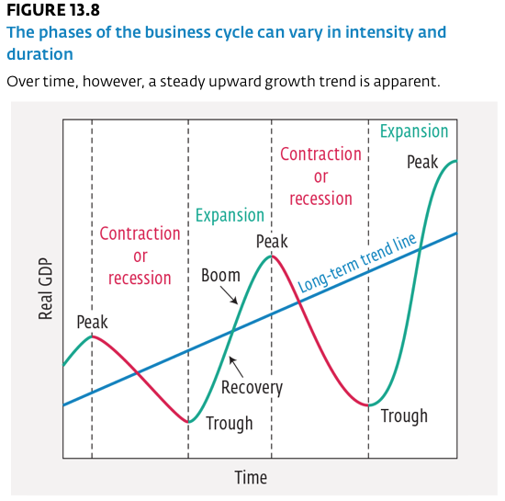
Business Cycles - Contraction

Slide 12
Fiscal Policy
Most mixed economies go through upheavals caused by the ups and downs of the business cycle. Should the government intervene in these economic booms and contractions, or should it let the market make its own adjustments?
Governments can become involved through fiscal and monetary stabilization policies.
Stabilization policies: Government intervention in the economy to try to stabilize it, using fiscal and monetary policies.
Fiscal policy is the use by a government of its powers of expenditure, taxation, and borrowing to stabilize the economy.

Slide 13
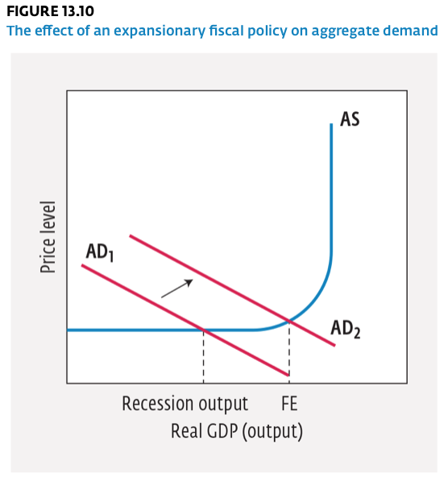
Expansionary Fiscal Policy
The government could increase aggregate demand by using an expansionary fiscal policy. This type of fiscal policy involves decreasing taxes, increasing government spending, or both to stimulate economic growth and lower unemployment rates.

Slide 14
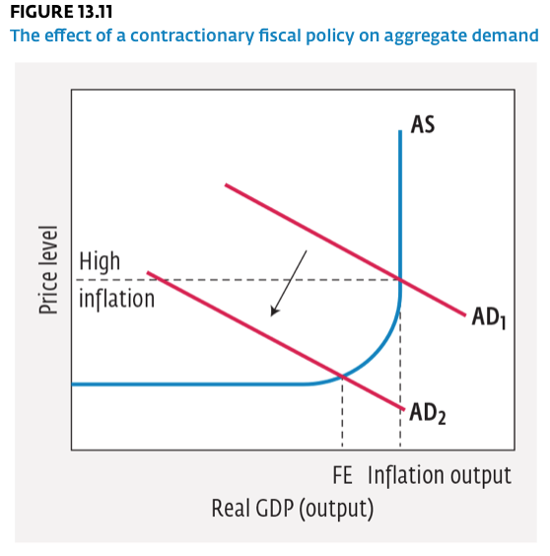
Contractionary Fiscal Policy
When the economy is suffering from inflation, aggregate demand is too high. Employment is high, and there is high output growth. In this context, the government may wish to decrease aggregate demand by using a contractionary fiscal policy.

Slide 15
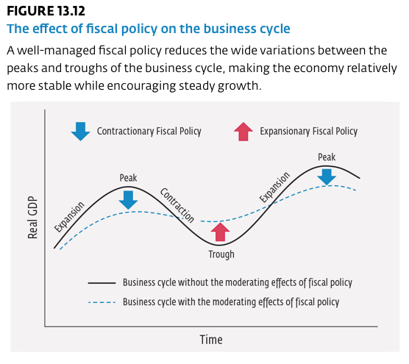
Impact of Fiscal Policy

Slide 16
Automatic Stabilizers
What are the tools that a government has at its disposal to enact fiscal policy? Some of the key tools are known as automatic stabilizers.
Automatic Stabilizers: Mechanisms built into the economy that help to stabilize it by automatically increasing or decreasing aggregate demand, such as Employment Insurance, welfare programs, and progressive taxes; often contrasted with discretionary fiscal policy.
Employment Insurance (EI) and social assistance programs are two examples of automatic stabilizers.
Another example of an automatic stabilizer is the tax rate, which varies with the level of income.
Any built-in mechanism that increases or decreases government spending or taxation as the business cycle fluctuates is considered an automatic stabilizer. It is important to note that there are also discretionary elements to automatic stabilizers. At any time, the government may decide to change the level of EI payments or taxation levels. These actions are considered to be discretionary fiscal measures.

Slide 17
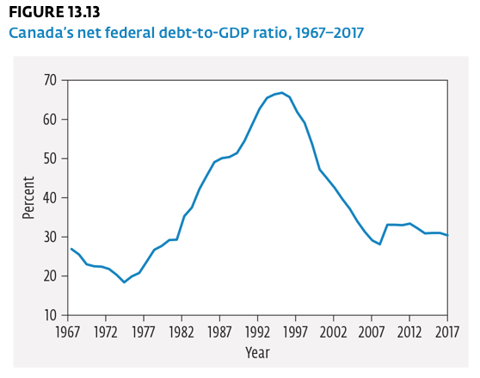
The Challenges of Using Fiscal Policy
Size of Government Debt: The size of the government debt can limit the use of fiscal policy as an effective tool. The higher the government debt, the higher the amount of government spending that must be devoted to servicing the debt.

Slide 18
The Challenges of Using Fiscal Policy
Government Budgets: Today, government budgets are incredibly complicated documents drafted for both political and economic purposes. They contain economic forecasts, macroeconomic goals, and social policy objectives. In establishing its budget, a government can end up with one of three scenarios:
A deficit budget, which occurs when the government spends more than it collects in tax revenue. It must borrow money to cover the shortfall
A surplus budget, which occurs when the government collects more in tax revenue than it spends. Consequently, it has money left over.
A balanced budget, which results when the government spends an amount equal to what it collects in tax revenue.

Slide 19
The Challenges of Using Fiscal Policy
Time Lags: The time lags that exist in utilizing fiscal policy can be problematic.
Initially, there is the recognition lag, or the time it takes for the government to recognize there is a problem in the economy.
Once a problem is identified, there is a decision lag. This is the time required for the government to determine the most appropriate spending and taxation actions to implement the desired fiscal policy.
Following this period, there is an implementation lag. Once the decision has been made, various government departments have to figure out how to implement the new directives regarding government spending and taxation.
Finally, there is the impact lag. Once the policy is in place, time is required before its full effects can be felt through the multiplier effect.

Slide 20
The Challenges of Using Fiscal Policy
Election Cycles: There tends to be a conflict between election cycles in Canada and the business cycle.
It is hard for governments to make budget cuts and raise taxes in general, but it is even harder when they are thinking about being re-elected.
Generally, in the first two years of their mandate, governments make the toughest spending cuts—long before voters must cast a ballot. The nearer the time for an election, the harder it is to make spending cuts. In fact, a government that wants to be re-elected is more likely to increase spending and decrease taxes, running a budget deficit even when the economy does not need it.

Slide 21
The Challenges of Using Fiscal Policy
Regional Variations: Regional variations may exist that interfere with the implementation of fiscal policy. If part of the country is doing well while another region is suffering from a slowdown, what policy should be used?
Targeting fiscal policy to a specific region does not work very well. While initial government spending and taxation policies could be targeted at a specific region, it is likely that the impact of the fiscal policy would be spread well beyond the specific region once the multiplier effect is fully felt.
Additionally, conflict between the various levels of government regarding the appropriate fiscal policy might limit its effectiveness. If the federal government is reducing spending and increasing taxes in an effort to slow down economic growth, and a powerful provincial government is increasing spending and cutting taxes to gain political support, the two policies would be at odds, limiting the desired impact on economic conditions.

Slide 22
Discretionary Policy
When the government takes deliberate actions through legislation to alter spending or taxation policies to influence the level of spending and taxation, it is using discretionary fiscal policy.
Changes in Spending. If the government wants to stimulate the economy, it can increase general spending in all areas of its normal budgetary programs—health and welfare, culture, education, and so on. Another way to increase spending is to undertake infrastructure programs.
Infrastructure: The foundation of goods and services (such as roads, power grids, transit systems, communications systems, schools, and hospitals) that allows an economy to operate efficiently.
Changes in Taxation. To restrain or stimulate economic activity, the government can also use discretionary fiscal policy to change the amount of tax that it collects. The government could raise or lower personal income taxes, corporate income taxes, or sales taxes, thus changing the amount of money leaking out of the circular flow of income during economic transactions.Another possibility is to alter tax deductions or tax credits.

