Slide 1
Chekhov quotations
are also his THEMES

Slide 3
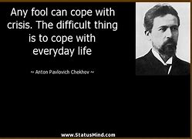

Slide 5
You must trust and believe in people or life
becomes impossible.
(Anton Chekhov)

