Slide 1
Watercolour Techniques

Slide 2
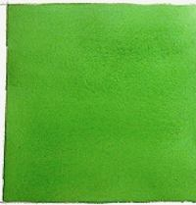
Flat wash
Begin by wetting the parts of the paper that you plan to cover with paint.
Move your paintbrush (with pigment) across the top of the paper in a horizontal direction.
Gradually move your brush down the page.
Your horizontal lines should overlap slightly.

Slide 3
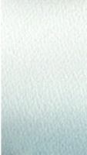
Graded wash
This approach is similar to creating a flat wash.
To create a graded wash, you dilute the pigment with water each time you move your paintbrush across the page.
Add slightly more water to your paintbrush each time you create a horizontal band across the page.
The colour should fade naturally.

Slide 4
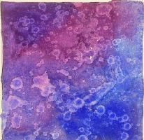
alcohol
When you add alcohol to wet watercolour paint, the alcohol repels the paint.
A Q-tip or other pointed object can help you control the amount of alcohol you want to add to your page (eg. Through tapping or dripping the alcohol).

Slide 5
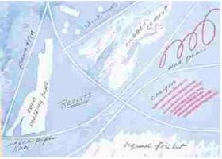
Wax resist
Using a waxy substance like a crayon can create an interesting effect.
Add the wax first and then apply the paint.
Wax repels watercolours.

Slide 6
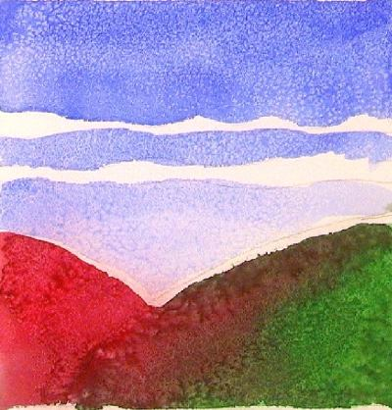
Salt
Salt absorbs watercolours.
After applying your paint, sprinkle salt on the areas where you want to create some lighter colours and spots.

Slide 7
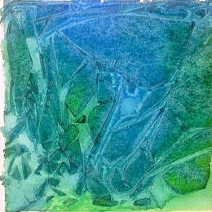
Plastic Wrap
Place plastic wrap over your wet watercolour painting.
Try to scrunch the plastic until it forms some interesting lines and shapes.
Keep the plastic wrap on until the paint dries.

Slide 8
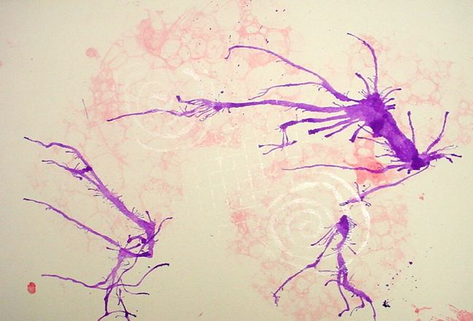
Straw
Dip your paintbrush into the paint and then add some water.
Allow drops of the watercolour paint to fall on your paper.
Blow on the drops of paint with a straw.

Slide 9
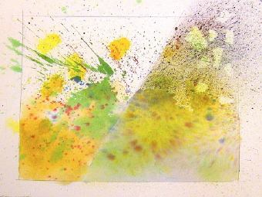
Splattering
This involves “splatter[ing] the paint off your brush by rapping the edge of the loaded brush against your finger.”

Slide 10
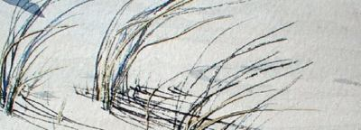
Dry Brush
Do not add water to your paintbrush.
Dip the brush into the paint and move it over dry paper.

Slide 11
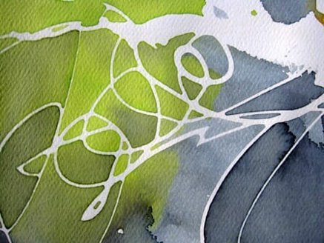
RUBBER CEMENT RESIST
You drip/apply some rubber cement to your paper.
You can create a pattern or be completely random with your application of the cement.
You need to let the cement dry before adding watercolour.

Slide 12
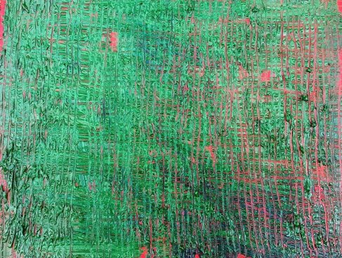
SGRAFFITO
Apply watercolour to your paper and then use the end of your paintbrush to create lines or textures over the wet paint.
You could also use something sharp or pointed to scratch the surface of your paper before applying paint. After scratching the surface, you would then apply your watercolour paint.

Slide 13
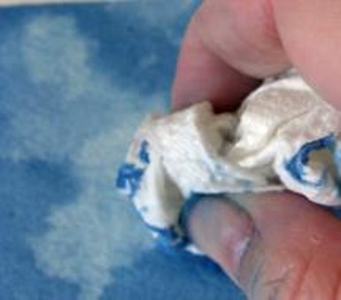
PAPER TOWEL
Apply watercolour paint over your surface.
Dab paper towel over the wet paint.

Slide 14
