Slide 1
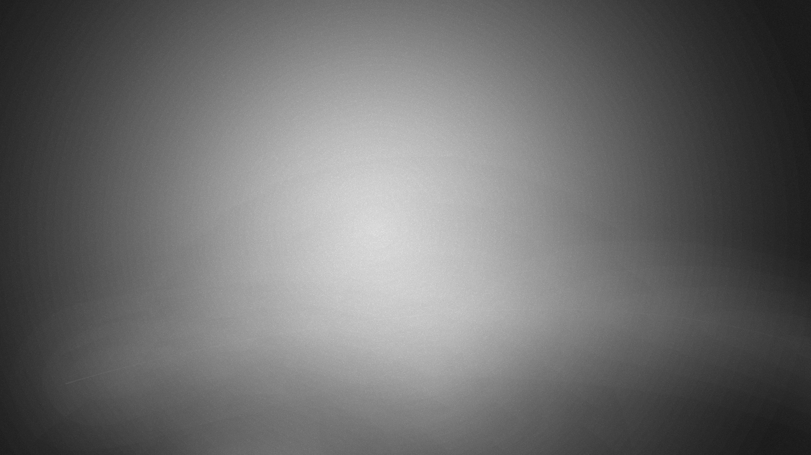
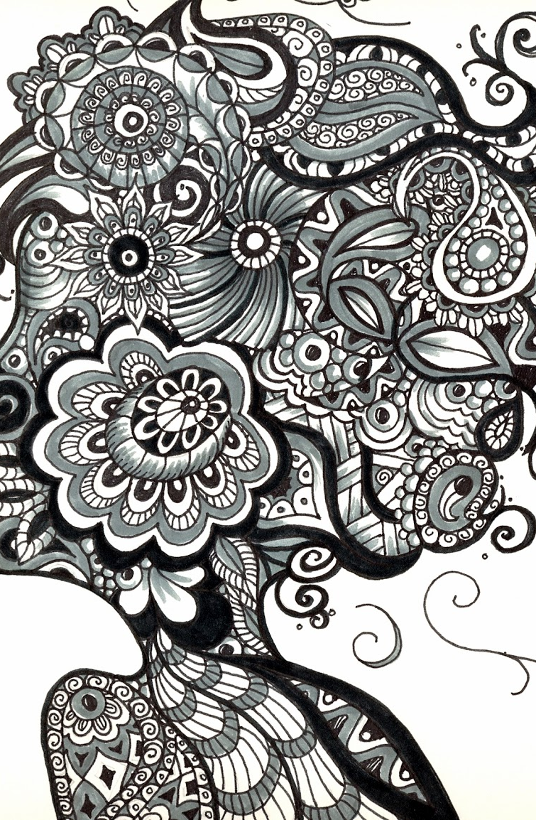
The Art of Zentangle

Slide 2
What is Zentangle?
Zentangle was created by Rick Roberts and Maria Thomas.
It helps increase focus, attentiveness, and creativity.
Zentangle is an abstract, relaxing technique that uses repetitive patterns.

Slide 3
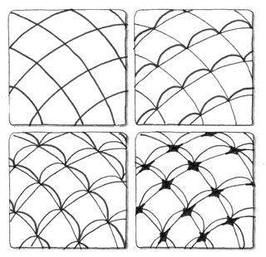
Tangle
Tangle - In its verb form “tangle” means to draw a tangle. You tangle a tangle, and in that process create Zentangle art. In its noun form this word is used as a replacement for “pattern.”

Slide 4
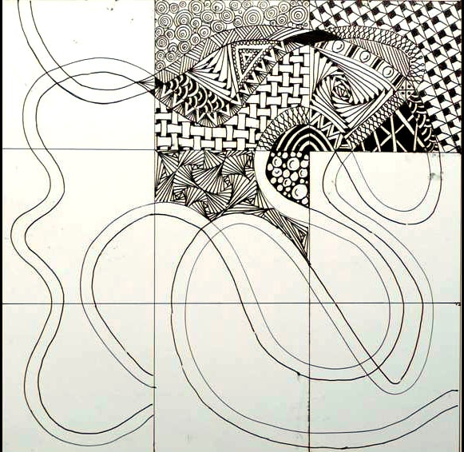
String
String - A string is generally a random line drawn in pencil which creates an area within which you draw your tangles (patterns).

Slide 5
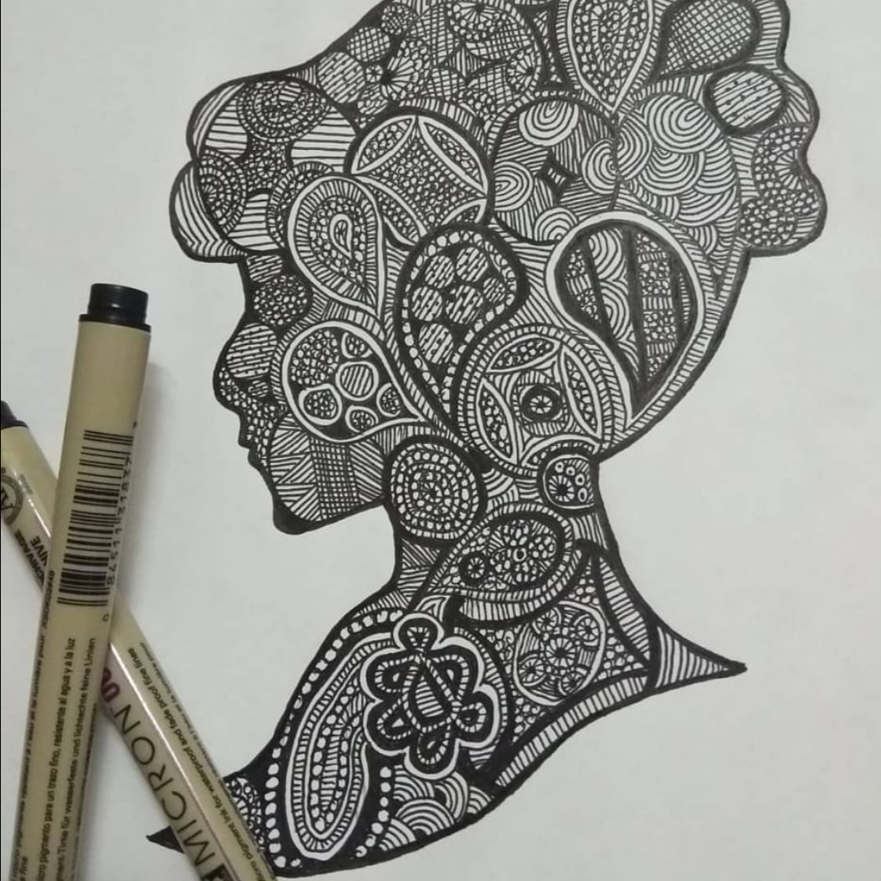
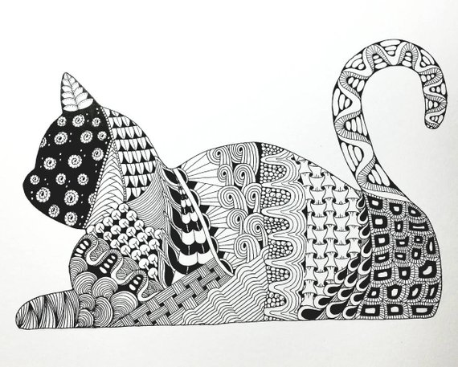

Slide 6
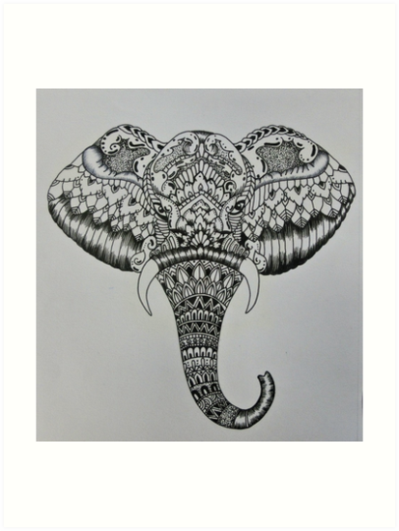
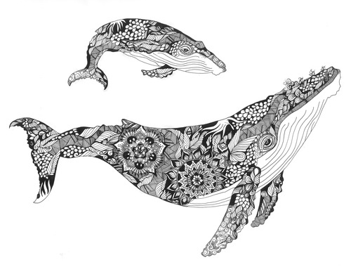

Slide 7
