Slide 1
DISC
DISC stands for Dominance, Influence, Steadiness, Conscientiousness

Slide 2
Introduction to Personality
Your personality is the combination of your personality traits that lead to the way you think and act. There are many personality traits, and different personality tests measure different traits.

Slide 3
Why is it important to understand people’s personalities?
There are two main reasons why knowing people’s personality is useful:
1. You know their objective strengths and weaknesses
2. You know how to create synergy with them
To improve our communication with others, have more harmony in teams (by appreciating everyone's different strengths), and choose work that matches our strengths.

Slide 4
Synergy is when two people can create more than adding up what they create alone. In other words, 1+1 = 3.
For example, let’s say John likes to make plans and Mary likes to be spontaneous. If they didn’t learn about personality, then John gets angry at Marky for never making plans. Mary gets angry at John for being so inflexible and unopen. This conflict is a personality conflict.
John would do the plans, and Mary would deal with unforeseen changes to the plans as they are carrying out the plan. They use their different strengths to cover up each other’s different weaknesses. That’s synergy.

Slide 5
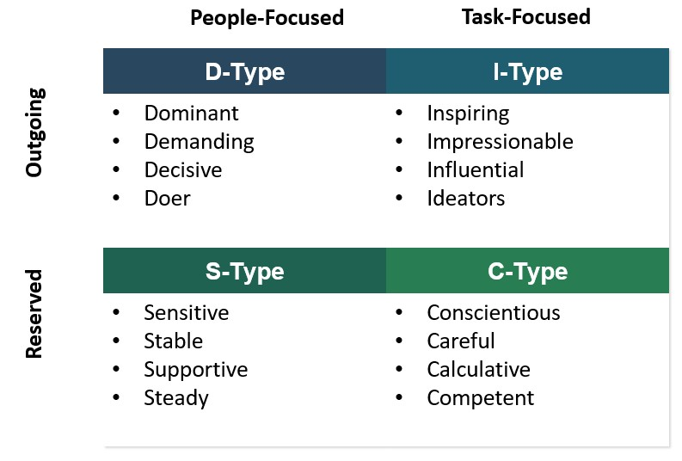
DISC Personality Test
When you are with people, are you more outgoing or reserved?
When you are doing a team project, are you more task-focused or people-focused?

Slide 6
