Slide 1
Conflict
Conflict refers to some form of friction, disagreement, or discord arising within a group when the beliefs or actions of one or more members of the group are either resisted by or unacceptable to one or more members of another group.
How to deal with workplace conflict? (Forbes)

Slide 2
How do you handle conflict?
Do you get angry and try to get your way?
Do you look to find common ground?

Slide 3
Conflict Resolution
Conflict resolution is a way for two or more parties to find a peaceful solution to a disagreement among them. The disagreement may be personal, financial, political, or emotional. When a dispute arises, often the best course of action is negotiation to resolve the disagreement.

Slide 4
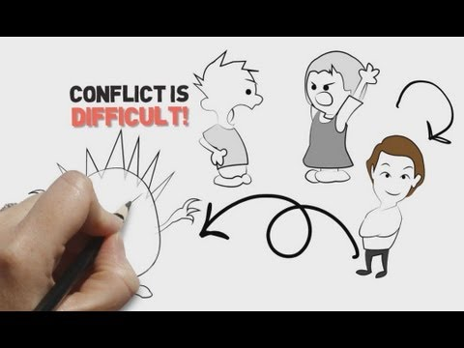
Conflict Resolution
How have you resolved conflicts in your life?

Slide 5
Conflict Management Styles
People respond to conflict through different combinations of cooperative and assertive behaviours
Cooperativeness: the desire to satisfy another party’s needs and concerns.
Assertiveness: the desire to satisfy one’s own needs and concerns.

Slide 6
Conflict Management Styles
Avoidance (lose-lose)
Being uncooperative and unassertive.
Downplaying disagreement, withdrawing from the situation, and/or staying neutral at all costs.
2. Accommodating (lose-lose)
Being cooperative but unassertive.
Letting the wishes of others rule, smoothing over or overlooking differences to maintain harmony.

Slide 7
Conflict Management Styles
3. Authoritative (win-lose)
Being uncooperative but assertive.
Working against the wishes of another party, engaging in win-lose competition
4. Compromising (win-lose)
Being moderately cooperative and assertive.
Bargaining for “acceptable” solutions in which each party wins a bit and loses a bit.

Slide 8
Conflict Management Styles
5. Collaboration (win-win)
Being both cooperative and assertive.
Trying to fully satisfy everyone’s concerns by working through differences, finding and solving problems so everyone gains.

