Slide 1
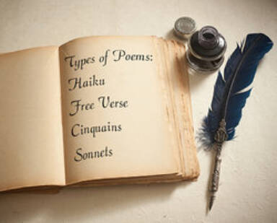
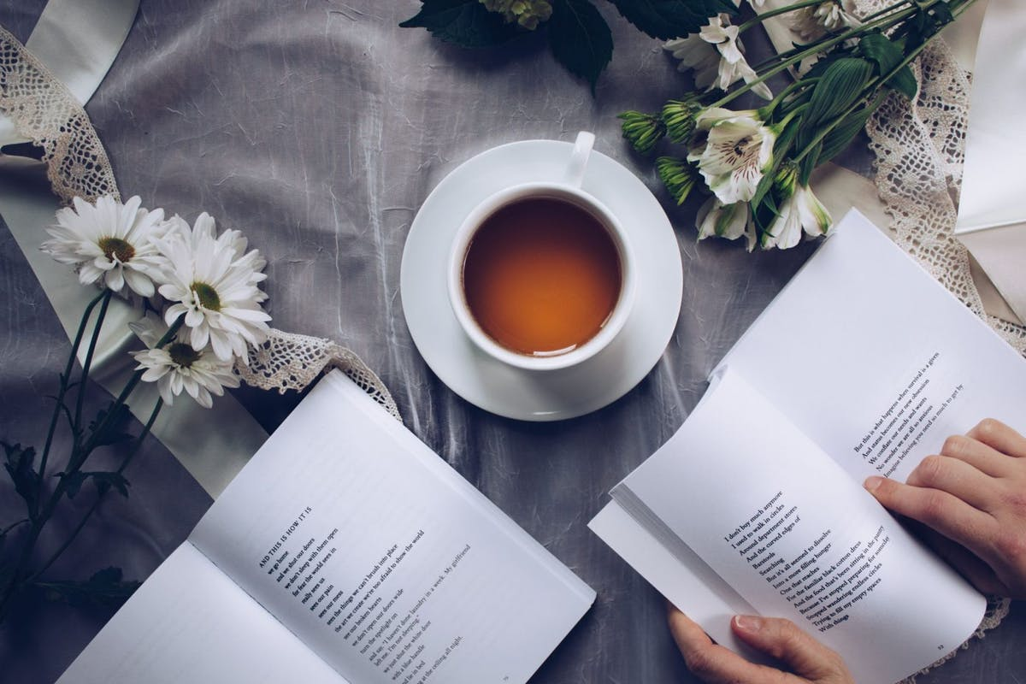
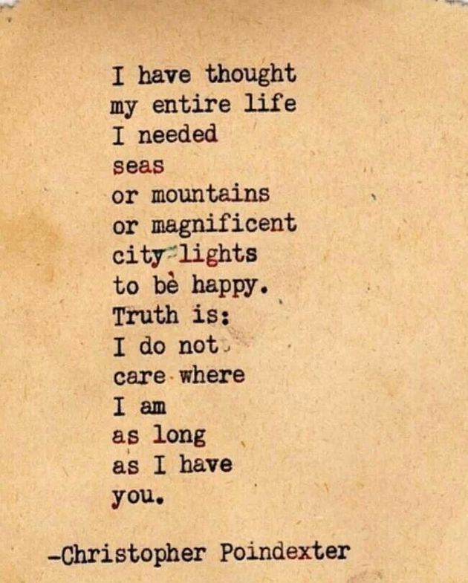
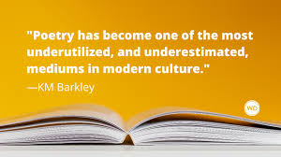
Intro to Poetry
Meaning of Poetry
Key Definitions
Key Ideas
Key Poets

Slide 2
Meaning of Poetry
Poetry is a type of literature based on the interplay of words and rhythm. It often employs rhyme and meter (a set of rules governing the number and arrangement of syllables in each line).
In poetry, words are strung together to form sounds, images, and ideas that might be too complex or abstract to describe directly.
Definition taken directly from: https://literaryterms.net/poetry/

Slide 3
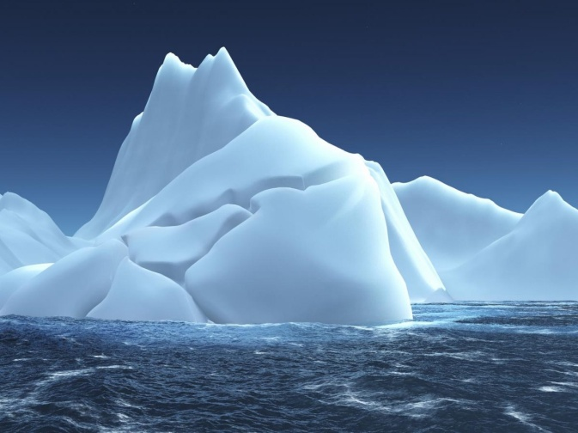
Poetry Analogy
Poetry is often described as:
“the tip of the iceberg”

Slide 4
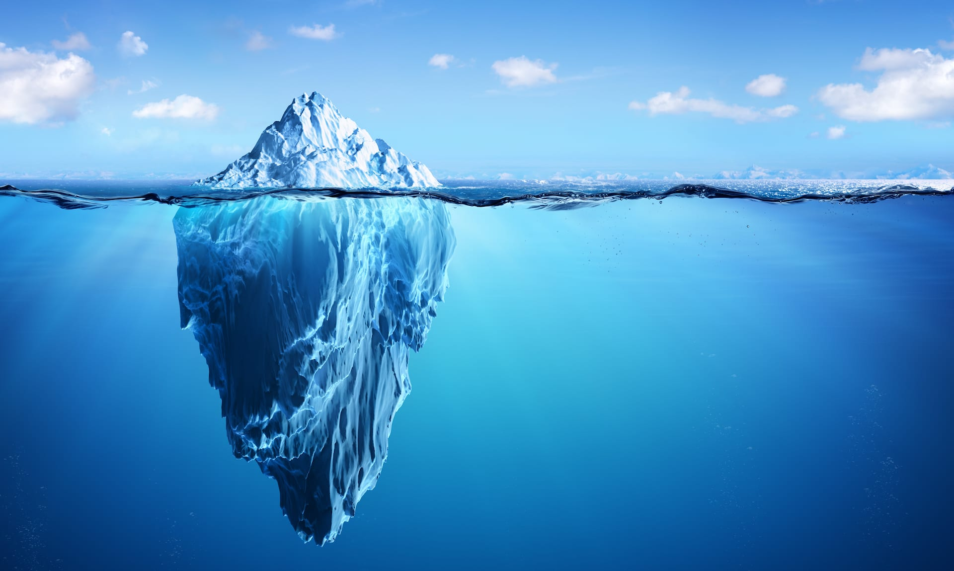

Slide 5
Short History of Poetry
Poetry was based on established system of meter and rhyme
Varying rules and models with each culture
Anglo-Saxon poets had their own rhyme schemes and meters
Greek poets and Arabic poets had other formats
classical forms are still popular today
modern poets often use no rules; poems generally do not rhyme, and do not fit any particular meter
Modern poems have rhythm, beauty and create inspiration

Slide 6
Poetry Terms
Add these Definitions to your Glossary.
Acrostic
Annotate
Haiku
Paraphrase
Imagery
Inference
Meter
Myth
Rhyme
Syllable

Slide 7
Useful Terms and Ideas
Annotate: to make notes on key literary elements to heighten understanding of a text
Narrative: a written account of a story or happening, usually from point of view of writer or poet; can be fictional or true
Ethos, Pathos, Logos: ethical appeal, persuading an audience of what is morally right; appealing to emotions; appealing to a sense of logic or reasoning; all created by Greek philosopher Aristotle

Slide 8
Haiku Poems
A haiku is a specific type of Japanese poem which has 17 syllables divided into three lines of 5, 7, and 5 syllables. Haikus or haiku are typically written on the subject of nature. The word haiku (pronounced hahy-koo) is derived from the Japanese word hokku meaning “starting verse.”
Definition From: https://literaryterms.net/haiku/

Slide 9
Japanese Poet Basho 1644-1694
Japanese Haiku master and author of several poems
Visit these websites for more info on him and his poems
https://www.poetryfoundation.org/poets/basho
https://www.britannica.com/biography/Basho-Japanese-poet
https://www.poemhunter.com/matsuo-basho

Slide 10
Poet Charles Bukowski
American Poet 1920-1994
https://poets.org/poet/charles-bukowski
https://mypoeticside.com/poets/charles-bukowski-poems

Slide 11
Poet Robert Frost
American Poet 1974
https://www.poetryfoundation.org/poets/robert-frost
https://poets.org/poet/robert-frost

Slide 12
Resources
Websites
https://literaryterms.net/poetry/
https://www.poetryfoundation.org/poets/basho
https://www.britannica.com/biography/Basho-Japanese-poet
https://www.poemhunter.com/matsuo-basho
https://allpoetry.com/Charles-Bukowski#:~:text=Charles%20Bukowski%20%5B1920%2D1994%5D,world%20of%20work%20and%20bars.&text=Bukowski%20claims%20he%20was%20illegitimate,a%20year%20before%20his%20birth.
https://poets.org/poet/charles-bukowski
https://mypoeticside.com/poets/charles-bukowski-poems
https://www.poetryfoundation.org/poets/robert-frost
https://poets.org/poet/robert-frost

